Slide 1
N34 - SOLUTIONS
Solubility Trends

Slide 2
N34 - SOLUTIONS
Target: I can describe how the solubility of a substance changes based on the phase of the substance.

Slide 3
Solubility Trends
Solids
Solubility of MOST solids increases with temperature.
The rate at which solids dissolve increases with increasing surface area of the solid.
Gases
Solubility decreases with temperature.
Solubility increases with the pressure above the solution.

Slide 4
Therefore…
Solids tend to dissolve best when:
Heated
Stirred
Ground into small particles
Gases tend to dissolve best when:
The solution is cold
Pressure is high

Slide 5
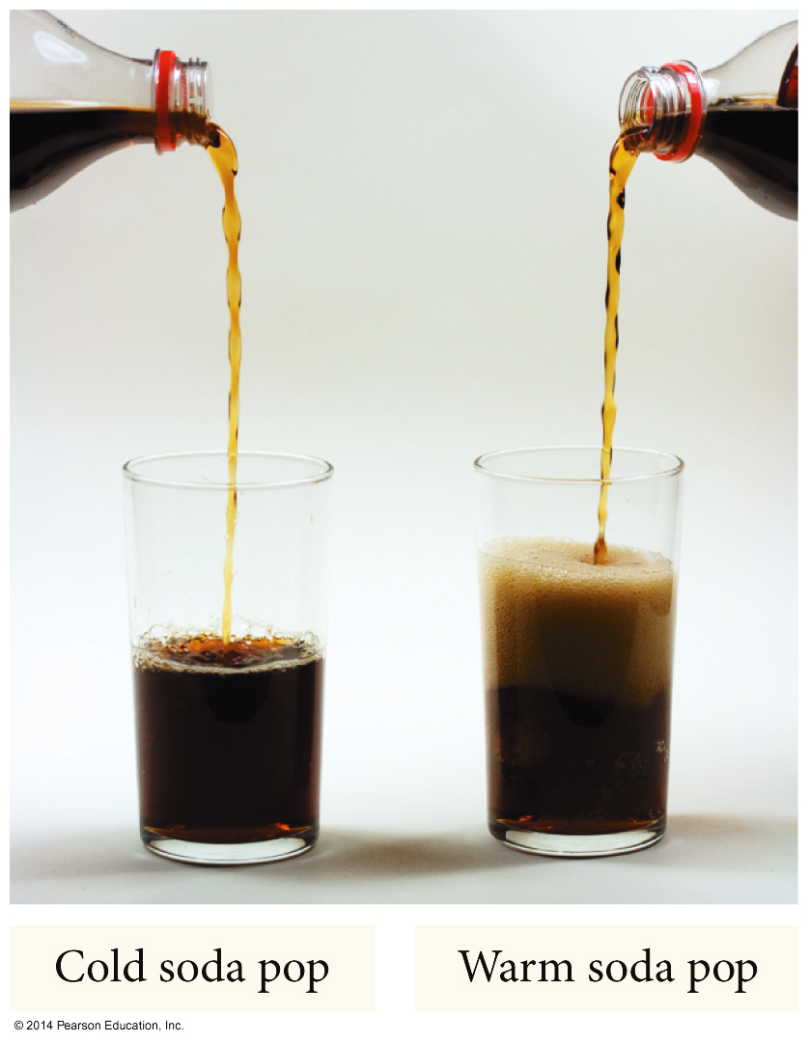
Temperature Dependence of Solubility of Gases in Water

Slide 6
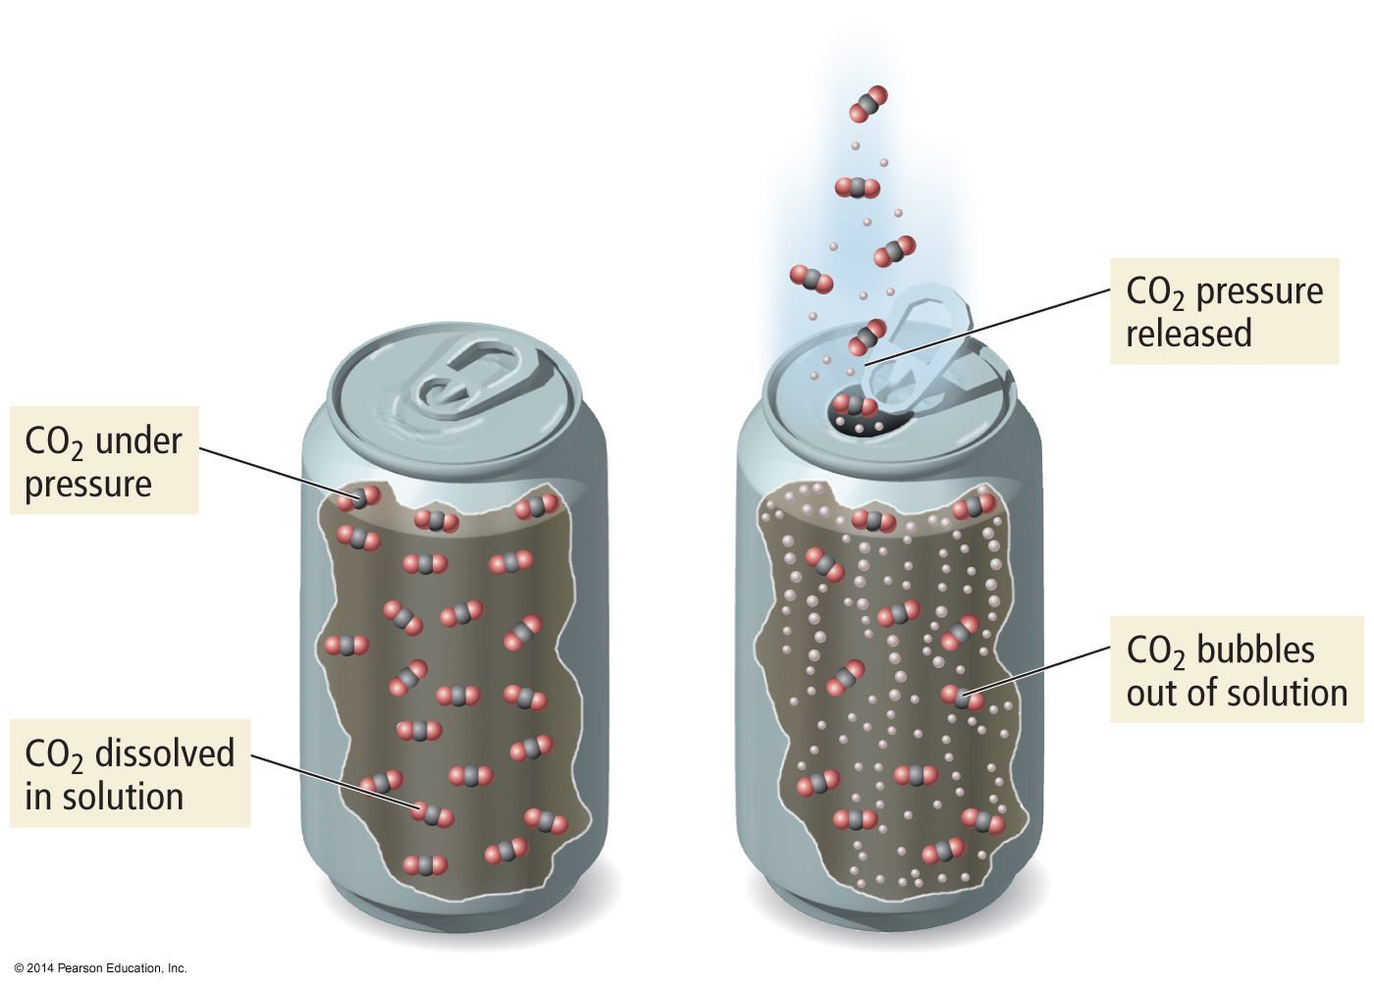
Pressure Dependence of Solubility of Gases in Water
The larger the partial pressure of a gas in contact with a liquid, the more soluble the gas is in the liquid.

Slide 7
Solubility Limit
Saturated - When the solute and solvent in dynamic equilibrium
If you add more solute it will not dissolve.
The saturation [ ] depends on the temperature and pressure of gases.
Unsaturated – When there is less solute than when saturated
More solute will dissolve at this temperature.
Supersaturated – When there is more solute than when saturated
Made by heating the solvent up, dissolving more solute than can be dissolved at the lower temperature, and then slowly cooling the solution down. Not a very stable situation, the extra solute will “crash out” if disturbed. http://www.youtube.com/watch?v=0wifFbGDv4I

Slide 8
Temperature Dependence of Solubility of Solids in Water
Units - Solubility is often in grams of solute that will dissolve in 100 g of water. Be sure to check though!
For most solids, the solubility of the solid increases as the temperature increases.
When ΔH_{solution} is endothermic

Slide 9
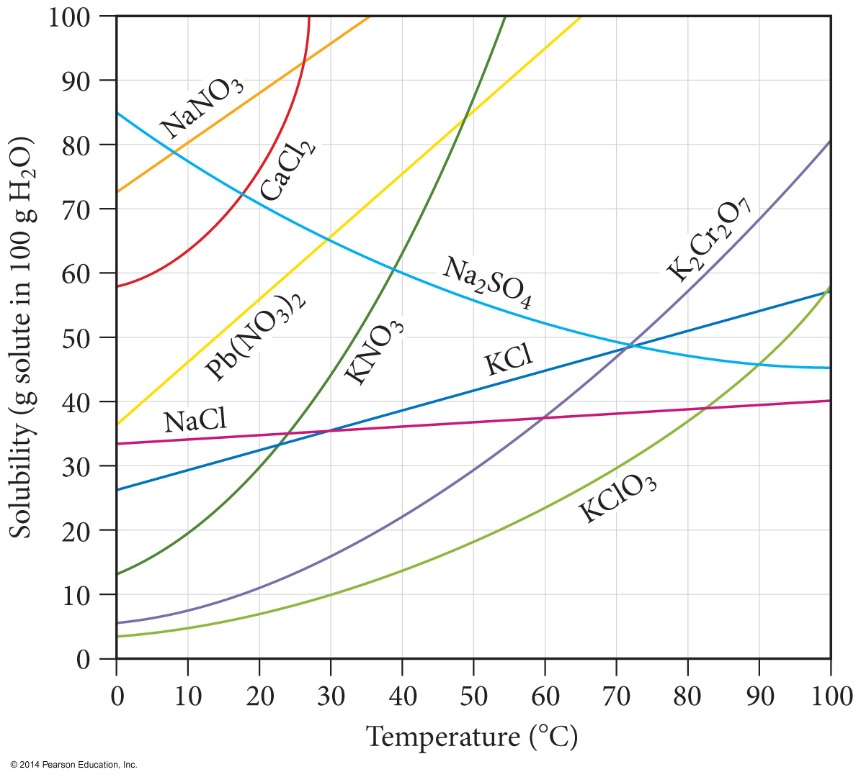
Solubility Curves
Can be used to predict solubility of a solute.
Saturated
On the line
Unsaturated
Below the line
Supersaturated
Above the line

Slide 10
Ionic Solutes
Ionic compounds lower the vapor pressure 2-3+ times more than nonelectrolyte solutes. When the ionic compounds dissociate it results in more particles.
Ionic Comp. AB → A⁺ + B⁻ C₂D → 2C⁻ + D²⁻
#particles 1 2 1 3
Nonelectrolyte XY(s) → XY(aq)
#particles 1 1
VP lowering depends on the number of particles, not the identities of the particles.

Slide 11
Electrolytes vs. Non-electrolytes
Electrolyte
A substance whose aqueous solution conducts an electric current.
Nonelectrolyte
A substance whose aqueous solution does not conduct an electric current.

Slide 12
Electrolytes vs. Non-electrolytes
The ammeter measures the flow of electrons (current) through the circuit.
If the ammeter measures a current, and the bulb glows, then the sol’n conducts.
If the ammeter fails to measure a current, and the bulb does not glow, the solution is non-conducting.

Slide 13
Electrolytes or Non-electrolytes?
Pure water
Tap water
Sugar solution
Sodium chloride solution
Hydrochloric acid solution
Lactic acid solution
Ethyl alcohol solution
Pure sodium chloride

Slide 14
Answers
ELECTROLYTES:
NONELECTROLYTES:
Tap water (weak)
NaCl solution
HCl solution
Lactic acid solution (weak)
Pure water
Sugar solution
Ethanol solution
Pure NaCl (unless molten!)

Slide 15
YouTube Link to Presentation
https://youtu.be/S6VuAo-LIYw

