Slide 1
N35 - SOLUTIONS
K_{sp}

Slide 2
N35 - SOLUTIONS
K_{sp}
Target: I can perform K_{sp} calculations to determine the solubility of different salts.

Slide 3
Just application of old info!

Slide 4
Just application of old info!
Equilibrium constants and ICE Tables.
Only real difference is that your reactant is always a solid so it doesn’t show up in the Law of Mass Action.
But that isn’t “new” – we’ve known that forever!

Slide 5
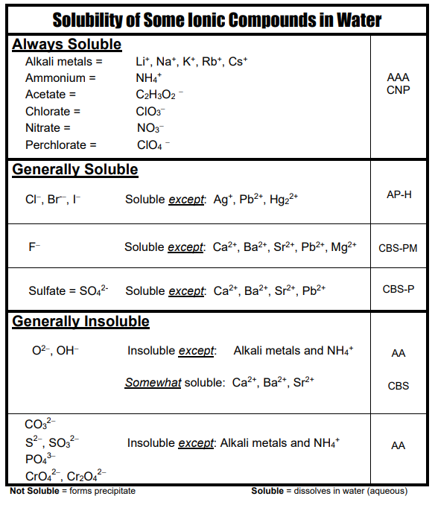
Solubility Chart
A solubility chart is a qualitative distinction!
When we say insoluble, we mean so little dissociates that it isn’t practical. A few will still dissociate!
Can do math to see how much dissociates.

Slide 6
Solubility Product
K_{sp} is called the solubility product
Example:
AgBr_{(s)} → Ag⁺_{(aq)} + Br⁻_{(aq)}
K_{sp} = [Ag⁺][Br⁻]

Slide 7
K_{sp} Values for Some Salts at 25°C
Name | Formula | K_{sp}
Barium carbonate | BaCO₃ | 2.6 x 10⁻⁹
Barium chromate | BaCrO₄ | 1.2 x 10⁻¹⁰
Barium sulfate | BaSO₄ | 1.1 x 10⁻¹⁰
Calcium carbonate | CaCO₃ | 5.0 x 10⁻⁹
Calcium oxalate | CaC₂O₄ | 2.3 x 10⁻⁹
Calcium sulfate | CaSO₄ | 7.1 x 10⁻⁵
Copper(I) iodide | CuI | 1.3 x 10⁻¹²
Copper(II) iodate | Cu(IO₃)₂ | 6.9 x 10⁻⁸
Copper(II) sulfide | CuS | 6.0 x 10⁻³⁷
Iron(II) hydroxide | Fe(OH)₂ | 4.9 x 10⁻¹⁷
Iron(II) sulfide | FeS | 6.0 x 10⁻¹⁹
Iron(III) hydroxide | Fe(OH)₃ | 2.6 x 10⁻³⁹
Lead(II) bromide | PbBr₂ | 6.6 x 10⁻⁶
Lead(II) chloride | PbCl₂ | 1.2 x 10⁻⁵
Lead(II) iodate | Pb(IO₃)₂ | 3.7 x 10⁻¹³
Lead(II) iodide | PbI₂ | 8.5 x 10⁻⁹
Lead(II) sulfate | PbSO₄ | 1.8 x 10⁻⁸
Name | Formula | K_{sp}
Lead(II) bromide | PbBr₂ | 6.6 x 10⁻⁶
Lead(II) chloride | PbCl₂ | 1.2 x 10⁻⁵
Lead(II) iodate | Pb(IO₃)₂ | 3.7 x 10⁻¹³
Lead(II) iodide | PbI₂ | 8.5 x 10⁻⁹
Lead(II) sulfate | PbSO₄ | 1.8 x 10⁻⁸
Magnesium carbonate | MgCO₃ | 6.8 x 10⁻⁶
Magnesium hydroxide | Mg(OH)₂ | 5.6 x 10⁻¹²
Silver bromate | AgBrO₃ | 5.3 x 10⁻⁵
Silver bromide | AgBr | 5.4 x 10⁻¹³
Silver carbonate | Ag₂CO₃ | 8.5 x 10⁻¹²
Silver chloride | AgCl | 1.8 x 10⁻¹⁰
Silver chromate | Ag₂CrO₄ | 1.1 x 10⁻¹²
Silver iodate | AgIO₃ | 3.2 x 10⁻⁸
Silver iodide | AgI | 8.5 x 10⁻¹⁷
Strontium carbonate | SrCO₃ | 5.6 x 10⁻¹⁰
Strontium fluoride | SrF₂ | 4.3 x 10⁻⁹
Strontium sulfate | SrSO₄ | 3.4 x 10⁻⁷
Zinc sulfide | ZnS | 2.0 x 10⁻²⁵

Slide 8
Ksp isn’t always the most useful value
You can’t always directly compare the solubility of substances based on their K_{sp} values because the stoichiometry comes into play also.
AgCl vs CaCl₂
2 ions 3 ions
Instead we will use a value that we calculate that allows us to compare the solubility of two compounds more directly.

Slide 9
Expressing Solubility
We typically describe the solubility as how much solute can you dissolve in how much solvent.
Moles / Liter - 0.25 moles will dissociate in 1 L sol’n
Grams / Liter
Etc…
(Always check what units it wants answers in!)
This value is called the Molar Solubility
Usually represented by “s”

Slide 10
Solving Solubility Problems
Calculate molar solubility for AgI at 25°C, K_{sp} = 1.5 x 10⁻¹⁶
AgI(s) → Ag⁺(aq) + I⁻(aq)
$$Ksp=\left[{Ag}^{+}\right][I^{−}]$$
I
C
E
O
O
Nothing on the denominator because the reactant was a solid!
+x
+x
x
x
Meaning: 1.2 x 10⁻⁸ moles of Ag⁺ and I⁻ can be present per 1 L of sol’n before the sol’n is saturated.
Or...you can get 1.2 x 10⁻⁸ moles of AgI to dissociate per L of sol’n
1.5 x 10⁻¹⁶ = x²
x =
s = molar solubility of AgI in mol/L
= 1.2 x 10⁻⁸ M

Slide 11
Solving Solubility Problems
Calculate molar solubility for AgI at 25°C, K_{sp} = 1.5 x 10⁻¹⁶
AgI(s) → Ag⁺(aq) + I⁻(aq)
$$Ksp=\left[{Ag}^{+}\right][I^{−}]$$
I
C
E
O
O
Nothing on the denominator because the reactant was a solid!
+s
+s
s
s
Meaning: 1.2 x 10⁻⁸ moles of Ag⁺ and I⁻ can be present per 1 L of sol’n before the sol’n is saturated.
Or...you can get 1.2 x 10⁻⁸ moles of AgI to dissociate per L of sol’n
1.5 x 10⁻¹⁶ = s²
s = molar solubility of AgI in mol/L
= 1.2 x 10⁻⁸ M

Slide 12
Solving Solubility Problems When Not 1:1
Calculate molar solubility for PbCl₂ at 25°C, K_{sp} = 1.6 x 10⁻⁵
Meaning: 1.6 x 10⁻² mol of Pb²⁺ and 3.2 x 10⁻² mol of Cl⁻ can be present per 1 L of sol’n before the sol’n is saturated.
Or...you can get 1.6 x 10⁻² moles of PbCl₂ to dissociate per L of solution
PbCl₂(s) → Pb²⁺(aq) + 2Cl⁻(aq)
I
C
E
O
O
Be careful with the stoichiometry!
+s
+2s
s
2s
1.6 x 10⁻⁵ = (s)(2s)² = 4s³
s = molar solubility of PbCl₂ in mol/L
= 1.6 x 10⁻² M

Slide 13
The molar solubility of PbI₂ is 1.50 × 10⁻³ M.
Calculate the value of K_{sp} for PbI₂.
3.38E⁻⁹
4.50E⁻⁶
1.35E⁻⁸
1.50E⁻³
none of these

Slide 14
The molar solubility of PbI₂ is 1.50 × 10⁻³ M.
Calculate the value of K_{sp} for PbI₂.
3.38E⁻⁹
PbI_{2 (s)} ↔ | Pb²⁺ _{(aq)} | + 2I⁻ _{(aq)}
- | 0 | 0
- | + s | + 2s
4.50E⁻⁶
1.35E⁻⁸
$$Ksp=(s){(2s)}^{2}$$
$$Ksp=4\left(s\right)3$$
1.50E⁻³
$$Ksp=4\left(1.5 ×{10}^{−3}\right)3$$
none of these
$$Ksp=1.35 x {10}^{−8}$$

Slide 15
Will Something Precipitate?
Have to check Q versus K !
Q < K_{sp} | No precipitate yet! The solution is unsaturated. All ions are still dissociated.
Q = K_{sp} | No precipitate yet! The solution is saturated. The maximum amount of ions are dissociated.
Q > K_{sp} | A precipitate will form! The maximum amount of ions are already dissociated, so the extra will “crash out” as a solid precipitate.
*Note* Supersaturated solutions have Q > K_{sp} but a ppt hasn’t crashed out yet because it was made at a higher temperature and slowly cooled down. It is unstable and the ppt will crash out once the sol’n is disturbed.

Slide 16
https://youtu.be/uxCgxBr6mQY

Slide 17
Common Ion Effect
What happens to the solubility of a substance if one of its ions is already present in the solution?
Will the solubility increase or decrease????
It decreases!
Let’s redo this problem but this time let’s have some I⁻ already in the solution. x should end up less than 1.2 x 10⁻⁸ mol/L
For the salt AgI at 25°C, K_{sp} = 1.5 x 10⁻¹⁶
AgI(s) → Ag⁺(aq) + I⁻(aq)
s = solubility of AgI in mol/L
= 1.2 x 10⁻⁸ M

Slide 18
Solving Solubility with a Common Ion
For the salt AgI at 25°C, K_{sp} = 1.5 x 10⁻¹⁶
What is its solubility in 0.05 M NaI?
AgI(s) → Ag⁺(aq) + I⁻(aq)
I
C
E
O
0.05
+s
+s
s
0.05+s
5% rule!
1.5 x 10⁻¹⁶ = (s)(0.05+s) ≅ (s)(0.05)
s = solubility of AgI in mol/L
= 3.0 x 10⁻¹⁵ M

Slide 19
Qualitatively describing how adding something changes solubility
Another Salt:
Look to see if the dissociated ions are in common
BaCl₂ + NaCl
Ba²⁺ 2Cl⁻ Na⁺ Cl⁻
Cl⁻ is in common with BaCl₂, so it will decrease the solubility.
BaCl₂ + NaF
Ba²⁺ 2Cl⁻ Na⁺ F⁻
F⁻ is NOT in common with BaCl₂, so it will not change the solubility.

Slide 20
Qualitatively describing how adding something changes solubility
Adding an Acid:
Look to see if the dissociated ions will react with one of the ions from the salt.
BaCl₂ + HNO₃
Ba²⁺ 2Cl⁻ H⁺ NO₃⁻
H⁺ and Cl⁻ make a strong acid which stays dissociated. Doesn’t affect the solubility of BaCl₂
CaF₂ + HNO₃
Ca²⁺ 2F⁻ H⁺ NO₃⁻
H⁺ and F⁻ make a weak acid which doesn’t dissociate fully! Removes F⁻ ions from solution. Increases the solubility of CaF₂, trying to replace F⁻ ions

Slide 21
In which solution is B a S O ₄ most soluble?
A solution that is 0.10 M in B a(N O ₃)₂
A solution that is 0.10 M in N a ₂ S O ₄
A solution that is 0.10 M in N a N O ₃
None of these, solubility never changes, it is a set value

Slide 22
In which solution is B a S O ₄ most soluble?
A solution that is 0.10 M in B a(N O ₃)₂
A solution that is 0.10 M in N a ₂ S O ₄
A solution that is 0.10 M in N a N O ₃
None of these, solubility never changes, it is a set value
The others have common ions that would drive equilibrium position to the left, resulting in less dissociation of the ions

Slide 23
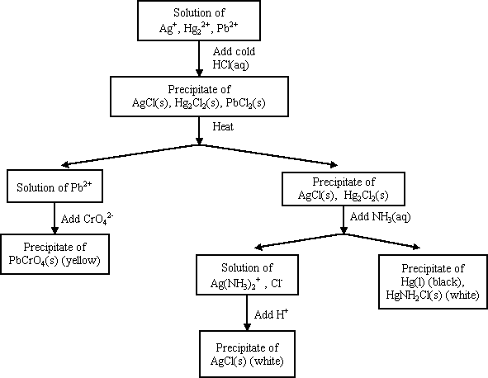
Precipitation and Qualitative Analysis
Not in the class anymore!

Slide 24
FYI - Complex Ions
Complex ion - a charged species composed of:
1. A metallic cation
2. Ligands
Ligand – Lewis bases that have a lone electron pair that can form a covalent bond with an empty orbital belonging to the metallic cation

Slide 25
NH₃, CN⁻, and H₂O are Common Ligands
[ ]⁻
*NOTE* A lot of Lewis acids/bases act as ligands. They are often involved in solubility problems, which is why we tend to put K_{sp} in the Acid Base chapter and not always Equilibrium or Solutions chapters.

Slide 26
Coordination Number
Coordination number
The number of ligands attached to the cation
2, 4, and 6 are the most common coordination numbers
Coordination # | Example(s)
2 | Ag(NH₃)₂⁺
4 | CoCl₄²⁻ Cu(NH₃)₄²⁺
6 | Co(H₂O)₆²⁺ Ni(NH₃)₆²⁺

Slide 27
Complex Ions and Solubility
AgCl(s)  Ag⁺ + Cl⁻ K_{sp} = 1.6 x 10⁻¹⁰
Ag⁺ + NH₃  Ag(NH₃)⁺ K₁ = 2.1 x 10³
Ag(NH₃)⁺ NH₃  Ag(NH₃)₂⁺ K₂ = 8.2 x 10³
AgCl + 2NH₃  Ag(NH₃)₂⁺ + Cl⁻
K = K_{sp}⋅K₁⋅K₂

Slide 28
Some more pretty precipitation videos if you are interested ☺

Slide 29
https://youtu.be/8oc1jFqYnFA

Slide 30
https://youtu.be/8oc1jFqYnFA

Slide 31
https://youtu.be/4soja4eu35o

Slide 32
YouTube Link to Presentation
This is an old version of the lecture, back when it used to be in the Acid Base chapter. If I get time I will update this with a new video for this AP lecture.
https://youtu.be/LWIR91gx-ac

