Slide 1
N33 - SOLUTIONS
Raoult’s Law

Slide 2
N33 - SOLUTIONS
Raoult’s Law
Target: I can use Raoult’s Law to perform calculations related to vapor pressure.

Slide 3
Raoult’s Law
The presence of a nonvolatile solute lowers the vapor pressure of the solvent.
$$P_{solution}={\text{χ}}_{solvent}P_{solvent}^{0}$$
P_{solution} = Observed Vapor pressure of the solution
χ_{solvent} = Mole fraction of the solvent
P⁰_{solvent} = Vapor pressure of the pure solvent

Slide 4
Vapor Pressure Lowering
The vapor pressure of a solvent in a solution is always lower than the vapor pressure of the pure solvent.
VP of the solution is directly proportional to the amount of the solvent in the solution.
Vapor Pressure Lowering - The difference between the VP of the pure solvent and the VP of the solvent in solution
$$∆P= P_{solvent}^{°}−P_{solution}={\text{χ}}_{solute} ∙ P_{solvent}^{°}$$

Slide 5
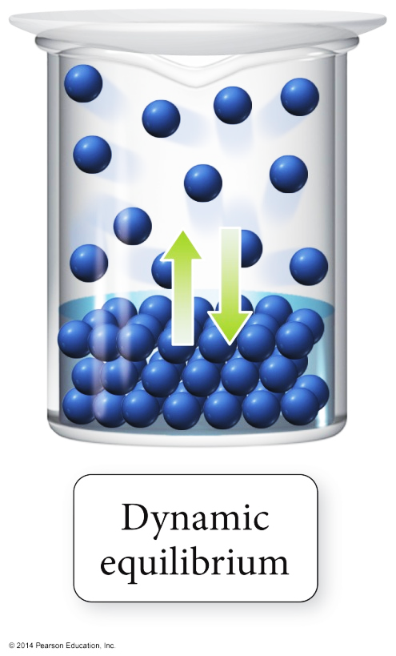
Vapor Pressure of Solutions
The VP of a solvent above a solution is lower than the VP of the pure solvent.
The solute particles replace some of the solvent molecules at the surface.
The pure solvent establishes a dynamic liquid vapor equilibrium.

Slide 6
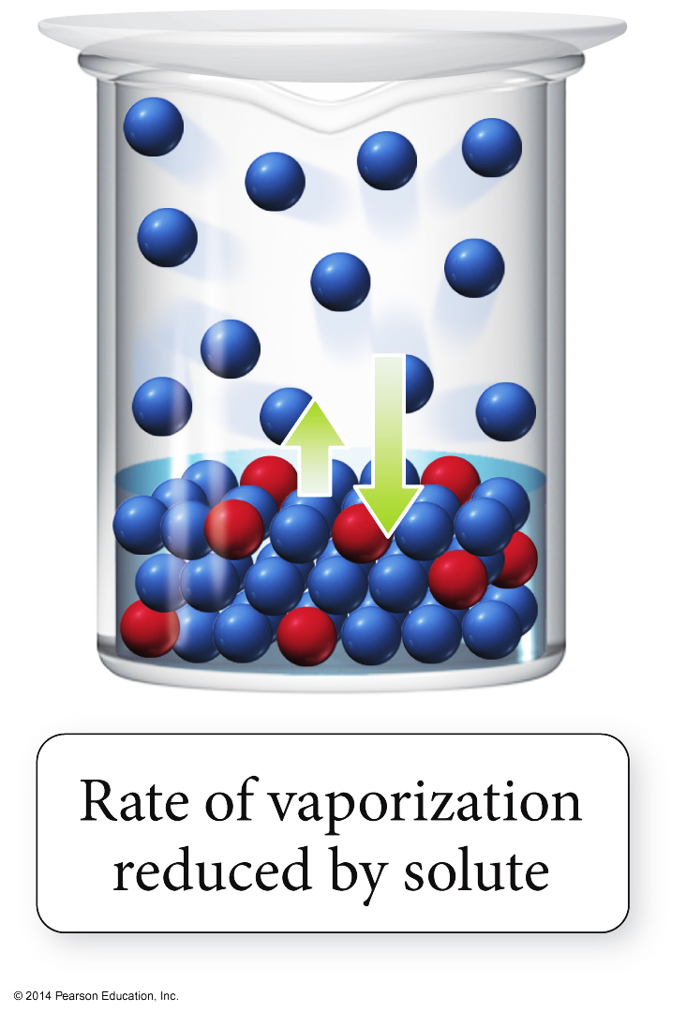
Vapor Pressure of Solutions
Addition of a nonvolatile solute reduces the rate of vaporization, decreasing the amount of vapor.

Slide 7
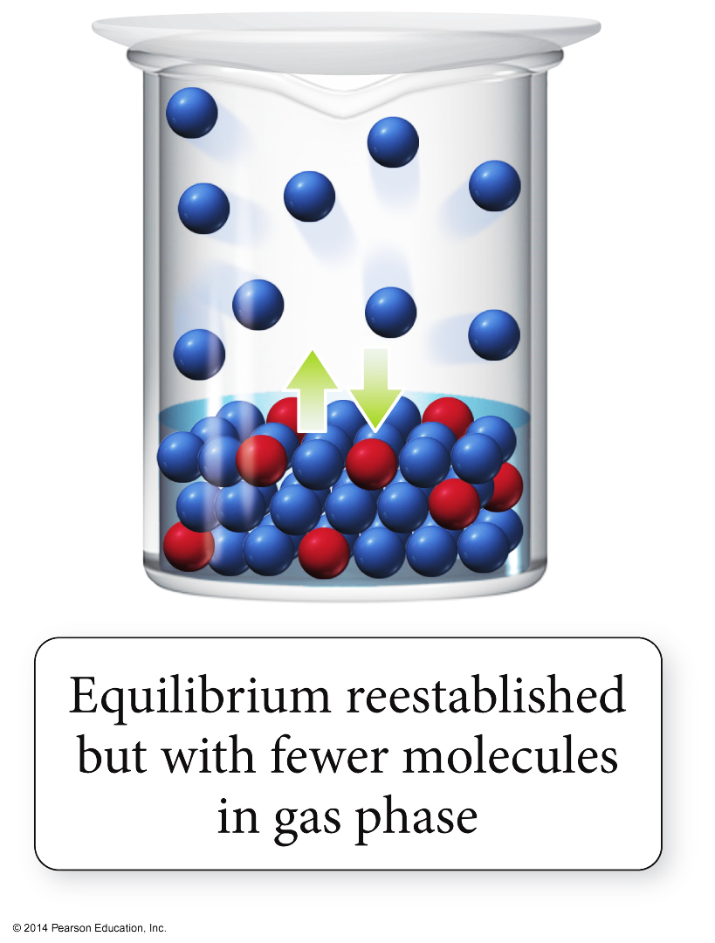
Vapor Pressure of Solutions
Eventually, equilibrium is re-established, but with a smaller number of vapor molecules; therefore, the vapor pressure will be lower.

Slide 8
Liquid-liquid solutions in which both components are volatile (Non-Ideal)
Non-Ideal Liquid-Liquid Solutions
Modified Raoult's Law:
$$P_{total}=P_{A}+P_{B}={\text{χ}}_{A}P_{A}^{°}+{\text{χ}}_{B}P_{B}^{°}$$
P° is the vapor pressure of the pure solvent
P_{A} and P_{B} are the partial pressures

Slide 9
Ideal Solutions
1. Liquid-liquid solution that obeys Raoult's law
No solution is perfectly ideal, though some are close
2. Negative deviations from Raoult's law = lower than predicted VP
Solute and solvent are similar, with strong forces of attraction
ΔHsol'n is large and negative
3. Positive deviations from Raoult's law = higher than predicted VP
Solute and solvent are dissimiliar, weak forces of attraction
Particles easily escape attractions in solution to enter the vapor phase

Slide 10
Ideal versus Non-Ideal Solutions
Ideal solutions
Solute–Solvent interactions being made are equal to the sum of the broken Solute–Solute and Solvent–Solvent interactions.
Ideal solutions follow Raoult’s law
Effectively, the solute is diluting the solvent.
If the solute–solvent interactions are stronger or weaker than the broken interactions the solution is nonideal.

Slide 11
Vapor Pressure of Non-Ideal Solutions
Negative Deviations
Solute–Solvent interactions are stronger than the Solute–Solute + Solvent–Solvent, Total VP of the solution will be less than predicted by Raoult’s law, because the VP of the solute and solvent are lower than ideal.
Positive Deviations
Solute–Solvent interactions are weaker than the Solute–Solute + Solvent–Solvent. Total VP of the solution will be more than predicted by Raoult’s Law.

Slide 12
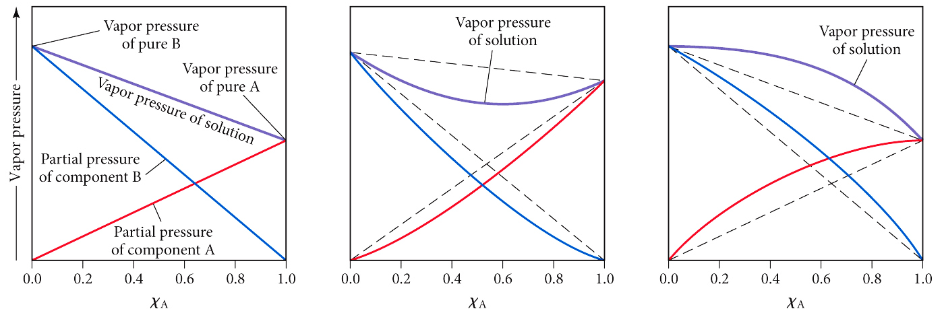
Deviations from Raoult’s Law
STRONG SOLUTE-SOLVENT ATTRACTIONS
NEGATIVE DEV.
WEAK SOLUTE-SOLVENT ATTRACTIONS POSITIVE DEV.
IDEAL SOL’N NO DEVIATION

Slide 13
YouTube Link to Presentation
https://youtu.be/FOtx5wrEcPU

