Slide 1
N35 - SOLUTIONS
Colligative Properties

Slide 2
N35 - SOLUTIONS
Colligative Properties
Target: I can take into account how the number of particles in a solution affects various properties.

Slide 3
Ionic Solutes
Colligative properties
Properties whose value depends only on the number of solute particles, and not on what they are.
  Value of the property depends on the concentration of the solution.
The difference between the solution and the pure substance is related to the different attractive forces present in the solution, and the solute particles occupying solvent molecules positions.
Notes:
3

Slide 4
Colligative Properties
Colligative properties are those that depend on the concentration of particles in a solution, not upon the identity of those properties.
Boiling Point Elevation
Freezing Point Depression
Vapor Pressure Lowering
Osmotic Pressure

Slide 5
The van’t Hoff Factor, i
Electrolytes may have two, three or more times the effect on boiling point, freezing point, and osmotic pressure, depending on its dissociation.
Ionic Comp. AB → A⁺ + B⁻ C₂D → 2C⁻ + D²⁻
#particles 1 2 1 3
Nonelectrolyte XY(s) → XY(aq)
#particles 1 1

Slide 6
Dissociation Equations and i
i = 2
NaCl(s) →
Na⁺(aq) + Cl⁻(aq)
i = 2
AgNO₃(s) →
Ag⁺(aq) + NO₃⁻(aq)
i = 3
MgCl₂(s) →
Mg²⁺(aq) + 2 Cl⁻(aq)
i = 3
Na₂SO₄(s) →
2 Na⁺(aq) + SO₄²⁻(aq)
AlCl₃(s) →
Al³⁺(aq) + 3 Cl⁻(aq)
i = 4

Slide 7
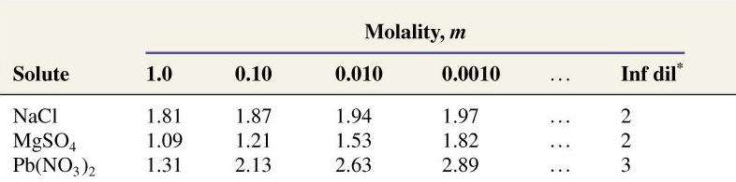
Ideal vs. Real van’t Hoff Factor
The ideal van’t Hoff Factor is only achieved in VERY DILUTE solution.

Slide 8
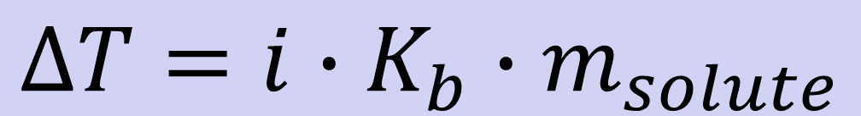
Boiling Point Elevation
Each mole of solute particles raises the boiling point of 1 kilogram of water by 0.51 degrees Celsius.
$$∆T=i∙K_{b}∙m_{solute}$$
K_{b}= kilogram/mol (for water 0.51 °C )
m = molality of the solution
i = van’t Hoff factor

Slide 9
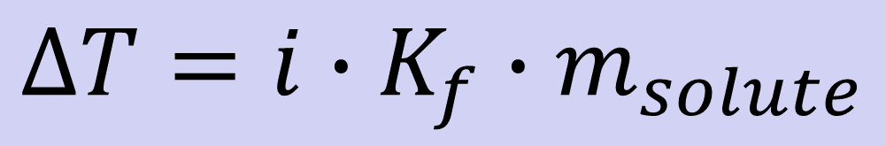
Freezing Point Depression
Each mole of solute particles lowers the freezing point of 1 kilogram of water by 1.86 degrees Celsius.
$$∆T=i∙K_{f}∙m_{solute}$$
K_{f} = kilogram/mol (for water 1.86 °C)
m = molality of the solution
i = van’t Hoff factor

Slide 10
Freezing Point Depression and Boiling Point Elevation Constants, °C/m
Solvent | K_{f} | K_{b}
Acetic acid | 3.90 | 3.07
Benzene | 5.12 | 2.53
Nitrobenzene | 8.1 | 5.24
Phenol | 7.27 | 3.56
Water | 1.86 | 0.512

Slide 11
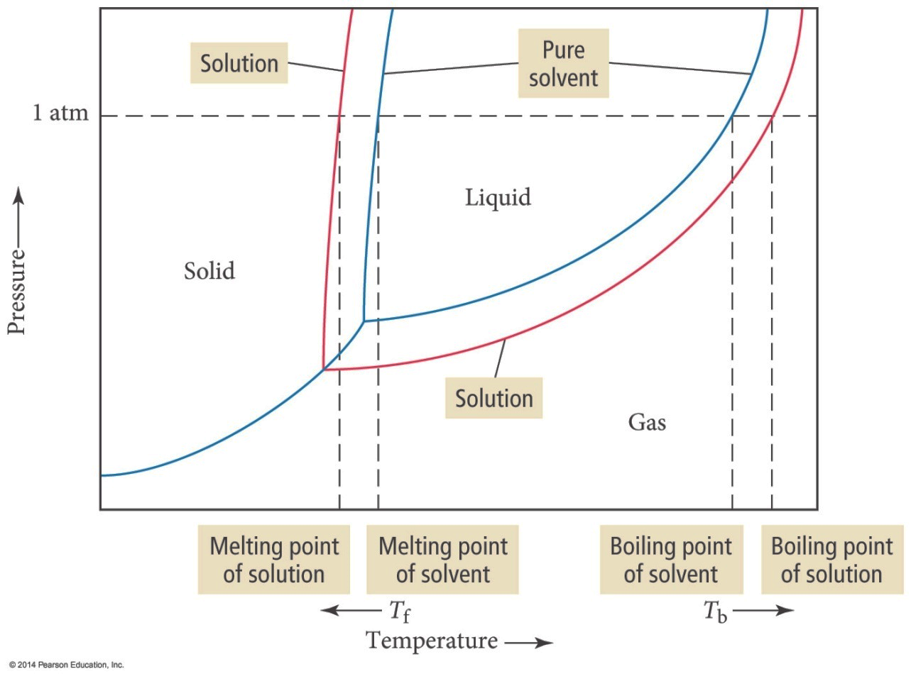
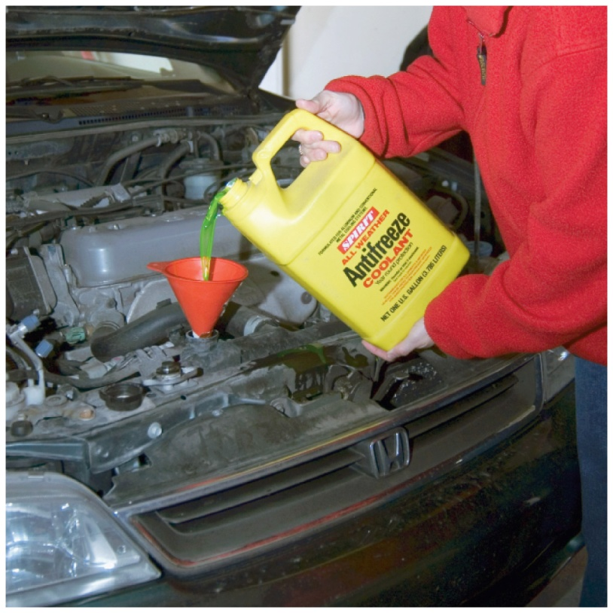
Freezing Point Depression and
Boiling Point Elevation

Slide 12
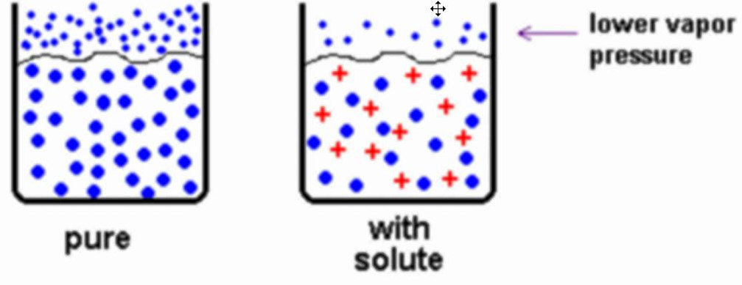
Vapor Pressure Lowering
P₁ = X₁P₁⁰

Slide 13
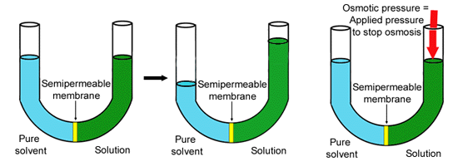
Osmotic Pressure
The minimum pressure that stops the osmosis is equal to the osmotic pressure of the solution

Slide 14

Osmotic Pressure Calculations
$$\text{}\text{ = }\text{iMRT}$$
Π = Osmotic pressure
M = Molarity of the solution
R = Gas Constant = 0.08206 L⋅atm/mol⋅K
T = Absolute Temperature (K)

Slide 15
Suspensions and Colloids
Suspensions and colloids are NOT solutions.
Suspensions - The particles are so large that they settle out of the solvent if not constantly stirred.
Colloids - The particles intermediate in size between those of a suspension and those of a solution.

Slide 16
Types of Colloids
Examples | Dispersing Medium | Dispersed Substance | Colloid Type
Fog, aerosol sprays | Gas | Liquid | Aerosol
Smoke, airborn germs | Gas | Solid | Aerosol
Whipped cream, soap suds | Liquid | Gas | Foam
Milk, mayonnaise | Liquid | Liquid | Emulsion
Paint, clays, gelatin | Liquid | Solid | Sol
Marshmallow, Styrofoam | Solid | Gas | Solid Foam
Butter, cheese | Solid | Liquid | Solid Emulsion
Ruby glass | Solid | Solid | Solid sol

Slide 17
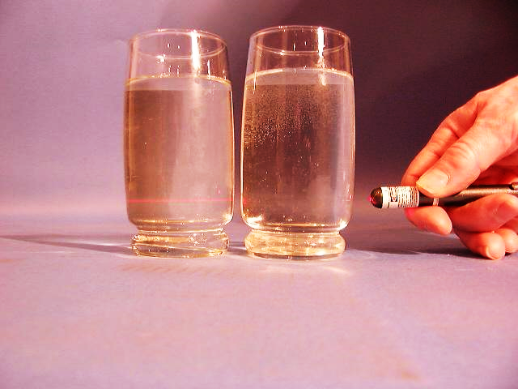
The Tyndall Effect
Colloids scatter light, making a beam visible. Solutions do not scatter light.
Which glass contains a colloid?
colloid
solution

Slide 18
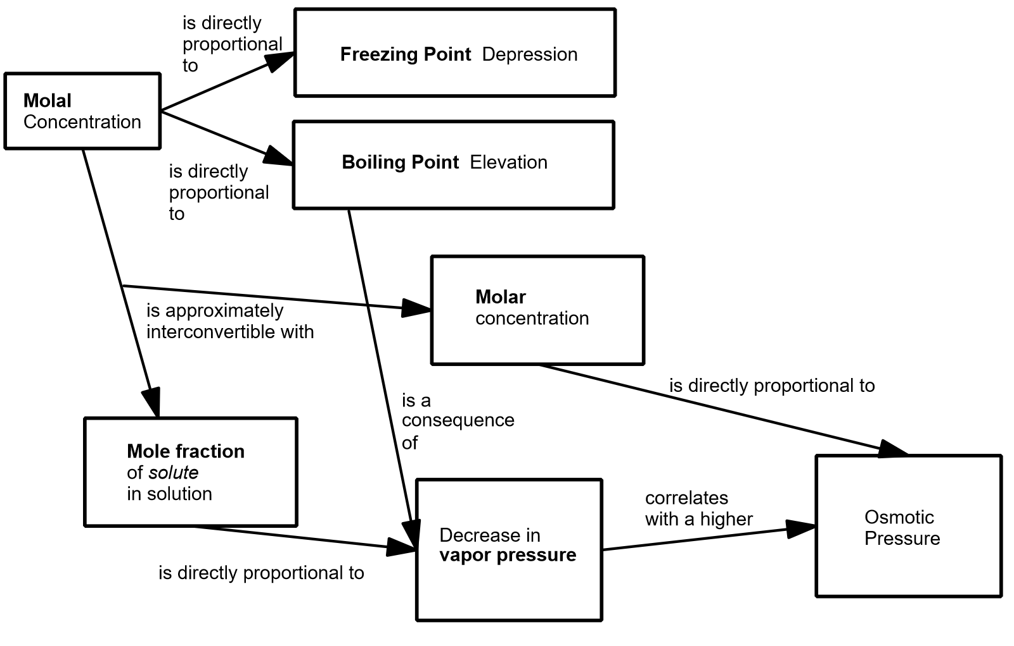

Slide 19





All of the following are colligative properties except:
Osmotic Pressure
Boiling Point elevation
Freezing Point depression
Density elevation
None of these

Slide 20
All of the following are colligative properties except:
Osmotic Pressure
Boiling Point elevation
Freezing Point depression
Density elevation
None of these

Slide 21
121.2 g of NaCl completely dissolve (producing Na⁺ and Cl⁻ ions) in 1.00 Kg of water at 25°C. The VP of pure water at this temp is 23.8 torr. Determine the VP of the solution
22.1 torr
22.9 torr
20.6 torr
19.9 torr
23.8 torr

Slide 22
121.2 g of NaCl completely dissolve (producing Na⁺ and Cl⁻ ions) in 1.00 Kg of water at 25°C. The VP of pure water at this temp is 23.8 torr. Determine the VP of the solution
121.2g
1mol
2mol ions
22.1 torr
=
4.15 mol
58.44g
1mol NaCl
22.9 torr
1000g
1mol
= 55.5mol
20.6 torr
18.02g
19.9 torr
P = (0.930)(23.8) = 22.1torr
55.5
X_{H2O} =
= 0.930
23.8 torr
(4.15 + 55.5)

Slide 23
At 40°C, heptane has a vapor pressure of about 92.0 torr and octane has a vapor pressure of about 31.2 torr. Assuming ideal behavior, what is the vapor pressure of a solution that contains twice as many moles of heptane as octane?
61.3 torr
51.5 torr
71.7 torr
82.1 torr
None of these

Slide 24
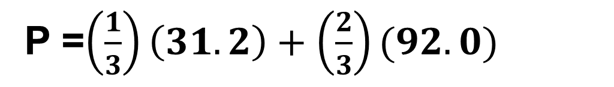
At 40°C, heptane has a vapor pressure of about 92.0 torr and octane has a vapor pressure of about 31.2 torr. Assuming ideal behavior, what is the vapor pressure of a solution that contains twice as many moles of heptane as octane?
61.3 torr
Octane = 1 mol
Heptane = 2 mol
51.5 torr
P = X₁P₁ + X₂P₂
71.7 torr
P =$\left(\frac{1}{3}\right)\left(31.2\right)+\left(\frac{2}{3}\right)(92.0)$
82.1 torr
P = 71.7 torr
None of these

Slide 25
What is the boiling point change for a solution containing 0.681 moles of naphthalene (a nonvolatile, nonionizing compound) in 250. g of liquid benzene? (K_{b} = 2.53 °C/m for benzene)
6.89 °C
0.93 °C
3.72 °C
1.723 °C
0.431 °C

Slide 26

What is the boiling point change for a solution containing 0.681 moles of naphthalene (a nonvolatile, nonionizing compound) in 250. g of liquid benzene? (K_{b} = 2.53 °C/m for benzene)
6.89 °C
∆T = iKm
m = mol_{solute}/kg_{solvent}
0.93 °C
$$=\frac{0.681 mol}{0.250 kg}$$
3.72 °C
= 2.724 m
1.723 °C
∆T = (1)(2.53)(2.724)
= 6.89°C
0.431 °C

Slide 27
A 7.12 g sample of a compound is dissolved in 250. grams of benzene. The freezing point of this solution is 1.02°C below that of pure benzene. What is the molar mass of this compound?
(K_{f} _{benzene} = 5.12 °C/m). Ignore sig. figs.
35.7 g/mol
143 g/mol
286 g/mol
5.67 g/mol
71.5 g/mol

Slide 28
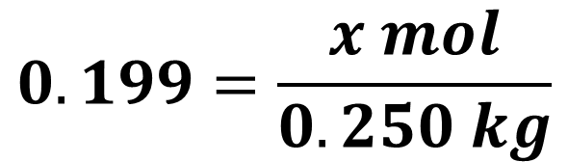
A 7.12 g sample of a compound is dissolved in 250. grams of benzene. The freezing point of this solution is 1.02°C below that of pure benzene. What is the molar mass of this compound?
(K_{f} _{benzene} = 5.12 °C/m). Ignore sig. figs.
35.7 g/mol
∆T = iKm
1.02 = (1)(5.12)(m)
143 g/mol
m = 0.199 mol_{solute}/kg_{solvent}
$$0.199=\frac{x mol}{0.250 kg}$$
286 g/mol
= 0.04975 moles
5.67 g/mol
mm = g/mol =
7.12g/0.04975mol
71.5 g/mol
= 143g/mol

Slide 29
Determine the Osmotic Pressure of a solution that contains 0.017 g of a hydrocarbon solute (molar mass = 340 g/mol) dissolved in benzene to make 350-ml solution. The temperature is 20.0°C
0.18 torr
0.9 torr
1.2 torr
2.6 torr
2.4 torr

Slide 30
Determine the Osmotic Pressure of a solution that contains 0.017 g of a hydrocarbon solute (molar mass = 340 g/mol) dissolved in benzene to make 350-ml solution. The temperature is 20.0°C
Π = iMRT
0.18 torr
0.017g
1mol
= 5x10⁻⁵ mol
0.9 torr
340g
1.2 torr
(5x10⁻⁵mol)/(0.350L) = 1.43x10⁻⁴ M
2.6 torr
Π = (1)(1.43x10⁻⁴)(62.4)(293)
2.4 torr
= 2.6 torr

Slide 31
YouTube Link to Presentation
https://youtu.be/pvzXm1hauo8

Slide 32
Can stop here!
Henry’s Law not covered anymore. You can keep going if interested though!

Slide 33
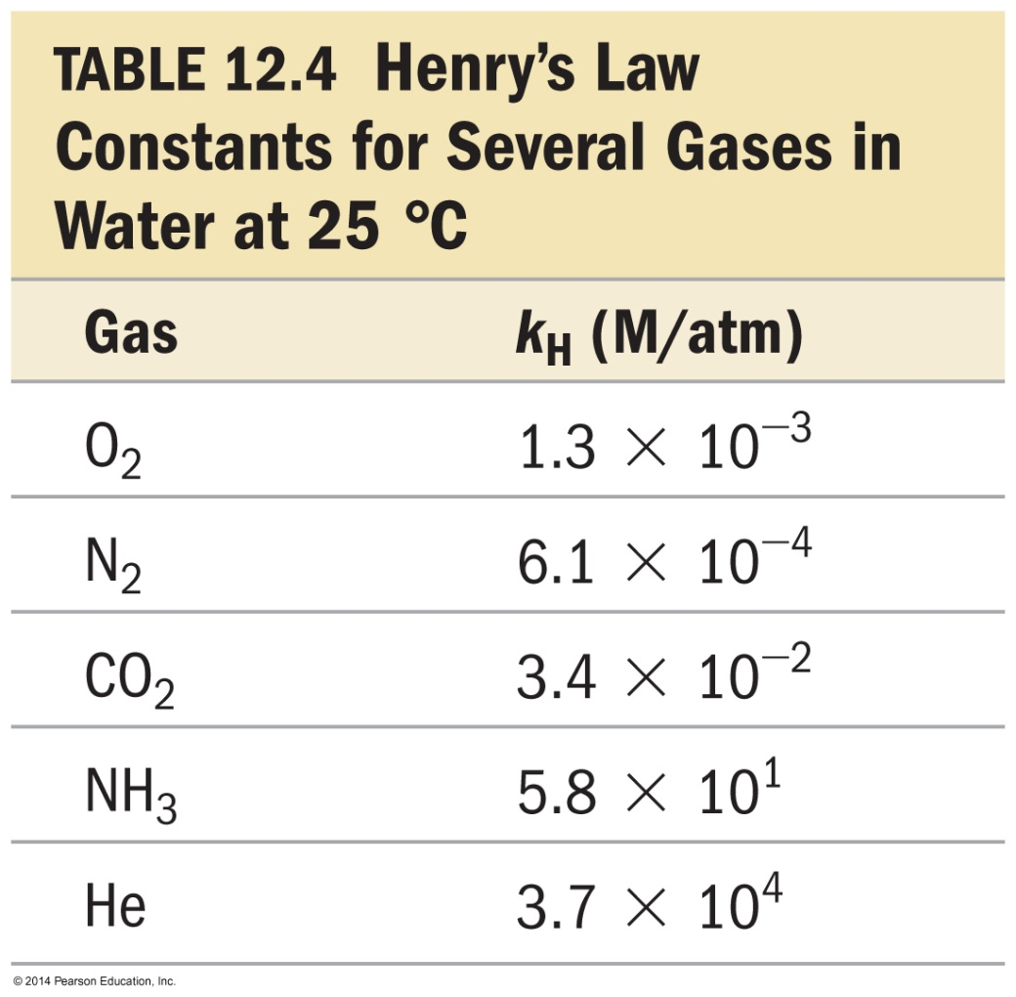
Henry’s Law (removed from AP)
The solubility of a gas (S_{gas}) is directly proportional to its partial pressure, (P_{gas}).
S_{gas} = k_{H}P_{gas}
k_{H} is called the Henry’s law constant.

Slide 34
A correct statement of Henry's law is:
the concentration of a gas in solution is inversely proportional to temperature.
the concentration of a gas in solution is directly proportional to the mole fraction of solvent.
the concentration of a gas in solution is independent of pressure.
the concentration of a gas in a solution is inversely proportional to pressure.
none of these

Slide 35
A correct statement of Henry's law is:
the concentration of a gas in solution is inversely proportional to temperature.
the concentration of a gas in solution is directly proportional to the mole fraction of solvent.
the concentration of a gas in solution is independent of pressure.
the concentration of a gas in a solution is inversely proportional to pressure.
none of these

Slide 36
The solubility of O₂ in water is 0.590g/L at an oxygen pressure of around 14.7 atm. What is the Henry’s Law constant for O₂ (in units of mol/L·atm)?
4.01E⁻²
1.25E⁻³
7.97E²
2.71E⁻¹
None of them are within 5% of the correct answer

Slide 37
The solubility of O₂ in water is 0.590g/L at an oxygen pressure of around 14.7 atm. What is the Henry’s Law constant for O₂ (in units of mol/L·atm)?
S = kP
4.01E⁻²
0.590g
1mol
=0.0184 mol
1.25E⁻³
32g
7.97E²
(0.0184 mol/L) = K (14.7atm)
2.71E⁻¹
K = 1.25E-3
None of them are within 5% of the correct answer

