Slide 1
N31 - SOLUTIONS
Target: I can convert between different concentration units and can use concentration calculations to find helpful information like how many moles are present.

Slide 2
N31 - SOLUTIONS
Concentration

Slide 3
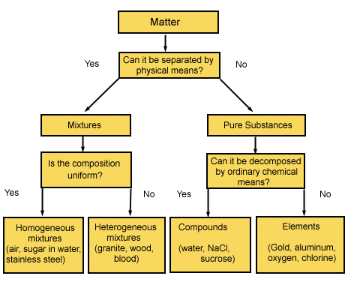
Classification
of Matter
Solutions are homogeneous mixtures

Slide 4
Solute
A solute is the dissolved substance in a solution.
Salt in salt water
Sugar in soda drinks
Carbon dioxide in soda drinks
Solvent
A solvent is the dissolving medium in a solution.
Water in salt water
Water in soda

Slide 5
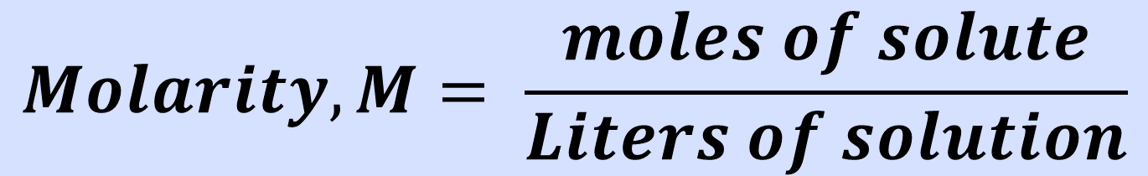
Molarity
Moles of solute per 1 liter of solution - Describes how many molecules of solute in each liter of solution
If a sugar solution concentration is 2.0 M,
  1 liter of solution contains 2.0 moles of sugar
  2 liters = 4.0 moles sugar
  0.5 liters = 1.0 mole sugar
$$Molarity, M= \frac{moles of solute}{Liters of solution}$$

Slide 6
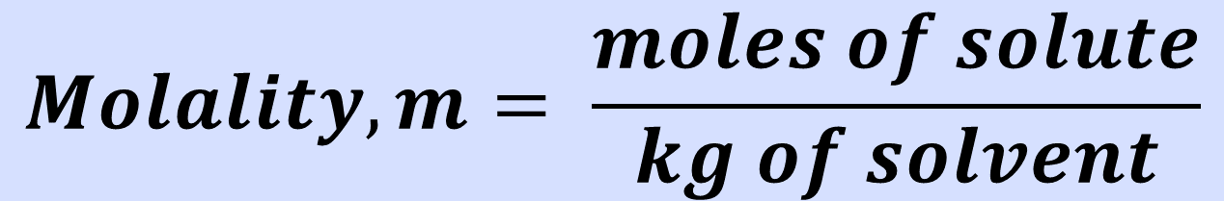
Molality
Moles of solute per 1 kilogram of solvent
Careful! Defined in terms of amount of solvent, not the solution like most of the other calculations
Does not vary with temperature
  Because based on masses, not volumes
$$Molality, m= \frac{moles of solute}{kg of solvent}$$

Slide 7
Parts Solute in Parts Solution
Parts can be measured by mass or volume.
Parts are generally measured in the same units.
  By mass in grams, kilogram, lbs, etc.
  By volume in mL, L, gallons, etc.
  Mass and volume combined in grams and mL

Slide 8
Parts Solute in Parts Solution
Percentage = parts of solute in every 100 parts solution
  If a solution is 0.9% by mass, then there are 0.9 grams of solute in every 100 grams of solution (or 0.9 kg solute in every 100 kg solution).
Parts per million = parts of solute in every
1 million parts solution
  If a solution is 36 ppm by volume, then there are 36 mL of solute in 1 million mL of solution.

Slide 9
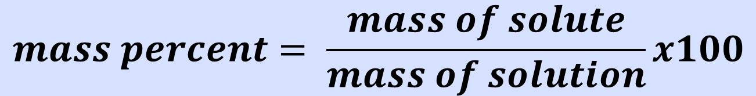
Mass Percent
Mass percent - the ratio of mass units of solute to mass units of solution, expressed as a percent
$$mass percent= \frac{mass of solute}{mass of solution}x100$$

Slide 10
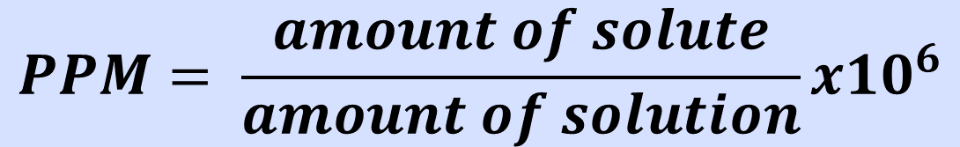
Parts per Million - PPM
Grams of solute per 1,000,000 g of solution
mg of solute per 1 kg of solution
1 liter of water = 1 kg of water
For aqueous solutions we often approximate the kg of the solution as the kg or L of water. For dilute solutions, the difference in density between the solution and pure water is usually negligible.
Remember that the density of water is 1g/1mL
Same as 1000g/1L
Same as 1kg/1L
$$PPM= \frac{amount of solute}{amount of solution}x{10}^{6}$$

Slide 11
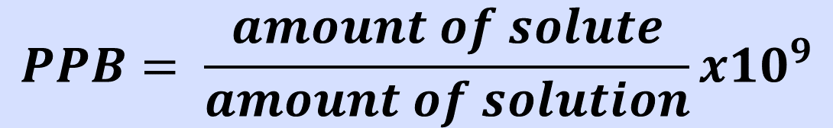
Parts per Billion - PPB
$$PPB= \frac{amount of solute}{amount of solution}x{10}^{9}$$
$$Parts per…= \frac{amount of solute \left(PART\right)}{amount of solution \left(WHOLE\right)}x some factor$$
% = x 100
ppm = x 1,000,000 = x10⁶
ppb = x1,000,000,000 = x10⁹
Notes:
11

Slide 12
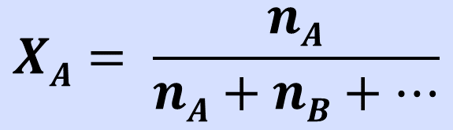
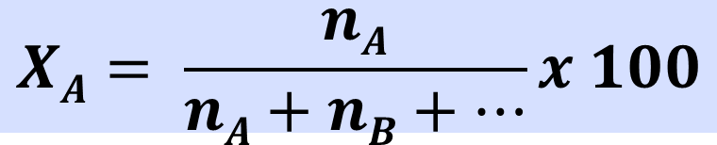
Mole Fraction X_{A}
Mole fraction - the fraction of the moles of one component in the total moles of all the components of the solution.
  Total of all the mole fractions in a solution = 1.
  No units
Mole percentage - the percentage of the moles of one component in the total moles of all the components of the solution.
  = mole fraction × 100%
$$XA= \frac{nA}{nA+nB+…}$$
$$XA= \frac{nA}{nA+nB+…}x 100$$

Slide 13
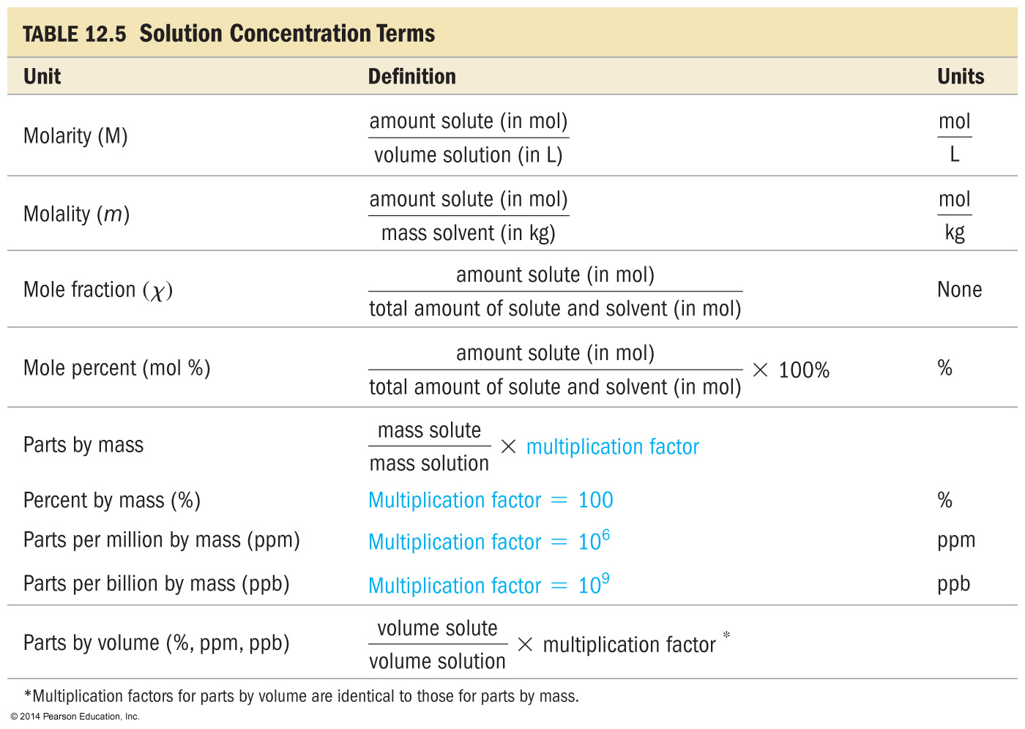
Concentrations

Slide 14
Converting Concentration Units
WRITE YOUR UNITS. SERIOUSLY.
Write the given concentration as a ratio.
3. Separate the numerator and denominator.
  Think about each separately
  Separate into the solute part and solution part
4. Convert the solute part into the required unit.
5. Convert the solution part into the required unit.
6. Use the definitions to calculate the new final concentration units.

Slide 15





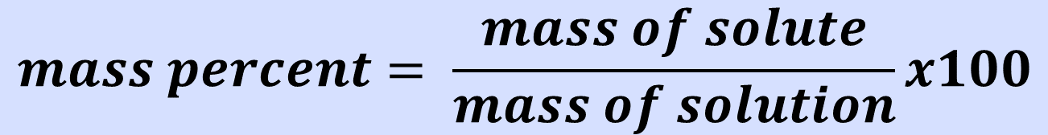
Find the mass percent of CuSO₄ in a solution whose density is 1.30 g/ml and whose molarity is 4.73 M.
41.9%
6.15%
$$mass percent= \frac{mass of solute}{mass of solution}x100$$
58.1%
6.03%
None of these

Slide 16
Find the mass percent of CuSO₄ in a solution whose density is 1.30 g/ml and whose molarity is 4.73 M.
1 L solution =
4.73 mol CuSO₄
41.9%
4.73mol
159.62g
= 755g
solute
6.15%
1mol
58.1%
1 L =
1000mL
1.30g
= 1300g
solution
6.03%
1mL
755g
x 100 = 58.15%
None of these
1300g

Slide 17
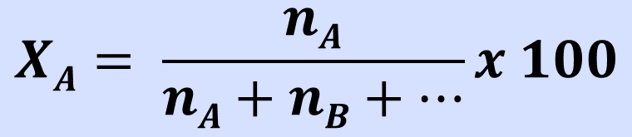
What is the mole percent of ethanol (C₂H₅OH), which consists of 71.0 g of ethanol for every 14.3 g of water present?
66.0%
1.94%
$$XA= \frac{nA}{nA+nB+…}x 100$$
1.52%
83.2%
34.0%

Slide 18
What is the mole percent of ethanol (C₂H₅OH), which consists of 71.0 g of ethanol for every 14.3 g of water present?
71.0g
1mol
= 1.54 mol
ethanol
66.0%
46.08g
1.94%
14.3g
1mol
= 0.794 mol
water
18.02g
1.52%
83.2%
1.54mol
x 100 = 65.99%
(1.54mol + 0.794mol)
34.0%

Slide 19
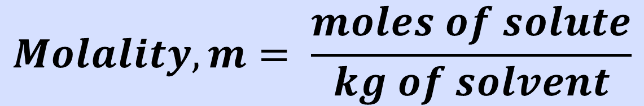
What is the molality of solution of 33.5 g propanol (CH₃CH₂CH₂OH) in 152 ml water, if the density of water is 1.00 g/ml?
3.67 m
0.00367 m
$$Molality, m= \frac{moles of solute}{kg of solvent}$$
0.273 m
0.557 m
None of these

Slide 20
What is the molality of solution of 33.5 g propanol (CH₃CH₂CH₂OH) in 152 ml water, if the density of water is 1.00 g/ml?
3.67 m
33.5g
1mol
= 0.557 mol
solute
60.11g
0.00367 m
0.273 m
0.557mol
= 3.67 m
0.557 m
0.152kg
None of these

Slide 21
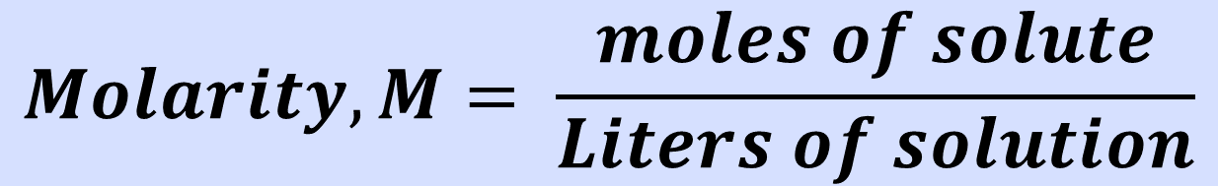
A solution containing 481.6 g of Mg(NO₃)₂ per liter has a density of 1.114 g/ml. The molarity of the solution is:
3.247 M
2.915 M
$$Molarity, M= \frac{moles of solute}{Liters of solution}$$
9.740 M
3.617 M
None of these

Slide 22
A solution containing 481.6 g of Mg(NO₃)₂ per liter has a density of 1.114 g/ml. The molarity of the solution is:
3.247 M
481.6g
1mol
= 3.247 mol
solute
2.915 M
148.33g
9.740 M
= 3.247 mol/1L = 3.247 M
3.617 M
*Density was just extra info! Very common in solutions problems to have more info than you need.
None of these

Slide 23
Link to YouTube Presentation
https://youtu.be/op8vqy3uxq8

