Slide 1
Properties of Solutions

Slide 2
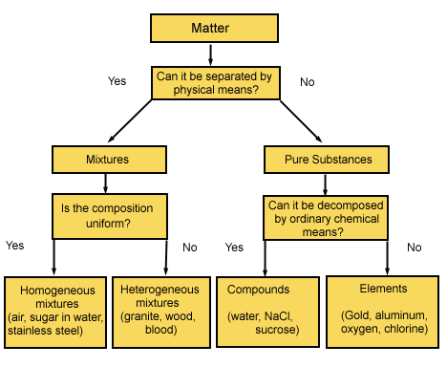
Classification of Matter
Solutions are homogeneous mixtures

Slide 3
Solute
A solute is the dissolved substance in a solution.
Salt in salt water
Sugar in soda drinks
Carbon dioxide in soda drinks
Solvent
A solvent is the dissolving medium in a solution.
Water in salt water
Water in soda

Slide 4

Solution Concentration: Molarity
Moles of solute per 1 liter of solution
Describes how many molecules of solute in each liter of solution
If a sugar solution concentration is 2.0 M,
  1 liter of solution contains 2.0 moles of sugar
  2 liters = 4.0 moles sugar
  0.5 liters = 1.0 mole sugar

Slide 5

Solution Concentration: Molality, m
Moles of solute per 1 kilogram of solvent
  Defined in terms of amount of solvent, not solution
    Like the others
Does not vary with temperature
  Because based on masses, not volumes

Slide 6
Parts Solute in Parts Solution
Parts can be measured by mass or volume.
Parts are generally measured in the same units.
  By mass in grams, kilogram, lbs, etc.
  By volume in mL, L, gallons, etc.
  Mass and volume combined in grams and mL

Slide 7
Parts Solute in Parts Solution
Percentage = parts of solute in every 100 parts solution
  If a solution is 0.9% by mass, then there are 0.9 grams of solute in every 100 grams of solution (or 0.9 kg solute in every 100 kg solution).
Parts per million = parts of solute in every 1 million parts solution
  If a solution is 36 ppm by volume, then there are 36 mL of solute in 1 million mL of solution.

Slide 8
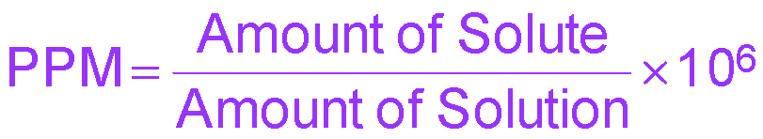
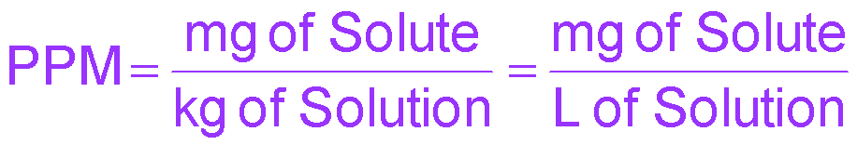
PPM
Grams of solute per 1,000,000 g of solution
mg of solute per 1 kg of solution
1 liter of water = 1 kg of water
  For aqueous solutions we often approximate the kg of the solution as the kg or L of water.
    For dilute solutions, the difference in density between the solution and pure water is usually negligible.

Slide 9
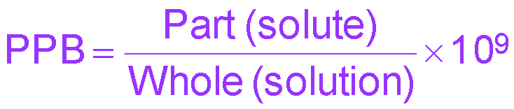
Parts Per Billion Concentration
Notes:
9

Slide 10
Solution Concentrations: Mole Fraction, X_{A}
The mole fraction is the fraction of the moles of one component in the total moles of all the components of the solution.
Total of all the mole fractions in a solution = 1.
Unitless
The mole percentage is the percentage of the moles of one component in the total moles of all the components of the solution.
  = mole fraction × 100%

Slide 11
Converting Concentration Units
1. Write the given concentration as a ratio.
2. Separate the numerator and denominator.
  Separate into the solute part and solution part
3. Convert the solute part into the required unit.
4. Convert the solution part into the required unit.
5. Use the definitions to calculate the new concentration units.

Slide 12
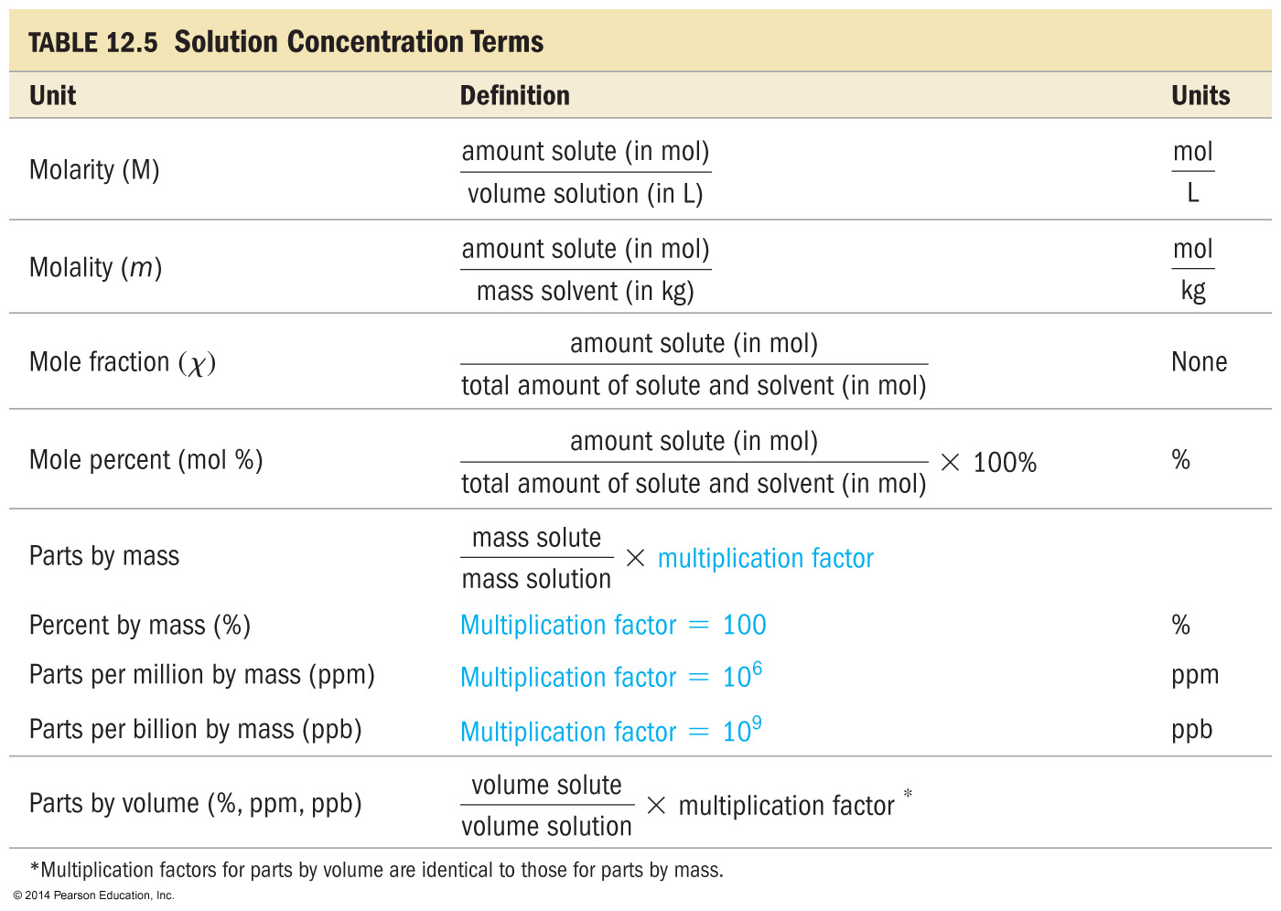
Concentrations

Slide 13
Heat of Solution
The Heat of Solution is the amount of heat energy absorbed (endothermic) or released (exothermic) when a specific amount of solute dissolves in a solvent.
Substance | Heat of Solution (kJ/mol)
NaOH | -44.51
NH₄NO₃ | +25.69
KNO₃ | +34.89
HCl | -74.84

Slide 14
Heat of Solution
When some compounds, such as NaOH, dissolve in water, a lot of heat is released.
  The container gets hot.
When other compounds, such as NH₄NO₃, dissolve in water, heat is absorbed from the surroundings.
  The container gets cold.
Why is this?

Slide 15
Energetics of Solution Formation:
The Enthalpy of Solution
To make a solution you must
overcome all attractions between the solute particles; therefore, ΔH_{solute} is endothermic. ΔH₁
overcome some attractions between solvent molecules; therefore, ΔH_{solvent} is endothermic. ΔH₂
3. form new attractions between solute particles and solvent molecules; therefore, ΔH_{mix} is exothermic. ΔH₃
The overall ΔH for making a solution depends on the relative sizes of the ΔH for these three processes.
ΔH_{sol’n} = ΔH_{solute} + ΔH_{solvent} + ΔH_{mix}

Slide 16
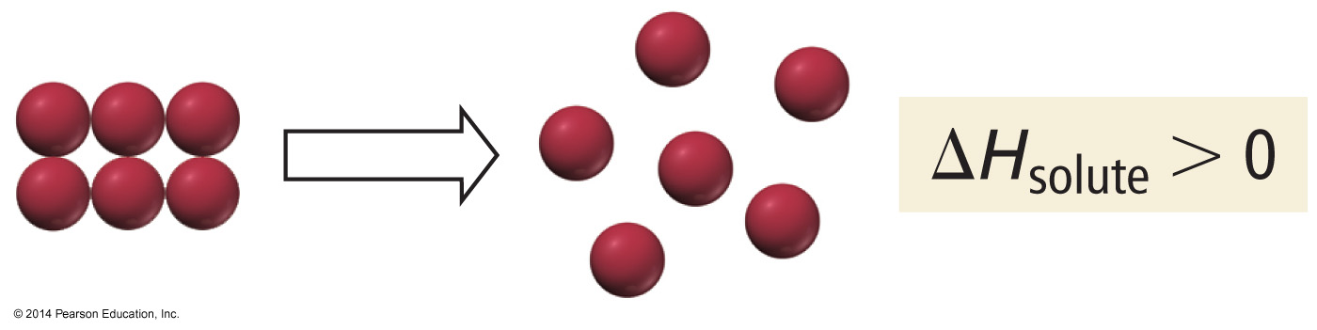
Solution Process
Step 1: Separating the solute into its constituent particles

Slide 17
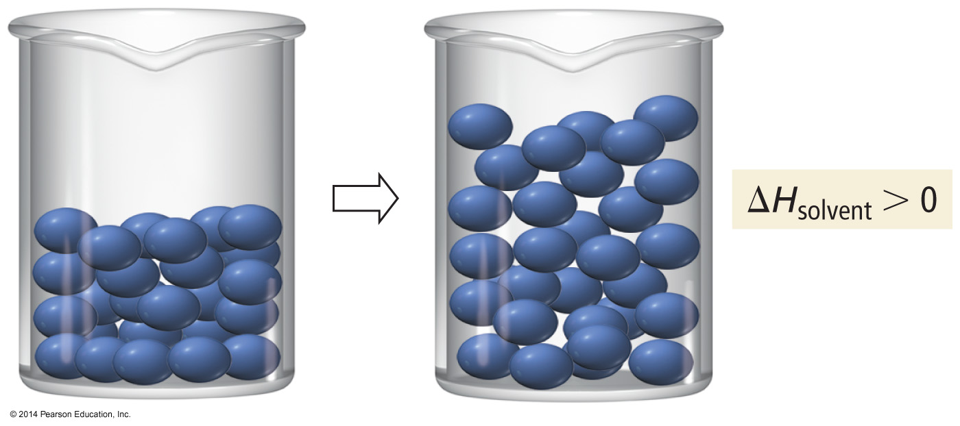
Solution Process
Step 2: Separating the solvent particles from each other to make room for the solute particles

Slide 18
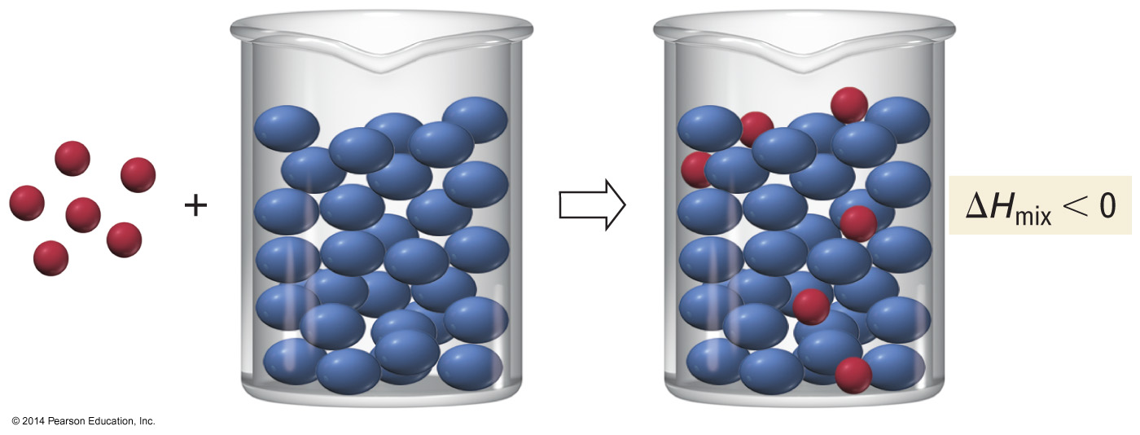
Solution Process
Step 3: Mixing the solute particles with the solvent particles

Slide 19
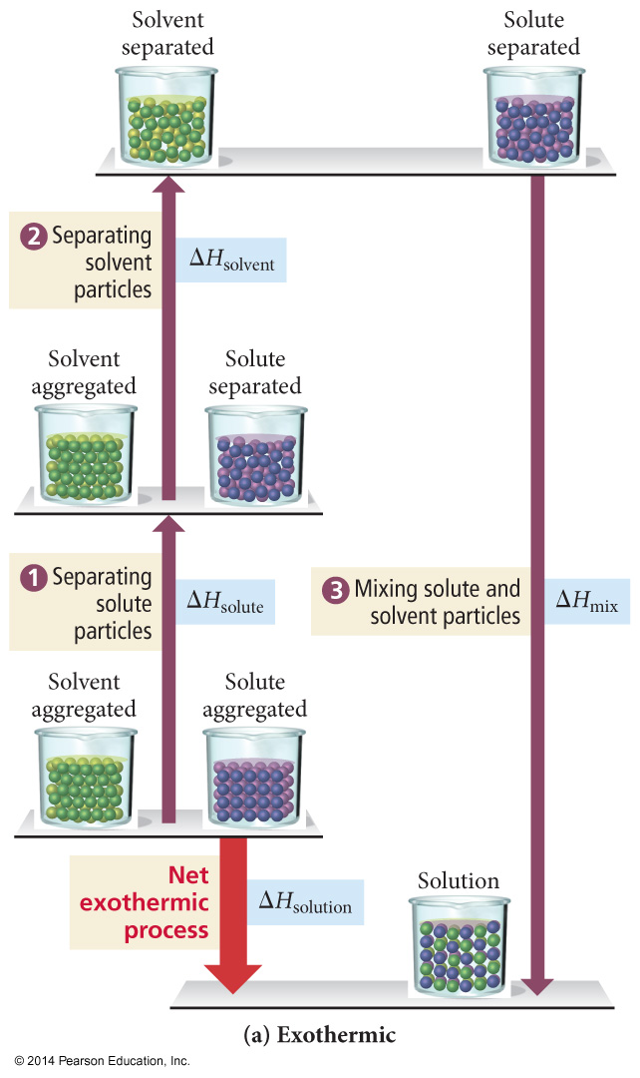
Energetics of Solution
Formation
If the total energy cost for breaking attractions between particles in the pure solute and pure solvent is less than the energy released in making the new attractions between the solute and solvent, the overall process will be exothermic.

Slide 20
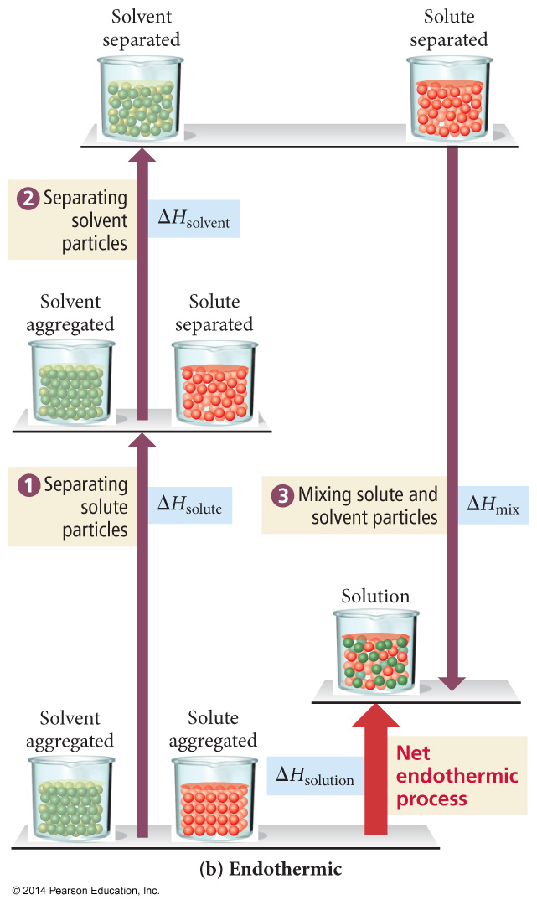
Energetics of Solution
Formation
If the total energy cost for breaking attractions between particles in the pure solute and pure solvent is greater than the energy released in making the new attractions between the solute and solvent, the overall process will be endothermic.

Slide 21
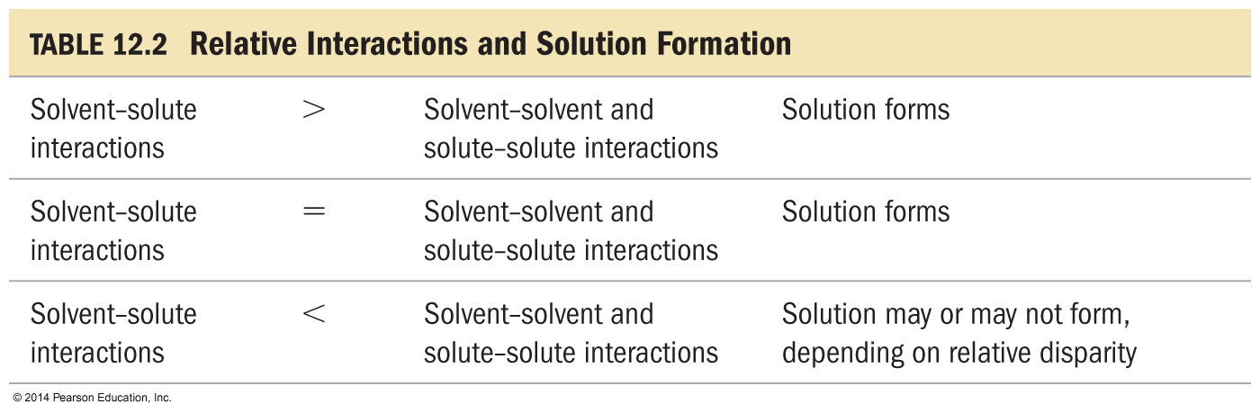
Relative Interactions and Solution Formation
When the solute-to-solvent attractions are weaker than the sum of the solute-to-solute and solvent-to-solvent attractions, the solution will only form if the energy difference is small enough to be overcome by the increase in entropy from mixing.

Slide 22
“Like Dissolves Like”
Nonpolar solutes dissolve best in nonpolar solvents
Fats | Benzene
Steroids | Hexane
Waxes | Toluene
Polar and ionic solutes dissolve best in polar solvents
Inorganic Salts | Water
Sugars | Small alcohols
 | Acetic acid

Slide 23
Predicting Solution Formation
Solvent/ Solute | ΔH₁ | ΔH₂ | ΔH₃ | ΔH_{sol’n} | Outcome
Polar/ Polar | + large | + large | - large | +/-small | Solution forms
Polar/ Nonpolar | + small | + large | +/- small | + large | No solution forms
Nonpolar/ Nonpolar | + small | + small | +/- small | +/- small | Solution forms
Nonpolar/ polar | + large | + small | +/- small | + large | No solution forms

Slide 24
Factors Favoring Sol’n formation
Negative value of ΔH_{sol’n}
Increase entropy
For positive values of ΔH_{sol’n} it is the increase in entropy that outweighs the increase in energy and causes the solution process of occur

Slide 25
Raoult’s Law
The presence of a nonvolatile solute lowers the vapor pressure of the solvent.
P_{solution} = Observed Vapor pressure of
the solution
χ_{solvent} = Mole fraction of the solvent
P⁰_{solvent} = Vapor pressure of the pure solvent

Slide 26
Vapor Pressure Lowering
The vapor pressure of a solvent in a solution is always lower than the vapor pressure of the
pure solvent.
The vapor pressure of the solution is directly proportional to the amount of the solvent in
the solution.
The difference between the vapor pressure of the pure solvent and the vapor pressure of the solvent in solution is called the vapor pressure lowering.
ΔP = P°_{solvent} − P_{solution} = χ_{solute} ∙ P°_{solvent}

Slide 27
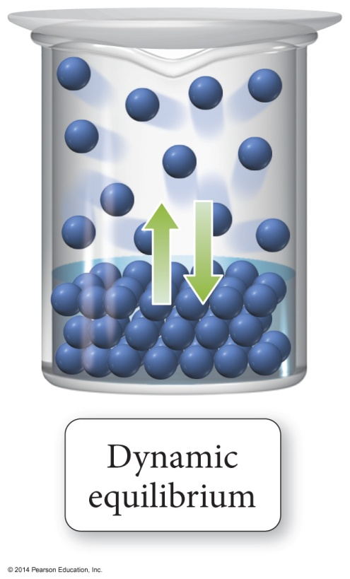
Vapor Pressure of Solutions
The vapor pressure of a solvent above a solution is lower than the vapor pressure of the pure solvent.
  The solute particles replace some of the solvent molecules at the surface.
  The pure solvent establishes a liquid vapor equilibrium.

Slide 28
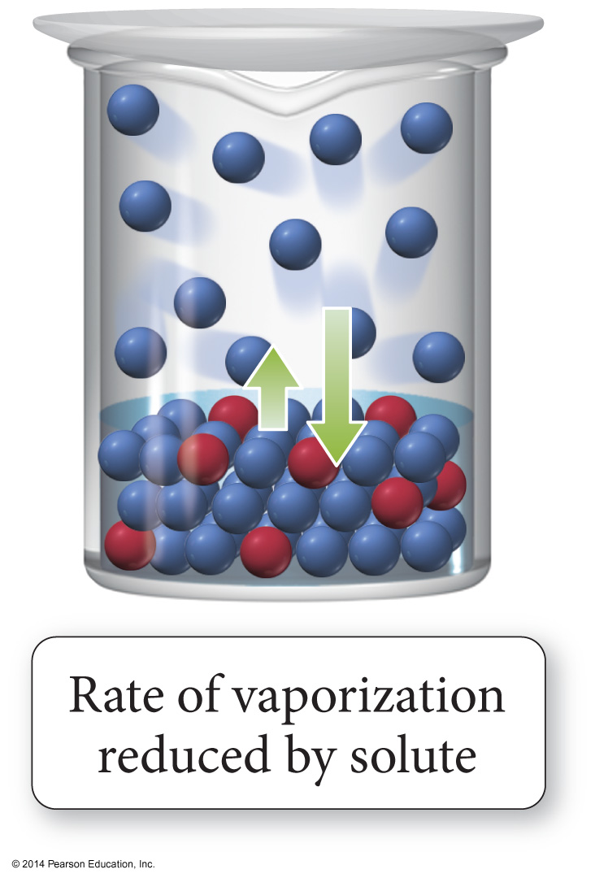
Vapor Pressure of Solutions
Addition of a nonvolatile solute reduces the rate of vaporization, decreasing the amount of vapor.

Slide 29
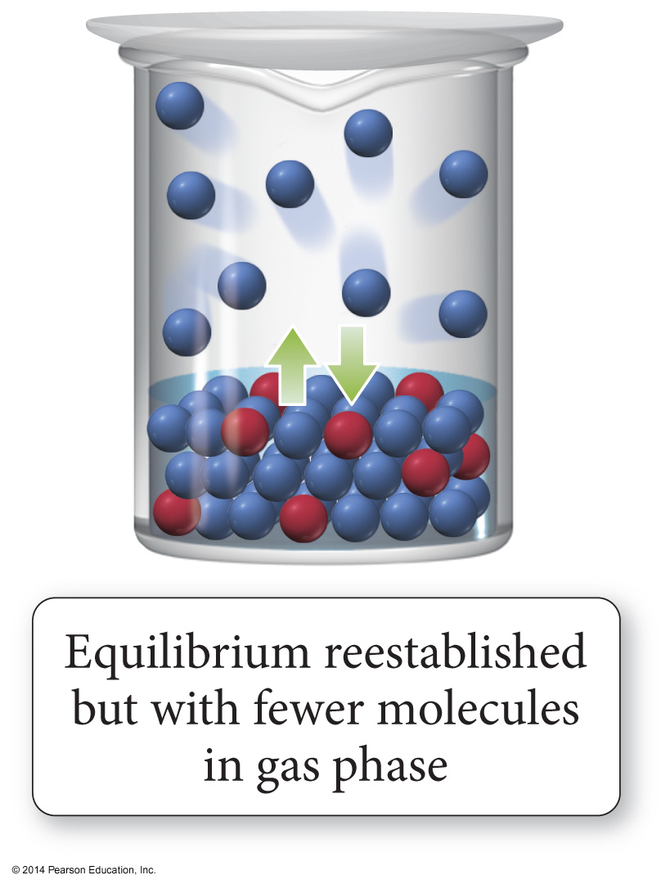
Vapor Pressure of Solutions
Eventually, equilibrium is re-established, but with a smaller number of vapor molecules; therefore, the vapor pressure will be lower.

Slide 30
Liquid-liquid solutions in which both components are volatile (Non-Ideal)
Modified Raoult's Law:
P⁰ is the vapor pressure of the pure solvent
P_{A} and P_{B} are the partial pressures

Slide 31
Ideal Sol’n
1. Liquid-liquid solution that obeys Raoult's law
  a. No solution is perfectly ideal, though some are close
2. Negative deviations from Raoult's law (lower than predicted vapor pressure for the solution)
  a. Solute and solvent are similar, with strong forces of attraction
  b. ΔHsol'n is large and negative
3. Positive deviations from Raoult's law (higher than predicted vapor pressure for the solution)
  a. Solute and solvent are dissimiliar, with only weak forces of attraction
  b. Particles easily escape attractions in solution to enter the vapor phase

Slide 32
Ideal versus Nonideal Solution
In ideal solutions, the made solute–solvent interactions are equal to the sum of the broken solute–solute and solvent–solvent interactions.
  Ideal solutions follow Raoult’s law
Effectively, the solute is diluting the solvent.
If the solute–solvent interactions are stronger or weaker than the broken interactions the solution is nonideal.

Slide 33
Vapor Pressure of a Non-ideal Solution
When the solute–solvent interactions are stronger than the solute–solute + solvent–solvent, the total vapor pressure of the solution will be less than predicted by Raoult’s law, because the vapor pressures of the solute and solvent are lower
than ideal.
When the solute–solvent interactions are weaker than the solute–solute + solvent–solvent, the total vapor pressure of the solution will be more than predicted by Raoult’s Law.

Slide 34
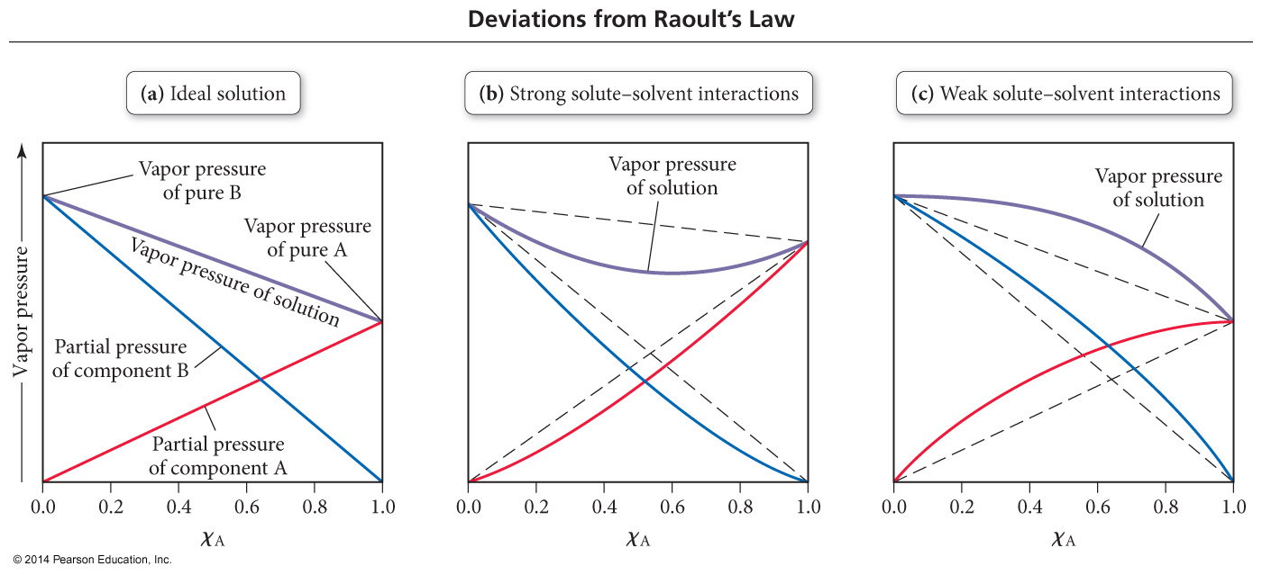
Deviations from Raoult’s Law

Slide 35
Solubility Trends
The solubility of MOST solids increases with temperature.
The rate at which solids dissolve increases with increasing surface area of the solid.
The solubility of gases decreases with increases in temperature.
The solubility of gases increases with the pressure above the solution.

Slide 36
Therefore…
Solids tend to dissolve best when:
Heated
Stirred
Ground into small particles
Gases tend to dissolve best when:
The solution is cold
Pressure is high

Slide 37
Solubility Limit
A solution that has the solute and solvent in dynamic equilibrium is said to be saturated.
  If you add more solute it will not dissolve.
  The saturation concentration depends on the temperature and pressure of gases.
A solution that has less solute than saturation is said to be unsaturated.
  More solute will dissolve at this temperature.
A solution that has more solute than saturation is said to be supersaturated.

Slide 38
Temperature Dependence of Solubility of Solids in Water
Solubility is generally given in grams of solute that will dissolve in 100 g of water.
For most solids, the solubility of the solid increases as the temperature increases.
  When ΔH_{solution} is endothermic
Solubility curves can be used to predict whether a solution with a particular amount of solute dissolved in water is saturated (on the line), unsaturated (below the line), or supersaturated (above the line).

Slide 39
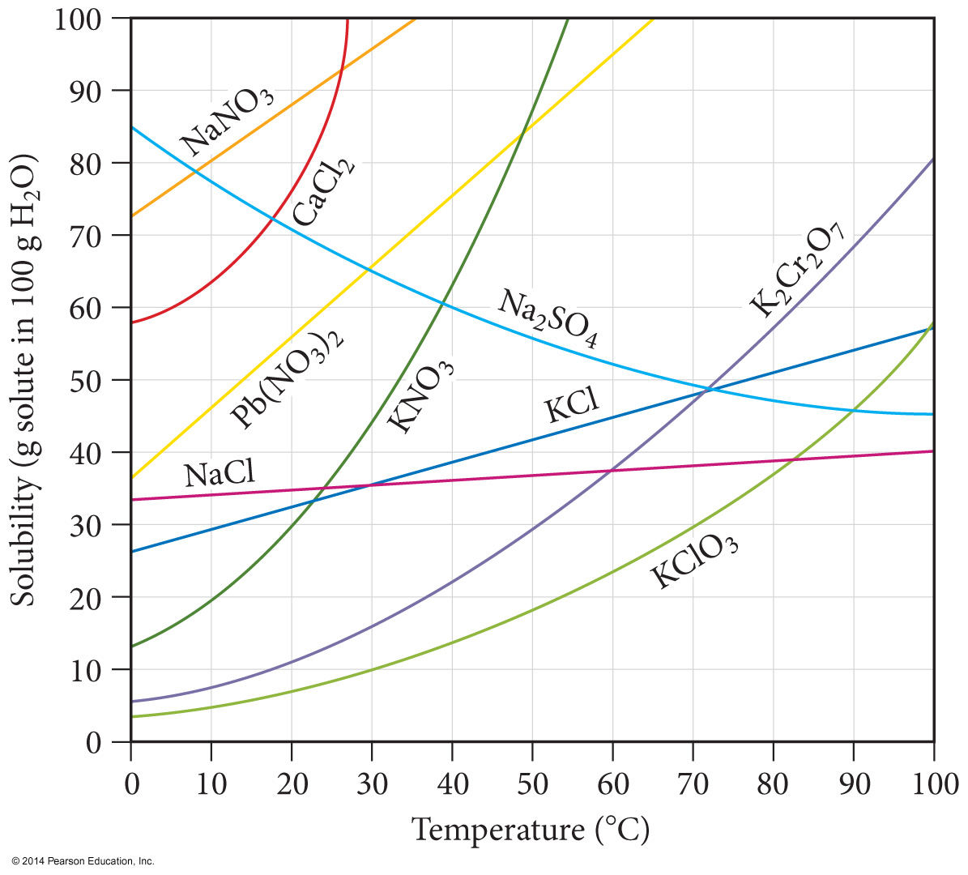
Solubility Curves

Slide 40
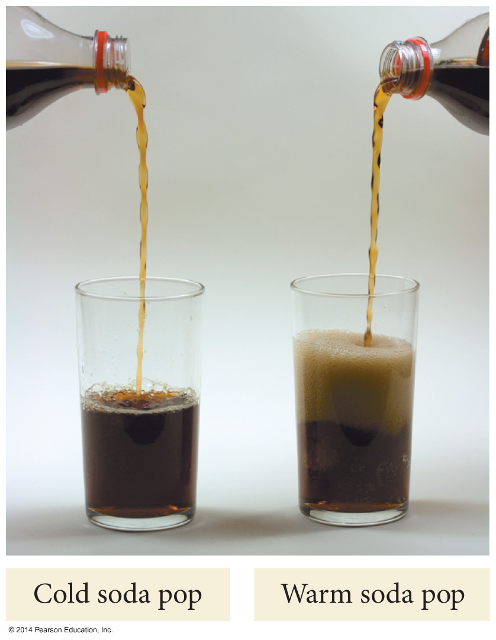
Temperature Dependence of Solubility of Gases in Water

Slide 41
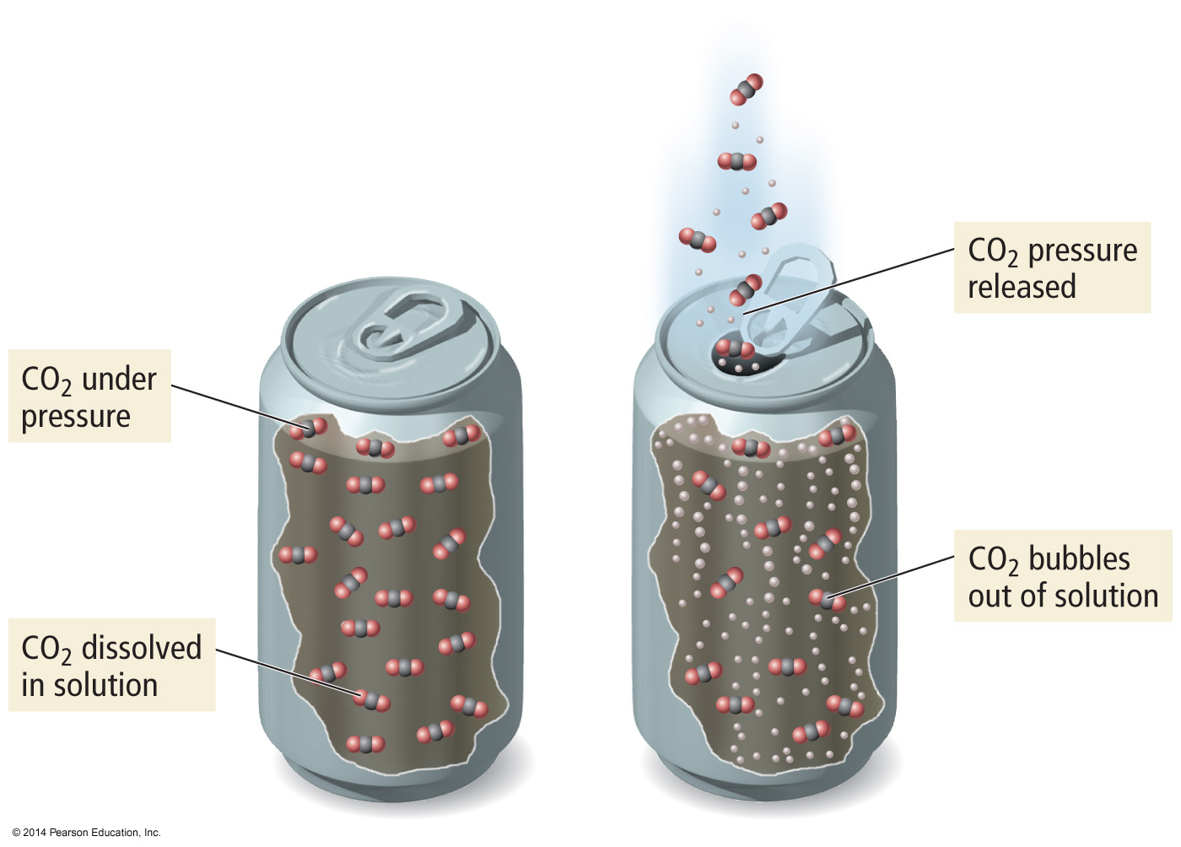
Pressure Dependence of Solubility of Gases in Water
The larger the partial pressure of a gas in contact with a liquid, the more soluble the gas is in the liquid.

Slide 42
Ionic Solutes
Dissociation of ionic compounds has nearly two, three or more times the vapor pressure lowering of nonionic (nonelectrolyte) solutes

Slide 43
Definition of Electrolytes and Nonelectrolytes
An electrolyte is:
A substance whose aqueous solution conducts
an electric current.
A nonelectrolyte is:
A substance whose aqueous solution does not
conduct an electric current.
Try to classify the following substances as
electrolytes or nonelectrolytes…

Slide 44
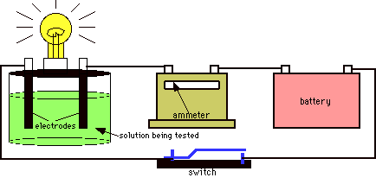
Electrolytes vs. Nonelectrolytes
The ammeter measures the flow of electrons (current)
through the circuit.
If the ammeter measures a current, and the bulb
glows, then the solution conducts.
If the ammeter fails to measure a current, and the
bulb does not glow, the solution is non-conducting.

Slide 45
Electrolytes?
Pure water
Tap water
Sugar solution
Sodium chloride solution
Hydrochloric acid solution
Lactic acid solution
Ethyl alcohol solution
Pure sodium chloride

Slide 46
Answers to Electrolytes
ELECTROLYTES:
NONELECTROLYTES:
Tap water (weak)
NaCl solution
HCl solution
Lactate solution (weak)
Pure water
Sugar solution
Ethanol solution
Pure NaCl

Slide 47
Colligative Properties
Colligative properties are properties whose value depends only on the number of solute particles, and not on what they are.
  Value of the property depends on the concentration of the solution.
The difference in the value of the property between the solution and the pure substance is generally related to the different attractive forces and solute particles occupying solvent molecules positions.
Notes:
47

Slide 48
Colligative Properties
Colligative properties are those that depend on the concentration of particles in a solution, not upon the identity of those properties.
Boiling Point Elevation
Freezing Point Depression
Osmotic Pressure

Slide 49
The van’t Hoff Factor, i
Electrolytes may have two, three or more times the effect on boiling point, freezing point, and osmotic pressure, depending on its dissociation.

Slide 50
Dissociation Equations and the Determination of i
i = 2
NaCl(s) →
Na⁺(aq) + Cl⁻(aq)
i = 2
AgNO₃(s) →
Ag⁺(aq) + NO₃⁻(aq)
i = 3
MgCl₂(s) →
Mg²⁺(aq) + 2 Cl⁻(aq)
i = 3
Na₂SO₄(s) →
2 Na⁺(aq) + SO₄²⁻(aq)
AlCl₃(s) →
Al³⁺(aq) + 3 Cl⁻(aq)
i = 4

Slide 51
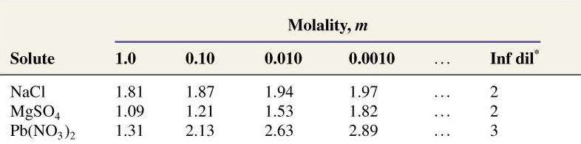
Ideal vs. Real van’t Hoff Factor
The ideal van’t Hoff Factor is only achieved in VERY DILUTE solution.

Slide 52
Freezing Point Depression
Each mole of solute particles lowers the freezing point of 1 kilogram of water by 1.86 degrees Celsius.
K_{f} = 1.86 °C ⋅ kilogram/mol
m = molality of the solution
i = van’t Hoff factor

Slide 53
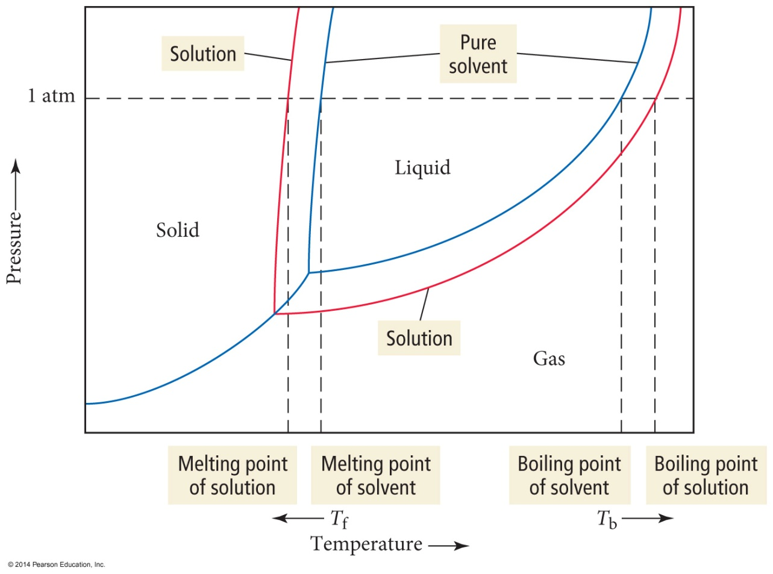
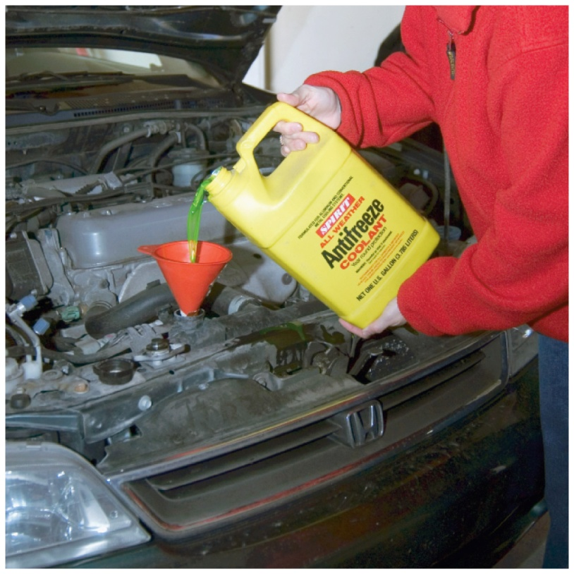
Freezing Point Depression and Boiling Point Elevation

Slide 54
Boiling Point Elevation
Each mole of solute particles raises the boiling point of 1 kilogram of water by 0.51 degrees Celsius.
K_{b} = 0.51 °C ⋅ kilogram/mol
m = molality of the solution
i = van’t Hoff factor

Slide 55
Freezing Point Depression and Boiling Point Elevation Constants, °C/m
Solvent | K_{f} | K_{b}
Acetic acid | 3.90 | 3.07
Benzene | 5.12 | 2.53
Nitrobenzene | 8.1 | 5.24
Phenol | 7.27 | 3.56
Water | 1.86 | 0.512

Slide 56
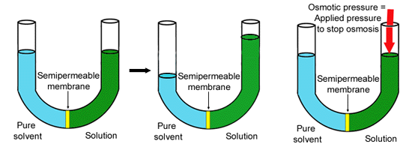
Osmotic Pressure
The minimum pressure that stops the osmosis is equal to the osmotic pressure of the solution

Slide 57
Osmotic Pressure Calculations
Π = Osmotic pressure
M = Molarity of the solution
R = Gas Constant = 0.08206 L⋅atm/mol⋅K
T = Absolute Temperature

Slide 58
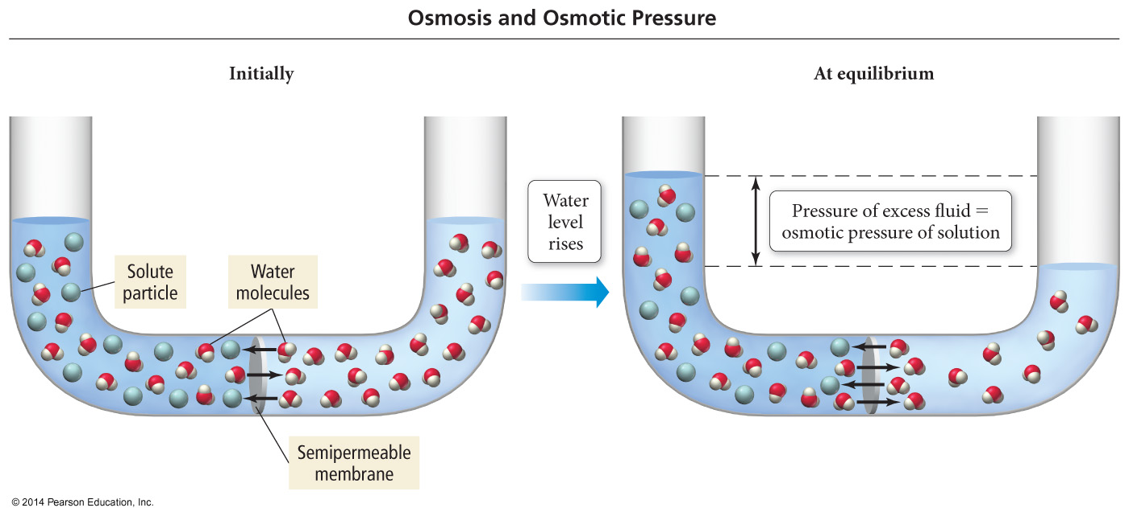
An Osmosis Cell

Slide 59
Done

Slide 60
Suspensions and Colloids
Suspensions and colloids are NOT solutions.
Suspensions: The particles are so large that they settle out of the solvent if not constantly stirred.
Colloids: The particles intermediate in size between those of a suspension and those of a solution.

Slide 61
Types of Colloids
Examples | Dispersing Medium | Dispersed Substance | Colloid Type
Fog, aerosol sprays | Gas | Liquid | Aerosol
Smoke, airborn germs | Gas | Solid | Aerosol
Whipped cream, soap suds | Liquid | Gas | Foam
Milk, mayonnaise | Liquid | Liquid | Emulsion
Paint, clays, gelatin | Liquid | Solid | Sol
Marshmallow, Styrofoam | Solid | Gas | Solid Foam
Butter, cheese | Solid | Liquid | Solid Emulsion
Ruby glass | Solid | Solid | Solid sol

Slide 62
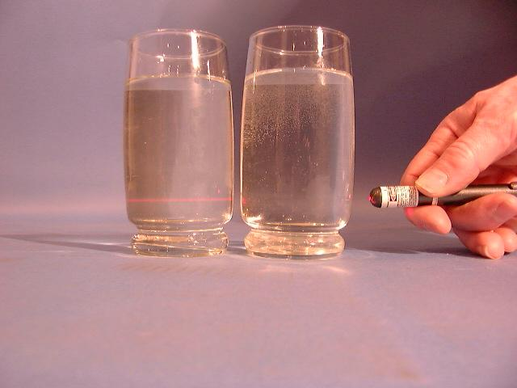
The Tyndall Effect
Colloids scatter light, making a beam visible. Solutions do not scatter light.
Which glass contains a colloid?
colloid
solution

Slide 63





All of the following are colligative properties except:
Osmotic Pressure
Boiling Point elevation
Freezing Point depression
Density elevation
None of these

Slide 64
Calculations of Solution Concentration
Mass percent - the ratio of mass units of solute to mass units of solution, expressed as a percent

Slide 65
Find the mass percent of CuSO₄ in a solution whose density is 1.30 g/ml and whose molarity is 4.73 M.
41.9%
6.15%
58.1%
6.03%
None of these

Slide 66
Calculations of Solution Concentration
Mole fraction – the ratio of moles of solute to total moles of solution

Slide 67
What is the mole percent of ethanol (C₂H₅OH), which consists of 71.0 g of ethanol for every 14.3 g of water present?
66.0%
1.94%
1.52%
83.2%
34.0%

Slide 68
Calculations of Solution Concentration
Molality – moles of solute per kilogram of solvent

Slide 69
What is the molality of solution of 33.5 g propanol (CH₃CH₂CH₂OH) in 152 ml water, if the density of water is 1.00 g/ml?
3.67 m
0.00367 m
0.273 m
0.557 m
None of these

Slide 70
Calculations of Solution Concentration
Molarity - the ratio of moles of solute to liters of solution

Slide 71
A solution containing 481.6 g of Mg(NO₃)₂ per liter has a density of 1.114 g/ml. The molarity of the solution is:
3.247 M
2.915 M
9.740 M
3.617 M
None of these

Slide 72
A correct statement of Henry's law is:
the concentration of a gas in solution is inversely proportional to temperature.
the concentration of a gas in solution is directly proportional to the mole fraction of solvent.
the concentration of a gas in solution is independent of pressure.
the concentration of a gas in a solution is inversely proportional to pressure.
none of these

Slide 73
The solubility of O₂ in water is 0.590g/L at an oxygen pressure of around 14.7 atm. What is the Henry’s Law constant for O₂ (in units of L·atm/mol)?
4.01E⁻²
1.25E⁻³
7.97E²
2.71E⁻¹
None of them are within 5% of the correct answer

Slide 74
121.2 g of NaCl completely dissolve (producing Na⁺ and Cl⁻ ions) in 1.00 Kg of water at 25°C. The vapor pressure of pure water at this temperature is 23.8 torr. Determine the vapor pressure of the solution
22.1 torr
22.9 torr
20.6 torr
19.9 torr
23.8 torr

Slide 75
At 40°C, heptane has a vapor pressure of about 92.0 torr and octane has a vapor pressure of about 31.2 torr. Assuming ideal behavior, what is the vapor pressure of a solution that contains twice as many moles of heptane as octane?
61.3 torr
51.5 torr
71.7 torr
82.1 torr
None of these

Slide 76
A 7.12 g sample of a compound is dissolved in 250. grams of benzene. The freezing point of this solution is 1.02°C below that of pure benzene. What is the molar mass of this compound? (K_{f} _{benzene} = 5.12 °C/m). Ignor sig. figs.
35.7 g/mol
143 g/mol
286 g/mol
5.67 g/mol
71.5 g/mol

Slide 77
What is the boiling point change for a solution containing 0.681 moles of naphthalene (a nonvolatile, nonionizing compound) in 250. g of liquid benzene? (K_{b} = 2.53 °C/m for benzene)
6.89 °C
0.93 °C
3.72 °C
1.723 °C
0.431 °C

Slide 78
Determine the Osmotic Pressure of a solution that contains 0.017 g of a hydrocarbon solute (molar mass = 340 g/mol) dissolved in benzene to make 350-ml solution. The temperature is 20.0°C
0.18 torr
0.9 torr
1.2 torr
2.6 torr
2.4 torr

Slide 79


Is Pure water an
Electrolyte
Non-electrolyte

Slide 80
Is Tap water an
Electrolyte
Non-electrolyte

Slide 81
Is a sugar solution an
Electrolyte
Non-electrolyte

Slide 82
Is Sodium Chloride an
Electrolyte
Non-electrolyte

Slide 83
Is hydrochloric acid solution an
Electrolyte
Non-electrolyte

Slide 84
Is lactic acid an
Weak electrolyte
Strong electrolyte

Slide 85
Is Ethyl Alcohol solution an
Electrolyte
Non-electrolyte

Slide 86
Answers to Electrolytes
ELECTROLYTES:
NONELECTROLYTES:
Tap water (weak)
NaCl solution
HCl solution
Lactate solution (weak)
Pure water
Sugar solution
Ethanol solution
Pure NaCl

Slide 87
Solutions: Effect of Intermolecular Forces
For the solvent and solute to mix you must overcome
  1. all of the solute–solute attractive forces, or
  2. some of the solvent–solvent attractive forces.
  Both processes are endothermic
At least some of the energy to do this comes from making new solute–solvent attractions, which is exothermic.

Slide 88
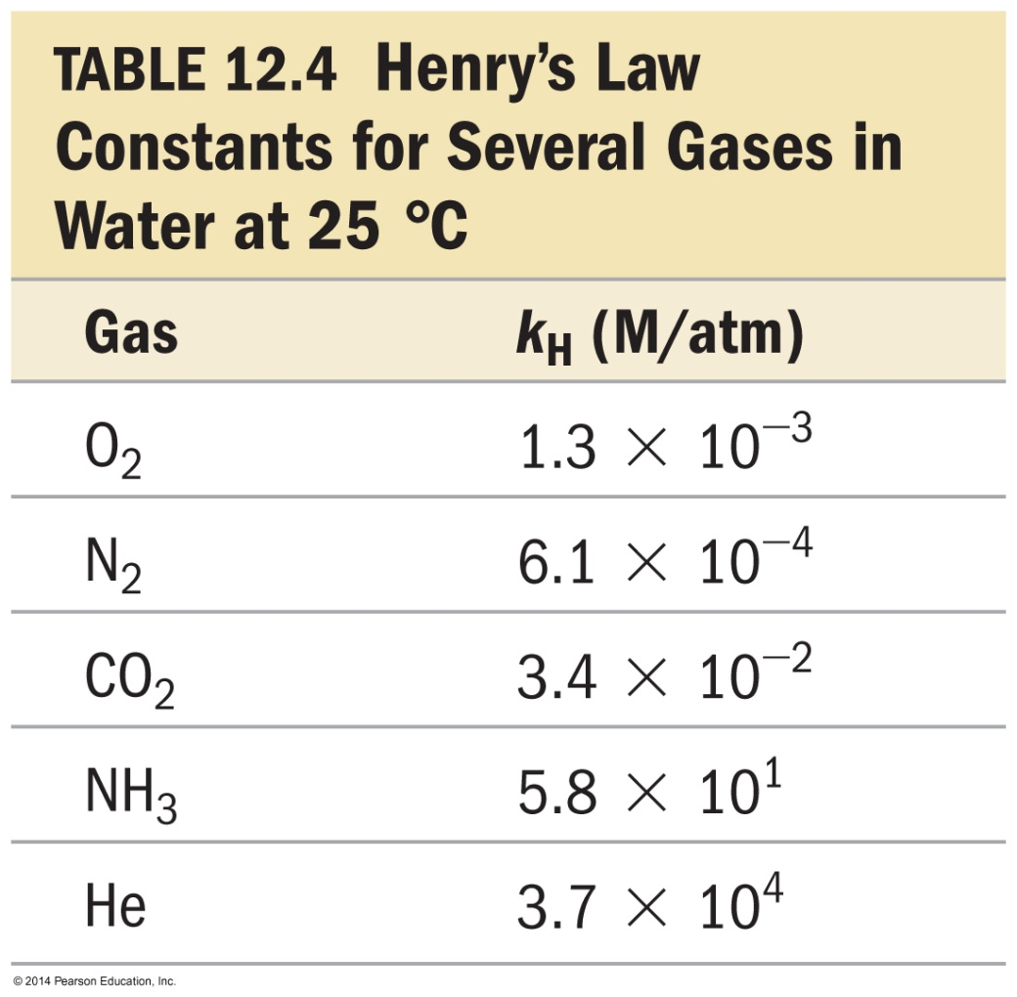
Henry’s Law (removed from AP)
The solubility of a gas (S_{gas}) is directly proportional to its partial pressure, (P_{gas}).
S_{gas} = k_{H}P_{gas}
k_{H} is called the Henry’s law constant.

