Slide 1
VSEPR YOGA
AP Chemistry Review
Relaxation Day

Slide 2
Angle?
Hybridization:
sp

Slide 3
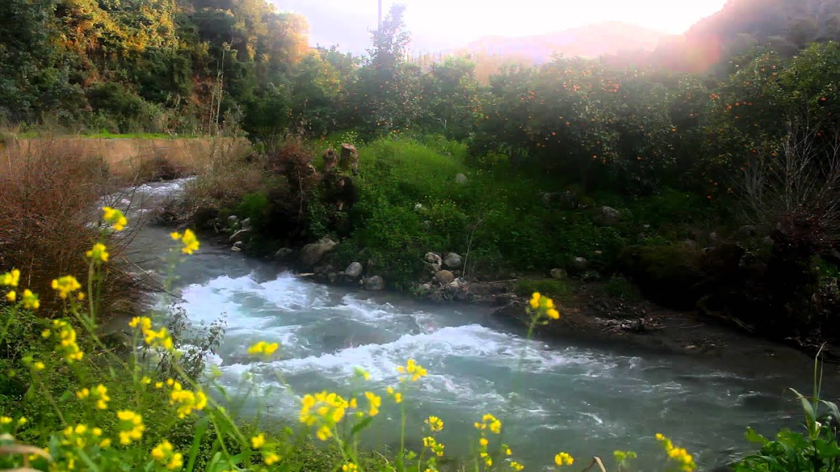
Angle?
Hybridization:
sp²

Slide 4
Hybridization:
sp²
Angle?
< 120⁰

Slide 5
Hybridization:
sp³
Angle?
109.5⁰

Slide 6
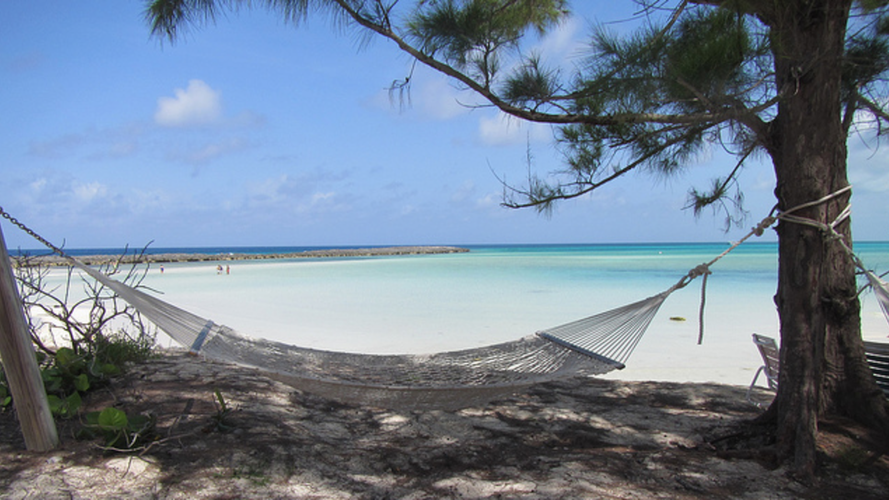
< 109.5⁰
Angle?
Hybridization:
sp³

Slide 7
< 109.5⁰
Angle?
Bent
Hybridization:
sp³

Slide 8
Trigonal bipyramidal
1: leg behind
2: your head
3: your other leg
4 and 5: your arms in front
Angle(s)?
Hybridization:
N/A

Slide 9
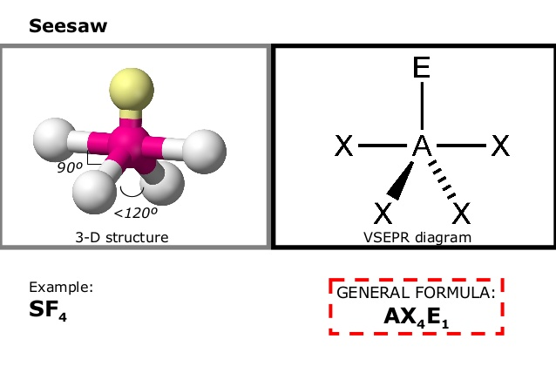
Angle(s)?
90⁰ and < 120⁰

Slide 10
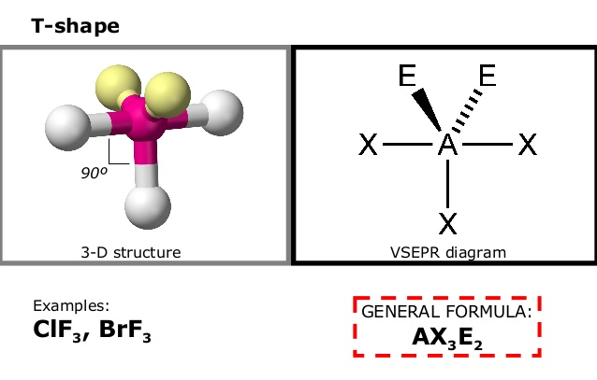
Angle?
<90⁰ and >180⁰

Slide 11
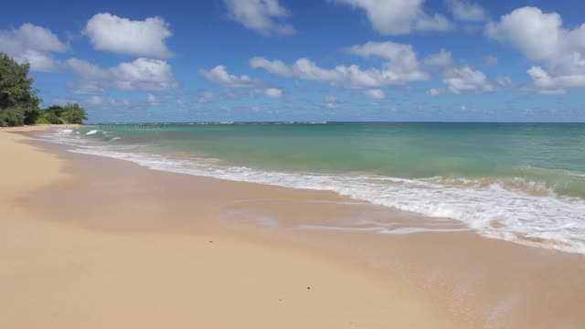
Angle?

Slide 12
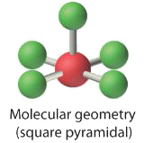
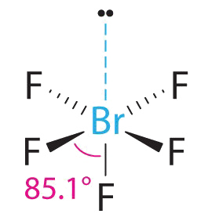
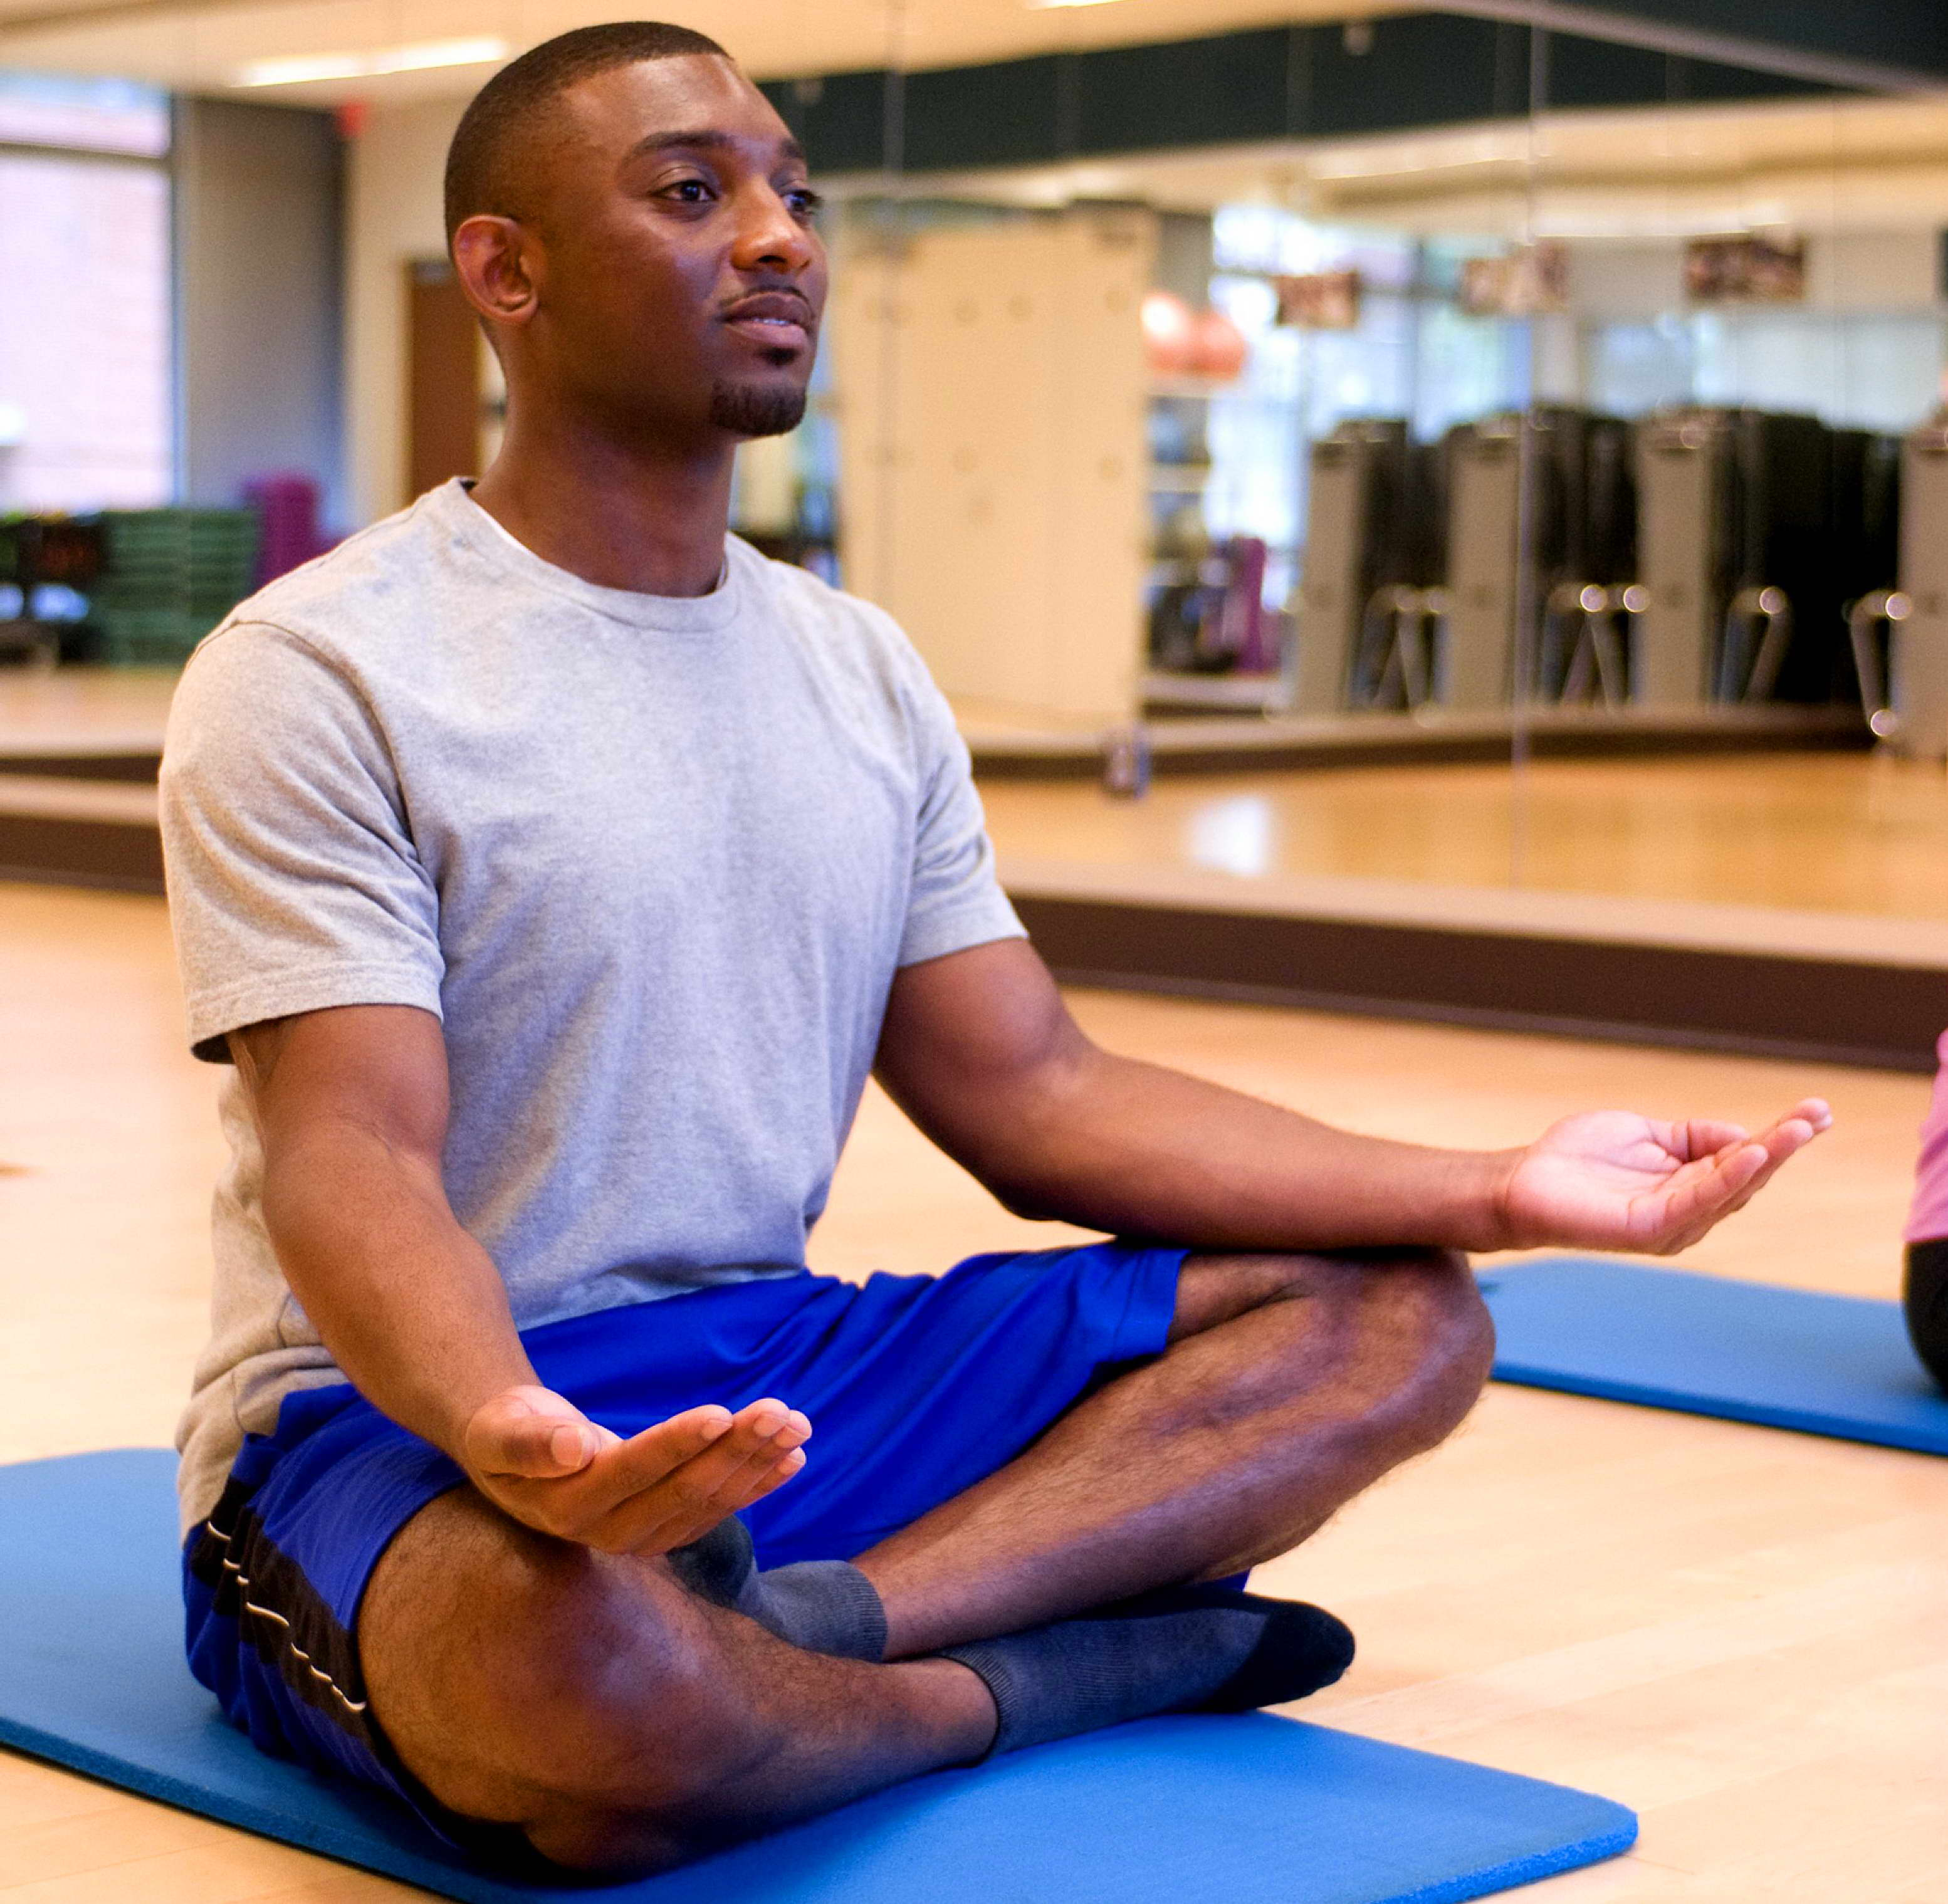
Angle?
90⁰ and <90⁰

Slide 13
Angle?
90⁰

Slide 15
Yoga Flow (Vinyasa)
Mountain pose
Linear to Mini Back Bend
Trigonal Planar
Forward Fold- Half-way lift/flat back-Forward Fold
Bent to Trigonal Pyramidal
Plank
Baby Cobra or Sphinx*
Trigonal Pyramidal
Linear
Tetrahedral
Square Planar
Seesaw
T-shape
Chair to Seated
Square Pyramidal
Notes:
*Great time to do a child’s pose

Slide 16
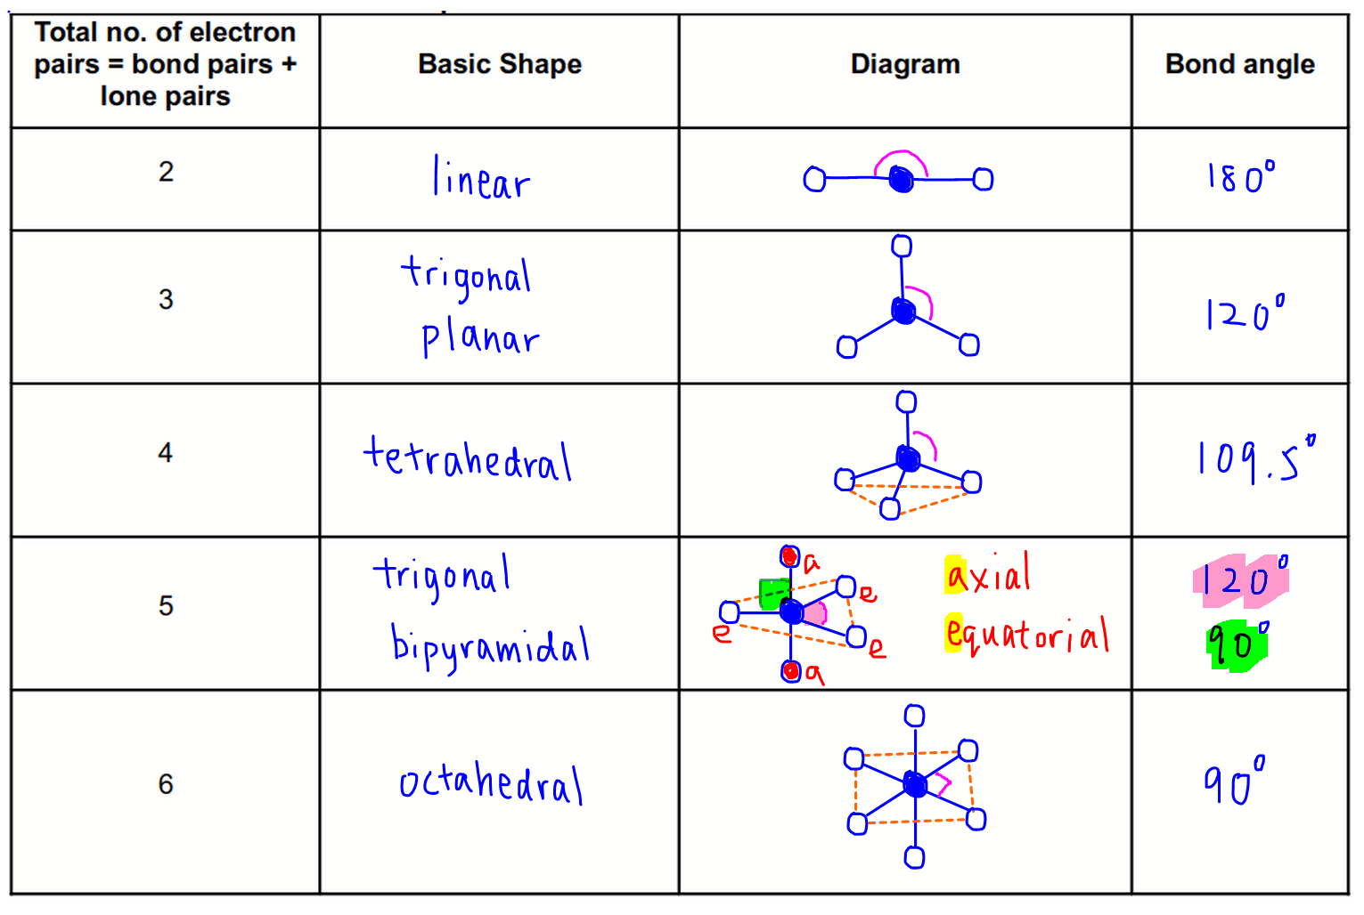

Slide 17
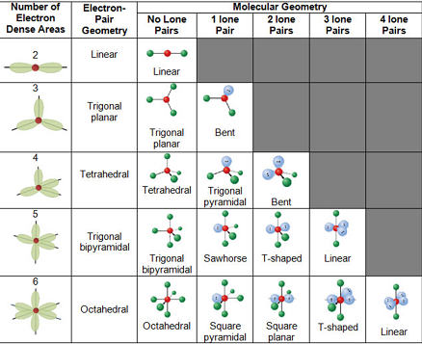
hybridization
sp
sp²
sp³
N/A
N/A

