Slide 1
THIS IS FOR ALL THREE CHEMISTRY LEVELS Click the link (or scroll) for the one you want! ☺
Regular Chem
Honors Chem
AP Chem

Slide 2
Regular chem

Slide 3
NOT UPDATED!!!!!!!!

Slide 4
Please quickly find an empty seat at a desk, not a lab table.
Please place your things under your chair so they are
not in the walkways.
Welcome to Chemistry!
Mrs. Farmer
Room 2212

Slide 5
Agenda
Attendance
Supplies
Packets
“All About Me”
Go over homework

Slide 6
Get Supplies!
BENCH #1 – Spiral Bound Notebooks
BENCH #2 – Packet
BENCH #6 – Ziploc bag of supplies
BENCH #7 – Color pencils (OR markers, not both)
BENCH #8 – Unwanted supplies if you want to use your own version of something. Missing something? Fill out a pink slip of paper on bench #8 and put it in the bin on the table

Slide 7
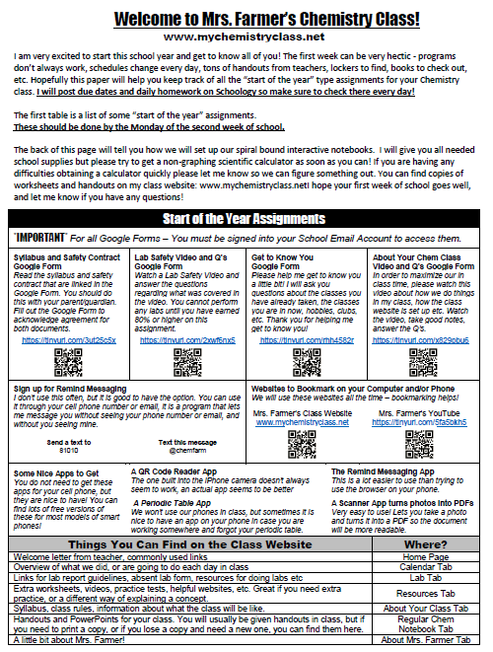
Syllabus and Donations
“SIGNATURES” DUE 8:30am MONDAY! On a Google Form!
PLEASE DONATE! Our labs depend on class donations.

Slide 8
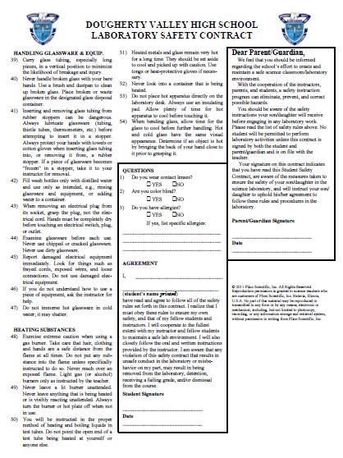
Safety Contracts
“SIGNATURES” DUE 8:30am MONDAY! On a Google Form
SAFETY QUIZ ON FRIDAY Need 80% to participate in labs

Slide 9
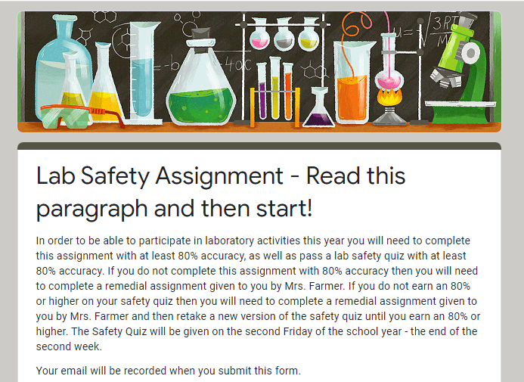
Safety Assignment
DUE by 8:30am ON MONDAY! Need 80% to participate in labs

Slide 10
All about me page #1 in notebook

Slide 11
Half the boxes = pictures
Half the boxes = complete sentences
FOUR COLORS at minimum
MINIMIZE THE WHITE SPACE!
This is your first chance to show me what level of effort you put into your work…it’s my first impression of you!

Slide 12
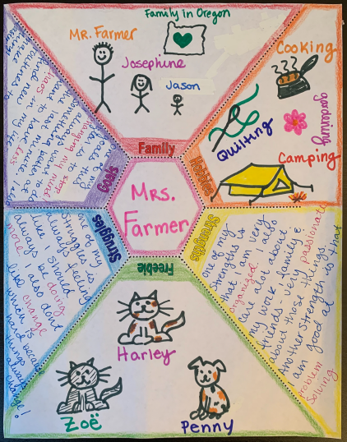
Josephine is eleven years old (6th grade) and Jason is eight years old (3rd grade)

Slide 13
Due NEXT CLASS Meeting
HOMEWORK
Number pages 1-25
Glue in pages from packet Finish All About Me page 1
Safety and Syllabus Google Form
Lab Safety Assignment Get to Know You Survey
About Your Chem Class Google Form
Sign up for Remind Text Messaging
Due 8:30am Monday

Slide 14
Please quickly find your seat number! The desks all have # stickers.
START TO PICKUP SUPPLIES FROM LAB TABLES
#3, 4, 5, 6, 7
YOU DO
NOT NEED
TO WAIT
FOR THE
BELL! JUST
GET STARTED!
Welcome to Honors Chemistry!
Please place
your things
under your
chair so they
are not in the walkways.
Mrs. Farmer
Room 2212

Slide 15
Get Supplies!
BENCH #3 – Lab notebooks BENCH #4 – Composition notebooks
BENCH #5 – Packet
BENCH #6 – Ziploc bag of supplies
BENCH #7 – Color pencils (OR markers, not both)
BENCH #8 – Unwanted supplies if you want to use your own version of something. Missing something? Fill out a pink slip of paper on bench #8 and put it in the bin on the table

Slide 16
All about me page #1 in notebook

Slide 17
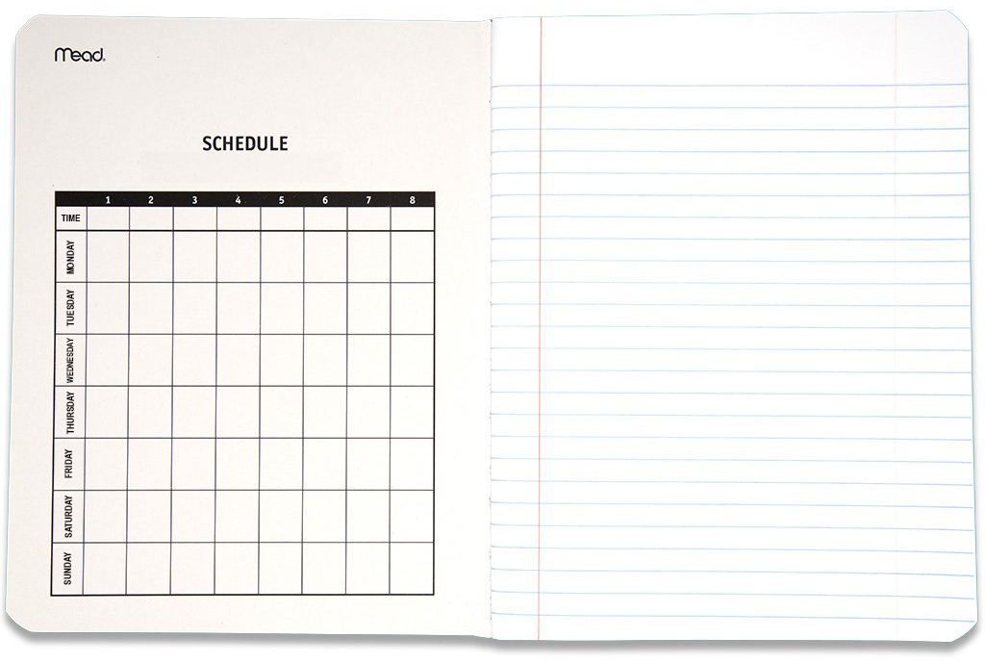
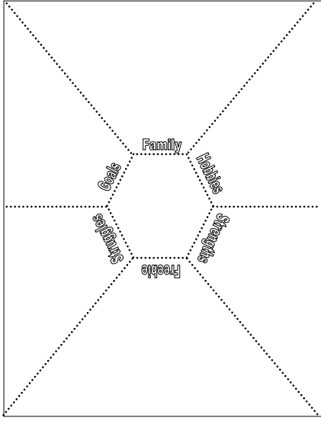
All about me
Page 1
1ST PAGE In college ruled
composition book.
Not the graphing paper notebook.
DO NOT GLUE IT IN NOW!
Work on it at home. DUE MONDAY

Slide 18
Half the boxes = pictures
Half the boxes = complete sentences
FOUR COLORS at minimum
MINIMIZE THE WHITE SPACE!
This is your first chance to show me what level of effort you put into your work…it’s my first impression of you!

Slide 19
Josephine is eleven years old (6th grade) and Jason is eight years old (3rd grade)

Slide 20
SAFETY work Google Form and notes on page #2 in notebook

Slide 21
SAFETY NOTES
Page 2
LABEL PAGE AS
“SAFETY NOTES” That way you remember what goes on that page
IT IS HOMEWORK Remember your “Welcome” handout has start of year assignments
on it!
Safety Notes

Slide 22
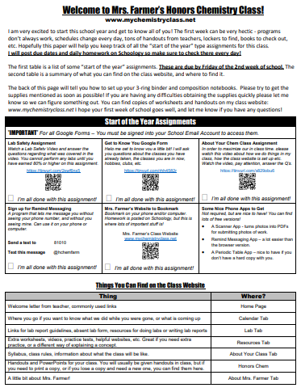
Safety Assignment
DUE by 8:00am on FRIDAY NEXT WEEK! Need 80% to participate in labs

Slide 23
Safety Contracts
“SIGNATURES” DUE 8:00am on FRIDAY NEXT WEEK Don’t need printed or signed.
Completing Google Doc counts as signature.
Need 80% to participate in labs

Slide 24
Syllabus “About your chem class” Google Form

Slide 25
Syllabus and Donations
“SIGNATURES” DUE 8:00am on FRIDAY NEXT WEEK! Don’t need printed or
signed. Completing
the “About Your Chem Class”
Google Doc counts as signature.
PLEASE DONATE! Our labs depend on class donations.

Slide 26
HOMEWORK Posted on class website calendar www.mychemistryclass.net

Slide 27
Due Next Class Day
HOMEWORK
Read Welcome Handout
Put dividers in 3-ring binders
Worksheet #1 (in your packet and notes in your new comp. book)
All About Me
Welcome Handout Assignments
Due MONDAY
Due 8:00am FRIDAY next WEEK

Slide 28
N1 – Chemistry Math Review Notes
Bold, obvious, underlined title “Target” written in RED pen (both listed on WS #1)
Take notes on the YouTube lecture – link on WS #1 Do not copy word for word! Do not cramp your notes!
( You do not need to do the annotations and KCQ boxes mentioned on R-4 yet. We will do them together in class! )
Safety Notes
N1 – Chemistry Math Review
Target: I can use scientific notation and the metric system this year in my chemistry class.
Page 3

Slide 29
Please quickly find your seat number! The desks all have # stickers.
START TO PICKUP SUPPLIES FROM LAB TABLES
#3, 4, 5, 6, 7
YOU DO
NOT NEED
TO WAIT
FOR THE
BELL! JUST
GET STARTED!
Welcome to AP Chemistry!
Please place
your things
under your
chair so they
are not in the walkways.
Mrs. Farmer
Room 2212

Slide 30
Get Supplies!
BENCH #3 – Lab notebooks BENCH #4 – Composition notebooks
BENCH #5 – Packet
BENCH #6 – Ziploc bag of supplies
BENCH #7 – Color pencils (OR markers not both)
BENCH #8 – Unwanted supplies if you want to use your own version of something. Missing something? Fill out a pink slip of paper on bench #8 and put it in the bin on the table

Slide 31
All about me page #1 in notebook

Slide 32
All about me
Page 1
1ST PAGE In college ruled
composition book.
Not the graphing paper notebook.
DO NOT GLUE IT IN NOW! Finish the work at home. DUE MONDAY

Slide 33
Half the boxes = pictures
Half the boxes = complete sentences
FOUR COLORS at minimum
MINIMIZE THE WHITE SPACE!
This is your first chance to show me what level of effort you put into your work…it’s my first impression of you!

Slide 34
Josephine is eleven years old (6th grade) and Jason is eight years old (3rd grade)

Slide 35
SAFETY work Google Form and notes on page #2 in notebook

Slide 36
SAFETY NOTES
Page 2
LABEL PAGE AS “SAFETY NOTES” That way you remember what goes on that page
IT IS HOMEWORK Remember your “Welcome” handout has start of year assignments
on it!
Safety Notes

Slide 37
Safety Assignment
DUE by 8:00am ON FRIDAY NEXT WEEK! Need 80% to participate in labs

Slide 38
Safety Contracts
“SIGNATURES” DUE 8:00am FRIDAY NEXT WEEK! Don’t need printed or signed.
Completing Google Doc counts as signature.
Need 80% to participate in labs

Slide 39
SYLLABUS “About your chem class” Google Form

Slide 40
Syllabus and Donations
“SIGNATURES” DUE 8:00am FRIDAY NEXT WEEK! Don’t need printed or
signed. Completing
the “About Your Chem Class”
Google Doc counts as signature.
PLEASE DONATE! Our labs depend on class donations.

Slide 41
HOMEWORK Posted on class website calendar www.mychemistryclass.net

Slide 42
Next Class day
HOMEWORK
Read Welcome Handout
Put dividers in 3-ring binders
All About Me
Summer Assignment
Worksheet #1 (in your packet)
Honors Review Quiz
Welcome Handout Assignments
MON. Next week
TUES. NEXT WEEK
BLOCK DAY NEXT WEEK
Fri. NEXT WEEK

