Slide 1
N2 – Dimensional Analysis
Also known as “Unit Conversion”
Target: I can use dimensional analysis to convert not just the numbers in a measurement but also the units

Slide 2
Remember - Canceling Units
One on top cancels with one on the bottom
y
xy =
3 cm²
15 cm³ =
x
5 cm

Slide 3
Conversion Factors
A relationship between how many of one thing equals how many of another thing
12in = 1ft 24hrs = 1,440min 1000m = 1km
You can rewrite as fractions:
12in = 1 24hr = 1 1km = 1
1ft 1,440min 1000m

Slide 4
Conversion Factors
You can flip conversion factors too
12in = 1ft 24hrs = 1,440min
Just depends on what you are doing
12in = 1 1ft = 1 24hr = 1 1,440min = 1
1ft 12in 1,440min 24hr

Slide 5
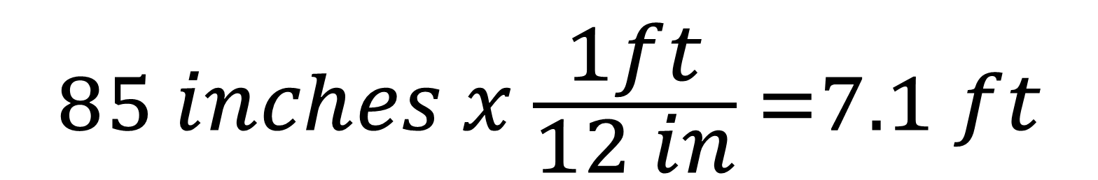
Using Conversion Factors
If you multiply by a conversion factor, you are just multiplying by 1…your answer LOOKS DIFFERENT because of the unit but is the same SIZE MEASURMENT. (12in/1ft or 1ft/12in)
$$85 inches x \frac{1ft}{12 in} =7.1 ft$$

Slide 6
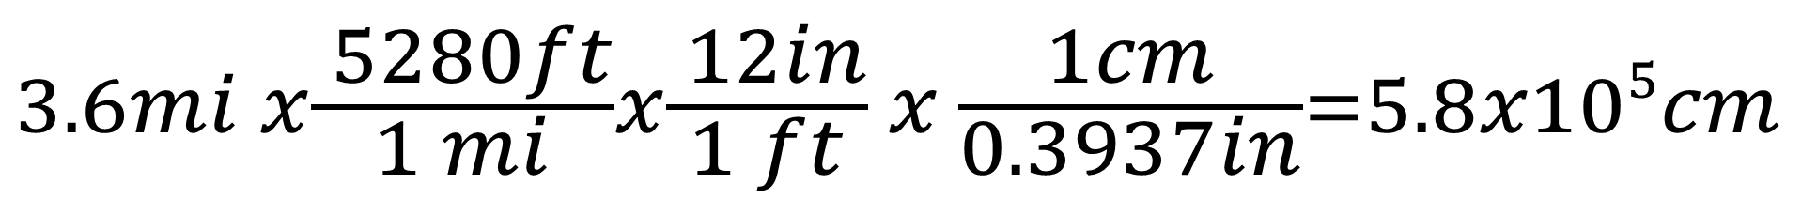
Using Conversion Factors
You can use multiple conversion factors –
“a frog hopping across a pond on lily pads”
Convert 3.6mi into cm.
(1cm=0.3937in, 12in=1ft, 1mi=5,280ft)
$$3.6mi x\frac{ 5280ft}{1 mi}x\frac{ 12in}{1 ft} x \frac{1cm}{0.3937in}=5.8x105cm$$

Slide 7
You try one…
Convert 15years into minutes
$$15yrs x\frac{ 365days}{1 year}x\frac{ 24hrs}{1 day} x\frac{60min}{1hr}=7.9x106min$$

Slide 8
Line Method
Keeps work neat, tidy, takes less space, easier to grade, a very typical way to show conversions in chemistry. I will always use the line method!
Convert 15years into minutes
$$15yrs x\frac{ 365days}{1 yr}x\frac{ 24hrs}{1 day} x\frac{60min}{1hr}=7.9x106min$$
15 yrs | 365 days | 24 hr | 60 min | = 7.9 x 10⁶ min
 | 1yr | 1 day | 1 hr

Slide 9
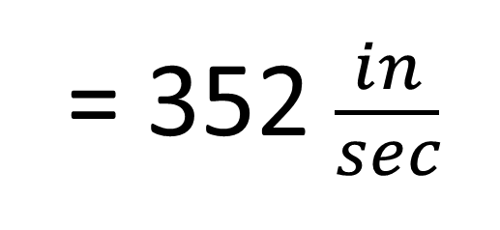
Dimensional Analysis with “Derived/Double Units”
Some units are combinations of two or more other units. Like miles per hour (mi/hr). Fix the top unit, then go back and fix the bottom unit
Convert 20mi/hr into in/sec.
20mi | 5280ft | 12in | 1hr | 1min
1hr | 1mi | 1ft | 60min | 60sec
= 352 $\frac{in}{sec}$

Slide 10
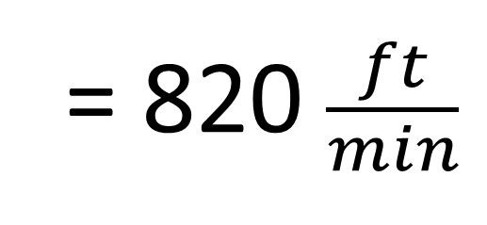
You try one…
Convert 30km/day into ft/min (1m=39.37in)
30km | 1000m | 39.37in | 1day | 1hr
1day | 1km | 1m | 24hr | 60min
= 820 $\frac{ft}{min}$

Slide 11
Dimensional Analysis - Squared, Cubed (etc) Units
If you have a unit that is raised to a power, then the conversion factors used will also need to be raised to that power. The number AND the unit.
1 in = 2.54cm but 1in² = (2.54cm)²
1 ft = 12in but 1ft³ = (12in)³
5in² | (2.54cm)²
 | (1in)²
= 32.258 cm²

Slide 12
YouTube Link to Presentation
https://youtu.be/fhj5d5zZa-4

