Slide 1
Atomic Structure
N5

Slide 2
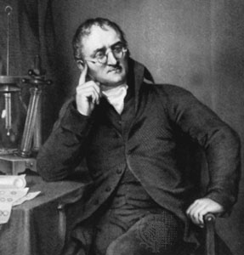
Dalton’s Atomic Theory (1808)
All matter is composed of extremely small particles called atoms
John Dalton

Slide 3
Dalton’s Atomic Theory (1808)
Atoms of a given element are identical in size, mass, and other properties
John Dalton

Slide 4
Dalton’s Atomic Theory (1808)
Atoms of different elements differ in size, mass, and other properties
John Dalton

Slide 5
Dalton’s Atomic Theory (1808)
Atoms cannot be subdivided, created, or destroyed
John Dalton

Slide 6
Dalton’s Atomic Theory (1808)
Atoms of different elements combine in simple whole-number ratios to form chemical compounds
John Dalton

Slide 7
Dalton’s Atomic Theory (1808)
In chemical reactions, atoms are combined, separated, or rearranged
John Dalton

Slide 8
Modern Atomic Theory
All matter is composed of atoms
Atoms cannot be subdivided, created, or destroyed in ordinary chemical reactions. However, these changes CAN occur in nuclear reactions!
Atoms of an element have a characteristic average mass which is unique to that element.
Atoms of any one element differ in properties from atoms of another element

Slide 9
Discovery of the Electron
In 1897, J.J. Thomson used a cathode ray tube to deduce the presence of a negatively charged particle.
Cathode ray tubes pass electricity through a gas that is contained at a very low pressure.

Slide 10
Conclusions from the Study of the Electron
Cathode rays have identical properties regardless of the element used to produce them. All elements must contain identically charged electrons.
Atoms are neutral, so there must be positive particles in the atom to balance the negative charge of the electrons
Electrons have so little mass that atoms must contain other heavier particles that account for most of the mass

Slide 11
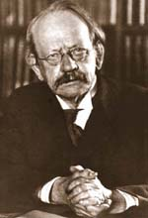
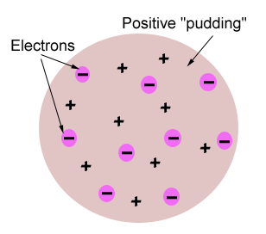
Thomson’s Atomic Model
Thomson believed that the electrons were like plums embedded in a positively charged “pudding,” thus it was called the “plum pudding” model.

Slide 12
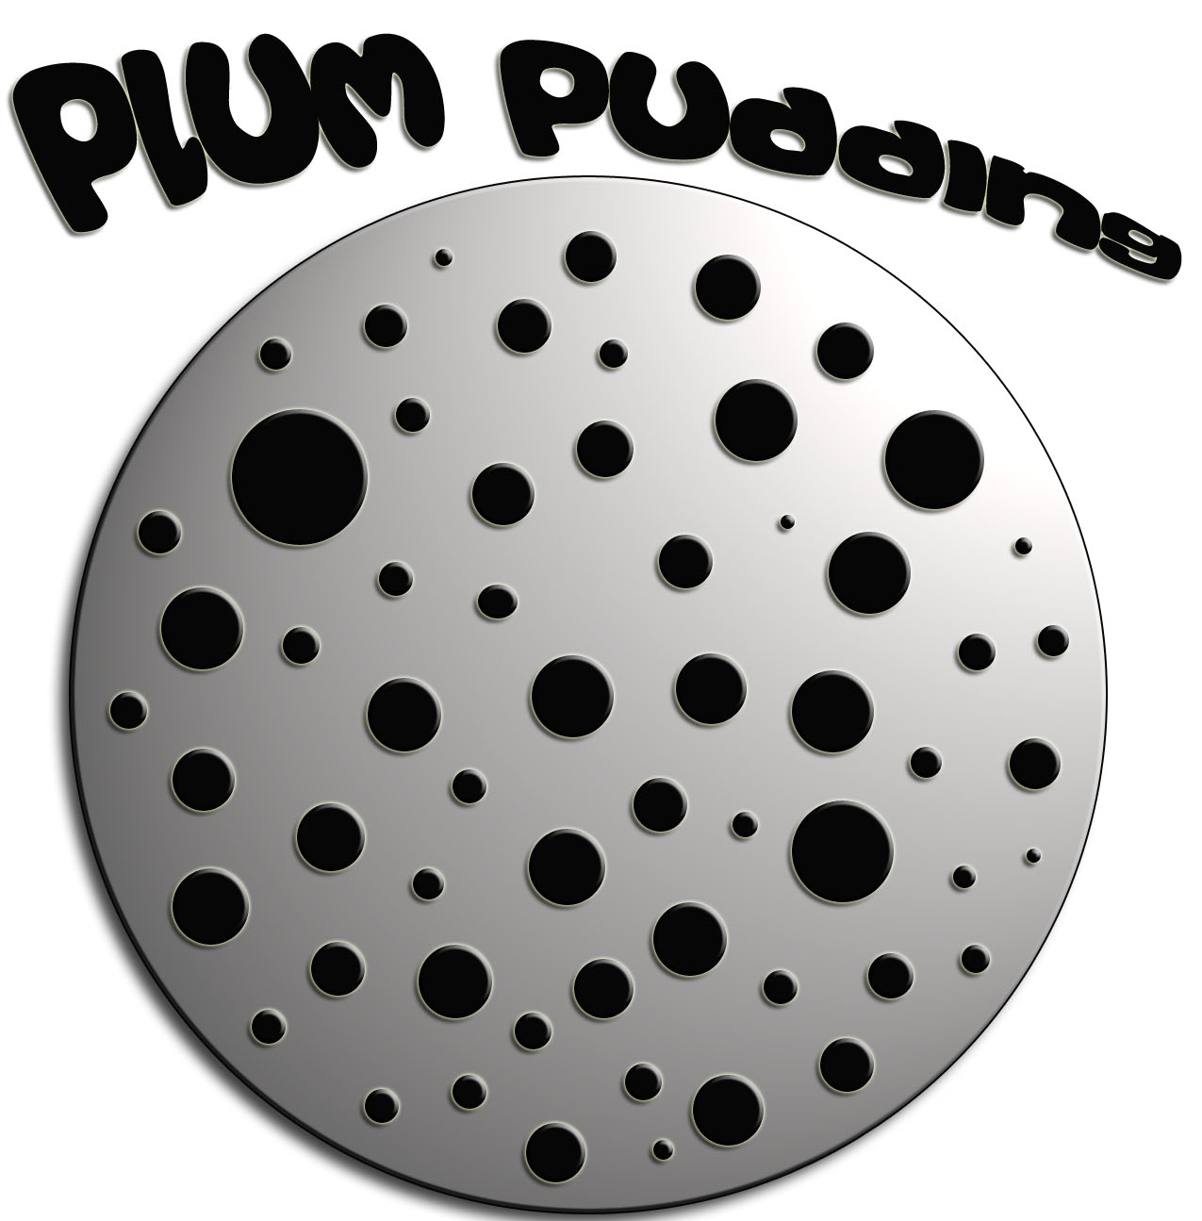

Slide 13
Rutherford’s Gold Foil Experiment
Alpha (α) particles are helium nuclei
Particles were fired at a thin sheet of gold foil
Particle hits on the detecting screen (film) are recorded

Slide 14
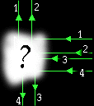
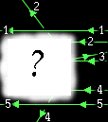
Try it Yourself!
In the following pictures, there is a target hidden by a cloud. To figure out the shape of the target, we shot some beams into the cloud and recorded where the beams came out. Can you figure out the shape of the target?

Slide 15
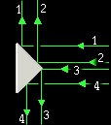
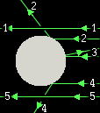
The Answers
Target #1
Target #2

Slide 16
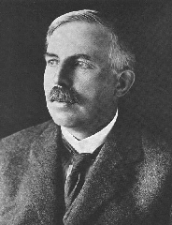
Rutherford’s Findings
Most of the particles passed right through
A few particles were deflected
VERY FEW were greatly deflected
CONCLUSIONS:
The nucleus is small
The nucleus is dense
The nucleus is positively charged

Slide 17
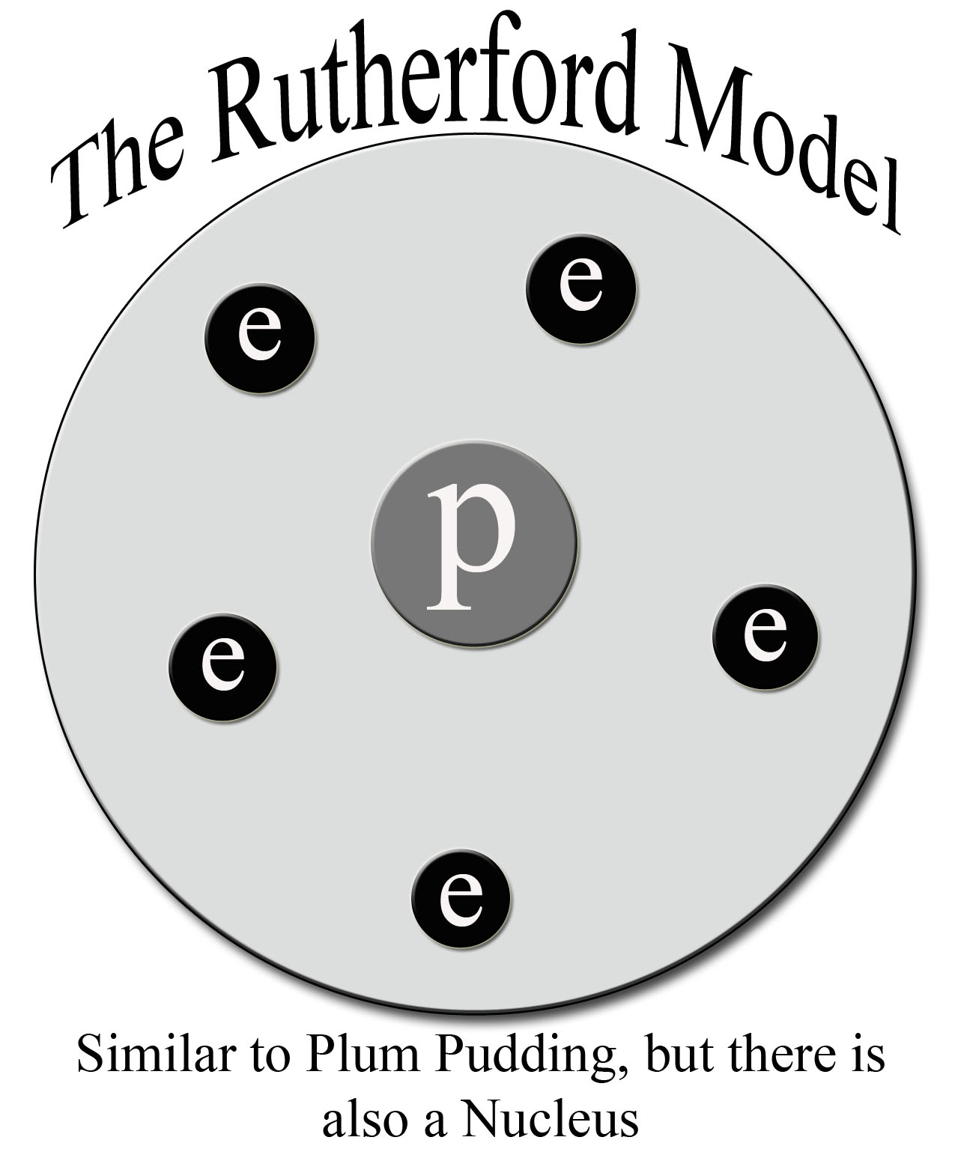

Slide 18
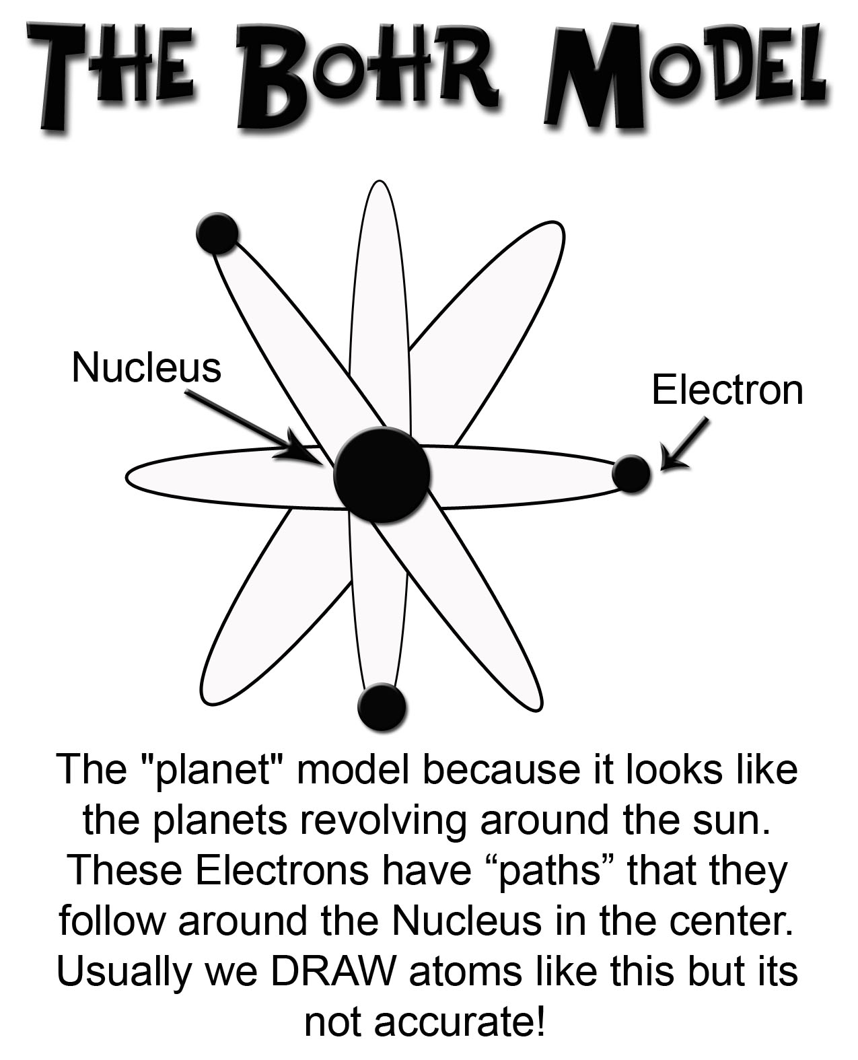

Slide 20
Atomic Particles
Particle | Charge | Mass # | Location
Electron | -1 | 0 | Electron cloud
Proton | +1 | 1 | Nucleus
Neutron | 0 | 1 | Nucleus

Slide 21
Atomic Number
The number of protons in the nucleus of each atom of that element.
Element | # of protons | Atomic # (Z)
Carbon | 6 | 6
Phosphorus | 15 | 15
Gold | 79 | 79

Slide 22
Mass Number
The number of protons and neutrons in the nucleus of an isotope.
Mass # = p⁺ + n⁰
Nuclide | p⁺ | n⁰ | e⁻ | Mass #
Oxygen - |  | 10
- | 33 | 42
- 31 | 15
18
8
8
18
Arsenic
75
33
75
Phosphorus
16
15
31

Slide 23
Which of the following determines the identity of an atom?
Number of protons
Number of electrons
Number of neutrons
Total number of protons and neutrons
Total number of protons and electrons
Notes:
Answer: a

Slide 24
Which of the following determines the identity of an atom?
Number of protons
Number of electrons
Number of neutrons
Total number of protons and neutrons
Total number of protons and electrons
Notes:
Answer: a

Slide 25
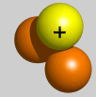
Isotopes
Atoms of the same element having different masses due to varying numbers of neutrons.
Isotope | Protons | Electrons | Neutrons | Nucleus
Hydrogen–1 (protium) | 1 | 1 | 0
Hydrogen-2 (deuterium) | 1 | 1 | 1
Hydrogen-3 (tritium) | 1 | 1 | 2

Slide 26
AVERAGE Atomic Masses
The average of all the naturally occurring isotopes of that element.
Isotope | Symbol | Composition of the nucleus | % in nature
Carbon-12 | ¹²C | 6 protons 6 neutrons | 98.89%
Carbon-13 | ¹³C | 6 protons 7 neutrons | 1.11%
Carbon-14 | ¹⁴C | 6 protons 8 neutrons | <0.01%
Carbon = 12.011

