Slide 1
N1 - Chemistry Math Review
Follow formatting requirements written on WS #1 given to you for homework!
Take NOTES don't copy word for word! Do not ask me “can you go back a slide?” The answer is no. If you need more detail add it at home – notes will be on class website. You need to get FAST at note taking! Use abbreviations, shorthand, pictures etc!
YOU ARE A NOTE TAKER,
NOT A PHOTOCOPY MACHINE!
This “should” be review…we review it quickly to refresh your memory. If you need extra help then come see me!
We will add “KCQ Boxes” to the end of your notes in class together the next day – it is a note taking technique to help process and retain the information you take notes on. You do not have to do this tonight for homework!

Slide 2
N1 - Chemistry Math Review
Target: I can use scientific notation and the metric system this year in my chemistry class.
Link to YouTube Presentation: https://youtu.be/IfPJ7xKOfQU

Slide 3
Tired of really big or really small numbers???
“x 10 ^{EXPONENT}” is the same a E
3.54E²
Use scientific notation!
Move your decimal and
rewrite it in “scientific
notation format”
3.54 x 10²
Exponent
One
#
Rest of the #s
10
(telling how many times to move the decimal, and which way to move it!)
•
x

Slide 4
Nature of Measurement
Measurement - quantitative observation
Consisting of 2 parts
  Part 1 – number
  Part 2 – scale (unit)
  Example: 20 grams
We will be using a lot of scientific notation for our numbers
We will be using the metric system for our units

Slide 5
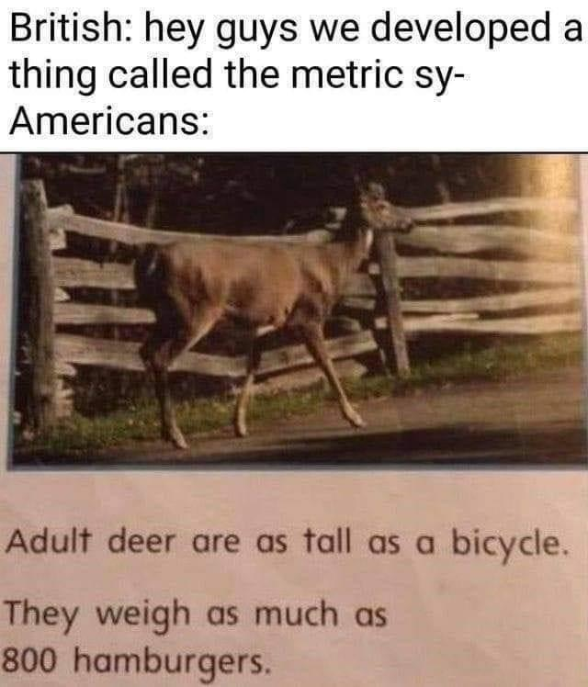
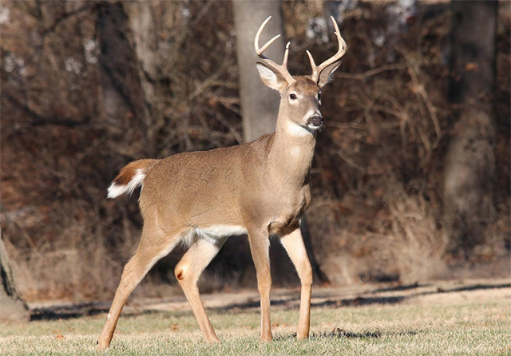
Why the Metric System?
We all need to speak the same “math language.”
Everyone else uses it!
It is easier!
The British: Hey guys, we developed this thing called the metric system…
Americans:
Adult deer are as tall as a bicycle. They weigh as much as 800 hamburgers.

Slide 6
How is it easier?
Unit | Compared to “base” unit of a foot
Foot | 1
Yard | 3
Fathom | 6.0761
Rod | 16.5
Chain | 66
Furlong | 660
Mile | 5,280
Nautical mi. | 6,076.1
League | 15,840
Metric system works on “BASE TEN”
Everything is changed by a factor of 10
English system is totally random!
Unit | Compared to “base” unit of a meter
Meter | 1
Decameter | 10
Hectometer | 100
Kilometer | 1000

Slide 7
Converting Metric System
Just move the decimal!
To convert to a smaller
unit, move decimal
point to the right
(or multiply)
Kilo
1000
units
Hecto
100
units
Deka
10
units
Base
Unit
Deci
0.1
units
Centi
0.01
units
To convert to a larger
unit, move decimal
point to the left
(or divide)
Milli
0.001
units

Slide 8


How do I remember the prefixes?
King Henry Died By Drinking Chocolate Milk
KILO
HECTO
DEKA
Base
DECI
CENTI
MILLI

Slide 9
What are the
“Base Units?”
Measuring | Unit
Length | Meter
Volume | Liter
Mass | Gram
Time | Second
Temp | Kelvin
# of molecules | Mole
Kilo
1000
units
Hecto
100
units
Deka
10
units
Base
Unit
Deci
0.1
units
Centi
0.01
units
Milli
0.001
units

Slide 10
Guided Practice
27500 mg → g
STEP 1
Are you going up or down the “ladder?”
STEP 2
How many steps to get there?
K H D B d c m
2 7 5 0 0.
STEP 3
Move decimal that many times, in that direction
27.500 g

Slide 11
Guided Practice
0.15 DL = ______ mL
STEP 1
Are you going up or down the “ladder?”
STEP 2
How many steps to get there?
K H D B d c m
0.1 5 0 0
STEP 3
Move decimal that many times, in that direction
1500 mL

Slide 12
The Fundamental SI Units
(le Système International, SI)
Careful – what we call the “Base Unit” for conversions is GRAMS but the “SI Base Unit” for mass is KILOGRAMS

Slide 13
Derived Units
Made by combining multiple units together
Examples:
  miles/hour = speed in our cars in US
  cm³ = volume
  m/s² = acceleration
  kg•m/s² = newton (measures force)

Slide 14
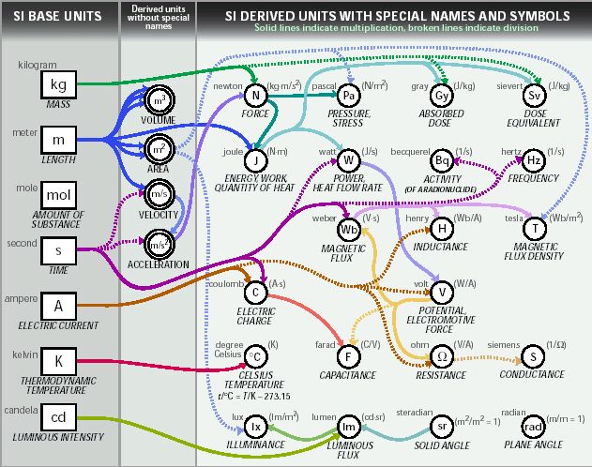

Slide 15
YouTube Link for this Presentation
https://youtu.be/IfPJ7xKOfQU

