Slide 1
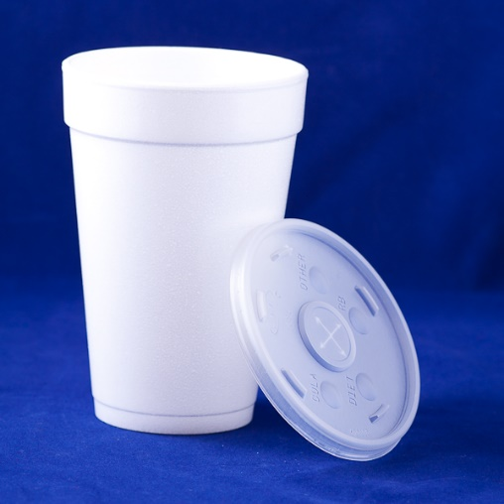
N-36
Calorimetry
You can use the 1st Law of Thermodynamics to solve “calorimetry problems” where you solve for information on one substance by knowing information on another substance.
Link to YouTube Presentation: https://youtu.be/s_2BJ7HgBmI

Slide 2
Concept Behind
Calorimetry
Sometimes it is hard to measure the thing you are actually interested in.
You may be interested in a chemical reaction but you can’t stick your thermometer inside the chemical bonds themselves!
BUT...you could put the chemicals in water and put your thermometer in the water instead!

Slide 3
Concept Behind
Calorimetry
So...if you can’t measure something you are interested in DIRECTLY...
You can try measuring it INdirectly instead!
If you can’t measure the SYSTEM, you can measure the SURROUNDINGS instead!

Slide 4
Concept Behind
Calorimetry
If one substance loses heat,
it has to go somewhere!
Has to go to another substance!
If one substance gains heat,
it had to come from somewhere!
Had to come from another substance!
Energy gained = -Energy lost
5 joules absorbed = -(-5 joules lost)
Q_{in} = -Q_{out}

Slide 5
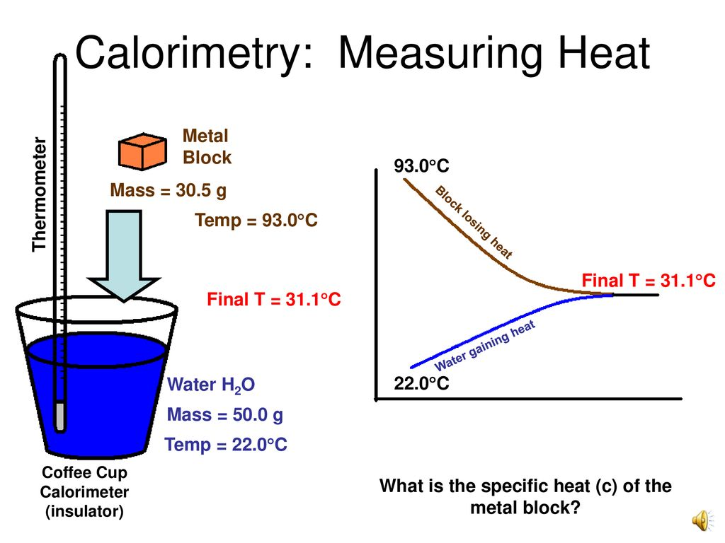
Concept Behind
Calorimetry
Understanding that
Q_{in} = -Q_{out}
Can be a very helpful trick in the lab!
If you can’t measure the thing you are actually interested in, you can measure the system instead!

Slide 6
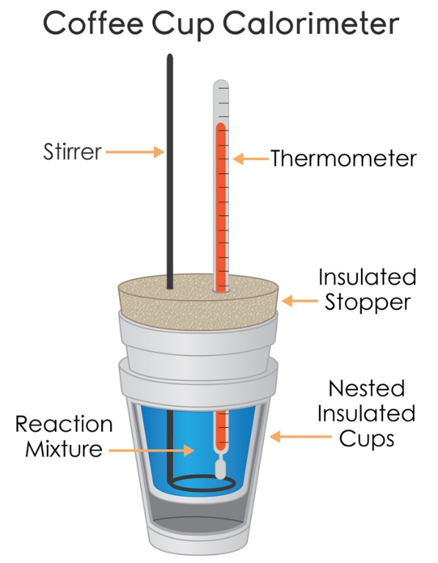
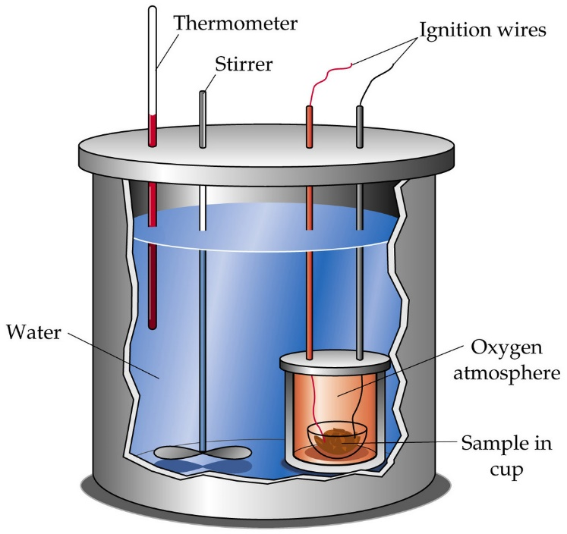
Purpose of
Calorimetry
Measure heat transferred from one object to another, or the energy transferred during a reaction.
Coffee Cup Calorimeter
Bomb Calorimeter

Slide 7
Common
Type of Question
Transferring a HOT object into a COLD liquid
Transferring a COLD object into a HOT liquid
Pouring two liquids together that start at different temperatures
Calculating the heat released/absorbed during a chemical reaction

Slide 8
Still Using
Q = mC∆T
These problems still involve energy
So we still use the Q = mC∆T equation
BUT THIS TIME…
  We need Q = mC∆T for each substance…
  We will have TWO Q=mC∆T equations

Slide 9
How can we solve for a substance when we don’t have enough information?
1st Law of Thermodynamics!

Slide 10
1st Law of Thermodynamics
Energy cannot be created or destroyed
We are TRANSFERRING energy
Therefore…
Energy In = Energy Out
Energy Absorbed = Energy Released
20 J of energy absorbed = 20 J of energy released

Slide 11
We need our math to match our concepts…
Energy In = Energy Out
Energy Absorbed = Energy Released
Q_{substance 1} = - Q_{substance 2}
Negative sign will stand for “OPPOSITE” not necessarily negative. Makes it so it doesn’t really matter which material you start with.

Slide 12
Q = - Q shown with numbers
You put a hot piece of metal into a cold cup of water.
The water absorbs 50 Joules of energy, so the metal released 50 Joules of energy
    Q_{water} = - Q_{metal}
    endo exo
    + -
    50 J = -(-50 J)
Since our negative sign in our equation means opposite,
the negatives will sort themselves out!

Slide 13
Think about where the negatives are coming from…
m = always +
C = always +
∆T = + or - !!!
Therefore…
Q can end up + or -

Slide 14
Example with Pictures
ENERGY IN = ENERGY OUT
Energy absorbed→ Q = +
Energy released → Q = -
beaker
calorimeter
Qmetal = -
Qwater = +
Qmetal = +
Qwater = -
Hot Water
Cold Water
Metal is heating up
Water is heating up
Energy transfer into METAL
Energy transfer into WATER

Slide 15
Key Thing to Note About T_{final}
If you leave the object/liquid/solutions together long enough they will come to the same temperature!
Example:
    Tfinal_{water} = Tfinal_{metal}
    A very convenient fact that will simplify the algebra to allow us to solve for various things.

Slide 16
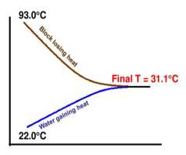
Key Thing to Note About T_{final}
If you leave the object/liquid/solutions together long enough they will come to the same temperature!

Slide 17
Q_{water} =
m_{water} =
C_{water} =
ΔT_{water} =
Q_{metal}=
m_{metal} =
C_{metal} =
ΔT_{metal} =
?
-Q_{water}
Energy IN must
= energy OUT!
(opposite sign, not necessarily negative)
From the water you put in the calorimeter
1mL = 1g
From your scale
?
4.184 J/g°C
-
Tf – Ti
Tf – Ti
(From your thermometer readings)
Tf
From water
100°C
From boiling
(At the end the metal and water will be same temp)
(The metal was put in the boiling water so it reached 100°C)

Slide 18
Practice Problems
Glue the questions in your notebook
Show your work the way I do!
Annotate the practice problems with comments, tips, warnings, explanations, etc! These are NOTES not just practice problems!

Slide 19
Practice Problems
Calculate the specific heat of a metal if 2.36 x 10² grams of it at 99.5°C is added to 125.0 mL of water at 22.0°C. The final temperature of the system is 25.4°C.

Slide 20
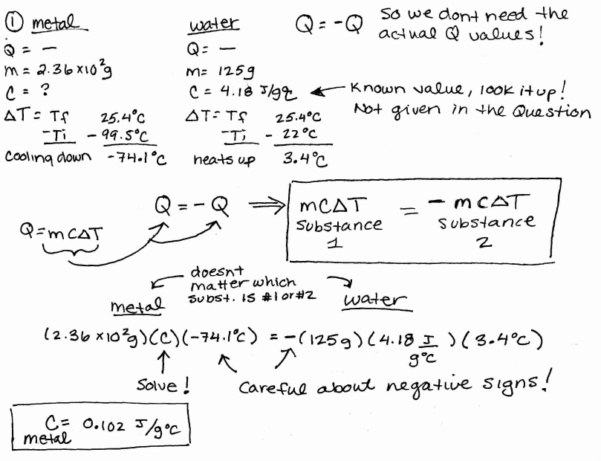

Slide 21
Practice Problems
2) A lump of chromium (Cr) has a mass of 95.3
grams and a temperature of 90.5°C. It is placed
into a calorimeter with 75.2 mL of water at
20.5°C. After stirring, the final temperature of
the water, Cr metal, and calorimeter is 28.6°C.
What is the specific heat of Cr metal?

Slide 22
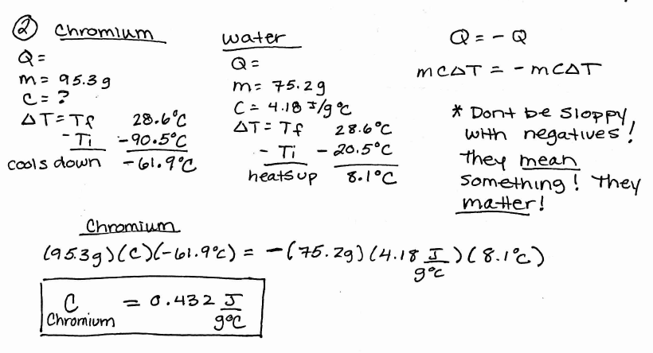

Slide 23
Practice Problems
3) A 100.0 gram sample of water at 50.0°C is mixed
with a 50.00 gram sample of water at 20.0°C.
What is the final temperature of the 150.0 grams
of water?
Who cares if it is two waters instead of a metal and a water?!
Still two substances! Nothing changes! Actually easier because the specific heats on each side will cancel out if you want! I don’t always do it in my keys because people always ask what happened to them ☺

Slide 24
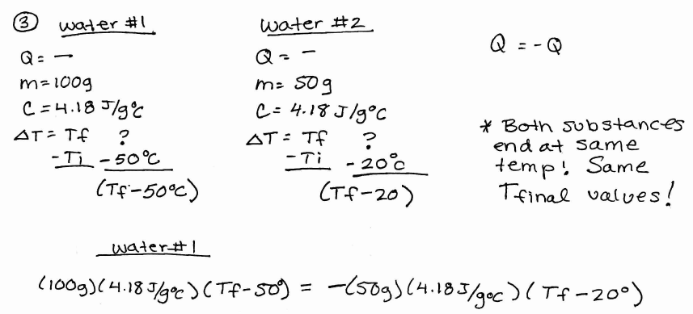
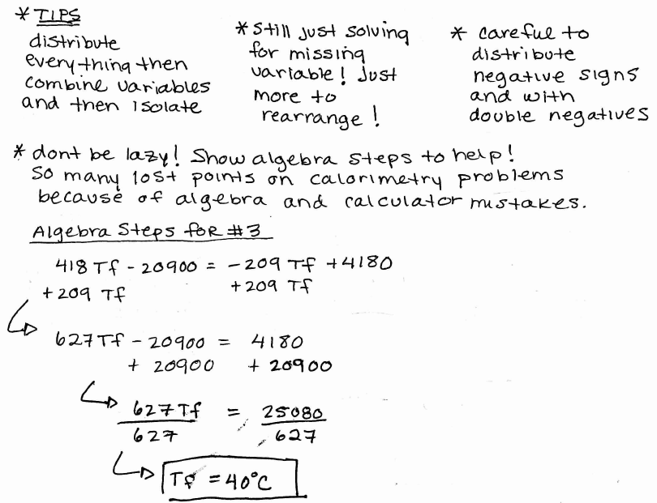
Continued on next slide! Cant fit it all here…

Slide 25
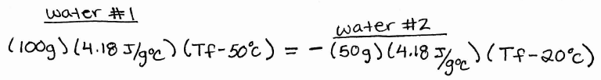

Slide 26
What if you forgot to cancel out the matching specific heats? No big deal!
You will get the same answer!

Slide 27
YouTube Link to Presentation
https://youtu.be/s_2BJ7HgBmI

