Slide 1
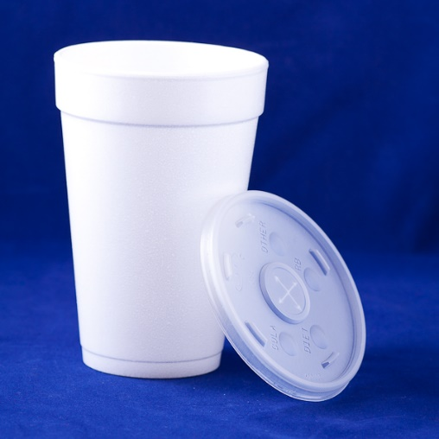
N-36 Calorimetry
You can use the 1st Law of Thermodynamics to solve “calorimetry problems” where you solve for information on one substance by knowing information on another substance.

Slide 2
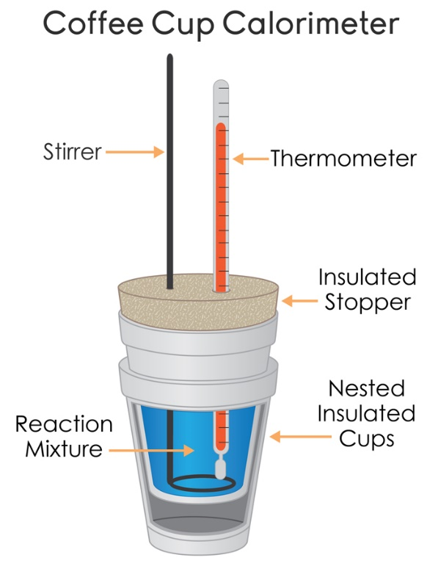
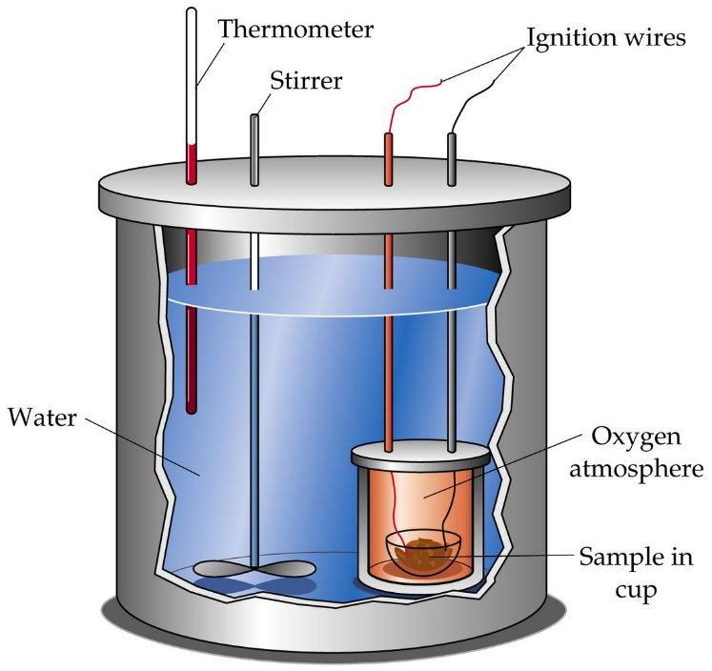
Purpose of Calorimetry
Measure heat transferred from one object to another, or the energy transferred during a reaction.
Coffee Cup Calorimeter
Bomb Calorimeter

Slide 3
Common Type of Question
Transferring a HOT object into a COLD liquid
Transferring a COLD object into a HOT liquid
Pouring two liquids together that start at different temperatures
Calculating the heat released/absorbed during a chemical reaction

Slide 4
Still Using Q = mC∆T
These problems still involve energy
So we still use the Q = mC∆T equation
BUT THIS TIME…
We need Q = mC∆T for each substance…
We will have TWO Q=mC∆T equations

Slide 5
How can we solve for a substance when we don’t have enough information?
1st Law of Thermodynamics!

Slide 6
1st Law of Thermodynamics
Energy cannot be created or destroyed
We are TRANSFERRING energy
Therefore…
Energy In = Energy Out
Energy Absorbed = Energy Released
20 J of energy absorbed = 20 J of energy released

Slide 7
We need our math to match our concepts…
Energy In = Energy Out
Energy Absorbed = Energy Released
Q_{substance 1} = - Q_{substance 2}
Negative sign will stand for “OPPOSITE” not necessarily negative. Makes it so it doesn’t really matter which material you start with.

Slide 8
Q = - Q shown with numbers
You put a hot piece of metal into a cold cup of water.
The water absorbs 50 Joules of energy, so the metal released 50 Joules of energy
Q_{water} = - Q_{metal}
endo exo
+ -
50 J = -(-50 J)
Since our negative sign in our equation means opposite, the negatives will sort themselves out!

Slide 9
Think about where the negatives are coming from…
m = always +
C = always +
∆T = + or - !!!
Therefore…
Q can end up + or -

Slide 10
Example with Pictures
ENERGY IN = ENERGY OUT
Energy absorbed→ Q = +
Energy released → Q = -
beaker
calorimeter
Qmetal = -
Qwater = +
Qmetal = +
Qwater = -
Hot Water
Cold Water
Metal is heating up
Water is heating up
Energy transfer into METAL
Energy transfer into WATER

Slide 11
Key Thing to Note About T_{final}
If you leave the object/liquid/solutions together long enough they will come to the same temperature!
Example:
Tfinal_{water} = Tfinal_{metal}
A very convenient fact that will simplify the algebra to allow us to solve for various things.

Slide 12
Q_{water} =
m_{water} =
C_{water} =
ΔT_{water} =
Q_{metal}=
m_{metal} =
C_{metal} =
ΔT_{metal} =
?
-Q_{water}
Energy IN must = energy OUT!
(opposite sign, not necessarily negative)
From the water you put in the calorimeter
1mL = 1g
From your scale
?
4.184 J/g°C
-
Tf – Ti
Tf – Ti
(From your thermometer readings)
Tf
From water
100°C
From boiling
(At the end the metal and water will be same temp)
(The metal was put in the boiling water so it reached 100°C)

Slide 13
Practice Problems
Glue the questions in your notebook
Show your work the way I do!
Annotate the practice problems with comments, tips, warnings, explanations, etc! These are NOTES not just practice problems!

Slide 14
Practice Problems
Calculate the specific heat of a metal if 2.36 x 10² grams of it at 99.5°C is added to 125.0 mL of water at 22.0°C. The final temperature of the system is 25.4°C.

Slide 15
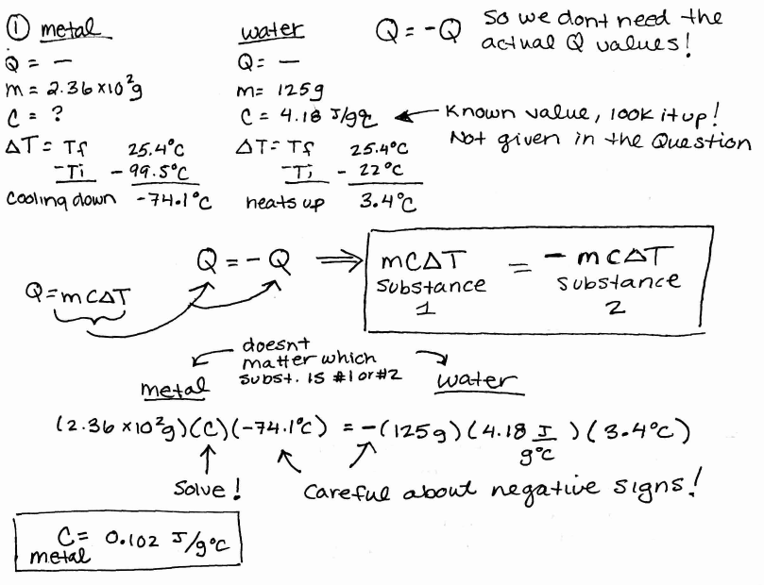

Slide 16
Practice Problems
2) A lump of chromium (Cr) has a mass of 95.3 grams and a temperature of 90.5°C. It is placed into a calorimeter with 75.2 mL of water at 20.5°C. After stirring, the final temperature of the water, Cr metal, and calorimeter is 28.6°C. What is the specific heat of Cr metal?

Slide 18
Practice Problems
3) A 100.0 gram sample of water at 50.0°C is mixed with a 50.00 gram sample of water at 20.0°C. What is the final temperature of the 150.0 grams of water?
Who cares if it is two waters instead of a metal and a water?!
Still two substances! Nothing changes! Actually easier because the specific heats on each side will cancel out if you want! I don’t always do it in my keys because people always ask what happened to them ☺

Slide 19
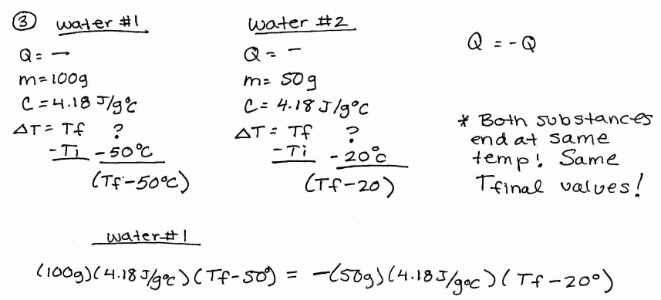
Continued on next slide! Cant fit it all here…

Slide 21
What if you forgot to cancel out the matching specific heats? No big deal!
You will get the same answer!

Slide 22
YouTube Link to Presentation
https://youtu.be/s_2BJ7HgBmI

