Slide 1
N37
Heating and Cooling Curves
Target: I can use heating and cooling curves to help calculate the energy changes during phase changes

Slide 2
What do they show us?
Heating or cooling → the sloped parts of graph
Phase changes → the flat parts of graph
TEMP
TIME

Slide 3
Heating Curve
Vaporizing
Liquid → Gas
Melting
Solid → Liquid
Heating a gas
Heating a liquid
Heating a solid

Slide 4
Cooling Curve
Condensing
Gas → Liquid
Cooling a gas
Freezing
Liquid → Solid
Cooling a liquid
Cooling a solid

Slide 5
Why are some areas sloped and some flat?
Heating | Phase Changes
Issue: SPEED | Issue: POSITION
All the energy is going towards SPEEDING UP the molecules | All the energy is going towards SPREADING OUT the molecules
Results in a temperature change | Results in NO temperature change
(Cooling would just be the opposite of these things!)

Slide 6
Why are some areas sloped and some flat?
Heating | Phase Changes
Issue: SPEED | Issue: POSITION
All the energy is going towards SPEEDING UP the molecules | All the energy is going towards SPREADING OUT the molecules
Results in a temperature change | Results in NO temperature change
(Cooling would just be the opposite of these things!)

Slide 7
How is our math changed by NO ∆T?
HEATING/COOLING
PHASE CHANGES
Q = mC∆T
C = J/g°C → Has a temperature component.
So…. Cant use it for phase changes
∆T = 0 BUT Q = 0
Get rid of ∆T, and replace C with something else
Q = mL
L = “Latent Heat” → J/g The energy required to phase change one gram of substance

Slide 8
Specific Heat and Latent Heat Labels
HEATING/COOLING
PHASE CHANGES
C_{solid}
C_{liquid}
C_{gas}
Always positive values
L_{fusion}
L_{vaporization}
Positive if endothermic process (melting/vaporizing)
Negative if exothermic process (condensing/freezing)

Slide 9
Values to Memorize for Water
Heating/Cooling |  | Phase Changes
C_{ice} | 2.09 J/g°C | L_{fus} | +/- 334 J/g
C_{liq} | 4.18 J/g°C | L_{vap} | +/- 2260 J/g
C_{steam} | 1.87 J/g°C | L is (+) or (–) depending on direction!

Slide 10
More Realistic Heating Curve of H2O
Vaporizing
Liquid → Gas
Melting
Solid → Liquid
Heating a gas
Heating a liquid
Heating a solid

Slide 11
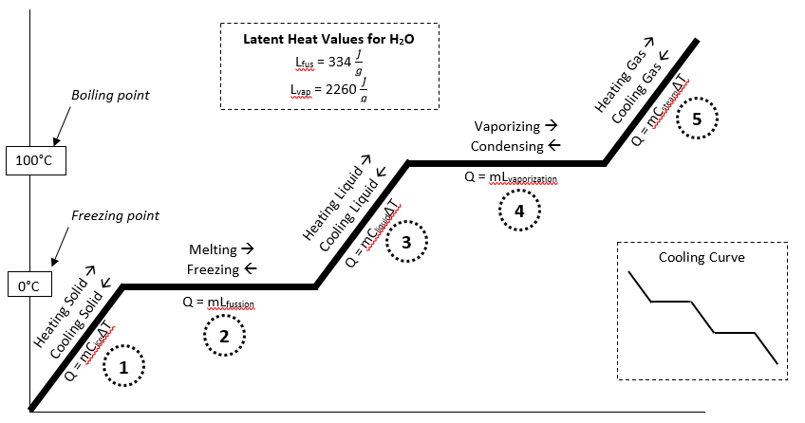
Completely Labeled Heating Curve

Slide 12
Calculate ONE line segment at a time!!!
Calculate everything separately and then add up your answers. You could have up to five Q values to add up!

Slide 13
Careful with ∆T Values!
Use ONLY the temperature change on the ONE LINE you are working with at a time! You will see this on our practice problems in a minute…

Slide 14
What phases are happening where?
A
ONLY Solid at 0°C
Liquid AND Gas
B
ONLY Liquid at 0°C
Solid AND Liquid
C
ONLY Liquid at 100°C
ONLY gas
C
D
D
ONLY Gas at 100°C
ONLY liquid
A
B
ONLY Solid

Slide 15
Practice Problems
Glue the questions in your notebook
Show your work the way I do!
Annotate the practice problems with comments, tips, warnings, explanations, etc! These are NOTES not just practice problems!

Slide 16
Practice Problems
What is the energy needed to melt 326 grams of ice and heat it to 100°C?
Determine the energy required to convert 21.1 grams of ice at -6°C to steam at 100°C
What is the heat transfer involved when you convert 51 grams of water 0°C to ice at -20.3°C?
What is the energy absorbed when you melt 75 grams of ice at -5°C to water at 90°C?

Slide 17
What is the energy needed to melt 326 grams of ice and heat it to 100°C?
2
Melt ice
Q₂ =
mL =
(326g)
(334 J/g) =
108884 J
3
Heat liquid
Q₃ =
mC∆T =
(326g)
(4.18J/gC)
(100° - 0°) =
136268 J
Q_{T} =
Q₂ +
Q₃
= 245152 J
You could put it in kJ but we often don’t bother
100
∆T₃
0

Slide 18
Determine the energy required to convert 21.1 grams of ice at -6°C to steam at 100°C
1
Heat ice
Double Negative! Be Careful!
Q₁ =
mC∆T =
(21.1g)
(2.09J/gC)
(0° 6°) =
264.59 J
2
Melt ice
Q₂ =
mL =
(21.1g)
(334 J/g) =
7047.4 J
3
Heat liquid
4
Vaporize
Q₃ =
mC∆T =
(21.1g)
(4.18J/gC)
(100° - 0°) =
8819.8 J
Steam @ 100, have to vaporize! Need line 4
Q₄ =
mL =
(21.1g)
(2260 J/g) =
47686 J
Q_{T} =
Q₁ +
Q₂ +
Q₃ +
Q₄
100
∆T₃
= 63817.79 J
0
∆T₁

Slide 19
What is the heat transfer involved when you convert 51 grams of water 0°C to ice at -20.3°C?
(- 334 J/g) =
- 17034 J
2
Freezing
Q₂ =
mL =
(51g)
1
Cooling ice
-2163.78 J
Q₁ =
mC∆T =
(51g)
(2.09J/gC)
(-20.3°- 0°) =
Going backwards!
L will be negative!
∆T will be negative
Q will be negative!
Q_{T} =
Q₂ +
Q₁
= -19197.78 J
Negative because energy was RELEASED!
Cooling down is EXOTHERMIC!
Yes, that seems strange to us but it is true!
100
LIQUID @ 0°c
0
∆T₁

Slide 20
What is the energy absorbed when you melt 75 grams of ice at -5°C to water at 90°C?
1
Heat ice
Double Negative! Be Careful!
Q₁ =
mC∆T =
(75g)
(2.09J/gC)
(0° 5°) =
783.75 J
2
Melt ice
Q₂ =
mL =
(75g)
(334 J/g) =
25050 J
3
Heat liquid
You aren’t “finishing” line 3! Stop early! Careful with you ∆T !
Q₃ =
mC∆T =
(75g)
(4.18J/gC)
(90° - 0°) =
28215 J
CAREFUL!
You are only going to 90°C ! You are stopping early!
Tfinal = 90°C
Q_{T} =
Q₁ +
Q₂ +
Q₃
100
∆T₃
= 54048.75 J
0
∆T₁

Slide 22
YouTube Link to Presentation
https://youtu.be/g2srRytHiX0

Slide 23
108884 J
245152 J

