Slide 1
N38 – Energy of Reactions
Target: I can perform various calculations involving the energy changes during chemical reactions.

Slide 2
N38 – Energy of Reactions
Reaction Diagrams
Molar Heat Capacities
Heat of Reaction
Heat of Formation
Bond Energy
Hess’s Law

Slide 3
1.
Reaction
Diagrams

Slide 4
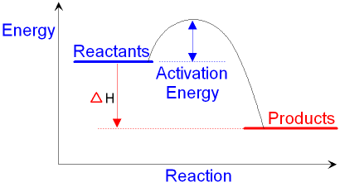
Reaction Diagrams
A graph representing energy changes during the course of a reaction
ΔQ
*Is this reaction endo or exothermic? How do you know???

Slide 5
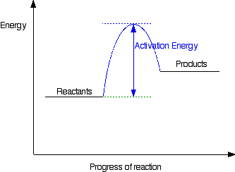
Reaction Diagrams
Draw and label an ENDOTHERMIC reaction diagram.
ΔH

Slide 6
But what is “Activation Energy?”
Activation energy:
the smallest amount of energy required for molecules to be “activated” in order to undergo a specific chemical change
Speed them up to hit
hard enough
Proper orientation to collide in the right spot
ΔH

Slide 7
2.
Molar
Heat Capacity

Slide 8
Molar Heat Capacity
Energy required to raise the temperature of one MOLE of a substance one degree.
Similar to Specific Heat Capacity but uses moles instead of grams!
Q = nCΔT
*If you make sure your units cancel, this is easy!!

Slide 9
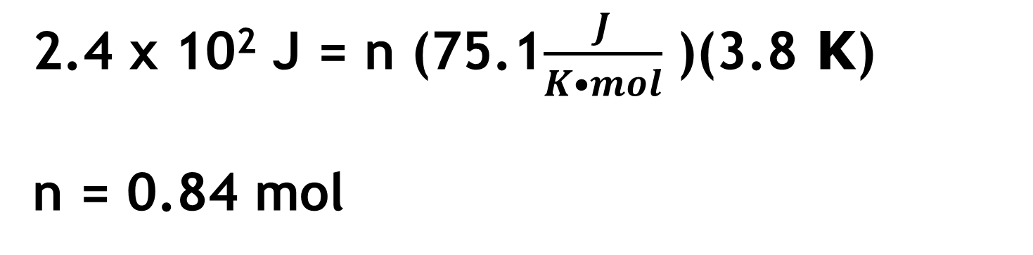
Molar Heat Capacity
A sample of barium chloride is increased in temperature by 3.8˚C when the sample absorbed 2.4x10² J of heat energy. Calculate the number of moles of barium chloride if its molar heat capacity is 75.1 J/K•mol.
Q = nCΔT
Do we care that it is in moles and Kelvins? No!
Does that change the concept of “plug and chug” and “cancel units” ? No!
2.4 x 10² J = n (75.1$\frac{J}{K•mol}$ )(3.8 K)
n = 0.84 mol

Slide 10
3.
Heat of
Reaction

Slide 11
Heat of Reactions
Amount of energy change involved in a reaction. Sometimes exo, sometimes endo.
Lots of different ways to calculate or measure it.
2Al + Fe₂O₃ → 2Fe + Al₂O₃ ΔH_{rxn}=−851.5kJ/mol_{rxn}
  ( Remember, ∆H is basically Q)
  ∆H negative → energy released → exothermic → product!
  ∆H positive → energy absorbed → endothermic → reactant!

Slide 12
Heat of Reactions
Amount of energy change involved in a reaction. Sometimes exo, sometimes endo.
Lots of different ways to calculate or measure it.
2Al + Fe₂O₃ → 2Fe + Al₂O₃ + energy
2Al + Fe₂O₃ → 2Fe + Al₂O₃ + 851.5kJ
Energy released! Product! Exothermic!

Slide 13
Heat of Reactions
Amount of energy change involved in a reaction. Sometimes exo, sometimes endo.
Lots of different ways to calculate or measure it.
2Fe + Al₂O₃ + energy → 2Al + Fe₂O₃
2Fe + Al₂O₃ + 851.5kJ → 2Al + Fe₂O₃
Energy absorbed! Reactant! Endothermic!

Slide 14
Heat of Reactions per mole
Sometimes you want it per mole of a certain substance.
Just take mole ratios into account!
2Al + Fe₂O₃ → 2Fe + Al₂O₃ ΔH_{rxn}=−851.5kJ/mol_{rxn}
-851.5kJ | 1 rxn | = | -425.75 kJ .
1 rxn | 2 mol Al |  | mol Al

Slide 15
Example Question
Calculate the energy released when
135g of aluminum is reacted in the below equation.
2Al + Fe₂O₃ → 2Fe + Al₂O₃ ΔH_{rxn}=−851.5kJ/mol_{rxn}
135 g Al | 1 mol Al | 1 rxn | -851.5 kJ | = | -2130.3 kJ
 | 26.98g Al | 2 mol Al | 1 rxn

Slide 16
Example Question
Calculate the energy released when
135g of aluminum is reacted in the below equation.
2Al + Fe₂O₃ → 2Fe + Al₂O₃ ΔH_{rxn}=−851.5kJ/mol_{rxn}
135 g Al | 1 mol Al | 1 rxn | -851.5 kJ | = | -2130.3 kJ
 | 26.98g Al | 2 mol Al | 1 rxn

Slide 17
4.
Heat of
Formation

Slide 18
Heat of Formation
If you know how much energy it takes to
form each substance in a reaction, you can
calculate the Heat of Reaction!
$∆H^{°}=Σn∆H_{f}^{°}\left(products\right)− Σn∆H_{f}^{°}$(reactants)
  Σ means sum.
  n is the coefficient of the reaction.
  values will be given to you in a chart.

Slide 19
Calculating Heat of Rxn from Heats of Formation
Calculate ΔH for the combustion of methane, CH₄ CH₄(g) + 2O₂(g) → CO₂(g) + 2H₂O(l)
$∆H^{°}=Σn∆H_{f}^{°}\left(products\right)− Σn∆H_{f}^{°}$(reactants)
Substance | ΔH_{f} (kJ)
CH₄ | -74.80
O₂ | 0
CO₂ | -393.50
H₂O | -285.83
ΔH_{rxn} = [-393.50kJ
+ 2(-285.83kJ)]
– [-74.80kJ
+2(0kJ)]
ΔH_{rxn} = -890.36 kJ/mol_{rxn}

Slide 20





Ethanol is used as an additive in many fuels today.
What is ΔHº_{rxn} (kJ) for the combustion of ethanol?
2 C₂H₅OH (l ) + 6 O₂ (g) → 4 CO₂ (g) + 6 H₂O (l )
Formula | ΔHº_{f}
C₂H₅OH (l) | –277.6
CO₂ (g) | –393.5
H₂O (g) | –241.8
H₂O (l) | –285.8
- 401.7
+ 401.7
- 2469
+ 2734
- 2734
Notes:
Answer: e

Slide 21
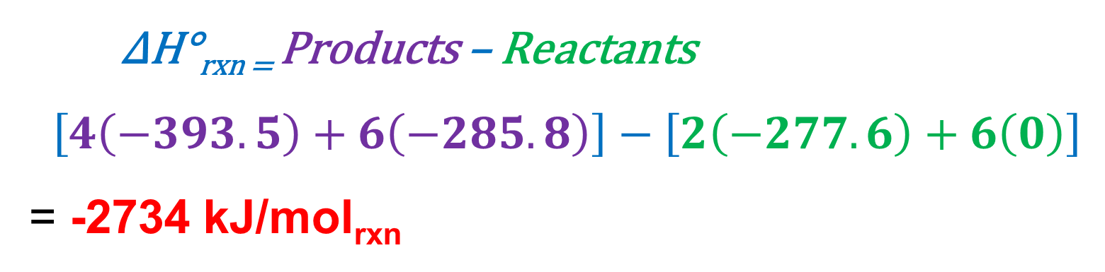
Ethanol is used as an additive in many fuels today.
What is ΔHº_{rxn} (kJ) for the combustion of ethanol?
2 C₂H₅OH (l ) + 6 O₂ (g) → 4 CO₂ (g) + 6 H₂O (l )
Formula | ΔHº_{f}
C₂H₅OH (l) | –277.6
CO₂ (g) | –393.5
H₂O (g) | –241.8
H₂O (l) | –285.8
- 401.7
∆H°_{rxn =} Products – Reactants
$$\left[4\left(−393.5\right)+6\left(−285.8\right)\right]−\left[2\left(−277.6\right)+6\left(0\right)\right]$$
= -2734 kJ/mol_{rxn}
+ 401.7
- 2469
+ 2734
- 2734
Notes:
Answer: e

Slide 22
5.
Bond
Energy

Slide 23
Bond Energy
It TAKES energy to break a bond – ENDO
- Otherwise they would just break by themselves!
Energy is RELEASED when a new bond forms – EXO
- If the new bond isn’t more stable, lower energy, it
wouldn’t want to form!

Slide 24
Bond Energy
If you know how much energy it takes to break a bond, and how much energy is released when new bonds form, you can add it all up to figure out the Heat of Reaction based on the bonds that are changing during the reaction!
Values will be given to you in a chart
Values in the table are averages

Slide 25
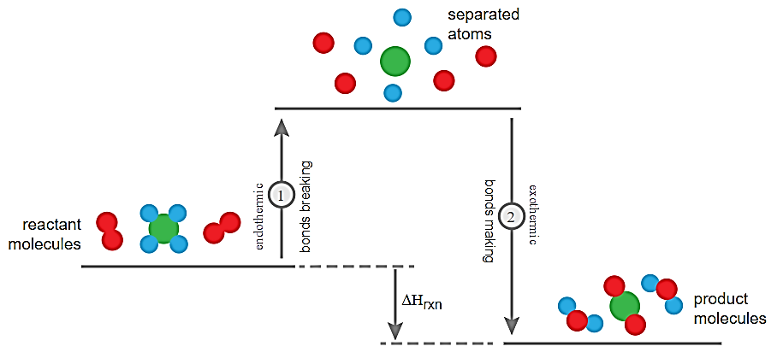
Bond Energy

Slide 26
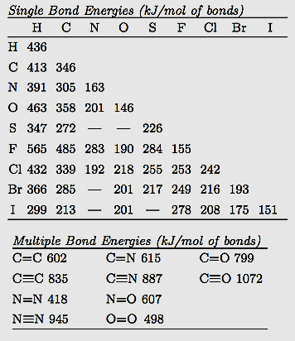
Use Bond Energy Chart
Action | Algebraic Sign | How to Remember
Break a Bond | + | Takes to Break
Form a Bond | - | Free to Form
2H₂ + O₂ → 2H₂O
You have to break: 2 H-H bond and 1 O=O bond
You have to form: 4 H-O bonds
2(436) + (498) + 4(- 463)= - 482 kJ/mol (exo)

Slide 27
6.
Hess’s
Law

Slide 28
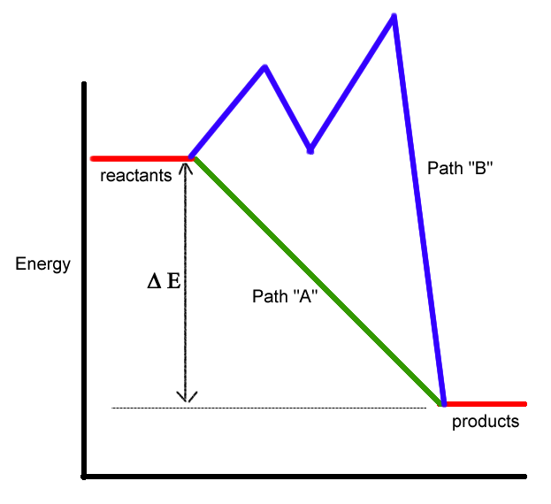
Hess’s Law
Path A – Mrs. Farmer
cleaning the house.
Path B – Mr. Farmer
cleaning the house.
Regardless of the path taken,
you still get to the same place.
Although Path B drives Mrs. Farmer bonkers – Ha!

Slide 29
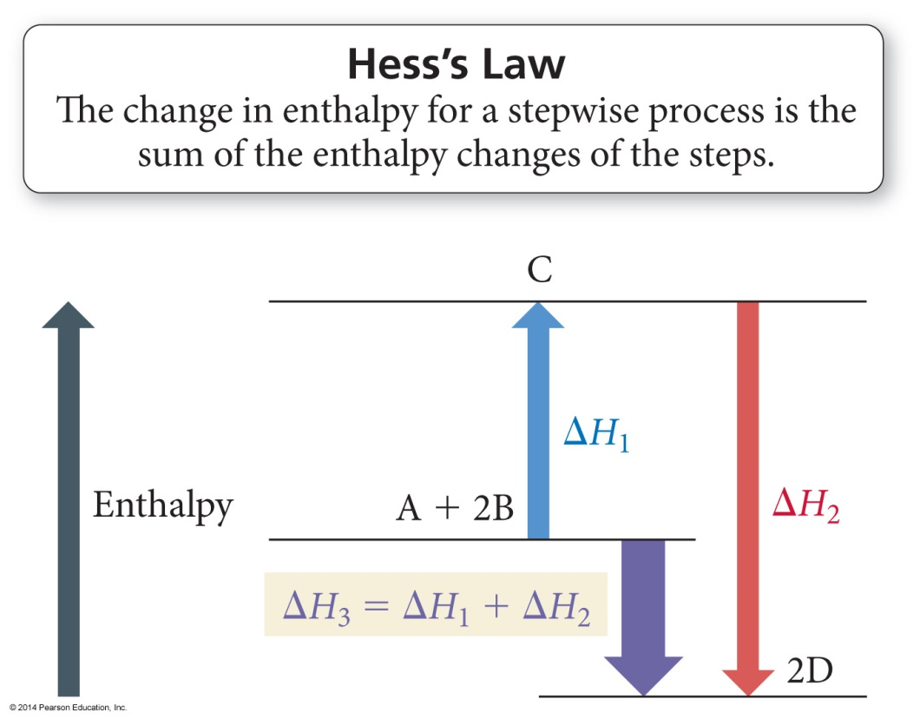
Hess’s Law
“In going from a particular set of reactants to a particular set of products, the change in enthalpy is the same whether the reaction takes place in one step or a series of steps.”

Slide 30
Relationships Involving ΔH_{rxn}
Multiplying Rxn by a # to Change Coefficients
ΔH_{rxn} is multiplied by that factor.
  Because ΔH_{rxn} is extensive – depends on the amount of substance
  C(s) + O₂(g) → CO₂(g) ΔH = −393.5 kJ
  2 C(s) + 2 O₂(g) → 2 CO₂(g) ΔH = 2 x (−393.5 kJ) = −787.0 kJ.
Reversing a rxn to flip which side the products/reactants are on
Flip the sign of ΔH, if positive now negative, if negative, now positive
C(s) + O₂(g) → CO₂(g) ΔH = −393.5 kJ
CO₂(g) → C(s) + O₂(g) ΔH = − (−393.5) = + 393.5 kJ

Slide 31
Hess’s Law Example Problem #1
Calculate ΔH for the combustion of methane, CH₄:
CH₄ + 2O₂ → CO₂ + 2H₂O
# | Reaction | ΔHº
1 | C + 2H₂ → CH₄ | -74.80 kJ
2 | C + O₂ → CO₂ | -393.50 kJ
3 | H₂ + ½ O₂ → H₂O | -285.83 kJ
Step #1:
CH₄ must appear on the reactant side, so we reverse reaction #1 and change the sign on ΔH.
- rxn 1
CH₄ → C + 2H₂ -(-74.80 kJ)

Slide 32
Hess’s Law Example Problem #1
Calculate ΔH for the combustion of methane, CH₄:
CH₄ + 2O₂ → CO₂ + 2H₂O
# | Reaction | ΔHº
1 | C + 2H₂ → CH₄ | -74.80 kJ
2 | C + O₂ → CO₂ | -393.50 kJ
3 | H₂ + ½ O₂ → H₂O | -285.83 kJ
Step #2:
Keep reaction #2 unchanged, because CO₂ belongs on the product side
- rxn 1
CH₄ → C + 2H₂ -(-74.80 kJ)
rxn 2
C + O₂ → CO₂ -393.50 kJ

Slide 33
Hess’s Law Example Problem #1
Calculate ΔH for the combustion of methane, CH₄:
CH₄ + 2O₂ → CO₂ + 2H₂O
# | Reaction | ΔHº
1 | C + 2H₂ → CH₄ | -74.80 kJ
2 | C + O₂ → CO₂ | -393.50 kJ
3 | H₂ + ½ O₂ → H₂O | -285.83 kJ
Step #3:
Use reaction #3 to get water as a product,
but multiply it by 2 since you have 2 H₂O
- rxn 1
CH₄ → C + 2H₂ -(-74.80 kJ)
rxn 2
C + O₂ → CO₂ -393.50 kJ
2 x rxn 3
2H₂ + O₂ → 2H₂O 2 x (-285.83 kJ)

Slide 34
Hess’s Law Example Problem #1
Calculate ΔH for the combustion of methane, CH₄:
CH₄ + 2O₂ → CO₂ + 2H₂O
# | Reaction | ΔHº
1 | C + 2H₂ → CH₄ | -74.80 kJ
2 | C + O₂ → CO₂ | -393.50 kJ
3 | H₂ + ½ O₂ → H₂O | -285.83 kJ
Step #4:
Cross out things that show up on both sides, then sum up your ∆H values
- rxn 1
CH₄ → C + 2H₂ -(-74.80 kJ)
rxn 2
C + O₂ → CO₂ -393.50 kJ
2 x rxn 3
2H₂ + O₂ → 2H₂O 2 x (-285.83 kJ)
CH₄ + 2O₂ → CO₂ + 2H₂O -890.36 kJ

Slide 35
Rxn #1) ½ N₂ (g) + ½ O₂ (g) → NO (g) ΔH = 90.3 kJ
Rxn #2) NO (g) + ½ Cl₂ (g) → NOCl (g) ΔH = –38.6 kJ
Hess’s Law Example Problem #2
2 NOCl (g) → N₂ (g) + O₂ (g) + Cl₂ (g) ΔH = ?
-51.7 kJ
51.7 kJ
-103.4 kJ
103.4 kJ
142.0 kJ
Notes:
Answer: c

Slide 36
Rxn #1) ½ N₂ (g) + ½ O₂ (g) → NO (g) ΔH = 90.3 kJ
Rxn #2) NO (g) + ½ Cl₂ (g) → NOCl (g) ΔH = –38.6 kJ
Hess’s Law Example Problem #2
2 NOCl (g) → N₂ (g) + O₂ (g) + Cl₂ (g) ΔH = ?
-51.7 kJ
Rxn # | How to change it | Rxn | ∆H
2 | - and x 2 | 2 NOCl → 2NO + Cl₂ | -2 (-38.6)
1 | - and x 2 | 2NO → N₂ + O₂ | - 2 (90.3)
 |  | 2NOCl → N₂ + O₂ + Cl₂ | -103.4 kJ
51.7 kJ
-103.4 kJ
103.4 kJ
142.0 kJ
Notes:
Answer: c

Slide 37




Its just a puzzle!
Sometimes it’s a really hard puzzle…
but it’s still just a puzzle!
All the pieces are there,
you just have to figure out how to
put them together…
Unfortunately no real “tricks” for
how to figure out which parts to
put together.

Slide 38
Old stuff after this slide. You do not have to go over this stuff. BUT if you plan to take AP Chem you may want to take a peek! ☺

Slide 39
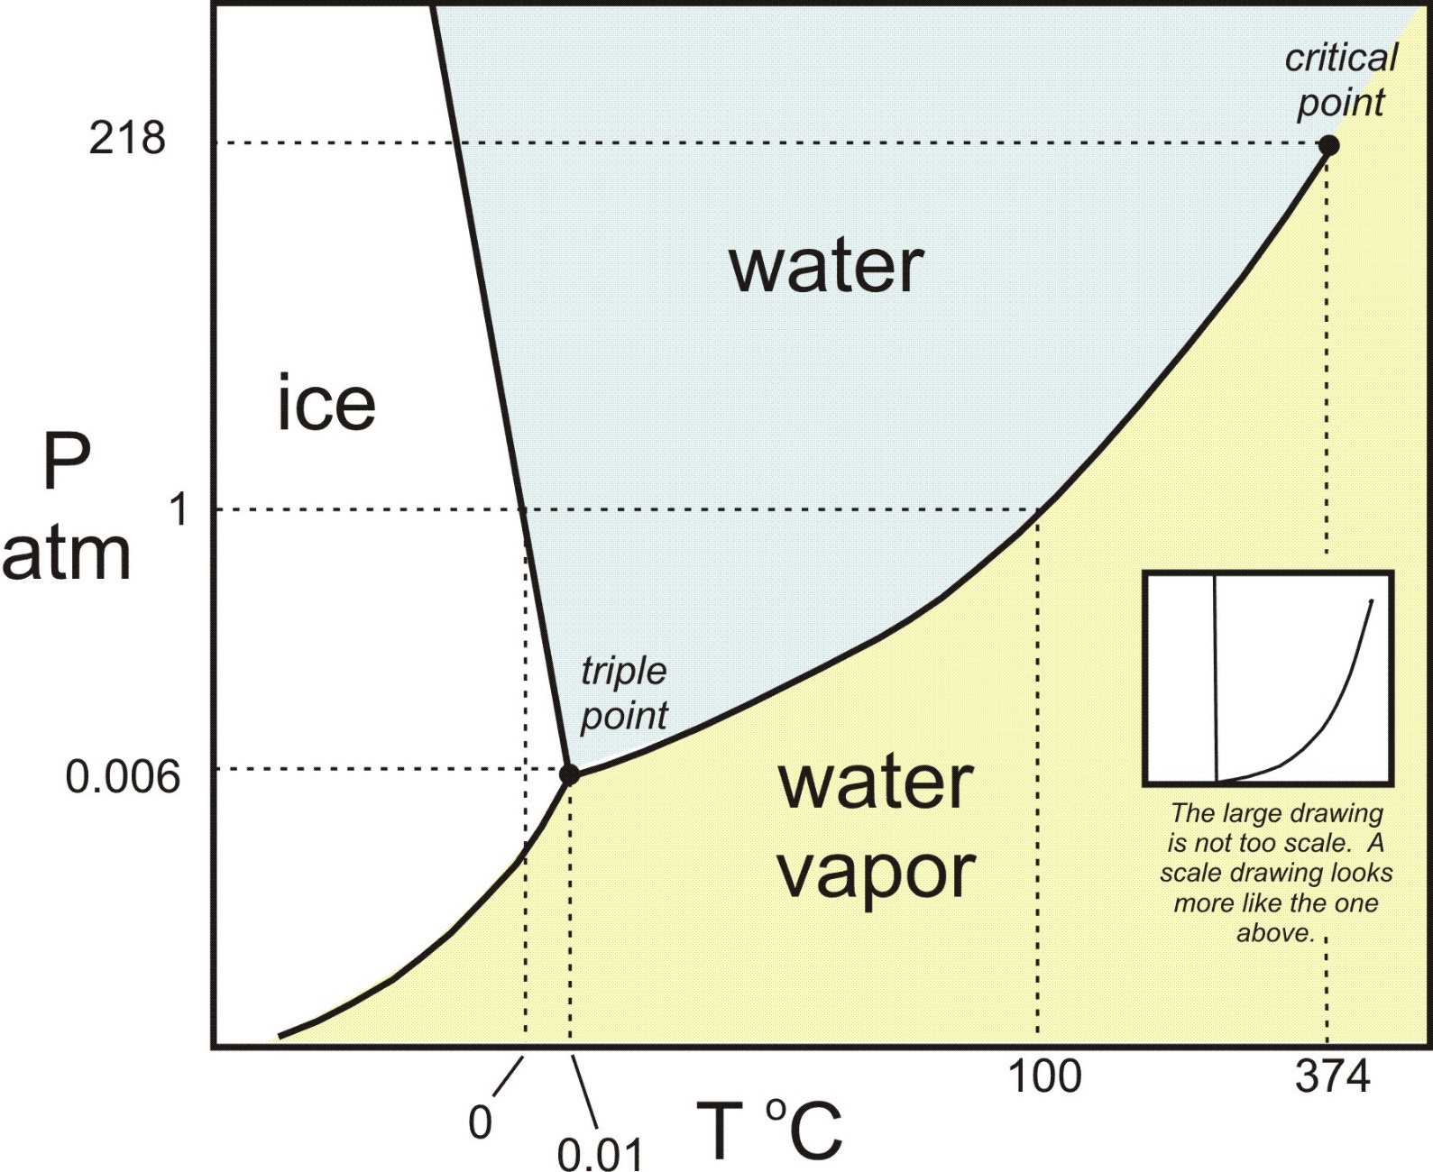
Phase Diagrams
A graph representing the phases of a substance at a given temperature and pressure

Slide 40
Phase Diagrams
Triple point-
The point (temp and pressure) where solid, liquid and gas can coexist simultaneously.

Slide 41
Phase Diagrams
Critical point- Above this point, gas and liquid have the same densities and have odd combinations of properties and cannot be distinguished from each other

Slide 42
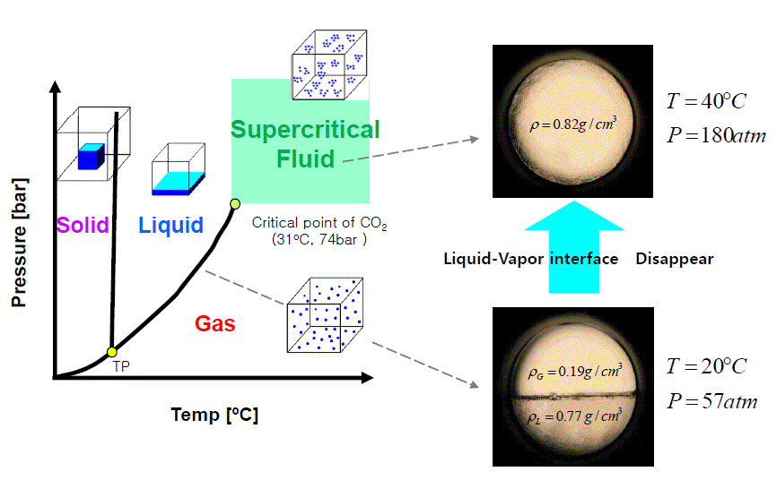
Supercritical Fluids!

Slide 43
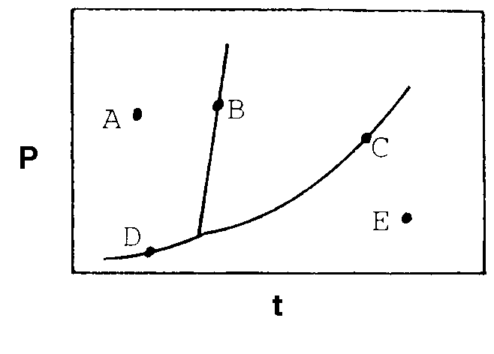
A typical phase diagram for a substance is given below. At what point on the diagram do solid and liquid exist at equilibrium?
A
SOLID
LIQUID
B
C
GAS
D
E

Slide 44
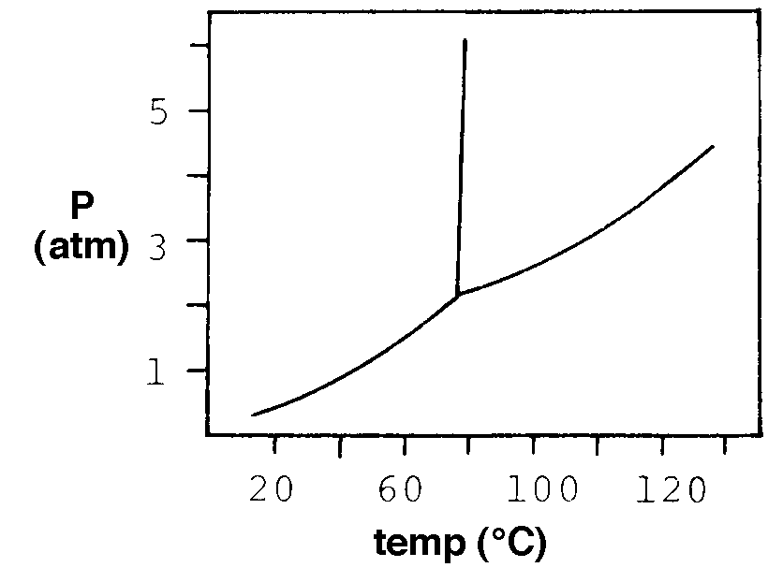
The phase diagram of a substance is given below. What occurs when the substance is heated from 100° C to 120 °C at 3 atm pressure?
LIQUID
It melts
SOLID
It sublimes
It vaporizes
GAS
It freezes
No phase change occurs

Slide 45
“Mixed Phase Calorimetry”
When you have a mixture
of solids, liquids, gases

Slide 46


Think About It
What happens when (in terms of heat) when you add ice to your water bottle?
Ice is absorbing, water is releasing energy…
+
We can still calculate Q!

Slide 47
Mixtures of Solids and Liquids
The Problem: We are going to do problems that involve a phase change AND heating. Something like you drop ice into water, what temperature will the mixture be at the end?
To solve this, think about this:
As ice melts, the temperature does not change
BUT as soon as the ice melts the temp will rise
We are still using
Q_{ice}=-Q_{water}

Slide 48
These can get tricky…
What if you have ice at -10°C and water at 50°C?
Have to heat ice AND melt it AND heat it up a bit
And also cool water down
Still have to do Q_{ice} = - Q_{water} but this time…
(mC∆T + mL + mC∆T ) = -mC∆T
Heat ice melt ice heat cold liq. cool warm liq.

Slide 49
Practice Problem
Let’s do problem #16 from
WS #7 together

Slide 50
Determine the final temperature when 18.0 g of ice at -10.0°C mixes with 275.0 grams of water at 60.0°C
Cold
Q
Cold water heats up
1
Heat ice
100
2
Melt ice
T_{final} of the mixture
Hot water
cools down
3
Heat liquid
- Q
Warm
0
Q = -Q
Cold Warm
3
Cool liquid

Slide 51
Determine the final temperature when 18.0 g of ice at -10.0°C mixes with 275.0 grams of water at 60.0°C
Qcold = -Qwarm
Cold
Cold
1
Heat ice
Q₁ =
mC∆T =
(18g)
(2.09J/gC)
(0° 10°) =
376.2 J
2
Melt ice
Q₂ =
mL =
(18g)
(334 J/g) =
6012 J
Q₃ =
mC∆T =
(18g)
(4.18J/gC)
(Tf° - 0°) =
75.24Tf
3
Heat liquid
Q_{cold} =
Q₁ +
Q₂ +
Q₃
= 6388.2 + 75.24Tf
Warm
Warm
3
Cool liquid
Q₃ =
mC∆T =
(275g)
(4.18 J/gC)
(Tf° - 60°) =
1149.5 – 68970Tf

Slide 52
Determine the final temperature when 18.0 g of ice at -10.0°C mixes with 275.0 grams of water at 60.0°C
Qcold = -Qwarm
Qcold = - Qwarm
I personally like to do this because I don’t see as many algebra mistakes or double negative issues!
Qcold + Qwarm = 0
6388.2 + 75.24Tf +
1149.5 – 68970Tf = 0
1224.74 Tf = 62581.8
Tf = 51.1 °C
1224.74 1224.74
Make sure your ending temperature is actually between the starting temps!

Slide 54
YouTube Link to Presentation
https://youtu.be/A7z5ixKMBQs

