Slide 1
N38 - Odds and Ends
Molar heat capacities to calculate changes in heat energy with moles instead of grams.
Heat change during a chemical reaction
Label reaction diagrams.
Interpret phase diagrams.
Calorimetry for solid and liquid mixtures.

Slide 2
Molar Heat Capacity
Energy required to raise the temperature of one MOLE of a substance one degree
Q = nCΔT
*If you make sure your units cancel, this is easy!!

Slide 3
Molar Heat Capacity
A sample of barium chloride is increased in temperature by 3.8˚C when the sample absorbed 2.4x10² J of heat energy. Calculate the number of moles of barium chloride if its molar heat capacity is 75.1 J/K•mol.
Q = nCΔT
Do we care that it is in moles and Kelvins? No!
Does that change the concept of “plug and chug” and “cancel units” ? No!
2.4 x 10² J = n (75.1$\frac{J}{K•mol}$ )(3.8 K)
n = 0.84 mol

Slide 4
Heat of Reactions
Amount of energy involved in a reaction
2Al + Fe₂O₃ → 2Fe + Al₂O₃ ΔH_{rxn}=−851.5kJ
( Remember, ∆H is basically Q)
∆H negative → exothermic → product
∆H positive → endothermic → reactant

Slide 5
Heat of Reactions per mole
Sometimes you want it per mole of a certain substance. Just take mole ratios into account!
2Al + Fe₂O₃ → 2Fe + Al₂O₃ ΔH_{rxn} = −851.5kJ/mol_{rxn}
-851.5kJ | 1 rxn | = | -425.75 kJ .
1 rxn | 2 mol Al |  | mol Al

Slide 6
Example Question
Calculate the energy released when 135g of aluminum is reacted in the below equation.
2Al + Fe₂O₃ → 2Fe + Al₂O₃ ΔH_{rxn}=−851.5kJ/mol_{rxn}
135 g Al | 1 mol Al | 1 rxn | -851.5 kJ | = | -2130.3 kJ
 | 26.98g Al | 2 mol Al | 1 rxn

Slide 7
Example Question
Calculate the energy released when 135g of aluminum is reacted in the below equation.
2Al + Fe₂O₃ → 2Fe + Al₂O₃ ΔH_{rxn}=−851.5kJ
135 g Al | 1 mol Al | 1 rxn | -851.5 kJ | = | -2130.3 kJ
 | 26.98g Al | 2 mol Al | 1 rxn

Slide 8
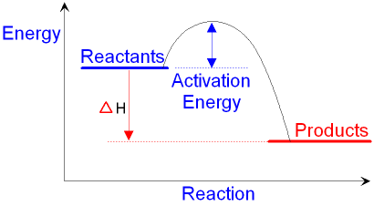
Reaction Diagrams
A graph representing energy changes during the course of a reaction
ΔQ
*Is this reaction endo or exothermic? How do you know???

Slide 9
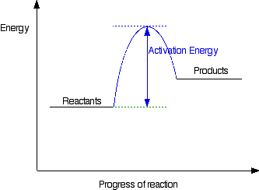
Reaction Diagrams
Draw and label an ENDOTHERMIC reaction diagram.
ΔH

Slide 10
But what is “Activation Energy?”
Activation energy: the smallest amount of energy required for molecules to be “activated” in order to undergo a specific chemical change
Speed them up to hit hard enough
Proper orientation to collide in the right spot
ΔH

Slide 11
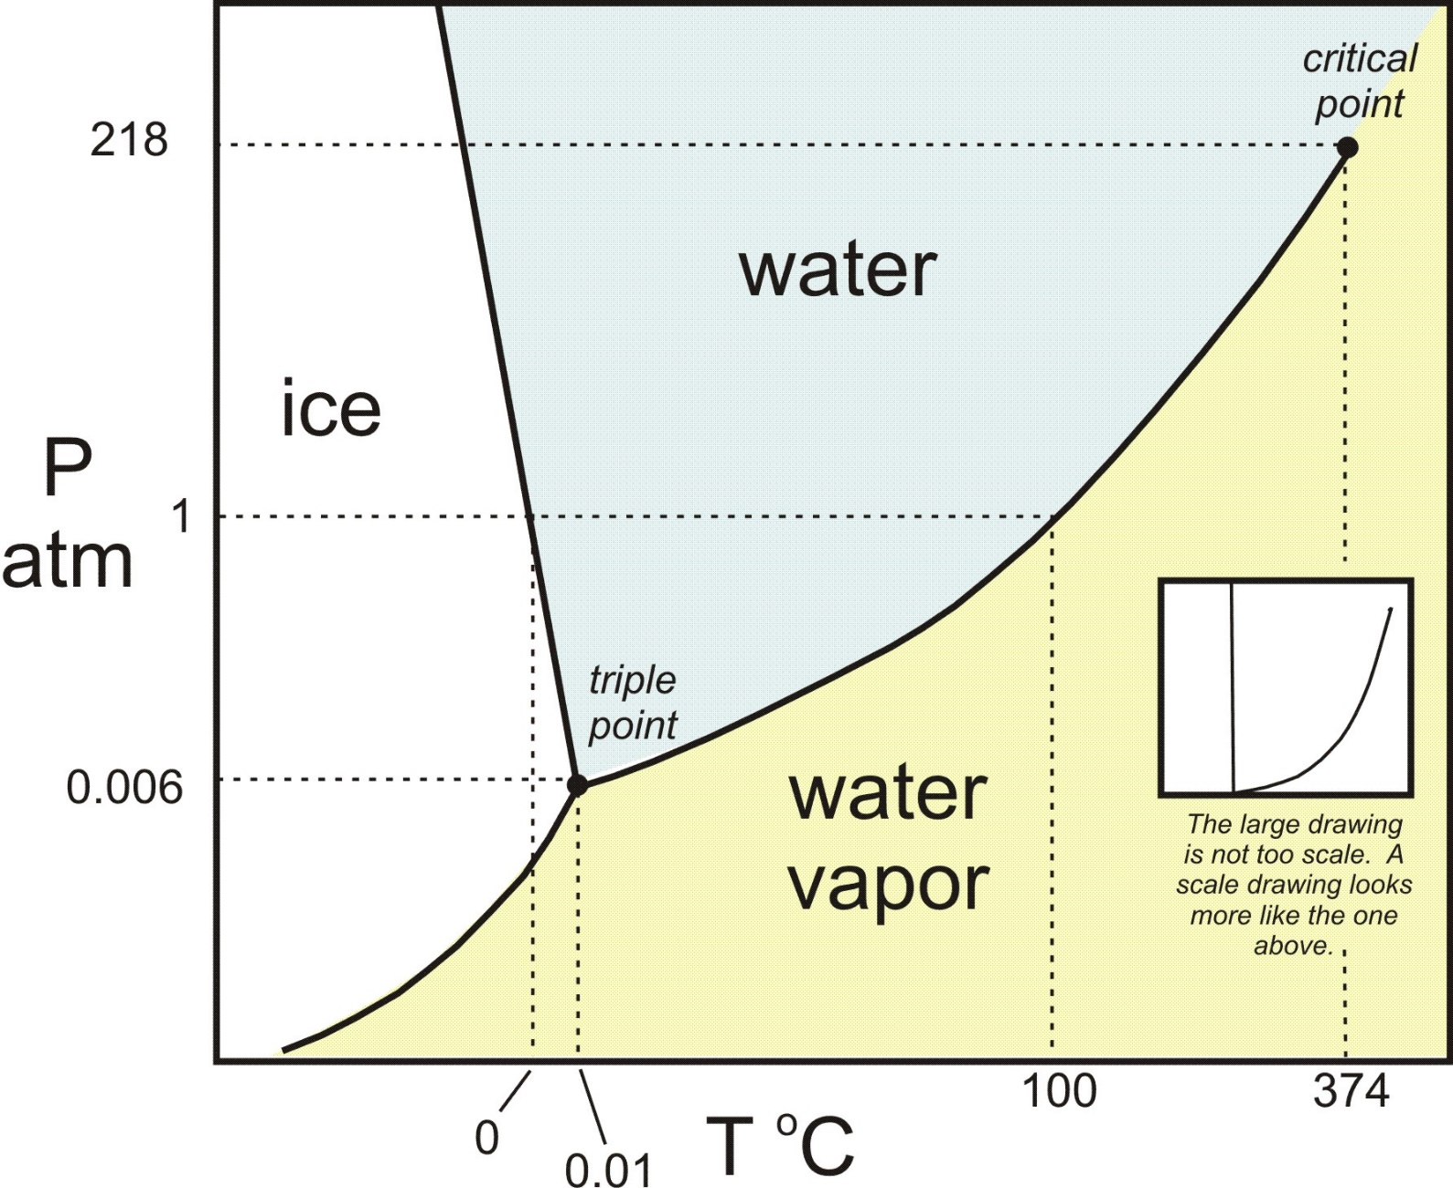
Phase Diagrams
A graph representing the phases of a substance at a given temperature and pressure

Slide 12
Phase Diagrams
Triple point-
The point (temp and pressure) where solid, liquid and gas can coexist simultaneously.

Slide 13
Phase Diagrams
Critical point- Above this point, gas and liquid have the same densities and have odd combinations of properties and cannot be distinguished from each other

Slide 14
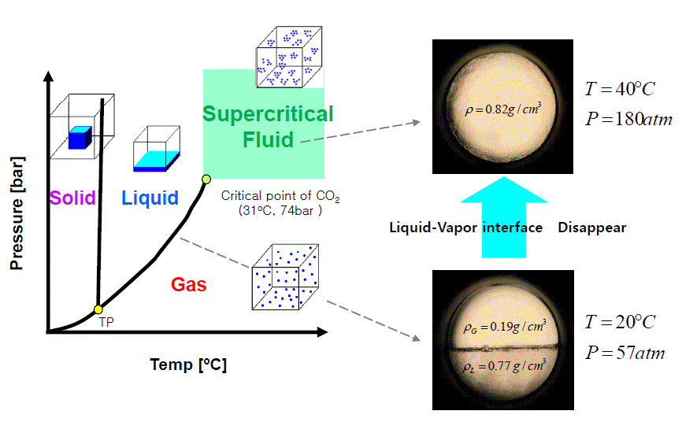
Supercritical Fluids!

Slide 15
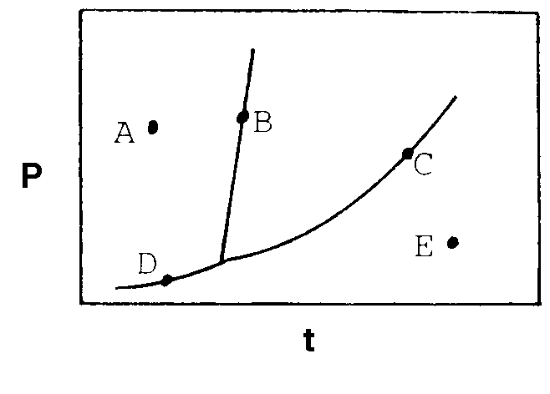
A typical phase diagram for a substance is given below. At what point on the diagram do solid and liquid exist at equilibrium?
A
SOLID
LIQUID
B
C
GAS
D
E

Slide 16
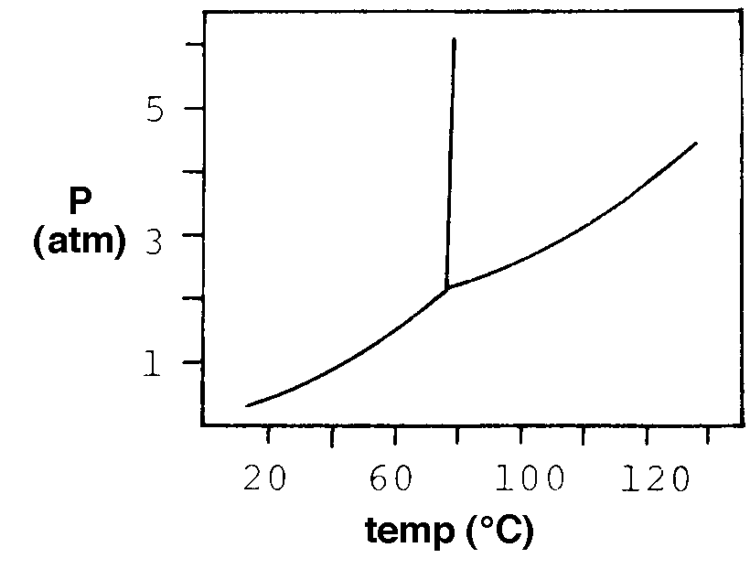
The phase diagram of a substance is given below. What occurs when the substance is heated from 100° C to 120 °C at 3 atm pressure?
LIQUID
It melts
SOLID
It sublimes
It vaporizes
GAS
It freezes
No phase change occurs

Slide 17
“Mixed Phase Calorimetry”
When you have a mixture of solids, liquids, gases

Slide 18
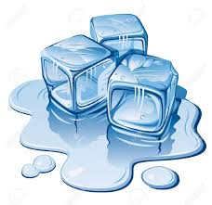
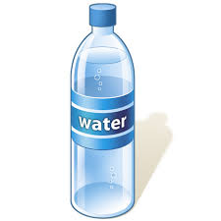
Think About It
What happens when (in terms of heat) when you add ice to your water bottle?
Ice is absorbing, water is releasing energy…
+
We can still calculate Q!

Slide 19
Mixtures of Solids and Liquids
The Problem: We are going to do problems that involve a phase change AND heating. Something like you drop ice into water, what temperature will the mixture be at the end?
To solve this, think about this:
As ice melts, the temperature does not change
BUT as soon as the ice melts the temp will rise
We are still using
Q_{ice}=-Q_{water}

Slide 20
These can get tricky…
What if you have ice at -10°C and water at 50°C?
Have to heat ice AND melt it AND heat it up a bit And also cool water down
Still have to do Q_{ice} = - Q_{water} but this time…
(mC∆T + mL + mC∆T ) = -mC∆T Heat ice melt ice heat cold liq. cool warm liq.

Slide 21
Practice Problem
Let’s do problem #16 from WS #7 together

Slide 22
Determine the final temperature when 18.0 g of ice at -10.0°C mixes with 275.0 grams of water at 60.0°C
Cold
Q
Cold water heats up
1
Heat ice
100
2
Melt ice
T_{final} of the mixture
Hot water cools down
3
Heat liquid
- Q
Warm
0
Q = -Q
Cold Warm
3
Cool liquid

Slide 23
Determine the final temperature when 18.0 g of ice at -10.0°C mixes with 275.0 grams of water at 60.0°C
Qcold = -Qwarm
Cold
Cold
1
Heat ice
Q₁ =
mC∆T =
(18g)
(2.09J/gC)
(0° 10°) =
376.2 J
2
Melt ice
Q₂ =
mL =
(18g)
(334 J/g) =
6012 J
Q₃ =
mC∆T =
(18g)
(4.18J/gC)
(Tf° - 0°) =
75.24Tf
3
Heat liquid
Q_{cold} =
Q₁ +
Q₂ +
Q₃
= 6388.2 + 75.24Tf
Warm
Warm
3
Cool liquid
Q₃ =
mC∆T =
(275g)
(4.18 J/gC)
(Tf° - 60°) =
1149.5 – 68970Tf

Slide 24
Determine the final temperature when 18.0 g of ice at -10.0°C mixes with 275.0 grams of water at 60.0°C
Qcold = -Qwarm
Qcold = - Qwarm
I personally like to do this because I don’t see as many algebra mistakes or double negative issues!
Qcold + Qwarm = 0
6388.2 + 75.24Tf +
1149.5 – 68970Tf = 0
1224.74 Tf = 62581.8
Tf = 51.1 °C
1224.74 1224.74
Make sure your ending temperature is actually between the starting temps!

Slide 26
YouTube Link to Presentation
https://youtu.be/A7z5ixKMBQs

