Slide 1
N-39 - Properties of Solutions
Target: I can use vocabulary related to solutions, and can describe some properties/behaviors of solutions.
Link to YouTube Presentation: https://youtu.be/rbui4x_CyvA

Slide 2
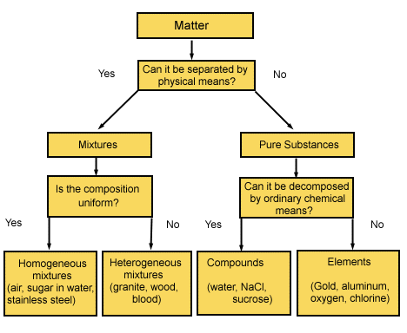
Classification
of Matter
Solutions are homogeneous mixtures

Slide 3
Solute
A solute is the substance that is being dissolved in a solution.
Salt in salt water
Sugar in soda drinks
Carbon dioxide in soda drinks
Solvent
A solvent is the thing that something is being dissolved into.
Water in salt water
Water in soda

Slide 4
Solution
The solute + solvent combined is then called the “solution”
Salt water
Soda

Slide 5
Types of Solutions
Solution Phase | Solute Phase | Solvent Phase | Example
Gaseous Solutions | Gas Liquid Solid* | Gas Gas Gas* | Air (mostly N₂ and O₂) Humid air (H₂O droplets in air) Moth balls*
Liquid solutions | Gas Liquid Solid | Liquid Liquid Liquid | Soda (CO₂ in H₂O) Rubbing Alcohol (alcohol in H₂O) Seawater (NaCl in H₂O)
Solid solutions | Gas* Liquid Solid | Solid* Solid Solid | Gas Stove Lighter (H₂ and Pd)* Dental fillings and other Amalgams Brass Alloy (Zn in Cu)
Combinations in italics and with a * are rare, very few “normal” examples. Most charts leave them off because there are so few examples – they are still possible, just rare

Slide 6
Colloids…not really solutions… tricky…
When “large” particles are suspended in a substance (5 – 200 nm is considered “big”)
Fat molecules suspended in milk, whipped cream, butter, mayo
Air bubbles suspended in foam rubbers
Color particles suspended in glass, paint, cosmetics,
Fog, smoke, clouds, aerosols

Slide 7
Dissolve
When molecules of solute are surrounded by molecules of solvent and are pulled apart from other solute molecules
Dissociate
When an ionic compound has it’s ionic bond disrupted by solvent molecules and breaks into its individual ions

Slide 8
Electrolytes:
Ionic solutes that dissociate (come apart) into ions in a solution
NaCl_{(s)} → Na⁺_{(aq)} + Cl⁻_{(aq)}
They can conduct electricity because there are charged particles for the electrons to move between!

Slide 9
Non-Electrolytes:
Covalent solutes that do not dissociate, but that can still potentially dissolve in a solvent
C₆H₁₂O₆(s) → C₆H₁₂O₆(aq)

Slide 10
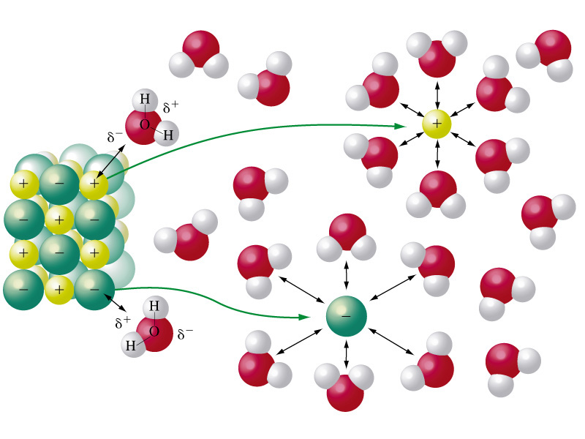
Which is dissolving and which is dissociating?
Dissociating
Dissolving

Slide 11
Dissolving Process
Heat of Solution
Can either be exothermic or endothermic
“Like Dissolves Like”
Polar things dissolve in polar things,
Non-polar things dissolve in non-polar things

Slide 12
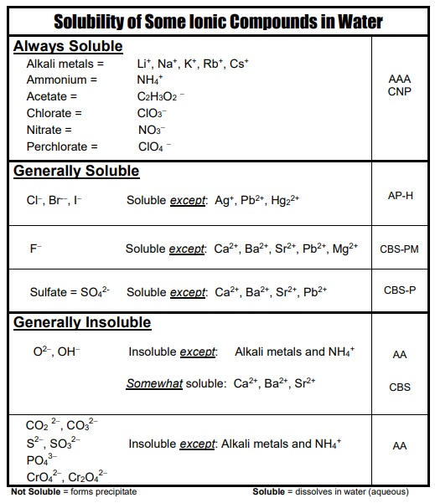
Solubility Chart
How do you know which substances will dissolve (be soluble)?
Use the chart!
MEMORIZE THE ALWAYS SOLUBLE ONES!

Slide 13
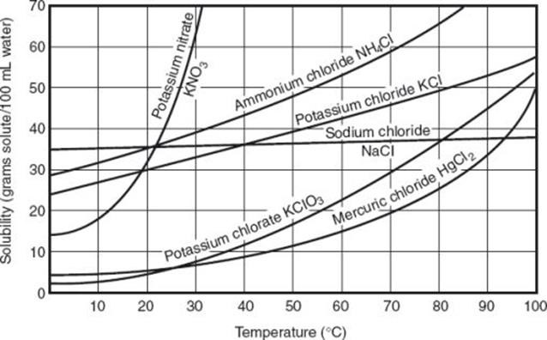
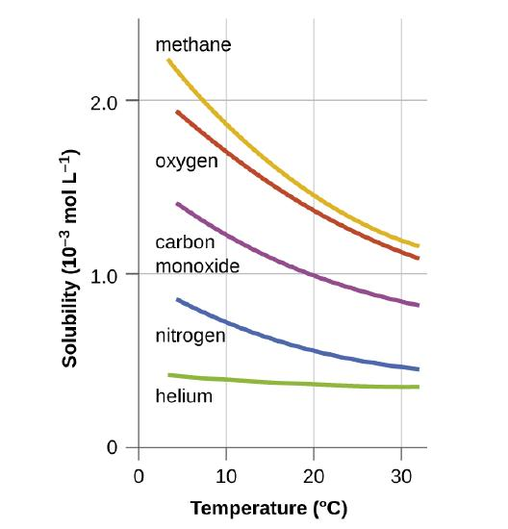
Solubility
The amount of solute that can be dissolved at a given temperature.
You can’t just dissolve infinite amounts of solute!
Solubility Curves

Slide 14
Changes to Solubility
Temperature and Pressure can affect the amount of solute that can be dissolved. Gases and solids are affected differently sometimes.
(most) Solids
Gases
Gases

Slide 15
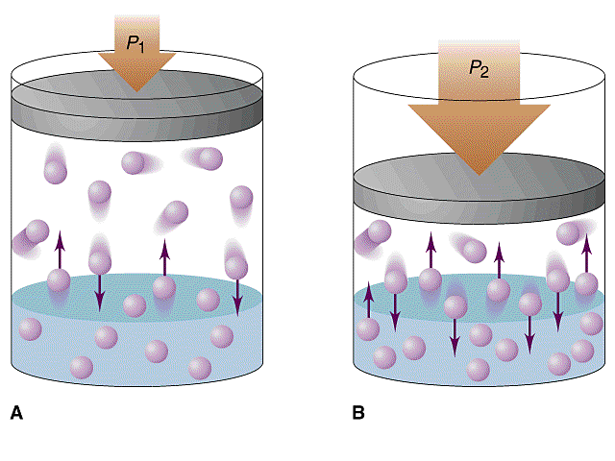
Increasing Rate of Dissolution (how FAST something dissolves)
Solids
Increase temperature for more collisions
Stir it to expose more surface area
Crush it up so more surface area
Gases
Decrease temperature
Increase pressure

Slide 16
Saturation
Saturated solution: The maximum amount of solute dissolved
Unsaturated solution: Less than the maximum amount of solute dissolved
Supersaturated solution: More than the maximum amount of solute dissolved http://www.youtube.com/watch?v=0wifFbGDv4I

Slide 17
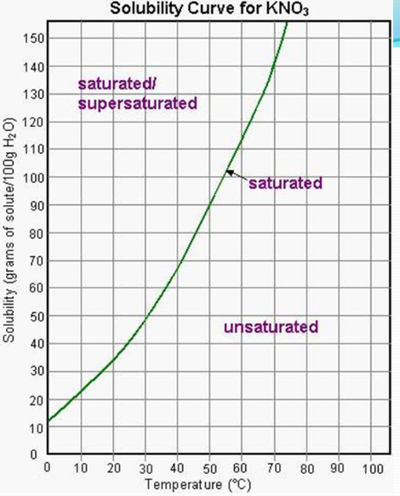
Saturation
Can identify saturation points
using a solubility
curve.

Slide 18
YouTube Link to Presentation:
https://youtu.be/rbui4x_CyvA

