Slide 1
N-40 – Solution Calculations
Target: I can perform calculations to determine various things such as the concentration of a solution.
Link to YouTube Presentation: https://youtu.be/A80wcIy9VVk

Slide 2
Calculations
Lots of different formats for our answers, sometimes certain units are more helpful than others. Some branches of chemistry have a tendency to use one unit more than another.

Slide 3
Assumptions to make…
UNLESS TOLD OTHERWISE…
Assume your solvent is water…it is the “Universal Solvent”
Assume the density of your solution is the same as water (1mL = 1g)
UNLESS TOLD OTHERWISE…

Slide 4
REMEMBER!!!!!!!!!! SOLUTION = SOLUTE + SOLVENT

Slide 5
Mass Percent or Percent Composition
Ratio of masses expressed as a %

Slide 6
Parts per Million - ppm
Ratio of masses but not expressed as a %, but rather out of one million – used when very low levels are significant like for pollution.
$$ppm= \left(\frac{mass of solute}{mass of solution}\right) x 1,000,000$$

Slide 7
Grams/Liter
Ratio of mass of solute to volume of solution. Easy for when measuring a solid solute dissolved in a liquid. Used to test solubility. “Quick and dirty” unit.
$$Grams per Liter= \left(\frac{mass of solute}{Volume of solution}\right)$$

Slide 8
Mole Fraction
Ratio of moles of solute n_{A} , to moles of total solution (solute n_{A} + solvent n_{B})

Slide 9
Molarity – the best one! ☺
Ratio of moles of solute to liters of solution. Similar to grams/L but converting it to moles lets us perform chemistry calculations better. Always trying to get to moles anyway!

Slide 10
Practice #1
734 grams of lithium sulfate are dissolved to make 2500 mL of solution. What is the Molarity?
Convert 734 grams of Li₂SO₄ in moles.
734g Li₂SO₄
1 mol Li₂SO₄
= 6.68 mol Li₂SO₄
109.962 g Li₂SO₄
$$M= \frac{Moles of solute}{Liters of solution }= \frac{6.68 mol}{2.500 Liters}=2.67 M$$

Slide 11
Practice #2
6.7 x 10⁻² grams of Pb(C₂H₃O₂)₄ are dissolved to make 3.5 mL of solution. What is the concentration?
When not told what unit to use, assume molarity!
6.7 x 10⁻² g Pb(C₂H₃O₂)₄
1 mol Pb(C₂H₃O₂)₄
= 1.51 x 10⁻⁴ mol Pb(C₂H₃O₂)₄
443.2 g Pb(C₂H₃O₂)₄
$$M=\frac{Moles of solute}{Liters of solution }=\frac{1.51 x {10}^{−4}mol}{0.0035 Liters}$$
$=0.0432 M$

Slide 12
Making Dilutions
When you take one more concentrated solution and take a small amount of it and dilute it down by adding more solvent.
$$M1V1=M2V2$$

Slide 13
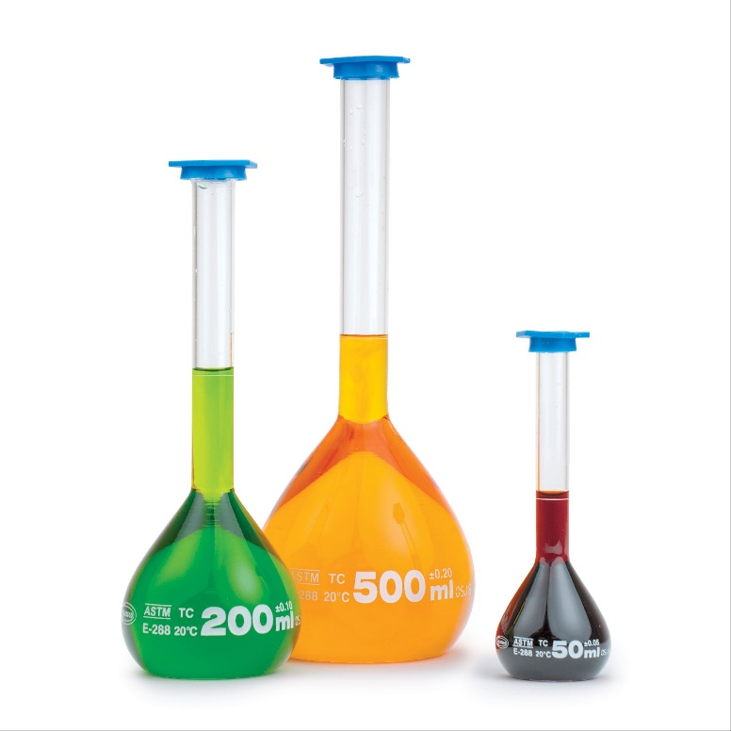
Volumetric Flasks
Very accurate marking for a specific volume. You can fill the flask with your strong V1 amount and then fill to the line to get the desired solution volume.

Slide 14
Volumetric Flasks
Add solute to a beaker.
Add a small amount of distilled water to dissolve the solute.
Pour into the volumetric flask.
Add distilled water until you get to the etched line. Make sure to read it from the bottom of the meniscus!
Swirl/invert the flask so it mixes well.

Slide 15
Practice #1
How much of a 2.3 M solution do you have to use in order to make 750mL of a 0.6 M solution?
$$\left(2.3M\right)\left(V1\right)=\left(0.6M\right)\left(750mL\right)$$
$$V1=195.65 mL of the \\ 2.3M solution is needed$$
How much water did you add???
Extra H₂O
750-195.65 = 554.35mL H₂O
750mL of 0.6 M SOLUTION
2.3M
195.65mL of the STRONGER STUFF
2.3M

Slide 16
YouTube Link to Presentation
https://youtu.be/A80wcIy9VVk

