Slide 1
N-41 Intro to Kinetics, Rate Expressions, and Average Rate
Target: I can describe factors that change the speed of a reaction, and can do calculations to find the average rate of a reaction.
Link to YouTube Presentation: https://youtu.be/sihC6aDsy3s

Slide 2
Thermo vs. Kinetics
Thermo
Energy (heat)
Q: is there enough energy for a reaction to happen? Is it GOING to happen?
YES NO
Kinetics
Speed
Q: Assuming the reaction does happen - How FAST is the reaction going to happen?
FAST SLOW

Slide 3
Does the reaction happen?
YES (Thermo) NO
FAST (Kinetics) SLOW

Slide 4
SLOW = DOESN’T HAPPEN

Slide 5
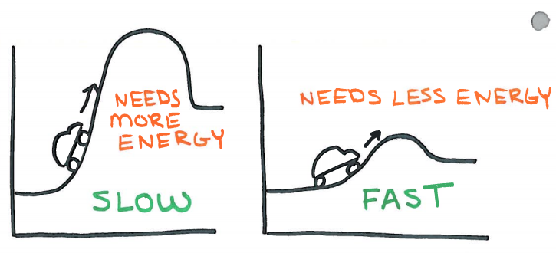
This is where THERMO turns into KINETICS

Slide 6
This is where THERMO turns into KINETICS

Slide 7
Collision theory
Reactants must collide in order to react
Activation energy
Minimum amount of energy colliding particles need in order to react.
EFFECTIVE Collisions have to be...
Fast Enough AND Correct Orientation

Slide 8
Factors of Reaction Rate
Temperature
Concentration/Pressure
Surface area
Catalysts
(Typically) Increase any of these, you get more effective collisions… so it goes faster!

Slide 9
Maxwell-Boltzmann Distribution for ∆Temp

Slide 10
Catalysts
What is it? - A chemical that you add to rxn
- Does NOT get used up during reaction
- Helps orient molecules to reach transition state easier OR provides an alternate pathway/mechanism/set of steps for it to occur
- So you do not need as much energy
- Lowers Activation Energy
= faster reaction BECAUSE more molecules will have the needed energy to get over Ea
You don’t get “more” collisions – you just get more collisions that will be EFFECTIVE!

Slide 11
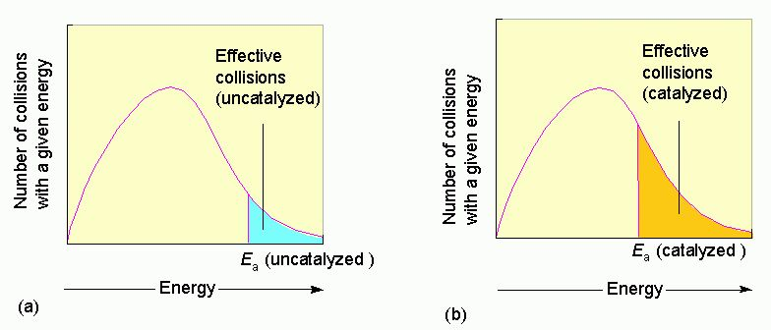
Maxwell-Boltzman Distribution for Catalyst

Slide 12
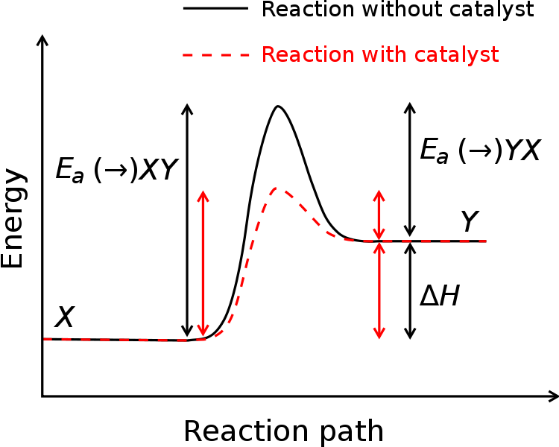
Ea
Ea

Slide 13
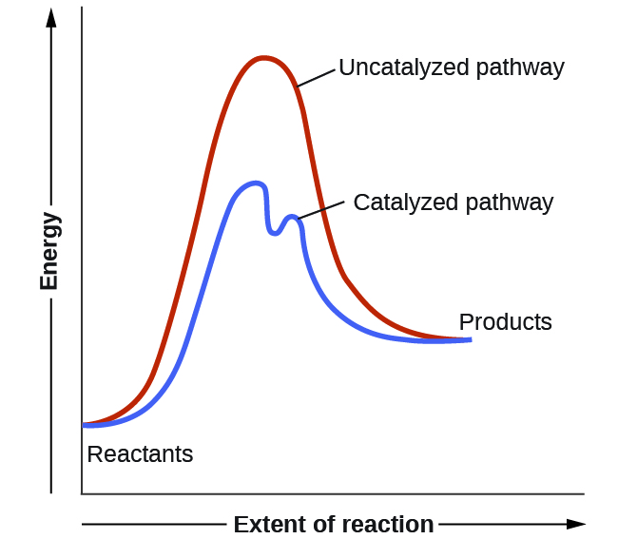

Slide 14
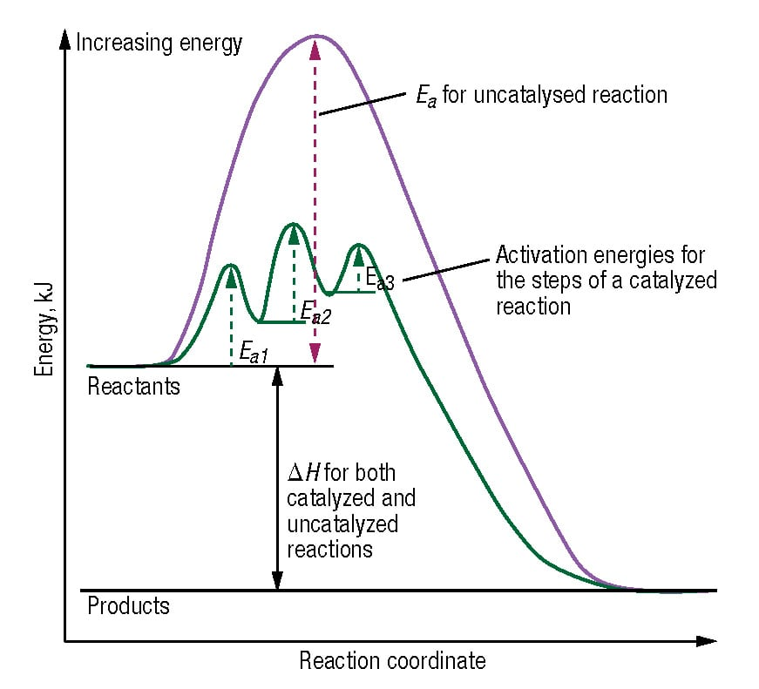

Slide 16
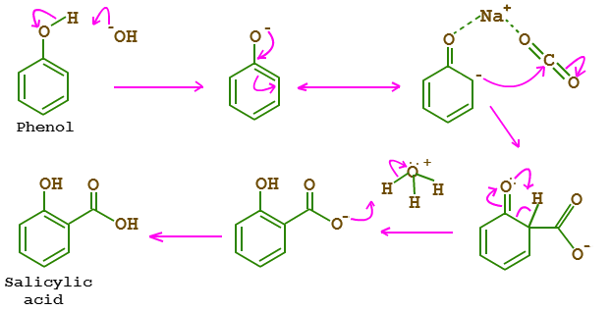
Reaction Mechanism
A normal balanced chemical equation does not tell us HOW reactants become products; just a summary of the overall process.
The reaction mechanism is the series of steps by which a chemical reaction occurs.
Some reactions take place in one step, two steps, three steps etc.

Slide 17
Reaction Mechanism
A normal balanced chemical equation does not tell us HOW reactants become products; just a summary of the overall process.
The reaction mechanism is the series of steps by which a chemical reaction occurs.
Some reactions take place in one step, two steps, three steps etc.

Slide 18
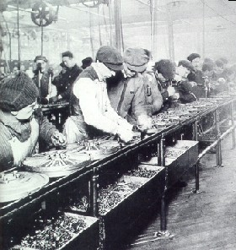
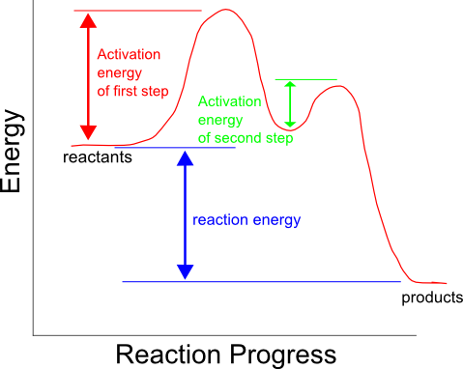
Rate Determining Step
In a multi-step reaction, the slowest step is the rate-determining step. It determines the rate of reaction.
Can only go as fast as your slowest step!

Slide 19
Reaction Rates
Where | Units | Equation | Issue
Car
Kinetics
Miles Hour
Δ Distance
Δ Time
SPEED
Molarity M .
second sec
∆ Concentration
∆ Time
SPEED
Using up reactants = decrease in # molecules = NEGATIVE rate
Making more products = increase in # molecules = POSTIVE rate

Slide 20
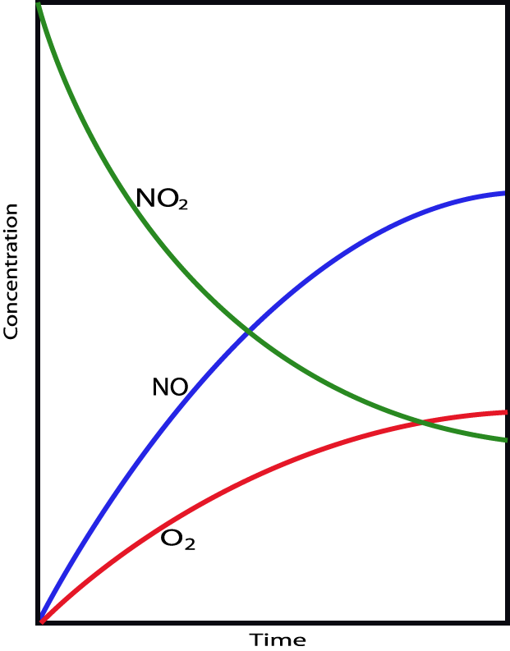
2NO₂(g) → 2NO(g) + O₂(g)
Reaction Rates
1) Can measure disappearance of reactants (NO₂)
2) Can measure appearance of
products (NO and O₂)
3) Are proportional
stoichiometrically
Have to take coefficients into account! We make twice as much NO as O₂ ever second

Slide 21
Average Rate
Rate is not always constant!
Can start fast and slow down, or start slow and speed up
Sometimes it is sufficient to just calculate the average rate over a given time period

Slide 22
Average Rate
In an experiment, the concentration of substance D was measured at different times. Determine the average rate between 0.0 and 7.0 sec.
Rate = (0.290-0.500) (7.0 – 0.0)
Rate = -0.0300 M/s
Is “D” a reactant or a product?
Reactant! Rate is negative!
Time , (s) | [D] , (M)
0 | 0.500
3.0 | 0.370
7.0 | 0.290
Weird thing… Sometimes we will say “What is the rate of disappearance” and then we don’t have to write the negative sign! We like that sometimes because of math reasons. Example: The rate of disappearance is 0.0300 M/s

Slide 23
Average Rate
In an experiment, the concentration of substance D was measured at different times. Determine the average rate between 3.0 and 7.0 sec.
Rate = (0.290 – 0.370) (7.0 – 3.0)
Rate = -0.0200 M/s
Is “D” a reactant or a product?
Reactant! Rate is negative!
Time , (s) | [D] , (M)
0 | 0.500
3.0 | 0.370
7.0 | 0.290
See! Rate is not constant over the course of the reaction!
That is why “average rate” is not always very helpful.

Slide 24
Pause here!
WS #3 – Q’s #1-16 can be done at this point

Slide 25
Reaction Rates and Stoichiometry
C₄H₉Cl + H₂O → C₄H₉OH + HCl
Ratio of C₄H₉Cl to C₄H₉OH is 1:1. For every mole of C₄H₉Cl lost, there was a mole of C₄H₉OH created.
Thus, the rate of disappearance of C₄H₉Cl is the same as the rate of appearance of C₄H₉OH. They are directly related.
-Δ[C₄H₉Cl]
Δt
Δ[C₄H₉OH]
Δt
Rate =
=

Slide 26
But…what if NOT a 1:1 ratio?!
H₂ + I₂ → 2 HI
For every 1 mole of H₂ that reacts, 2 moles of HI are made!
The rate of disappearance of H₂ is HALF the rate of appearance of HI.
Want to set them equal to each other? Divide the HI expression by 2
Always divide by your coefficients, don’t multiply!
Remember! Reactants are negative!
-Δ[H₂]
Δt
1 Δ[HI]
2 Δt
Rate =
=

Slide 27
Reaction Rates and Stoichiometry
N₂ + 3 H₂ → 2 NH₃
“Rate of Reaction”= -Δ[N₂] = -1 Δ[H₂] = 1 Δ[NH₃] Δt 3 Δt 2 Δt
Entire thing is the RATE EXPRESSION
REMEMBER! Reactants are negative, Products are positive. Your double negatives will work themselves out so the REACTION rate comes out positive. Its all semantics in kinetics!

Slide 28
Generic Rate Expression
aA + bB
cC + dD
Reactants decrease (Negative rates)
Products increase (Positive rates)

Slide 29
Practice Problem #1
Write the rate expression for the following Rxn: 2 N₂O → 2 N₂ + O₂
Rate = -1 Δ[N₂O] = 1 Δ[N₂] = Δ[O₂] 2 Δt 2 Δt Δt
The “Rate of Reaction” is
½ the rate of disappearance of N₂O
OR ½ the rate of appearance of N₂
OR the same as the rate of appearance of O₂

Slide 30
Practice Problem #1
GENERIC “REACTION RATE”
-1 Δ[N₂O] 2 Δt
1 Δ[N₂] 2 Δt
-1 Δ[N₂O] 2 Δt
1 Δ[N₂] 2 Δt
Rate = = = Δ[O₂] Δt
The disappearance of N₂O occurs at a rate of -3.25 x 10⁶ Ms⁻¹. What is the rate of N₂ appearance.
-1 [-3.25 x 10⁶Ms⁻¹] = 1 Δ[N₂] 2 2 Δt
$$THIS IS \frac{∆[N2O]}{∆t}$$
Rate N₂ = 3.25 x 10⁶ Ms⁻¹
SPECIFIC “RATE OF APPEARANCE OF N₂”
The “Reaction Rate” would be ½ the rate of appearance of N₂ = 1.63 x 10⁶ , or – ½ the rate of N₂O disappearance = 1.63 x 10⁶ also! See how that works out?

Slide 31
Practice Problem #1
-1 Δ[N₂O] 2 Δt
1 Δ[N₂] 2 Δt
-1 Δ[N₂O] 2 Δt
Δ[O₂] Δt
Δ[O₂] Δt
Rate = = =
The disappearance of N₂O occurs at a rate of -3.25 x 10⁶ Ms⁻¹. What is the rate of O₂ appearance.
-1 [-3.25 x 10⁶Ms⁻¹] = Δ[O₂] 2 Δt
$$THIS IS \frac{∆[N2O]}{∆t}$$
Rate O₂ = 1.63 x 10⁶ Ms⁻¹
The “Reaction Rate” would be the same as the rate of appearance of O₂ = 1.63 x 10⁶ , which was the same as the other two parts earlier! See how that works out?

Slide 32
Practice Problem #2
Write the rate expression for the following Rxn: 4Fe + 3O₂ → 2Fe₂O₃
Rate = - 1 Δ[Fe] = - 1 Δ[O₂] = 1 Δ[Fe₂O₃] 4 Δt 3 Δt 2 Δt

Slide 33
Practice Problem #2
Rate = - 1 Δ[Fe] = - 1 Δ[O₂] = 1 Δ[Fe₂O₃] 4 Δt 3 Δt 2 Δt
The appearance of Fe₂O₃ occurs at a rate of 7.05 x 10⁻² Ms⁻¹. What is the rate of O₂ and Fe disappearance.
1 [7.05x 10⁻²Ms⁻¹] = -1 Δ[O₂] 2 3 Δt
$$THIS IS \frac{∆[{Fe2O}_{3}]}{∆t}$$
Rate O₂ = - 0.106 Ms⁻¹
The “Reaction Rate” would be – ¹/₃ the rate of disappearance of O₂ = 3.53 x 10⁻², or ½ the rate of Fe₂O₃ appearance = 3.53 x 10⁻² also! See how that works out?

Slide 34
Practice Problem #2
Rate = - 1 Δ[Fe] = - 1 Δ[O₂] = 1 Δ[Fe₂O₃] 4 Δt 3 Δt 2 Δt
The appearance of Fe₂O₃ occurs at a rate of 7.05 x 10⁻² Ms⁻¹. What is the rate of O₂ and Fe disappearance.
1 [7.05x 10⁻²Ms⁻¹] = -1 Δ[Fe] 2 4 Δt
$$THIS IS \frac{∆[{Fe2O}_{3}]}{∆t}$$
Rate Fe = - 0.141 Ms⁻¹
The “Reaction Rate” would be – ¹/₄ the rate of disappearance of Fe = 3.53 x 10⁻², which was the same as the other two parts! See how that works out?

Slide 35
Practice Problem #3
Write the rate expression for the following Rxn: N₂ + 3 H₂ → 2NH₃
Rate = - Δ[N₂] = - 1 Δ[H₂] = 1 Δ[NH₃] Δt 3 Δt 2 Δt

Slide 36
Practice Problem #3
Rate = - Δ[N₂] = -1 Δ[H₂] = 1 Δ[NH₃] Δt 3 Δt 2 Δt
The rate of reaction is 1.70 x 10⁴ Ms⁻¹. What is the rate of disappearance of H₂ and the disappearance of N₂ ?
1.70 x 10⁴Ms⁻¹ = - 1 Δ[H₂] 3 Δt
Rate H₂ = - 5.1 x 10⁴ Ms⁻¹
“Rate of Reaction” can sometimes be given to you!
Sometimes you solve for it, sometimes you are solving for a appearance/disappearance rate, could be anything!

Slide 37
Practice Problem #3
Rate = - Δ[N₂] = -1 Δ[H₂] = 1 Δ[NH₃] Δt 3 Δt 2 Δt
The rate of reaction is 1.70 x 10⁴ Ms⁻¹. What is the rate of disappearance of H₂ and the disappearance of N₂ ?
1.70 x 10⁴Ms⁻¹ = -Δ[N₂] Δt
Rate N₂ = - 1.70 x 10⁴ Ms⁻¹

Slide 38
Link to YouTube Presentation
https://youtu.be/sihC6aDsy3s

