Slide 1
N44 Equilibrium Constant & Quotient
↔

Slide 2
N44 Equilibrium Constant & Quotient
↔
Target: I can mathematically determine if a reaction is at equilibrium or not.
Link to YouTube Presentation: https://youtu.be/stWybrjoM3w

Slide 3
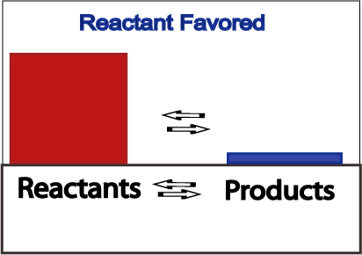
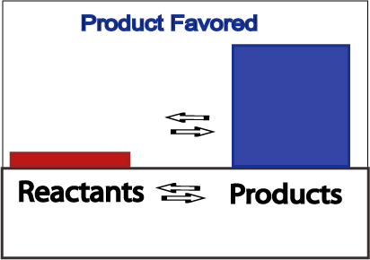
Product or reactant favored?
Once equilibrium is reached, you may have more products present, or you may have more reactants present.

Slide 4
Product Favored or Reactant Favored?
K_{eq} is a value (with no units) that allows us to determine if more products or reactants are being made. It is a ratio of products to reactants.
SIMPLIFIED VERSION FIRST: $K_{eq}= \frac{[Products]}{[Reactants]}$
K > 1 then more products!
K < 1 then more reactants!

Slide 5
Calculating K_{eq}
The “Law of Mass Action” will allow us to calculate K_{eq} – Ratio of Products over Reactants
$$aA+bB ↔cC+dD$$
$$K_{eq}= \frac{{[C]}^{c}{[D]}^{d}}{{[A]}^{a}{[B]}^{b}}$$
* Remember how solids and liquids don’t factor into equilibrium? They don’t have true concentrations so there is nowhere to plug them into this equation is there!
Still simplified, there is an additional part that we wont use that helps “fix” the units so Keq can have no units. Don’t worry about it!

Slide 6
Practice Problem:
Write the equilibrium expression for the reaction: 2NO_{2(g)} ↔2NO_{(g)} + O_{2(g)}
$$K_{eq}= \frac{{[NO]}^{2}{[O2]}^{1}}{{[NO2]}^{2}}$$
$$K_{eq}= \frac{{[C]}^{c}{[D]}^{d}}{{[A]}^{a}{[B]}^{b}}$$
Equilibrium expression is the same thing as the Law of Mass Action! ☺

Slide 7
Assume forward reaction…but what if asked for backwards Rxn?
Just flip it! Write K as K’ for backwards reaction. 2NO_{2(g)} ↔2NO_{(g)} + O_{2(g)}
$${K′}_{eq}= \frac{{{[NO2]}^{2}}^{}}{{[NO]}^{2}[O2]1}$$
$${K′}_{eq}= \frac{1}{Keq}$$
Don’t even bother writing the equation flipped! Just flip your Law of Mass Action!

Slide 8
What if I have pressures not [ ] ?
Just use partial pressures the same way you use concentrations!
$$aA+bB ↔cC+dD$$
$$K_{eq}= \frac{{(P_{C})}^{c}{(P_{D})}^{d}}{{(P_{A})}^{a}{(P_{B})}^{b}}$$

Slide 9
How can you tell if it is at equilibrium or not?
Calculate the values you have, and compare them to the K_{eq} value
Reaction Quotient is what it is called if it isn’t at equilibrium
$$aA+bB ↔cC+dD$$
$$Q=\frac{{[C]}^{c}{[D]}^{d}}{{[A]}^{a}{[B]}^{b}}$$

Slide 10
So what does q tell you?
K = Q then you are at equilibrium!
K < Q you have too many products!
SHIFT LEFT until you make enough reactants to get back to equilibrium
Reverse reaction will proceed faster until at equilibrium!
K > Q you have too many reactants!
SHIFT RIGHT until you make enough product to get back to equilibrium
Forward reaction will proceed faster until at equilibrium!

Slide 11
Why do we care about k_{eq} ?
Knowing K_{eq} allows you to solve for:
Which combos of [ ]s would reach an equilibrium position
Whether or not your given [ ]s are at an equilibrium point by comparing to Q
If you can compare K and Q then you can predict which way it needs to shift to reach equilibrium

Slide 12
Practice Problem
Given the equation X(g) ↔ Y(g) + 2 Z(g). At a particular temperature, K = 1.4 x 10³. If you mixed 1.2 mol Y, 0.070 mol Z, and 0.003 mol X in a 1-L container, in which direction would the reaction initially proceed?
$$Q=\frac{{{[Y]}^{1}[Z]}^{2}}{{[X]}^{1}}$$
$$Q=\frac{{{[1.2]}^{1}[0.070]}^{2}}{{[0.003]}^{1}}=1.96$$
$K=1.4 x 103$ $> Q=1.96$ Q is too small - Not enough products!
Shift to the RIGHT!

Slide 13
Things that change K_{eq}
These things DON’T CHANGE K_{eq}
Changing Concentrations
Changing Pressures
Adding Solids or Liquids
Adding Catalysts
These things DO CHANGE K_{eq}
Temperature

Slide 14
Equilibrium Constant versus “Equilibrium Point”
The constant, Keq, is the actual NUMBER you get from your Law of Mass Action.
ONE Keq PER TEMPERATURE!
The “Equilibrium Point” is the combination of SPECIFIC CONCENTRATIONS you plug in that get you the Keq number for that temperature.
LOTS of combinations that can get you Keq per temperature

Slide 15
Equilibrium Constant versus “Equilibrium Point”
$$\frac{2}{1}=2$$
K = 2
Lots of different “equilibrium points” will get you that same number!
$$\frac{4}{2}=2$$
$$\frac{100}{50}=2$$

Slide 16
Can it change anything?
Factor | Rate of Reaction | Rate Constant k | Equilibrium Point | Equilibrium Constant Keq
∆ [ ]
∆ Pressure
∆ Surface Area
∆ Amount of s/l
Inert Gas
Catalyst
Temperature

Slide 17
YouTube link to Presentation
https://youtu.be/stWybrjoM3w

