Slide 1
N-46 Acids, Bases, & pH Calculations
Target: I can define acids and bases in various ways, and can perform simple pH calculations.
YouTube Link to Presentation: https://youtu.be/RY1SB8vuxzI

Slide 2
PROPERTIES OF ACIDS AND BASES
ACIDS
Juices/Fruits
Tart, sour, sharp taste
They are electrolytes
Conduct electricity
React with Metals
Common as aqueous and liquids
BASES
Cleaning products
Bitter tasting
Slippery to the touch
Common as Solids

Slide 3
THREE DIFFERENT DEFINITIONS OF ACIDS/BASES
Arrhenius
Acids make H⁺ ions in aqueous solutions
Bases make OH⁻ ions in solution
Bronsted-Lowry
Acids donate protons
Bases accept protons
Lewis
Acids accept electron pairs
Bases donate electron pairs

Slide 4
THREE DIFFERENT DEFINITIONS OF ACIDS/BASES
Arrhenius
Acids make H⁺ ions in aqueous solutions
Bases make OH⁻ ions in solution
HNO₃ → H⁺ + NO₃⁻
KOH → K⁺ + OH⁻
Exactly what we are used to thinking of as acids and bases!

Slide 5
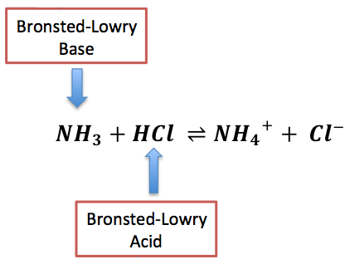
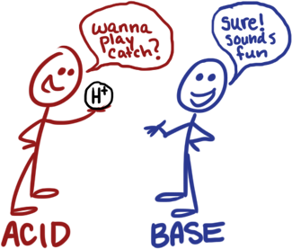
THREE DIFFERENT DEFINITIONS OF ACIDS/BASES
Bronsted-Lowry
Acids donate protons
Bases accept protons
More things count as bases than in Arrhenius model!

Slide 6
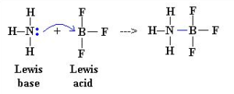
THREE DIFFERENT DEFINITIONS OF ACIDS/BASES
Lewis
Acids accept electron pairs
Bases donate electron pairs
More things count as acids and bases than either Arrhenius or Bronsted-Lowry

Slide 7
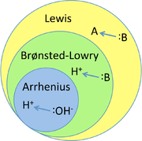
THREE DIFFERENT DEFINITIONS OF ACIDS/BASES
Arrhenius is MOST specific
Bronsted-Lowry is less specific
Lewis is LEAST specific

Slide 8
WEIRD FACT!
Water can act as an acid or a base!
NH₃ + H(OH) → NH₄⁺ + OH⁻
Water is donating a proton…
ACID!
HCl + H(OH) → H₃O⁺ + Cl⁻
Water is accepting a proton…
BASE!

Slide 9
WEIRD FACT!
Water can act as an acid or a base!
NH₃ + H(OH) → NH₄⁺ + OH⁻
Water is donating a proton…
ACID!
HCl + H(OH) → H₃O⁺ + Cl⁻
Water is accepting a proton…
BASE!
Amphoteric!
Greek amphoteros = “each of two”

Slide 10
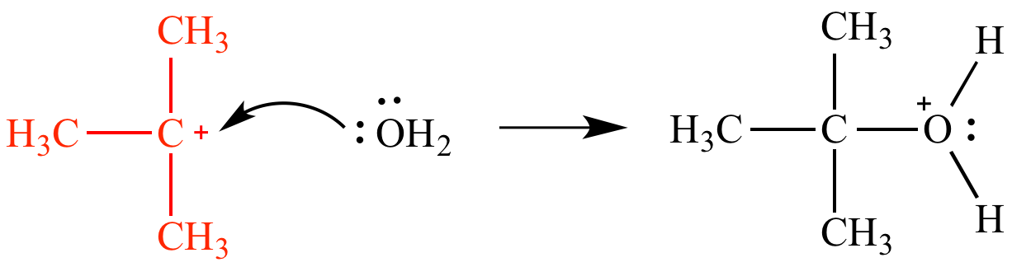
Which type of acid/base???
HBr
LiOH
Arrhenius Acid
Arrhenius Base
CO₃²⁻ + 2H⁺ → H₂CO₃
Bronsted-Lowry Base
C₆H₅OH + NH₂⁻ → C₆H₅O⁻ + NH₃
Lewis Acid
Lewis Base
Arrhenius Acid
B.L
Base

Slide 11
CONJUGATES
Acids turn into “Conjugate Bases” once they have lost their proton/hydrogen
Bases turn into “Conjugate Acids” once they have gained a proton/hydrogen

Slide 12
CONJUGATES
NH₃ + HBr → NH₄⁺ + Br⁻
Base
Acid
Conjugate Acid
Conjugate Base
Tips for Finding Each
- Find the Acid First – usually easiest!
- Find It’s Conjugate Base – the part left after donating its H+!
- Repeat with Base and Conjugate Acid

Slide 13
Identify A/B/CA/CB
HF + SO₃²⁻ → F⁻ + HSO₃⁻
ACID
BASE
CONJ. BASE
CONJ. ACID
H₂O + CH₃COOH→ H₃O⁺ + CH₃COO⁻
BASE
ACID
CONJ. ACID
CONJ. BASE

Slide 14
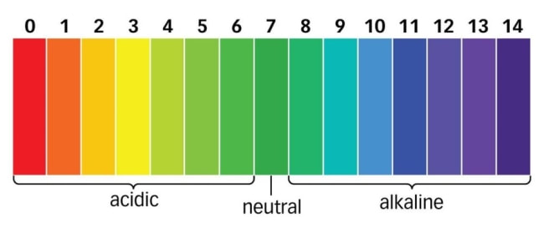
pH SCALE
A scale that lets us measure the relative “power of hydronium ions” in a solution – how acidic or basic is it.

Slide 15
pOH IS OPPOSITE OF pH
Sometimes it is easier to measure the pOH instead of the pH

Slide 16
pH IS KIND OF A BACKWARDS SCALE
pH = 0
7
14
[H+] = 10⁰
10⁻⁷
10⁻¹⁴
[H+]
[OH-]
[OH-] = 10⁻¹⁴
10⁻⁷
10⁰
pOH = 14
7
0

Slide 17
So how do we go from [H+] to the pH number???
Logarithms!
[H+] = 10⁰
-Log (10⁰) pH = 0
[H+] = 10⁻⁷
-Log (10⁻⁷) pH = 7
[H+] = 10⁻¹⁴
-Log (10⁻¹⁴) pH = 14
14
10⁻¹⁴

Slide 18
Various pH Calculations
pH = -log [H⁺] | pOH = -log [OH⁻]
[H⁺] = 10^{-pH} | [OH⁻] = 10^{-pOH}
pH + pOH = 14
[H⁺][OH⁻] = 1 x 10⁻¹⁴
With these calculations you can plug in, rearrange, substitute and find everything no matter what you are given in the problem!

Slide 19
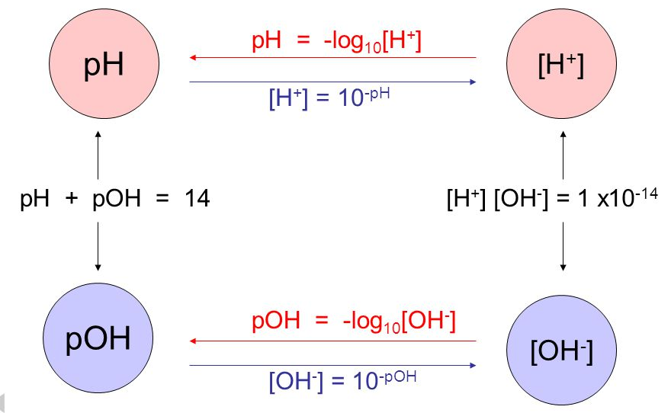
pH Square #1

Slide 20
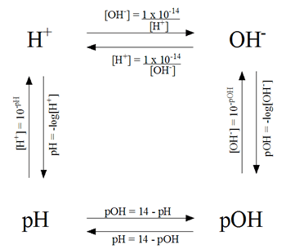
pH Square #2

Slide 21
WS #2 – Crash Course Video Notes
http://tinyurl.com/crashcourseacidrain

Slide 22
YouTube Link to Presentation:
https://youtu.be/RY1SB8vuxzI

