Slide 1
A little different than normal… We will do the first part of the lecture in our desks, and then the rest of this PowerPoint will be done as you do the lab activity.

Slide 2
N50 – Titrations Our last lecture of the year!
Target: I can set up and perform a titration.
Link to YouTube Presentation: https://youtu.be/6owm822vyhI

Slide 3
What is titration?
A way to determine the concentration of an unknown substance.
Uses the fact that acids and bases react with each other in “neutralization reactions”
At the point where the neutralization reaction is finished # moles Acid = # moles Base

Slide 4
Key Terms
Titrand The unknown solution you are interested in
Titrant
The solution with the known concentration
Equivalence Point
The point at which all the titrand has reacted with the titrant. # Moles Acid = # Moles Base
End Point
The point at which your titration seems finished during the lab – a color change happens for example

Slide 5
How do you know you reached the end point?
Use an INDICATOR
Turns colors based on pH – can show you visually when you have reached the end point.

Slide 6
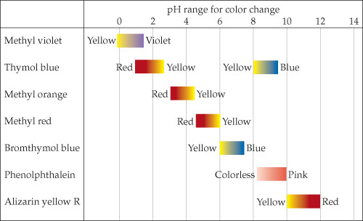
Pick the right indicator!

Slide 7
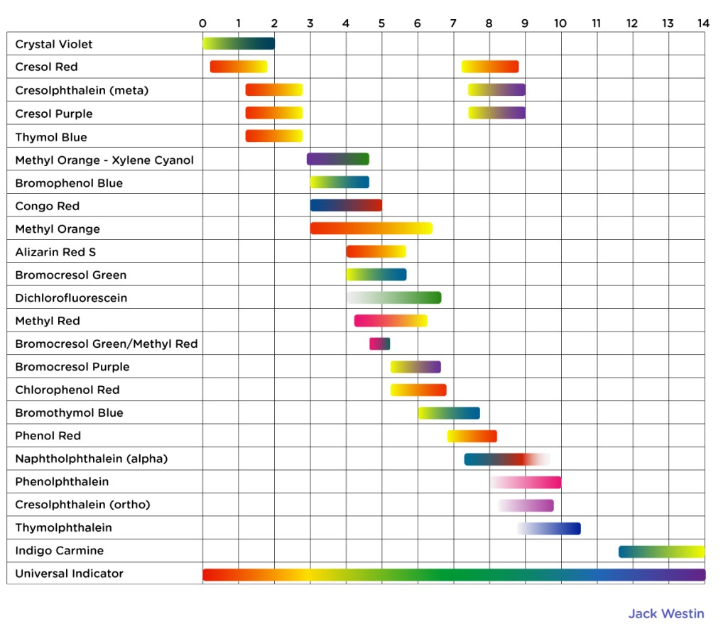
Pick the right indicator!

Slide 8
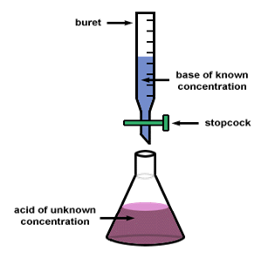
Lab Set Up
Burette
Base of known concentration
Stopcock valve
Acid of unknown concentration

Slide 9
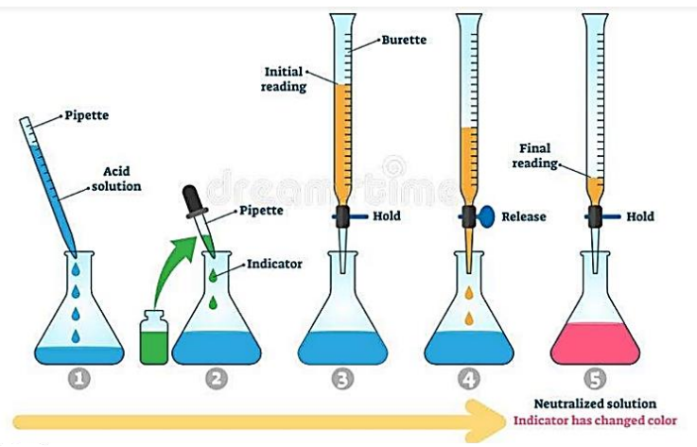

Slide 10
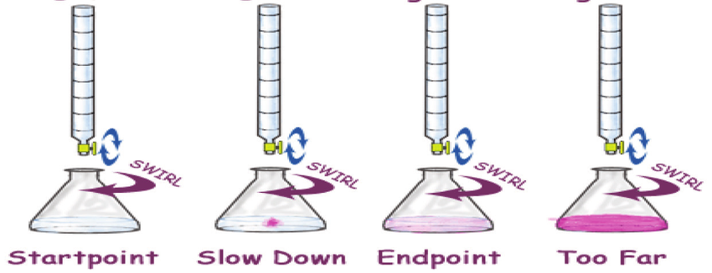
Careful! Don’t go too fast!

Slide 11
So…
Known [base] & unknown [acid]
Volume Base used to get to end point
Moles Base used to get to end point
Moles Acid in unknown solution
Convert Vol → Moles using M = mol/L
At end point
(assuming you did a good job titrating!)
Moles Acid = Moles Base
From burette during lab
Convert Moles → Molarity using M = mol/L
Concentration of unknown Acid

Slide 12
So…
Known [acid] & unknown [base]
Volume Acid used to get to end point
Moles Acid used to get to end point
Moles Base in unknown solution
Convert Vol → Moles using M = mol/L
At end point
(assuming you did a good job titrating!)
Moles Acid = Moles Base
From burette during lab
Convert Moles → Molarity using M = mol/L
Concentration of unknown Base

Slide 13
Some things to be careful of…
mL versus L
Stoichiometry – is it a 1:1 ratio H⁺ : OH⁻ ? Or is it 1:2, or 2:1, or 2:3, etc
1 mol NaOH = 1 mol OH⁻
1 mole Ca(OH)₂ = 2 mol OH⁻
End point and equivalence point are only identical if your titration is absolutely perfect. It never is, there are lab errors!

Slide 14
Lab Activity Portion of Lecture
Instead of a practice problem just on paper, we are going to have our practice problem be an actual titration! On WS #14

Slide 15
Question #1: What is our titrand?
Question #2: What is our titrant?
Titrand = HCl – unknown [ ]
Titrant = NaOH – known [ ], 0.10 M

Slide 16
Lab Set Up
Make sure everything is rinsed with distilled water, and then rinse the burette with the titrant (NaOH).
Clamp burette into burette clamp onto a ring stand
Fill burette with NaOH with a known concentration (0.10 M)
Put a beaker under burette and slowly open valve, letting some NaOH out until bottom of meniscus is reading at an easy to read value. Careful! Make sure that the entire tip of the burette is filled with NaOH.

Slide 17
Lab Set Up continued…
Using a graduated cylinder, put a known volume of your titrand (unknown concentration HCL) into an Erlenmeyer flask.
Add a small amount of appropriate indicator to the flask (phenolphthalein).

Slide 18
Question #3: Which indicator should we pick? Our unknown will be in the 7-10 range.

Slide 19
Question #4: What color shift do you expect to see for this indicator? From __ → ___.

Slide 20
How many trials to do?
Do FOUR trials (typically)
1st Trial – Rough trial – “Quick and dirty” Just a rough estimate so you have an idea of when you need to start slowing down. DON’T include this trial when averaging your data!
2nd – 4th Trials – Real ones – Be careful!

Slide 21
Set up your Data Table
Every group needs to do one rough trial, and each person will do a real trial. Four people in a group = Four trials. Make the right number of columns in your table!
 | Titration of Unknown HCl Solution with Phenolphthalein
 | [ ] of Titrant: |  | Volume of Titrand Used:
 | Rough Trial | Trial #1 |  | Trial #2 | Trial #3
Name
Burette Starting Volume (mL)
Burette Ending Volume (mL)
Volume of Titrant Used (mL)

Slide 22
Set up your Data Table
 | Titration of Unknown HCl Solution with Phenolphthalein
 | [ ] of Titrant: 0.10 M |  | Volume of Titrand Used: 5 mL
 | Rough Trial | Trial #1 |  | Trial #2 | Trial #3
Name
Burette Starting Volume (mL)
Burette Ending Volume (mL)
Volume of Titrant Used (mL)

Slide 23
Titration Lecture Videos
What is a titration? FuseSchool https://youtu.be/tIbD8MG1qMM
Setting up and Performing a Titration. CarolinaBiological https://youtu.be/sFpFCPTDv2w
How to Prepare a Burette for a Titration. Wits University https://youtu.be/Lr1nLTCqZvM
How to Read the Volume off a Burette. Wits University https://youtu.be/qdmp4_Nwd-Q
What is a Titration and how is it performed? Wits University https://www.youtube.com/watch?v=YqfvRBJ-iPg
Acid Base Equilibrium. Bozeman Science https://youtu.be/l5fk7HPmo5g

Slide 24
Set up your lab station
Burette’s are already clamped in for you, and filled with NaOH – not super safe to fill them, so I did it for you.

Slide 25
Perform Rough Trial
 | Titration of Unknown HCl Solution with Phenolphthalein
 | [ ] of Titrant: 0.10 M |  | Volume of Titrand Used: 5 mL
 | Rough Trial | Trial #1 |  | Trial #2 | Trial #3
Burette Starting Volume (mL)
Burette Ending Volume (mL)
Volume of Titrant Used (mL)

Slide 26
Each person does their trial
 | Titration of Unknown HCl Solution with Phenolphthalein
 | [ ] of Titrant: 0.10 M |  | Volume of Titrand Used: 5 mL
 | Rough Trial | Trial #1 |  | Trial #2 | Trial #3
Burette Starting Volume (mL)
Burette Ending Volume (mL)
Volume of Titrant Used (mL)

Slide 27
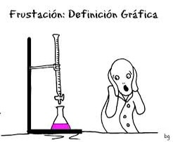
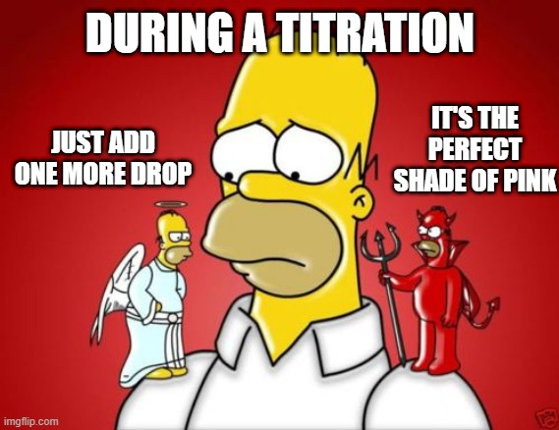
When your titration turns bright pink, and the professor starts walking towards you...
The perfect game doesn’t exi-

Slide 28
Calculate how many moles of NaOH you used
Molarity = Moles / Liters
Moles NaOH used = Volume used x Molarity NaOH
Moles = L x mol L
Moles NaOH = x mL 1L Y mol 1000 mL 1 L
From burette in the lab
Known [ ] given to you

Slide 29
Calculate the unknown concentration of the acid
At End Point → Moles NaOH = Moles HCl
Molarity = Moles / Liter
Molarity Acid = Moles Acid Liters Acid Used
Same as mol NaOH used!
The amount in your Erlenmeyer flask!

Slide 30
Come check what your unknown concentration of Acid was!
Calculate the % error for each person’s acid – let’s see which person had the most accurate titration per group!
Average your group member’s answers together – report % error of averaged data on the whiteboard – let’s see which group had the best titration skills!

Slide 31
YouTube Link to Presentation
https://youtu.be/6owm822vyhI

