Slide 1
Electrochemistry Concepts
Target: I can assign oxidation numbers and balance redox reactions.

Slide 2
N42 - Electrochemistry
Concepts

Slide 3
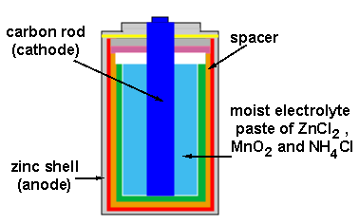
Electrochemistry

Slide 4
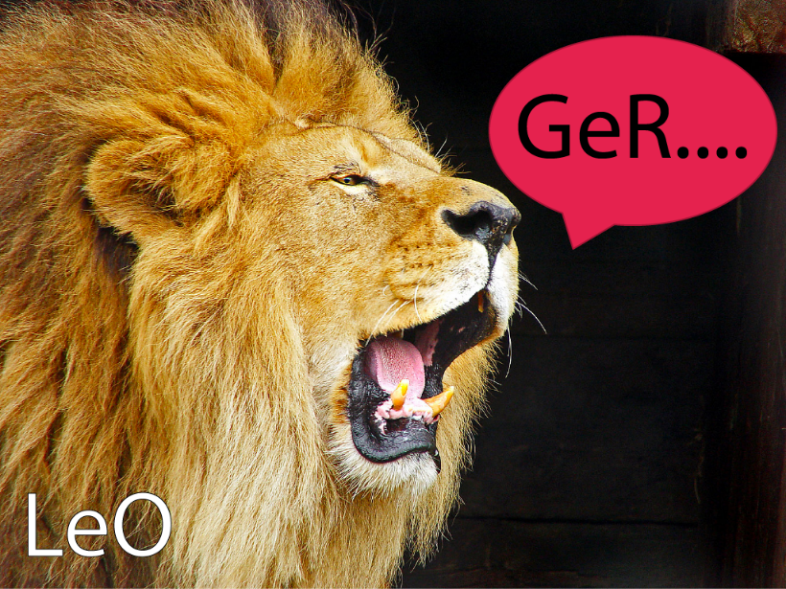
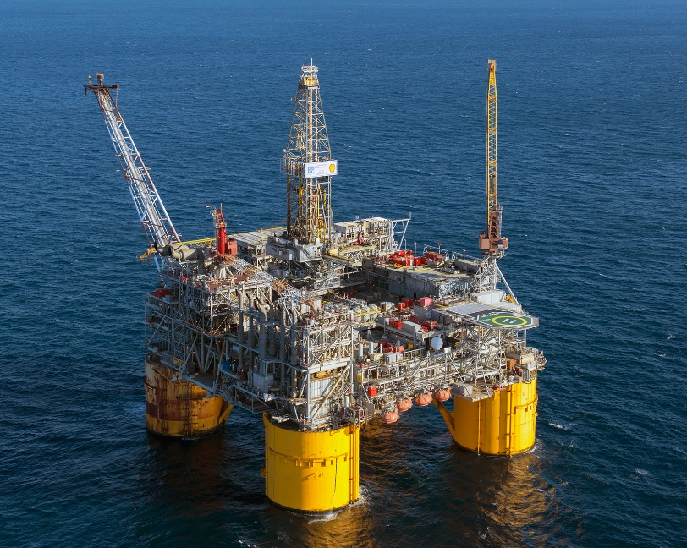
Mnemonics
LEO goes GER
Loss of Electrons is Oxidation
Gain of Electrons is Reduction
OIL RIG
Oxidation is Loss of Electrons
Reduction is Gain of Electrons

Slide 5
Examples
Oxidation
Ag → Ag⁺ + e⁻
Cu → Cu²⁺ + 2e⁻
Reduction
Ag⁺ + e⁻ → Ag
Cu²⁺ + 2e⁻ → Cu

Slide 6
Oxidation Numbers
The charge an atom in a compound would have if the compound was composed of ions.
Helps track how the electrons are moving around during a reaction.
Sometimes easy to determine, sometimes complex.
KF → K⁺ + F⁻ K ox # = +1, F ox # = -1

Slide 7
Rules for Assigning Oxidation Numbers
Any uncombined element is 0.
Monatomic ion equals the charge on the ion.
The more-electronegative element in a binary compound is assigned the number equal to the charge it would have if it were an ion.
Fluorine in a compound is always -1
Oxygen is -2 unless it is combined with F,
when it is +2, or it is in a peroxide, such as H₂O₂, when it is -1

Slide 8
Hydrogen in most of its compounds is +1 unless it is combined with a metal, in which case it is -1
In compounds, the elements of groups 1 and 2 as well as aluminum have oxidation numbers +1, +2 and +3 respectively.
The sum of the oxidation numbers of all atoms in a neutral compound is 0.
The sum of the oxidation numbers of all atoms in a polyatomic ion equals charge of the ion.

Slide 9
Balancing Redox Equations
More complicated than balancing normal reactions.
You have to balance the electrons, not just the atoms!
Steps
Assign oxidation numbers to determine which things
are oxidized and which are reduced.
Split the rxn into two halves – oxidation half
and reduction half. Include electrons.
Balance the atoms.
Balance the charge by balancing the number of electrons.
Add half reactions back together, simplify, and CHECK.

Slide 10
Best Advice…
USE PENCIL!
DON’T CRAM YOUR WORK! USE LOTS OF SPACE!
DON’T PANIC!
STUCK??? ERASE AND START OVER.

Slide 11
Balancing Redox Reactions
1
Assign oxidation states
  Determine the element oxidized and the element reduced.
Ce⁴⁺ + Sn²⁺ → Ce³⁺ + Sn⁴⁺
+4
+2
+3
+4
monoatomic ions match their charge

Slide 12
Balancing Redox Reactions
1
Assign oxidation states
  Determine the element oxidized and the element reduced.
Ce⁴⁺ + Sn²⁺ → Ce³⁺ + Sn⁴⁺
+4
+2
+3
+4
LEO goes GER
Sn²⁺ lost electrons = oxidized, +2 → +4
Ce⁴⁺ gained electrons = reduced, +4 → +3

Slide 13
Balancing Redox Reactions
2
Write oxidation and reduction half-reactions, including electrons
  Oxidation electrons being lost, products
  Reduction electrons being gained, reactants
Sn went from +2 → +4, that’s a loss of…
2e⁻
Oxidation: Sn²⁺→ Sn⁴⁺ + _____
e⁻
Reduction: Ce⁴⁺ + ____→ Ce³⁺
Ce went from +4 → +3, that’s a gain of…

Slide 14
Balancing Redox Reactions
3
Balance Atoms – already done this time!
  Oxidation electrons being lost, products
  Reduction electrons being gained, reactants
Sn went from +2 → +4, that’s a loss of…
2e⁻
Oxidation: Sn²⁺→ Sn⁴⁺ + _____
e⁻
Reduction: Ce⁴⁺ + ____→ Ce³⁺
Ce went from +4 → +3, that’s a gain of…

Slide 15
Balancing Redox Reactions
4
Balance the charge by balancing the # of e⁻
  Balance electrons between half-reactions.
  Least Common Multiple
1 x
Oxidation: ( Sn²⁺ → Sn⁴⁺ + 2e⁻ )
2 x
Reduction: ( Ce⁴⁺ + e⁻ → Ce³⁺ )
Oxidation: Sn²⁺ → Sn⁴⁺ + 2e⁻
Reduction: 2Ce⁴⁺ + 2e⁻ → 2Ce³⁺

Slide 16
Balancing Redox Reactions
5
Add half reactions together, simplify, check
  Make sure the atoms balance AND the charges
Oxidation: Sn²⁺ → Sn⁴⁺ + 2e⁻
Reduction: 2Ce⁴⁺ + 2e⁻ → 2Ce³⁺
Sn²⁺ + 2Ce⁴⁺ + 2e⁻ → Sn⁴⁺ + 2e⁻ + 2Ce³⁺
Sn²⁺ + 2Ce⁴⁺ → Sn⁴⁺ + 2Ce³⁺
CHECK:
Atoms balanced – yes!
Charges balanced – yes!

Slide 17
Balancing Redox Reactions
Yes, I know this isn’t balanced! That is what we are working on!
1
Assign oxidation states
  Determine the element oxidized and the element reduced.
oxygen -2, not in one of the exceptions.
Cl₂ + I⁻ + → 2Cl⁻ + IO₃⁻
0
-1
-1
+5
-2
elements are 0
monoatomic ions match their charge
monoatomic ions match their charge
x + 3(-2) = -1
sum must equal the overall charge on ion
x = +5

Slide 18
Balancing Redox Reactions
1
Assign oxidation states
  Determine the element oxidized and the element reduced.
Cl₂ + I⁻ + → 2Cl⁻ + IO₃⁻
0
-1
-1
+5
LEO goes GER
I⁻ lost electrons = oxidized, -1 → +5
Cl gained electrons = reduced, 0 → -1

Slide 19
Balancing Redox Reactions
2
Write oxidation and reduction half-reactions, including electrons
  Oxidation electrons being lost, products
  Reduction electrons being gained, reactants
I went from -1 → +5, that’s a loss of…
Yes, I know these are not balanced! That is what we are still working on! It takes a while!
6e⁻
Oxidation: I⁻ → IO₃⁻ + _____
2e⁻
Reduction: Cl₂ + ____→ 2Cl⁻
Each Cl went from 0 → -1, that’s a gain of…

Slide 20
Balancing Redox Reactions
3
Balance the atoms in the half reactions
  First balance elements other than H and O.
  Add H₂O where O is needed.
  Add H⁺ where H is needed
3H₂O
6H⁺
Oxidation: I⁻ + ______ → IO₃⁻ + 6e⁻ + _______
Reduction: Cl₂ + 2e⁻ → 2Cl⁻

Slide 21
Balancing Redox Reactions
4
Balance the charge by balancing the # of e⁻
  Balance electrons between half-reactions.
  Least Common Multiple
1 x
Oxidation: ( I⁻ + 3H₂O → IO₃⁻ + 6 e⁻ + 6H⁺ )
3 x
Reduction: ( Cl₂ + 2 e⁻ → 2 Cl⁻ )
Oxidation: I⁻ + 3H₂O → IO₃⁻ + 6 e⁻ + 6H⁺
Reduction: 3Cl₂ + 6 e⁻ → 6 Cl⁻

Slide 22
Balancing Redox Reactions
5
Add half reactions together, simplify, check
  Make sure the atoms balance AND the charges
Oxidation: I⁻ + 3H₂O → IO₃⁻ + 6 e⁻ + 6H⁺
Reduction: 3Cl₂ + 6 e⁻ → 6 Cl⁻
I⁻ + 3H₂O + 3Cl₂ + 6 e⁻ → IO₃⁻ + 6 e⁻ + 6H⁺ + 6 Cl⁻
I⁻ + 3H₂O + 3Cl₂ → IO₃⁻ + 6H⁺ + 6 Cl⁻
CHECK:
Atoms balanced – yes!
Charges balanced – yes!

Slide 23
Balancing Redox Reactions
6
WHAT IF IT IS IN BASIC SOLUTION!?!?!
  Add OH- to both sides to balance out the H⁺ present
I⁻ + 3H₂O + 3Cl₂ → IO₃⁻ + 6H⁺ + 6 Cl⁻
+ 6OH⁻
+ 6OH⁻
I⁻ + 3H₂O + 3Cl₂ + 6OH⁻ → IO₃⁻ + 6H₂O + 6 Cl⁻

Slide 24
Balancing Redox Reactions
6
WHAT IF IT IS IN BASIC SOLUTION!?!?!
  Then cancel out any waters that you can
I⁻ + 3H₂O + 3Cl₂ → IO₃⁻ + 6H⁺ + 6 Cl⁻
+ 6OH⁻
+ 6OH⁻
I⁻ + 3H₂O + 3Cl₂ + 6OH⁻ → IO₃⁻ + 6H₂O + 6 Cl⁻
3H₂O left!
I⁻ + 3Cl₂ + 6OH⁻ → IO₃⁻ + 3H₂O + 6 Cl⁻
CHECK:
Atoms balanced – yes!
Charges balanced – yes!

Slide 25
A Few More Electrochemistry Terms
Oxidizing agent
The substance that is doing the oxidizing of the other substance. Whichever substance is reduced is the oxidizing agent.
Reducing agent
The substance that is doing the reducing of the other substance. Whichever substance is oxidized is the reducing agent.

Slide 26
YouTube Link to Presentation
https://youtu.be/-y2xTX_BVsA

