Slide 1
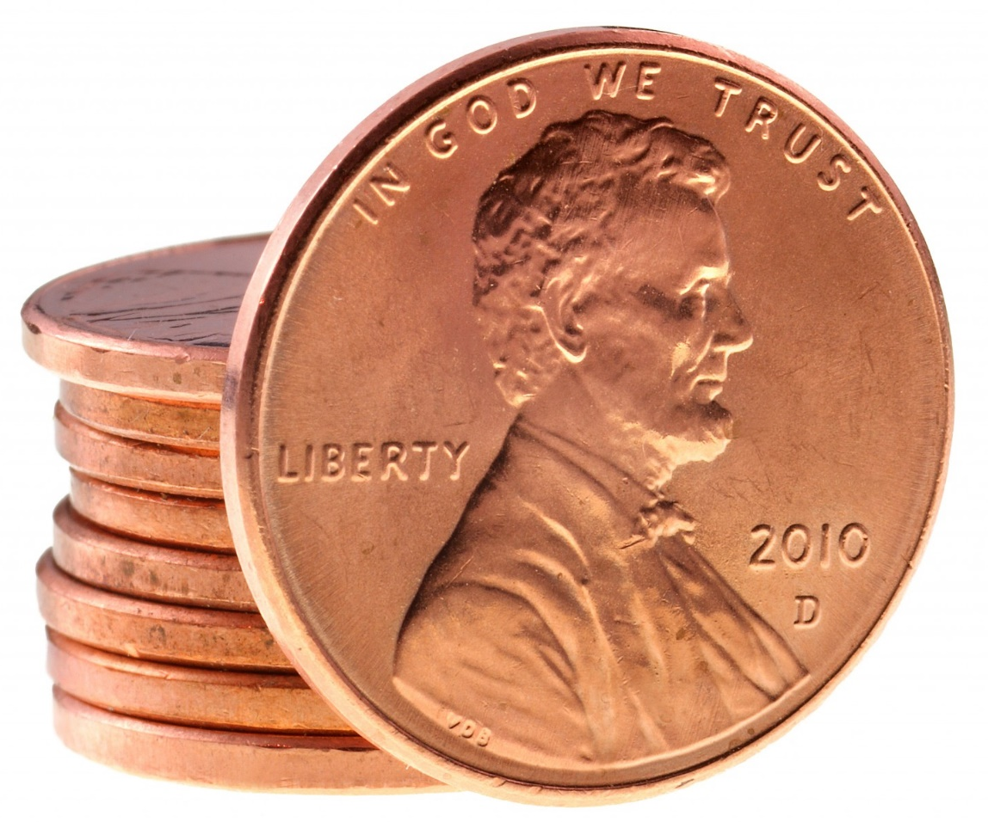
Pre-1982 Penny: 3.08 g
Post-1982 Penny: 2.52 g
Empty Container: 7.82 g
10 pennies per container
Why (x) and (10-x) not (1-x)? Because we have TEN pennies (10-x), we aren’t using 100% (1-x)

