Slide 1
N4 – Properties, Changes, and Types of Matter
Target: I can classify matter and types of changes to matter.
Link to YouTube Presentation: https://youtu.be/gQ64-kFWW_Q

Slide 2
Properties of Matter
Extensive properties
Volume
Mass
Energy Content
(think Calories)
Depend on the AMOUNT of matter that is present.
Intensive properties
Depend only on the TYPE of matter present, not the amount present
Melting point
Boiling point
Density

Slide 3





Which of the following is an EXTENSIVE property?
AMOUNT
It is a solid at 25 °C.
It has a density of 1.38 g/cm³.
It melts at 62.0 °C.
It has a volume of 0.52 cm³.
It is shiny.

Slide 4
Which of the following is an EXTENSIVE property?
AMOUNT
It is a solid at 25 °C.
It has a density of 1.38 g/cm³.
It melts at 62.0 °C.
It has a volume of 0.52 cm³.
It is shiny.

Slide 5
Physical and Chemical Properties
PHYSICAL PROPERTY
a property that a substance displays without changing its composition.
  Odor, taste, color, appearance, melting point, boiling point, and density
CHEMICAL PROPERTY
a property that a substance displays
only by changing its composition via a chemical change/rxn
  Corrosiveness, acidity, and toxicity.

Slide 6
All of the following are examples of physical properties EXCEPT:
Density
Hardness
Melting Point
Combustible
Luster

Slide 7
All of the following are examples of physical properties EXCEPT:
Density
Hardness
Melting Point
Combustible
Luster

Slide 8
Which of the following is a
chemical property?
You can squeeze oranges to make orange juice
Butter can be melted for popcorn
Sand can be separated from gravel
Hydrogen peroxide decompose into water and oxygen
Ozone is a gas at room temperature

Slide 9
Which of the following is a
chemical property?
You can squeeze oranges to make orange juice
Butter can be melted for popcorn
Sand can be separated from gravel
Hydrogen peroxide decompose into water and oxygen
Ozone is a gas at room temperature

Slide 10
Types of Changes
Physical Change
Chemical Change

Slide 11
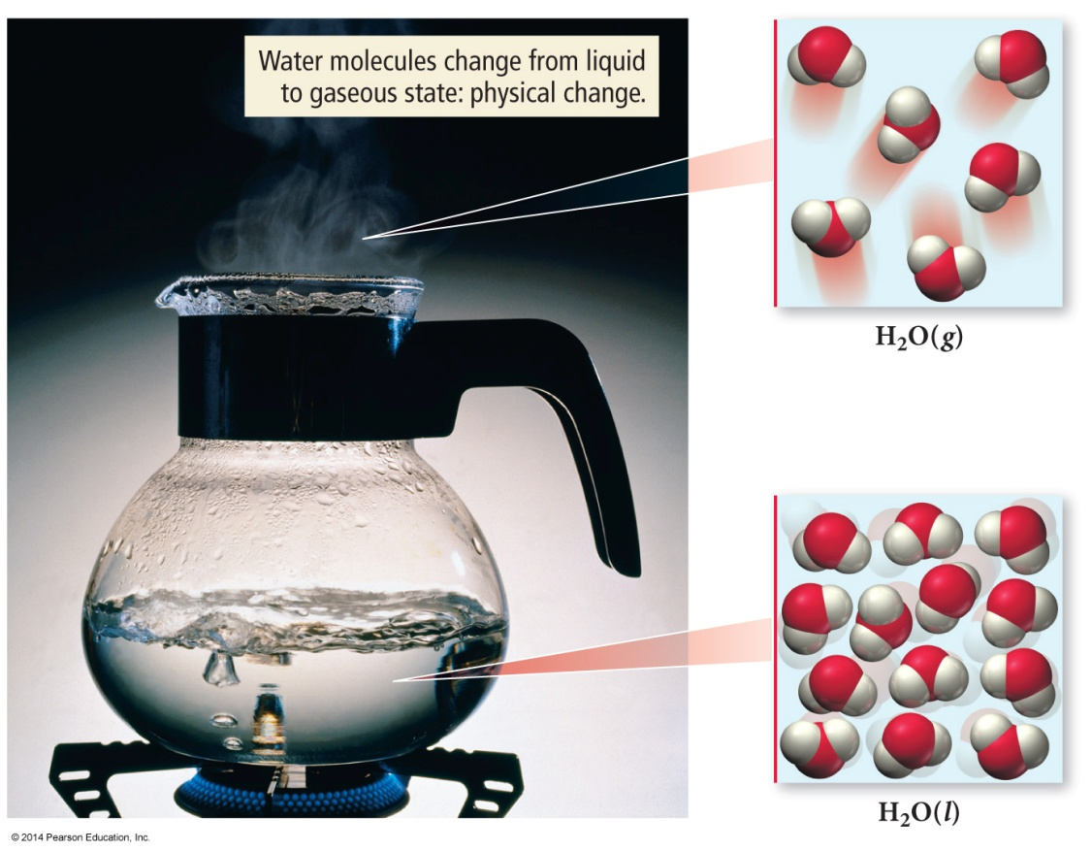
Physical Change
Changes only the state or appearance,
but not composition
The atoms or molecules do not change their identity during a physical change.
EXAMPLE: Boiling water

Slide 12
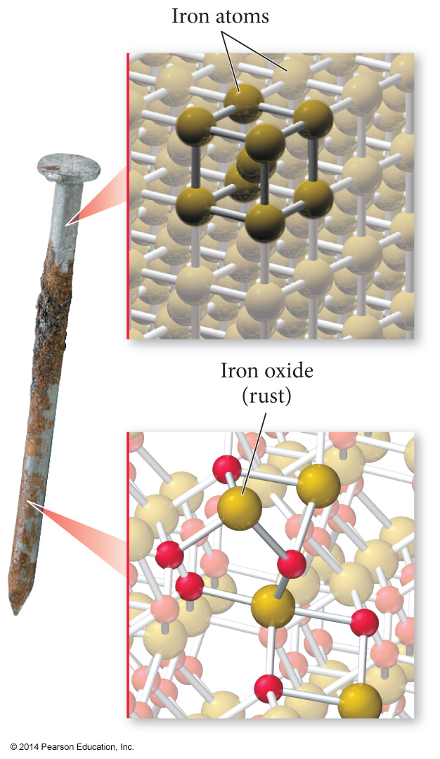
Chemical Change
Changes the composition/ identity of the substance
Atoms rearrange, transforming the original substances into different substances.
EXAMPLE: Iron rusting. Started as Fe and then it bonds with oxygen to make FeO.

Slide 13
The Classification of Matter
Matter is anything that occupies space and has mass.
We can classify matter according to:
  state (solid, liquid, gas)
  composition (the basic components its made of).

Slide 14
Classification of Matter by Components
The first division in the classification of matter is between a pure substance and a mixture.
Pure substance is made up of only one component and its composition is invariant.
Mixture, by contrast, is a substance composed of two or more components in proportions that can vary from one sample to another.

Slide 15
Classification of Pure Substances
Element: a substance that cannot be chemically broken down into simpler substances.
    Basic building blocks of matter
    Composed of single type of atom, like helium
Molecule is a substance composed of two or more atoms, but can be the same element –
H₂, Br₂, H₂O, CO₂
Compound is a substance composed of two or more types of elements. H₂O, CO₂

Slide 16
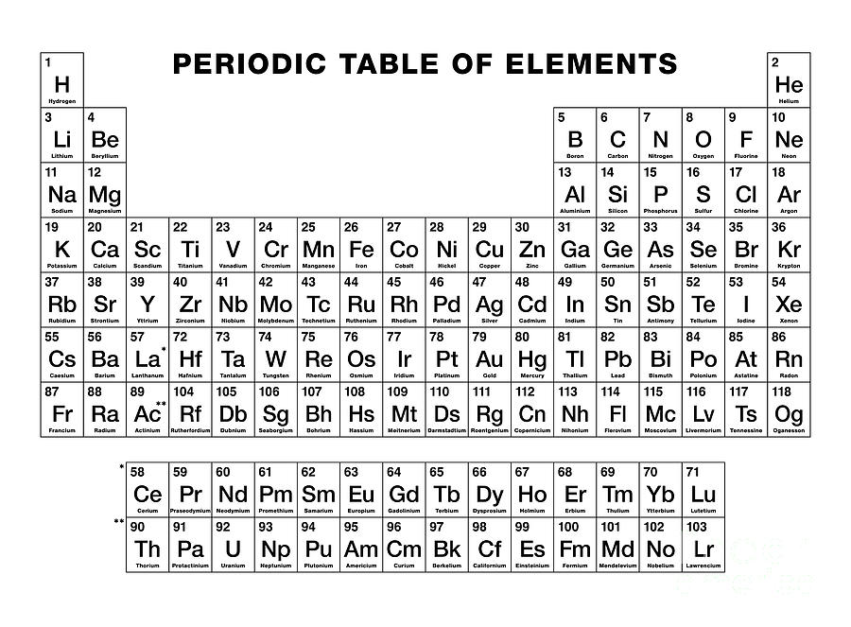
Classification of Pure Substances
Careful!
  “Diatomic Elements” are actually molecules!
  H₂ Horses
  N₂ Need
  O₂ Oats
  F₂ For
  Cl₂ Clear
  Br₂ Brown
  I₂ “Eyes”
H-7

Slide 17
Classification of Mixtures
Heterogeneous: composition varies from one region of the mixture to another.
  Chicken noodle soup, oil and vinegar
Homogeneous mixtures: uniform compositions because the atoms or molecules that compose them mix uniformly.
  Salt water, air

Slide 18
Which of the following is a
heterogeneous mixture?
Kool-aid
Coffee
A latte
Hydrogen peroxide
Ice

Slide 19
Which of the following is a
heterogeneous mixture?
Kool-aid
Coffee
A latte
Hydrogen peroxide
Ice

Slide 20
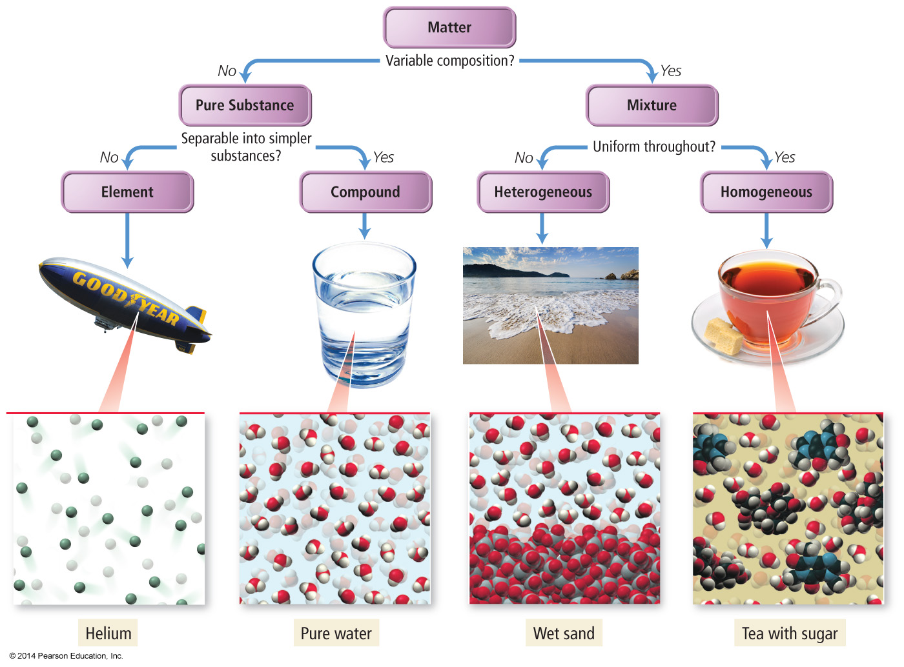
The Classification of Matter by Components
Elements, compounds, and types of mixtures.
MOLECULE!

Slide 21
Separating Mixtures
Are separable because the different components have different physical or chemical properties.
Various techniques that exploit these differences are used to achieve separation.

Slide 22
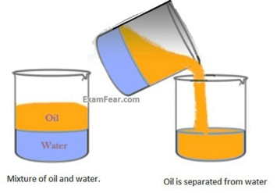
Separating Mixtures
A mixture of sand and water, or oil and water, can be separated by decanting—carefully pouring off the water into another container.

Slide 23
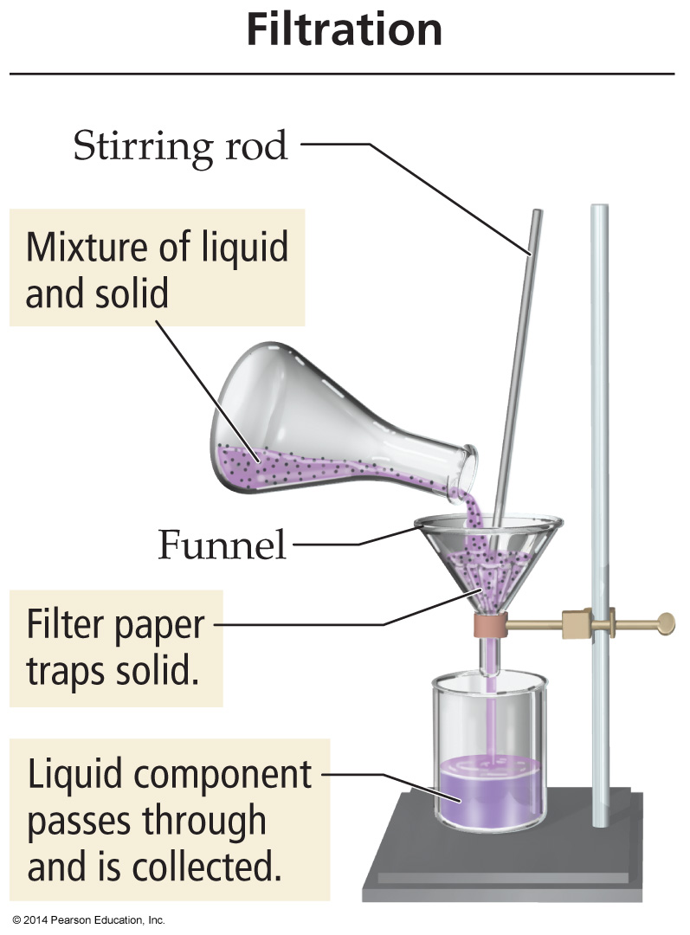
Separating Mixtures
A mixture of an insoluble solid and a liquid can be separated by filtration—process in which the mixture is poured through filter paper in a funnel.

Slide 24
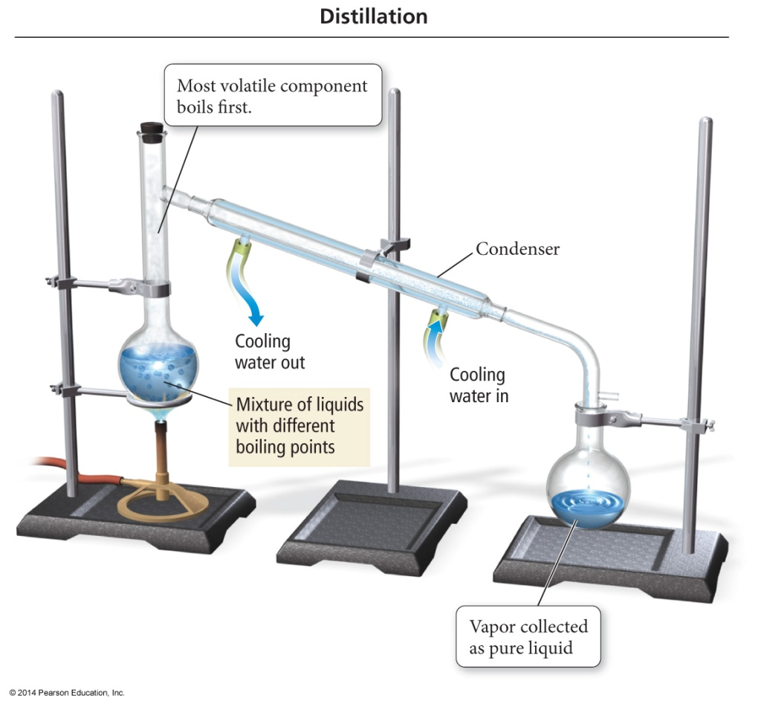
Separating Mixtures
A homogeneous mixture of liquids can usually be separated by distillation,
Mixture is heated to boil off the more volatile (easily vaporizable) liquid.
The volatile liquid is then re-condensed in a condenser and collected in a separate flask.

Slide 25
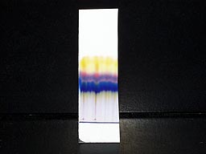
Separation of a Mixture
The components of dyes such as ink may be separated by paper chromatography
Some elements can travel further up the paper than others

Slide 26
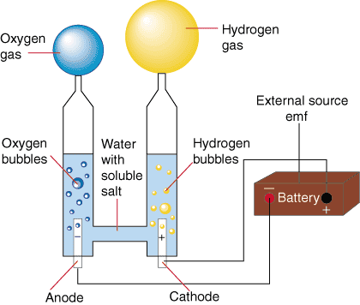
Separation of a Molecule/Compound
The Electrolysis of water
Compounds must be separated by chemical means.
With the application of electricity, water can be separated into its elements
Reactant → Products
Water → Hydrogen + Oxygen
2H₂O → 2H₂ + O₂

Slide 27
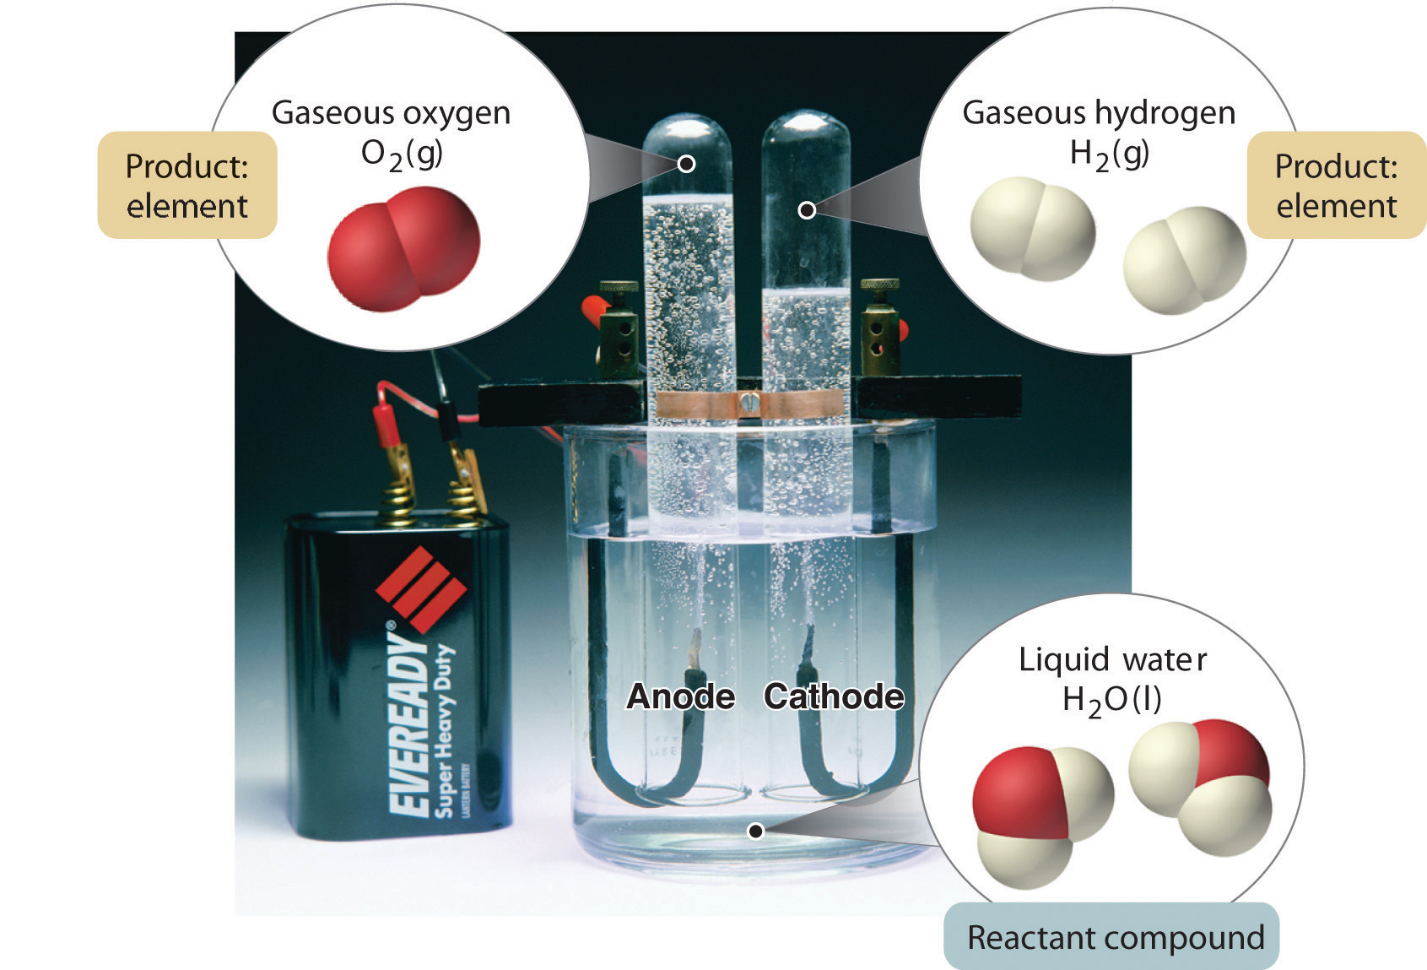

Slide 28
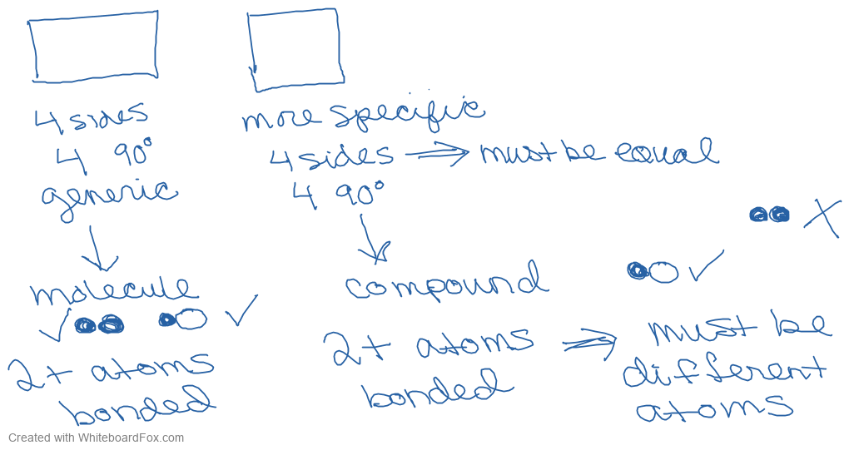
Extra Help about molecules vs. compounds using the “Rectangle versus square” analogy

Slide 29
Link to YouTube Video of Presentation: https://youtu.be/gQ64-kFWW_Q

