Slide 1
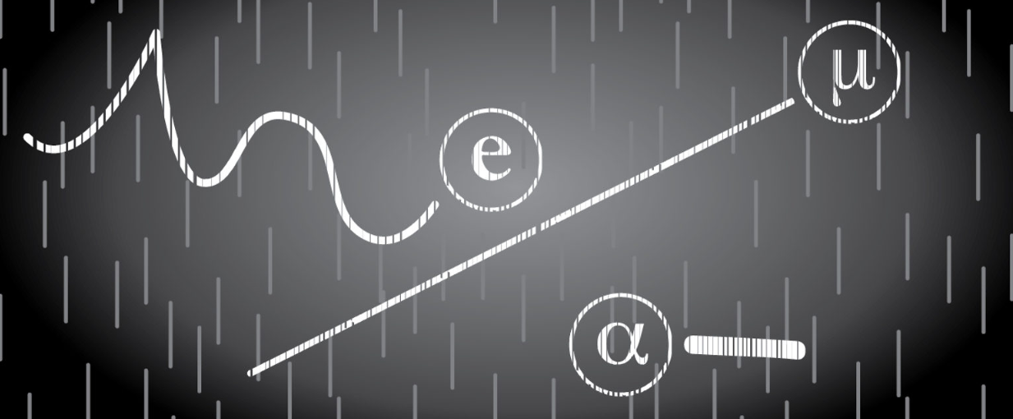
CLOUD CHAMBER LINKS and PHOTOS

Slide 2
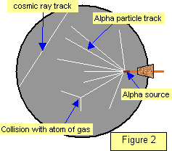
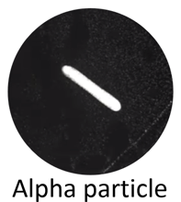
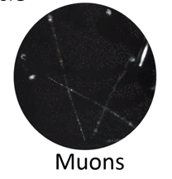
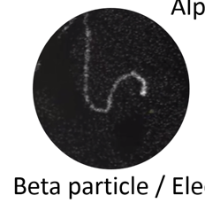
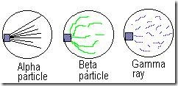

Slide 3
Frost Bite Theater – Jefferson Lab
https://www.youtube.com/watch?v=pewTySxfTQk&feature=youtu.be
Harvard Natural Sciences Lecture Demonstration
https://www.youtube.com/watch?v=e3fi6uyyrEs
Symmetry Magazine – Building a Cloud Chamber
https://www.symmetrymagazine.org/article/january-2015/how-to-build-your-own-particle-detector

Slide 4
Neat extension about cosmic rays and how they mess up experiments trying to discover dark matter
Website with information
https://www.sciencefriday.com/educational-resources/build-a-cloud-chamber/
Video
https://www.youtube.com/watch?v=YxMGWQMoR10&feature=youtu.be

