Slide 1
N-8 Nuclear decay series
Target: I can write nuclear equations for reactions that don’t occur in one single step.
Link to YouTube Presentation: https://youtu.be/hi81Yp7qRkk

Slide 2
Nuclear decay series
Things don’t always decay in one single step!
Sometimes it takes lots of little decays before
it reaches a more stable isotope

Slide 3
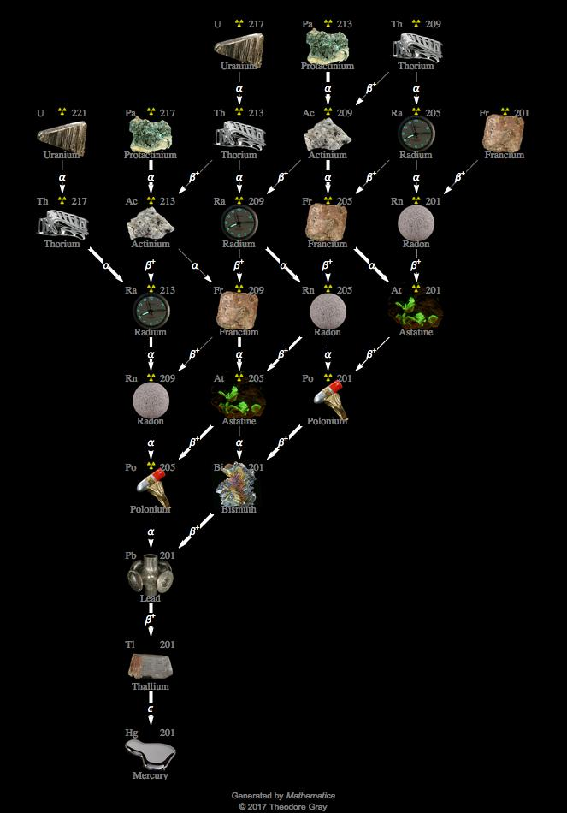

Slide 4
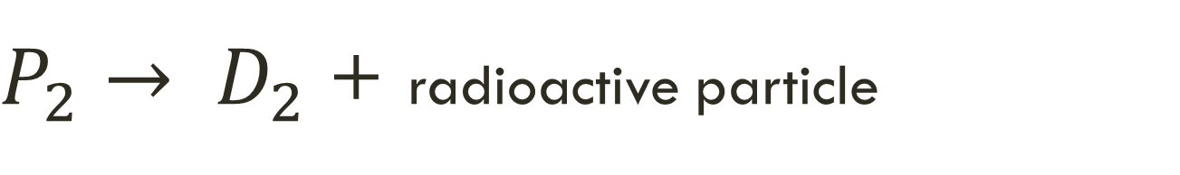
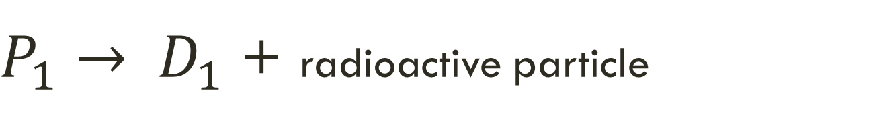
Nuclear decay series
Parent #1 decays into Daughter Product #1
Daughter Product #1 is now the Parent #2 !
Parent #2 decays into Daughter Product #2
Etc…etc…etc…
$P_{1}→ D_{1}$ + radioactive particle
$P_{2}→ D_{2}$ + radioactive particle

Slide 5
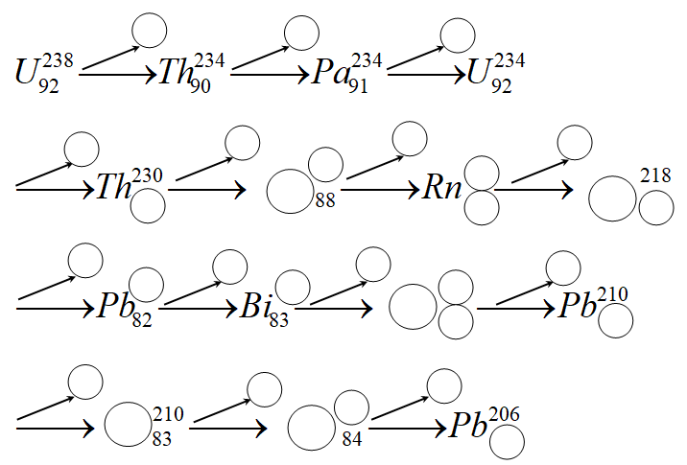






























$$α$$
$$β$$
$$β$$
$$α$$
$$α$$
$$α$$
$$α$$
$$226$$
$$222$$
$$Ra$$
$$Po$$
$$90$$
$$86$$
$$84$$
$$α$$
$$β$$
$$β$$
$$α$$
$$214$$
$$214$$
$$214$$
$$Po$$
$$84$$
$$82$$
$$β$$
$$β$$
$$α$$
$$210$$
$$Bi$$
$$Po$$
$$82$$

Slide 6
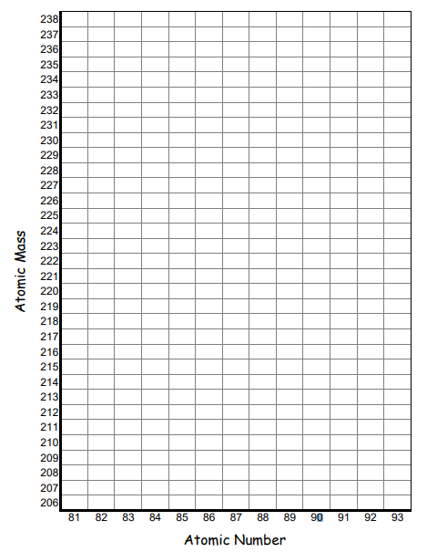
Graphing decay series
(Going to zoom in so its big enough to see on the screen)

Slide 7




KEEP GOING!
All the way to the end!
U
$$α$$
Th
Pa
U
$$β$$
$$β$$

Slide 8
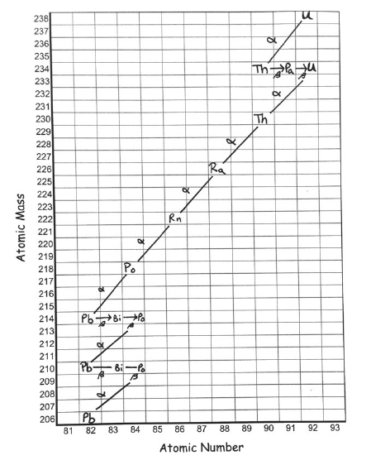

Slide 9
YouTube Link to Presentation
https://youtu.be/hi81Yp7qRkk

