Slide 1
N27 - Real Life Stoichiometry Examples
Target: I can apply stoichiometry to real life examples that have context/stories behind them.

Slide 2
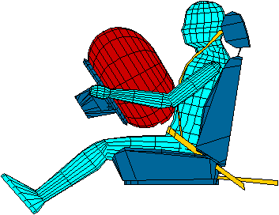
Example #1 – AIR BAGS
Exact quantity of nitrogen gas must be produced in an instant.
__ NaN₃(s) → __Na(s) + __N₂(g)

Slide 3
2 NaN₃(s) → 2 Na(s) + 3 N₂(g)
If an airbag is made with 90 grams of NaN₃ will it be safe?
Assume that 65.1 L of N₂ gas are needed to inflate an air bag to the proper size to protect you during an accident.
(Hints: Make NaN₃ your A value. The density of N₂ gas at this temperature is about 0.916 g/L).

Slide 4

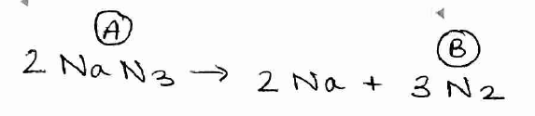






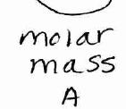
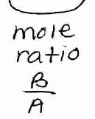
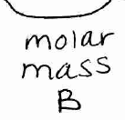

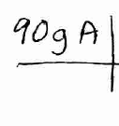
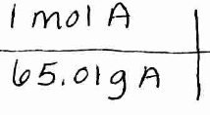
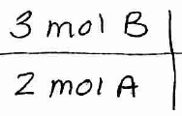
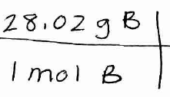
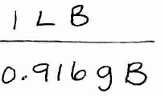
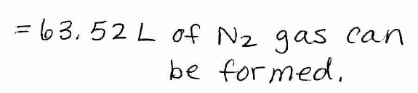


Slide 5
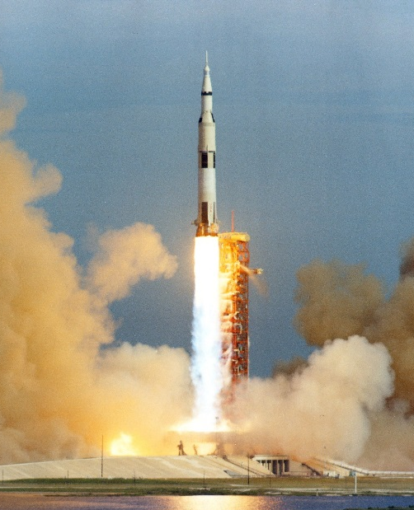
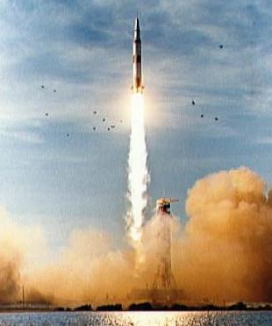
Example #2 – ROCKET FUEL
In 1967 the Saturn V Rocket did an unmanned test flight to the moon. It used kerosene fuel to get through the atmosphere into outer space. The kerosene (C₁₂H₂₆) combusts with liquid oxygen (O₂) on board the rocket to form carbon dioxide and water.

Slide 6

Example #2 – ROCKET FUEL
2 C₁₂H₂₆ + 37 O₂ → 24 CO₂ + 26 H₂O
If the Saturn V rocket was loaded with 770,886 Liters of kerosene fuel and 890,650 Liters of liquid oxygen, would it have enough liquid oxygen on board to use up all the kerosene in order to get out of the atmosphere?
(Hints: Make kerosene your A value.
The density of kerosene is 749g/L,
and the density of liquid oxygen
is 1141 g/L)

Slide 7









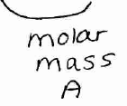
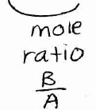
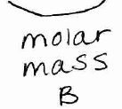
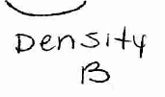
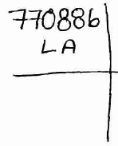
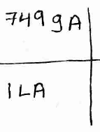
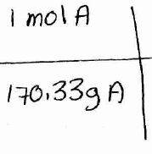
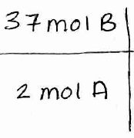
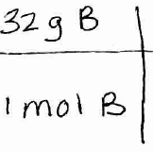
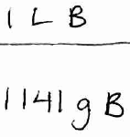


Slide 8
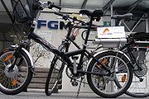
Example#3 - HYDROGEN POWERED
BICYCLES
Electric Bicycles are becoming very popular these days. They typically have a rechargeable battery pack and electric hub motor.
A new electricity source combines a hydrogen fuel cell with a "sodium silicide" fuel cartridge (winner of a "Green Chemistry Challenge Award)

Slide 9
Example#3 – H₂ POWERED BICYCLES
The sodium silicide reacts with water to make the hydrogen fuel to run the bicycle.
2 NaSi_{(s)} + 5H₂O_{(l)} → Na₂Si₂O_{5(s)} + 5H_{2(g)}
If you start with 1Kg of sodium silicide, and your tank can hold 500mL of water, will you have enough water to use up the battery?
(Hints: Use 1kg of sodium silicide as your A value. The Density of water is 1g/mL)

Slide 10







