Slide 1
N5 - Atomic #’s & Isotopes
Target: I can describe advancements in the model of the atom, and can count subatomic particles
Link to YouTube Presentation: https://youtu.be/vDzHcK1MUHo

Slide 2
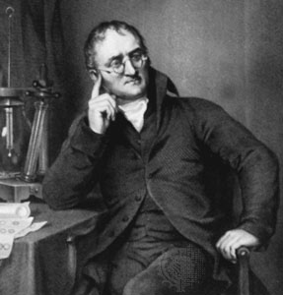

Dalton’s Atomic Theory (1808)
All matter composed of extremely small particles called atoms
John Dalton

Slide 3

Dalton’s Atomic Theory (1808)
Atoms of a given element are identical in size, mass, and other properties
John Dalton

Slide 4
Dalton’s Atomic Theory (1808)
Atoms of different elements differ in size, mass, and other properties
John Dalton

Slide 5
Dalton’s Atomic Theory (1808)
Atoms cannot be subdivided, created, or destroyed
John Dalton

Slide 6
Dalton’s Atomic Theory (1808)
Atoms of different elements combine in simple whole-number ratios to form chemical compounds
John Dalton

Slide 7
Dalton’s Atomic Theory (1808)
In chemical reactions, atoms are combined, separated, or rearranged
John Dalton

Slide 8
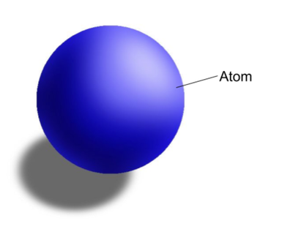
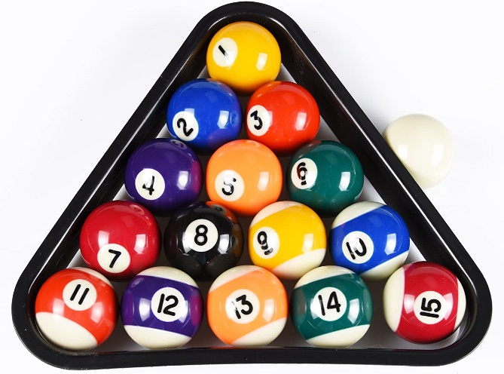
Dalton’s Billiard Ball Model
John Dalton

Slide 9
Modern Atomic Theory – what was wrong with Dalton’s theory?
Atoms have an AVERAGE MASS! | It is an AVERAGE because of ISOTOPES!
Atoms cannot be divided, created or destroyed during NORMAL chemical reactions | BUT they CAN do those things during NUCLEAR reactions!

Slide 10
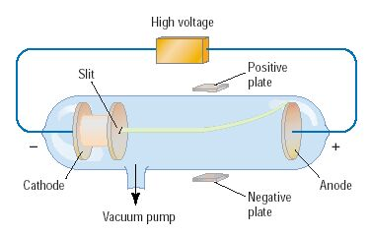
Discovery of the Electron
In 1897, J.J. Thomson used a cathode ray tube to deduce the presence of a negatively charged particle.
Cathode ray tubes pass electricity through a gas that is contained at a very low pressure.
https://www.youtube.com/watch?v=O9Goyscbazk

Slide 11
Conclusions from the
Study of the Electron
Cathode rays have identical properties regardless of element used | All elements must contain identically charged electrons.
Atoms are neutral | Must be positive particles balancing the negative charge of electrons
Electrons have very little mass compared to the atom’s mass | Atoms must contain other heavier particles that account for most of the mass

Slide 12
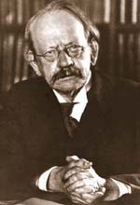
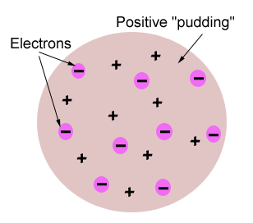
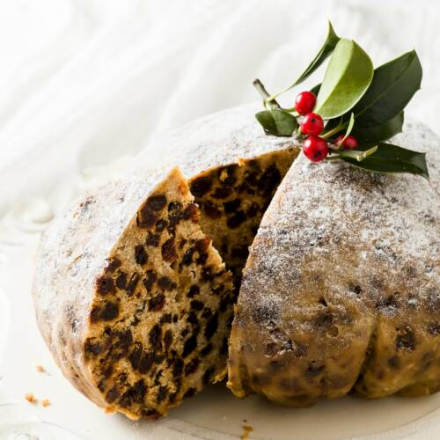
Thomson’s Atomic Model
Thomson believed that the electrons were like plums embedded in a positively charged “pudding,” thus it was called the “plum pudding” model. We don’t usually eat plum pudding in this country, so I like to call it the chocolate chip cookie model.

Slide 13
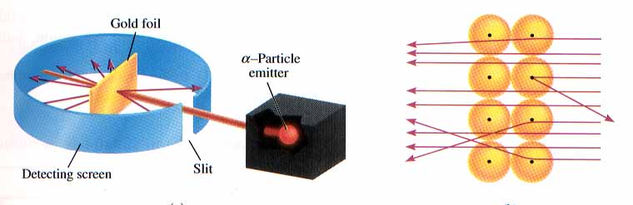
Rutherford’s Gold Foil Experiment
Alpha (α) particles are helium nuclei
Particles were fired at a thin sheet of gold foil
Particle hits on the detecting screen (film) are recorded

Slide 14
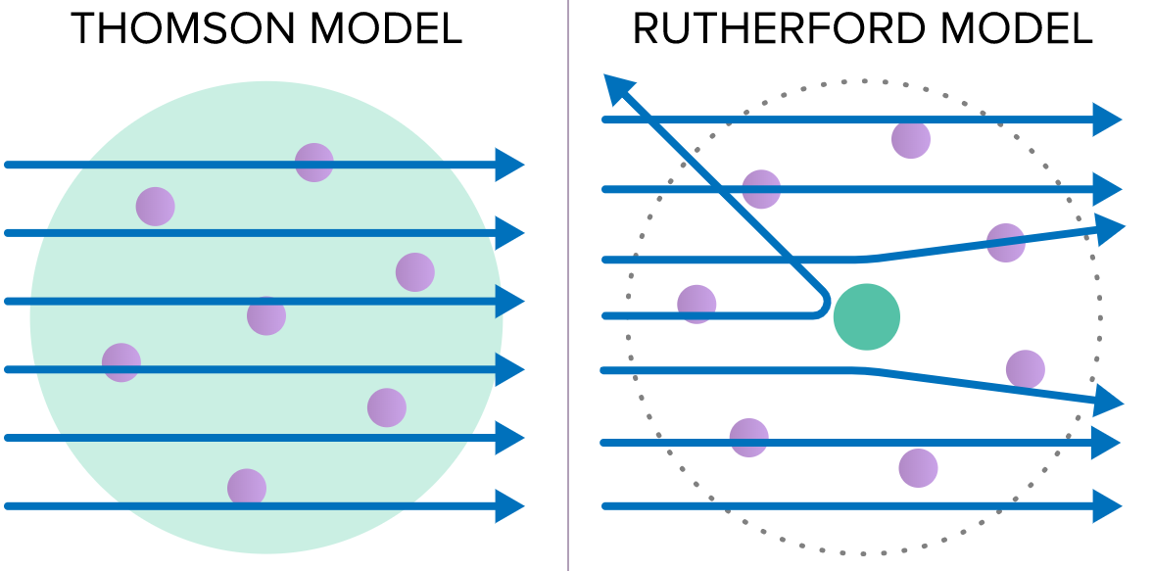
https://www.youtube.com/watch?v=XBqHkraf8iE

Slide 15
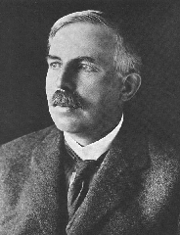
Rutherford’s Findings
Most of the particles passed right through
A few particles were deflected
A FEW were greatly deflected
CONCLUSIONS:
The nucleus is small
The atom is mostly
empty space
The nucleus is dense
The nucleus is
positively charged

Slide 16
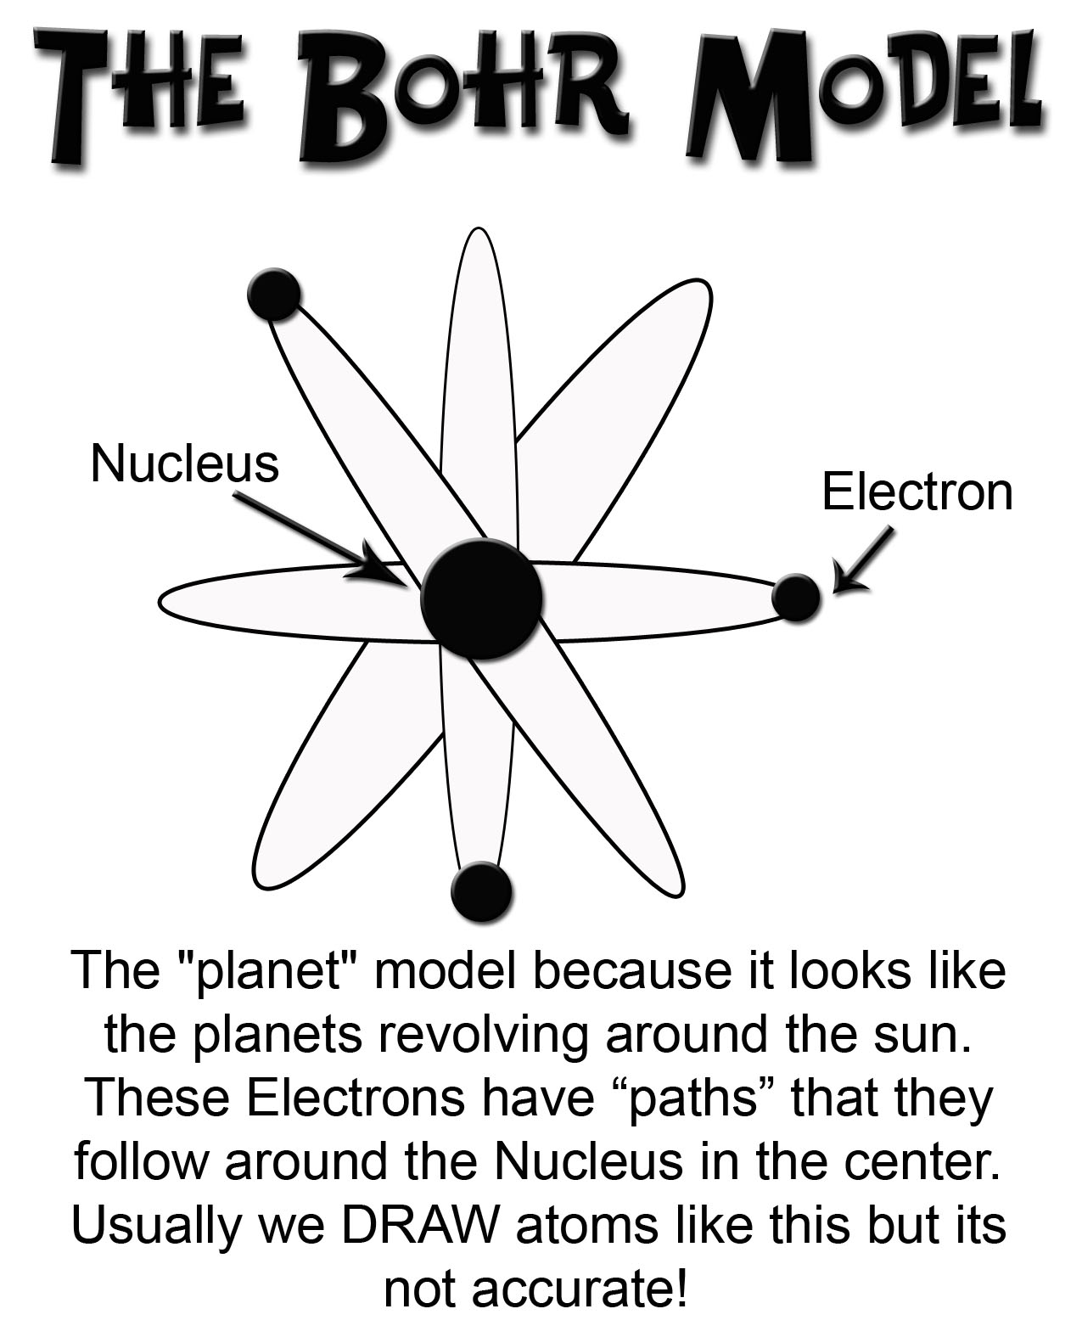
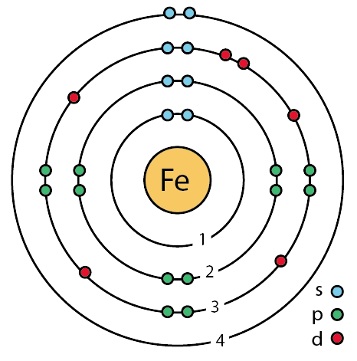

Slide 17
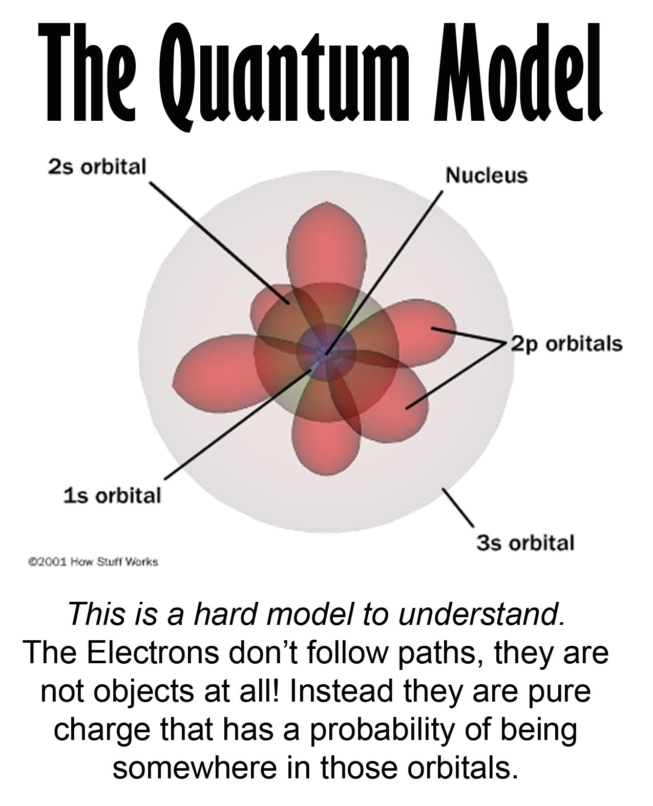

Slide 18
Atomic Particles
Particle | Charge | Mass # | Location
Electron | -1 | 0 | Electron cloud
Proton | +1 | 1 | Nucleus
Neutron | 0 | 1 | Nucleus

Slide 19
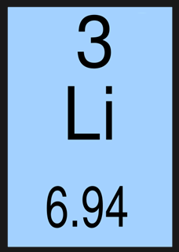
ATOMIC NUMBERS
We know: Nucleus has protons (p⁺ ), neutrons (n⁰ ), and electrons(e⁻ ) are on the outside of nucleus
But how many of each???
Atomic Number
# of protons
Atomic Mass Number
(round to the nearest whole #)
# of protons # of neutrons
+
# of electrons
=
# of protons

Slide 20
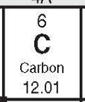
Atomic Number
The number of protons in the
nucleus of each atom of that
element.
Element | # of protons | Atomic # (Z)
Carbon | 6 | 6
Phosphorus | 15 | 15
Gold | 79 | 79

Slide 21
Changing Protons makes a new
ELEMENT
with a NEW name!

Slide 22
Sodium has 11 protons. Take one away and it has 10 and is no longer sodium…it is now Neon!

Slide 23
Which of the following determines the identity of an atom?
Number of protons
Number of electrons
Number of neutrons
Total number of protons and neutrons
Total number of protons and electrons
Notes:
Answer: a

Slide 24
Which of the following determines the identity of an atom?
Number of protons
Number of electrons
Number of neutrons
Total number of protons and neutrons
Total number of protons and electrons
Notes:
Answer: a

Slide 25
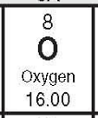
Mass Number
The number of protons
and neutrons in the
nucleus of an isotope.
Mass # = p⁺ + n⁰
Nuclide | p⁺ | n⁰ | e⁻ | Mass #
Oxygen - |  | 10
- | 33 | 42
- 31 | 15
18
8
8
18
Arsenic
75
33
75
Phosphorus
16
15
31

Slide 26
Changing Neutrons makes a new
ISOTOPE

Slide 27


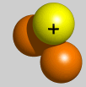
Isotopes
Atoms of the same element having different masses due to varying numbers of neutrons.
Isotope | Protons | Electrons | Neutrons | Nucleus
Hydrogen–1 (protium) | 1 | 1 | 0
Hydrogen-2 (deuterium) | 1 | 1 | 1
Hydrogen-3 (tritium) | 1 | 1 | 2

Slide 28
AVERAGE Atomic Masses
The average of all the naturally occurring isotopes of that element.
Isotope | Symbol | Composition of the nucleus | % in nature
Carbon-12 | ¹²C | 6 protons 6 neutrons | 98.89%
Carbon-13 | ¹³C | 6 protons 7 neutrons | 1.11%
Carbon-14 | ¹⁴C | 6 protons 8 neutrons | <0.01%
Carbon = 12.011

Slide 29
Changing Electrons makes a new
ION

Slide 30
IONS
When you change the number of electrons in an atom.
Ion | Change | # of P to # of e- | Charge | Example symbol
Cation | Lost electrons | P > e- | positive | Ca²⁺
Anion | Gained electrons | P < e- | negative | N³⁻

Slide 31
Sodium
Normally: 11 protons +11
11 electrons -11
zero charge 0

Slide 32
Sodium
Take away: 11 protons +11
an electron 10 electrons -10
positive charge +1

Slide 33
Oxygen
Normally: 8 protons +8
8 electrons -8
zero charge 0

Slide 34
Oxygen
Give 2 extra: 8 protons +8
electrons 10 electrons -10
negative charge -2

Slide 35
+
-
+
0 charge
+1 charge
+
-
+
-
+
-
+
-
-
-
-1 charge
-
-2 charge
+
-
+
-
+
-
+
-
+
-
+
-

Slide 36
IONS!
Oxygen
O⁻²
Negative
Anion
Gained
electrons
Sodium
Na⁺¹
Positive
Cation
Took away
electrons

Slide 37
Need some extra explanation?
What are Isotopes Video
https://www.youtube.com/watch?v=EboWeWmh5Pg
What are Ions Video
https://www.youtube.com/watch?v=WWc3k2723IM

Slide 38
Link to YouTube Video of Presentation
https://youtu.be/vDzHcK1MUHo

