Slide 1
N6 – Intro to the Nucleus
Target: I can describe how the nucleus can change to become more stable if needed.
Link to YouTube Presentation: https://youtu.be/LrCO_eciSLQ

Slide 2
Not all atoms are stable!
Sometimes the nucleus of an atom is unstable and cannot stay together.
This is called being radioactive.

Slide 3
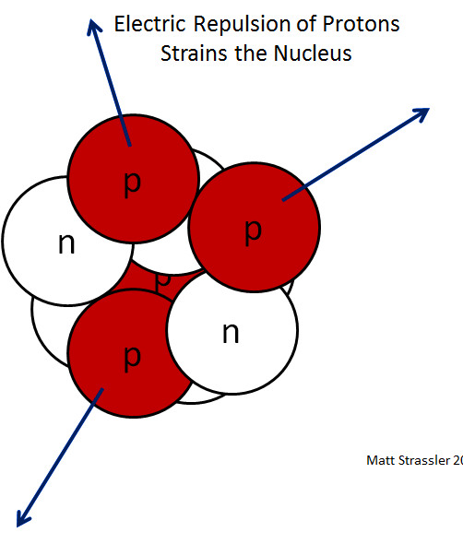
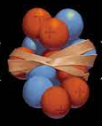
What keeps nuclei together normally?
STRONG FORCE – Holds the nucleus together, even though the protons want to repel each other.

Slide 4

Why do nuclei come apart sometimes?
Too many neutrons!
Strong force won’t be strong enough.
Like a rubber band that is stretched too far...it will break!

Slide 5
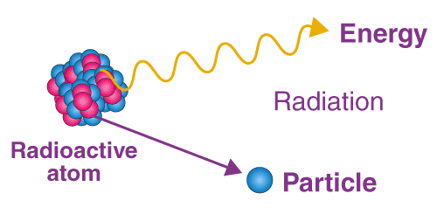
What happens when it comes apart?
Radiation!
Also called
Radioactive Decay
Particles and energy
come flying out of the
nucleus at high
speeds/energies
Radioactivity is these particles being released

Slide 6
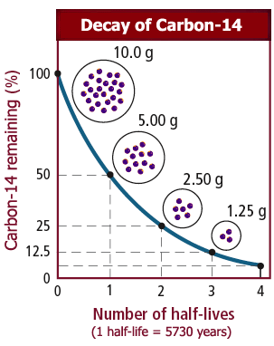
How long does it take?
Depends only on which isotope you have. Each one is unique!
The time it takes for ½ the particles to “decay” is called half life

Slide 7
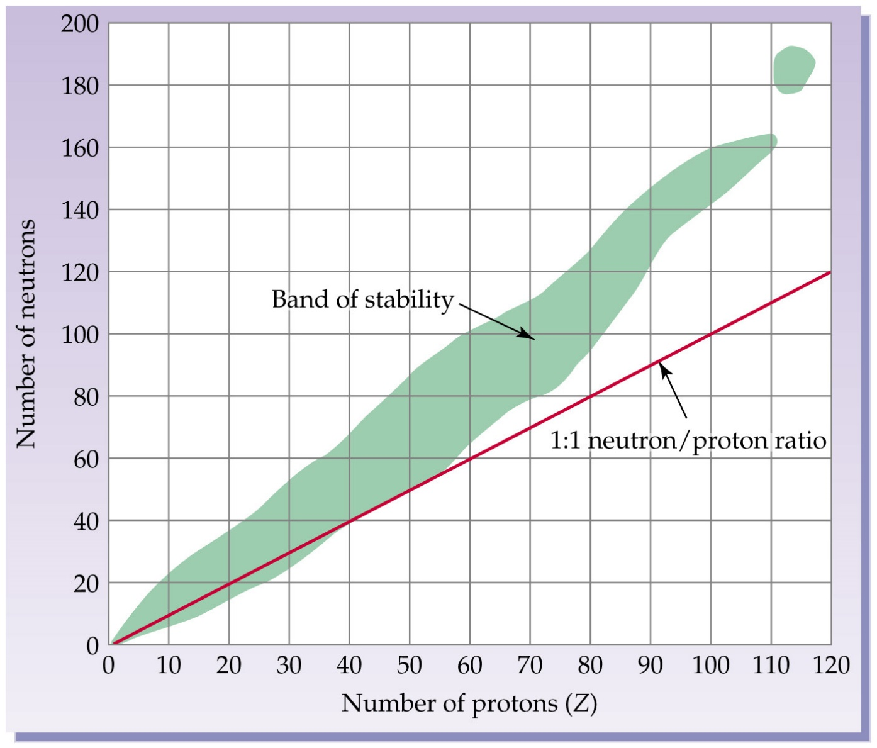
Band of Stability and Island of Stability
Neutron : Proton
ratio larger than
1:1 makes it more
likely to be
unstable, radioactive
(Clearly the 1:1 ratio is an over simplification – just go with it ☺ If asked which is most stable just calculate the ratio and pick the one closest to 1:1. That is good enough for this level of chemistry!)

Slide 8
Nuclear Stability
Very Stable | Marginally Stable | Unstable/Radioactive
Atomic #s 1-20 | Atomic #s 21-82 | Atomic #s > 82
1:1 ratio Protons : Neutrons | 1:1.5 ratio Protons : Neutrons | > 1:1.5 ratio Protons : Neutrons
Example: Carbon-12 6p : 6n | Example: Mercury-200 80p : 120n | Example: Uranium Plutonium

Slide 9
Nuclear Stability
Very Stable | Marginally Stable | Unstable/Radioactive
Atomic #s 1-20 | Atomic #s 21-82 | Atomic #s > 82
1:1 ratio Protons : Neutrons | 1:1.5 ratio Protons : Neutrons | > 1:1.5 ratio Protons : Neutrons
Example: Carbon-12 6p : 6n | Example: Mercury-200 80p : 120n | Example: Uranium Plutonium

Slide 10
Chemical vs. Nuclear Reactions
Chemical Reactions | Nuclear Reactions
Occur when bonds are broken | Occur when nuclei emit particles and/or rays

Slide 11
Chemical vs. Nuclear Reactions
Chemical Reactions | Nuclear Reactions
Occur when bonds are broken | Occur when nuclei emit particles and/or rays
Particles in the nucleus remain unchanged, although they may be rearranged | Particles in the nucleus often converted into atoms of another element

Slide 12
Chemical vs. Nuclear Reactions
Chemical Reactions | Nuclear Reactions
Occur when bonds are broken | Occur when nuclei emit particles and/or rays
Particles in the nucleus remain unchanged, although they may be rearranged | Particles in the nucleus often converted into atoms of another element
Involve only valence electrons | May involve protons, neutrons, and electrons

Slide 13
Chemical vs. Nuclear Reactions
Chemical Reactions | Nuclear Reactions
Occur when bonds are broken | Occur when nuclei emit particles and/or rays
Particles in the nucleus remain unchanged, although they may be rearranged | Particles in the nucleus often converted into atoms of another element
Involve only valence electrons | May involve protons, neutrons, and electrons
Associated with small energy changes | Associated with large energy changes

Slide 14
Chemical vs. Nuclear Reactions
Chemical Reactions | Nuclear Reactions
Occur when bonds are broken | Occur when nuclei emit particles and/or rays
Particles in the nucleus remain unchanged, although they may be rearranged | Particles in the nucleus often converted into atoms of another element
Involve only valence electrons | May involve protons, neutrons, and electrons
Associated with small energy changes | Associated with large energy changes
Reaction rate influenced by temperature, particle size, concentration, etc. | Reaction rate is not influenced by temperature, particle size, concentration, etc.

Slide 15
Nuclear Reactions
Isotopes of one element are changed into isotopes of another element
Contents of the nucleus change
Large amounts of energy released

Slide 16
Uses of Nuclear Reactions
Uncontrolled reactions are dangerous, but when used properly they can be useful!
Power plants
Tracking chemical reactions and biological processes
Radiation therapy for cancer
Determining the age of dead plants/animals, or even rocks.

Slide 17
Nuclear Fission
Splitting of a nucleus
Chain Rxn – one released particle sets
off another atom, keeps happening
Nuclear Reactor – controlled situation, energy
released slowly

Slide 18
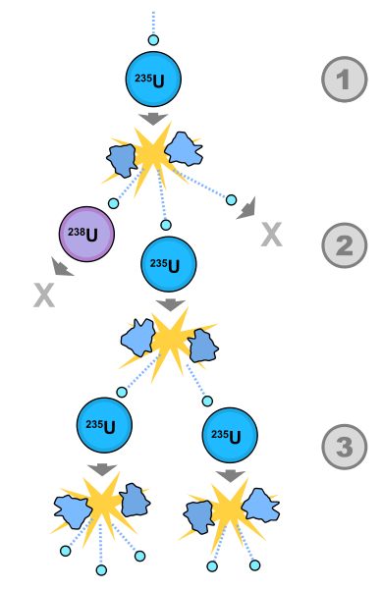
Nuclear Fission

Slide 19
Nuclear Fission (don’t need to write this)
1st controlled nuclear reaction in December 1942.
1st uncontrolled nuclear explosion occurred July 1945.
Examples – atomic bomb, current nuclear power plants

Slide 20
Nuclear Fusion
Combining nuclei
Doesn’t normally happen (+ and + repel)
Pros – Inexpensive, no radioactive waste
Cons – Hard to control, large startup energy
Examples – stars, hydrogen bomb, future
nuclear power plants

Slide 21
Nuclear Atomic Symbols
We will be writing our symbols like this:
mass #
Remember…to find # of neutrons, subtract mass # - atomic #
14
C
atomic #
6

Slide 22
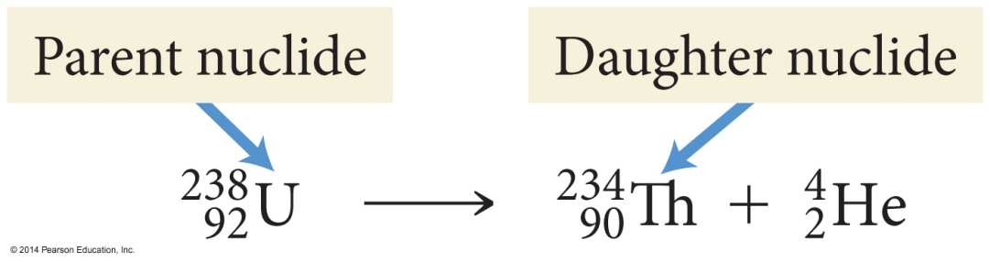
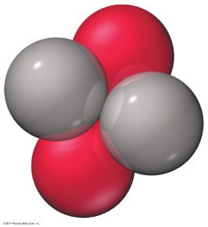
Type of Decay: Alpha Decay
Nucleus emits a particle made of
two protons and two neutrons – like a helium nucleus (not a helium atom, because it doesn’t have any e⁻)

Slide 23
Alpha radiation
Composition | Symbol | Charge | Mass
helium nuclei | He, α | +2 | 4amu
Shielding | Approx. Energy | Penetrating power
Paper, clothing | 5 MeV | Low 0.05mm body tissue
4
2

Slide 24


Type of Decay - Beta Decay
Neutron is split into a proton an a “beta particle” which is like an electron

Slide 25
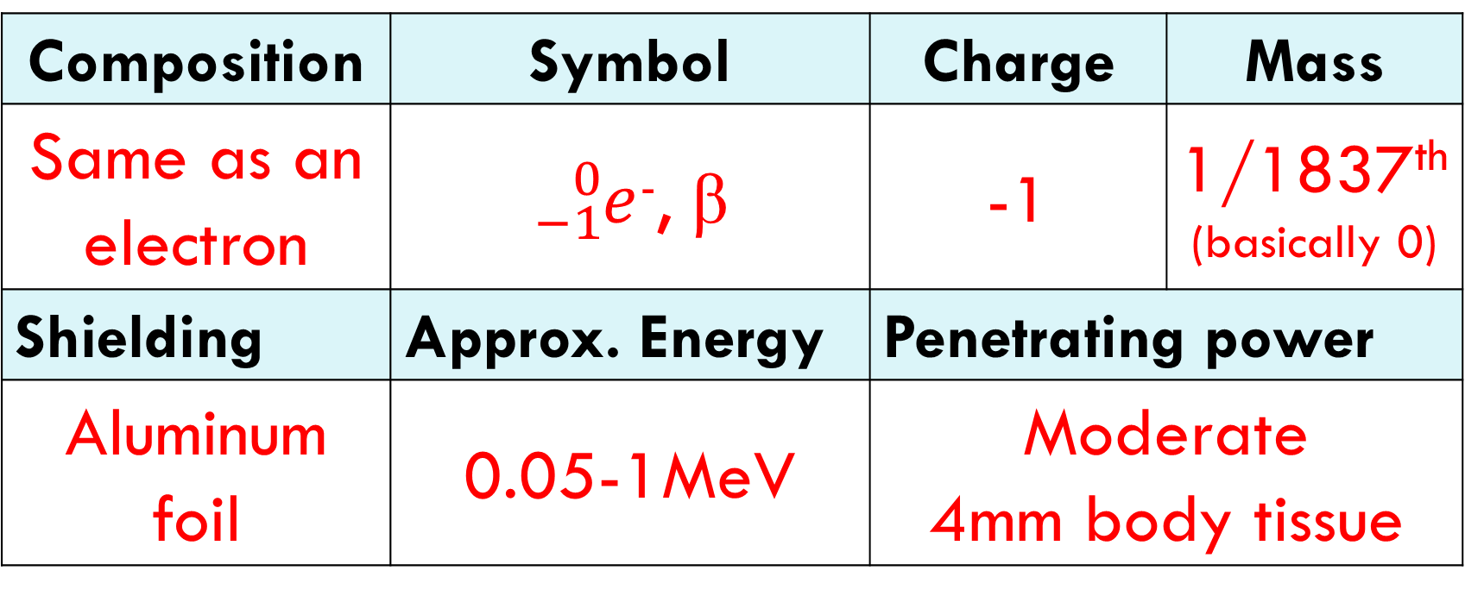
Beta radiation
Composition | Symbol | Charge | Mass
Same as an electron | ${}_{−1}^{0}e$⁻, β | -1 | 1/1837th (basically 0)
Shielding | Approx. Energy | Penetrating power
Aluminum foil | 0.05-1MeV | Moderate 4mm body tissue

Slide 26


Type of Decay - Positron
Proton splits into a neutron and a positron.
Like a beta particle, but has a charge of +1

Slide 27


Type of Decay - Gamma Emission
High energy photons.
No loss of particles from the nucleus
Usually after the nucleus undergoes some other type of decay and the remaining particles rearrange
*

Slide 28
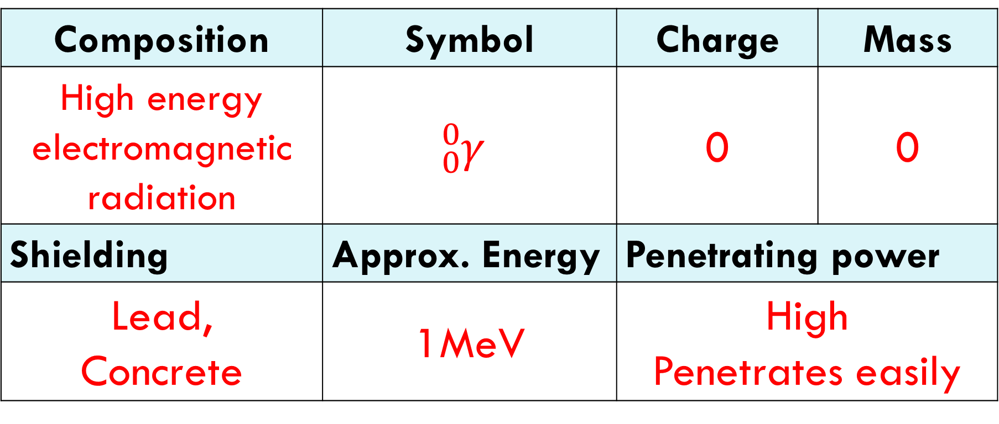
Gamma radiation
Composition | Symbol | Charge | Mass
High energy electromagnetic radiation | $${}_{0}^{0}γ$$ | 0 | 0
Shielding | Approx. Energy | Penetrating power
Lead, Concrete | 1MeV | High Penetrates easily

Slide 29
YouTube Link to Presentation
https://youtu.be/LrCO_eciSLQ

