Slide 1
N7 - Nuclear Chemistry
Target: I can describe different types of radioactive decay, and can write nuclear equations to show how the decay reactions take place.

Slide 2
PART 1 - CONCEPTS

Slide 3
Introduction to Nuclear Chemistry
The study of the structure of atomic nuclei and the changes they undergo.

Slide 4
Nuclear Atomic Symbols You already know this, don’t write
A chemical symbol looks like…
mass #
Remember…to find # of neutrons, subtract mass # - atomic #
14
C
atomic #
6

Slide 5
Chemical vs. Nuclear Reactions
Chemical Reactions | Nuclear Reactions
Occur when bonds are broken | Occur when nuclei emit particles and/or rays

Slide 6
Chemical vs. Nuclear Reactions
Chemical Reactions | Nuclear Reactions
Occur when bonds are broken | Occur when nuclei emit particles and/or rays
Atoms remain unchanged, although they may be rearranged | Atoms often converted into atoms of another element

Slide 7
Chemical vs. Nuclear Reactions
Chemical Reactions | Nuclear Reactions
Occur when bonds are broken | Occur when nuclei emit particles and/or rays
Atoms remain unchanged, although they may be rearranged | Atoms often converted into atoms of another element
Involve only valence electrons | May involve protons, neutrons, and electrons

Slide 8
Chemical vs. Nuclear Reactions
Chemical Reactions | Nuclear Reactions
Occur when bonds are broken | Occur when nuclei emit particles and/or rays
Atoms remain unchanged, although they may be rearranged | Atoms often converted into atoms of another element
Involve only valence electrons | May involve protons, neutrons, and electrons
Associated with small energy changes | Associated with large energy changes

Slide 9
Chemical vs. Nuclear Reactions
Chemical Reactions | Nuclear Reactions
Occur when bonds are broken | Occur when nuclei emit particles and/or rays
Atoms remain unchanged, although they may be rearranged | Atoms often converted into atoms of another element
Involve only valence electrons | May involve protons, neutrons, and electrons
Associated with small energy changes | Associated with large energy changes
Reaction rate influenced by temperature, particle size, concentration, etc. | Reaction rate is not influenced by temperature, particle size, concentration, etc.

Slide 10
Nuclear Reactions
Isotopes of one element are changed into isotopes of another element
Contents of the nucleus change
Large amounts of energy released

Slide 11
Uses of Nuclear Reactions
Uncontrolled reactions are dangerous, but when used properly they can be useful!
Power plants
Tracking chemical reactions and biological processes
Radiation therapy for cancer
Determining the age of dead plants/animals, or even rocks.

Slide 12
Nuclear Fission
Splitting of a nucleus
Chain Rxn – one released particle sets off another atom, keeps happening
Nuclear Reactor – controlled situation, energy released slowly

Slide 13
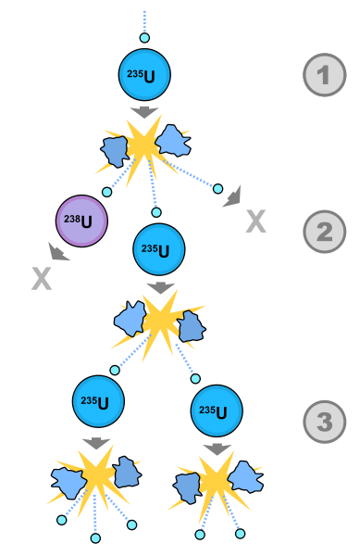
Nuclear Fission

Slide 14
Nuclear Fission (don’t need to write this)
1st controlled nuclear reaction in December 1942.
1st uncontrolled nuclear explosion occurred July 1945.
Examples – atomic bomb, current nuclear power plants

Slide 15
Nuclear Fusion
Combining nuclei
Doesn’t normally happen (+ and + repel)
Pros – Inexpensive, no radioactive waste
Cons – Hard to control, large startup energy
Examples – stars, hydrogen bomb, future nuclear power plants

Slide 16
Nuclear Stability
Very Stable | Marginally Stable | Unstable/Radioactive
Atomic #s 1-20 | Atomic #s 21-82 | Atomic #s > 82
1:1 ratio Protons : Neutrons | 1:1.5 ratio Protons : Neutrons | > 1:1.5 ratio Protons : Neutrons
Example: Carbon-12 6p : 6n | Example: Mercury-200 80p : 120n | Example: Uranium Plutonium

Slide 17
Nuclear Stability
Very Stable | Marginally Stable | Unstable/Radioactive
Atomic #s 1-20 | Atomic #s 21-82 | Atomic #s > 82
1:1 ratio Protons : Neutrons | 1:1.5 ratio Protons : Neutrons | > 1:1.5 ratio Protons : Neutrons
Example: Carbon-12 6p : 6n | Example: Mercury-200 80p : 120n | Example: Uranium Plutonium

Slide 18
What keeps nuclei together? Why do they fall apart?
STRONG FORCE! – Holds the nucleus together, even though the protons want to repel each other.
Too many neutrons? – Strong force wont be strong enough, like a rubber band that is stretched too far…it will break!
When it breaks, particles come flying out of the nucleus!
Too many neutrons = radioactive!

Slide 19
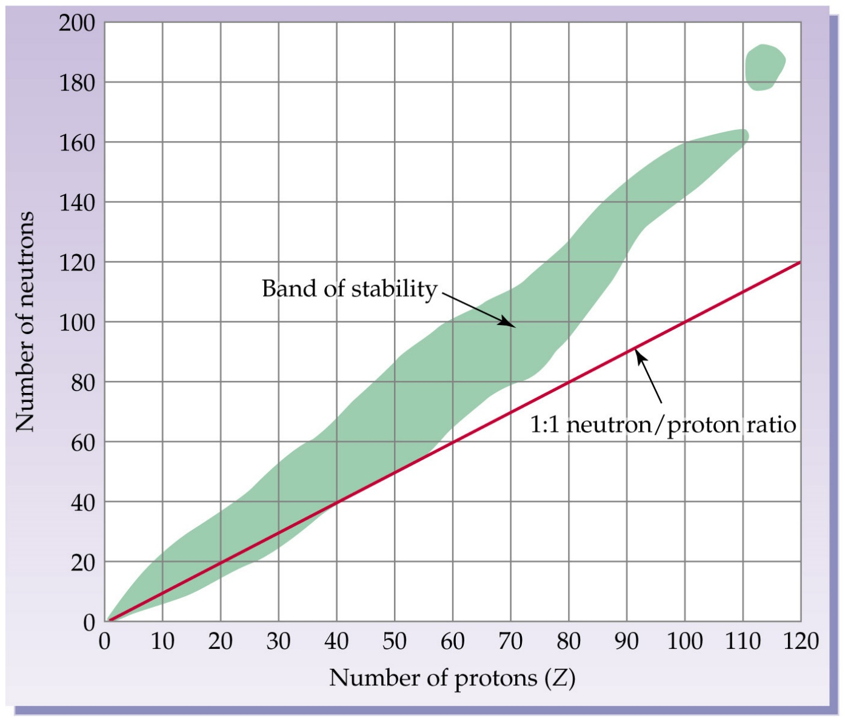
Band of Stability and Island of Stability

Slide 20
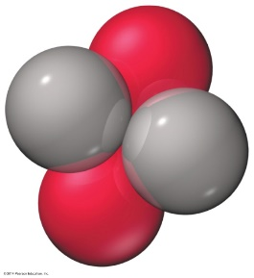
Type of Decay: Alpha Decay
When an unstable nucleus emits a particle composed of two protons and two neutrons

Slide 21
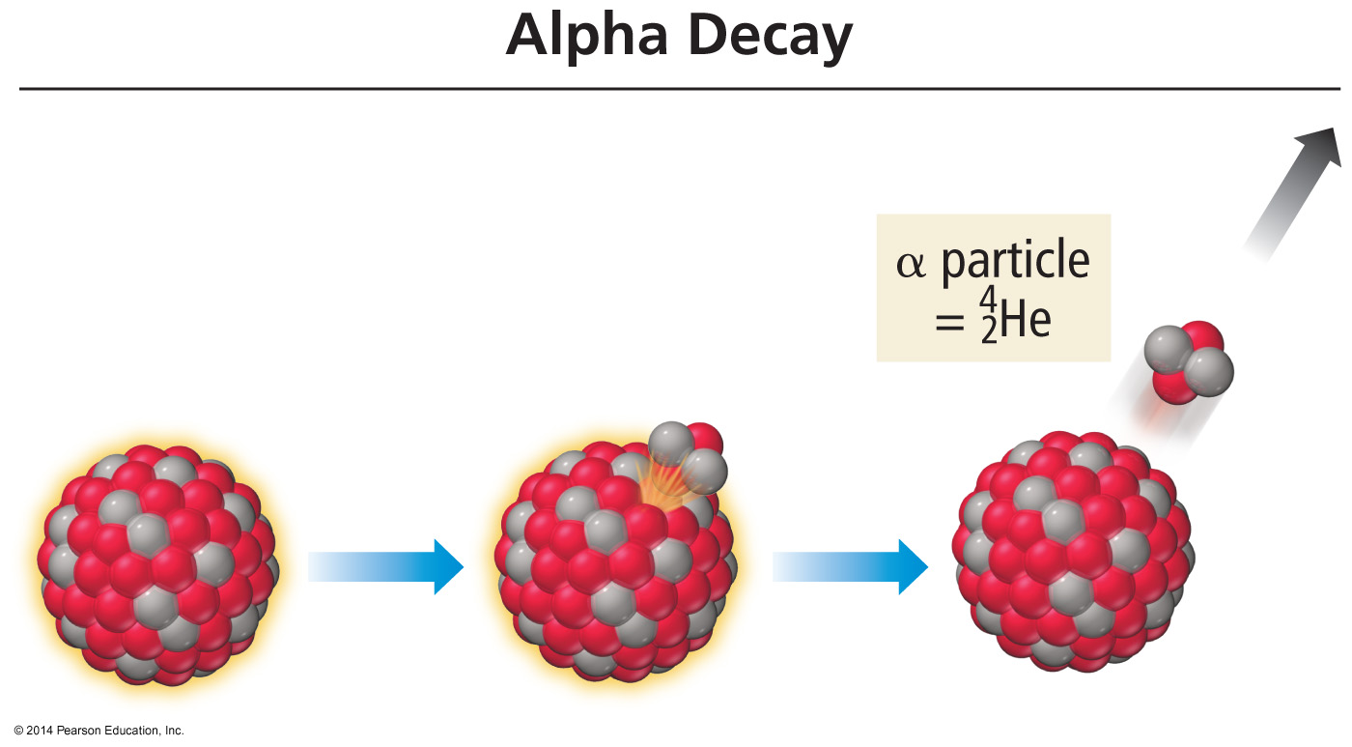
Alpha decay is limited to VERY large, nuclei such as those in heavy metals.

Slide 22
Alpha radiation
Composition | Symbol | Charge | Mass
helium nuclei | He, α | +2 | 4amu
Shielding | Approx. Energy | Penetrating power
Paper, clothing | 5 MeV | Low 0.05mm body tissue
4
2

Slide 23
Type of Decay - Beta Decay
When an unstable nucleus emits an electron

Slide 24
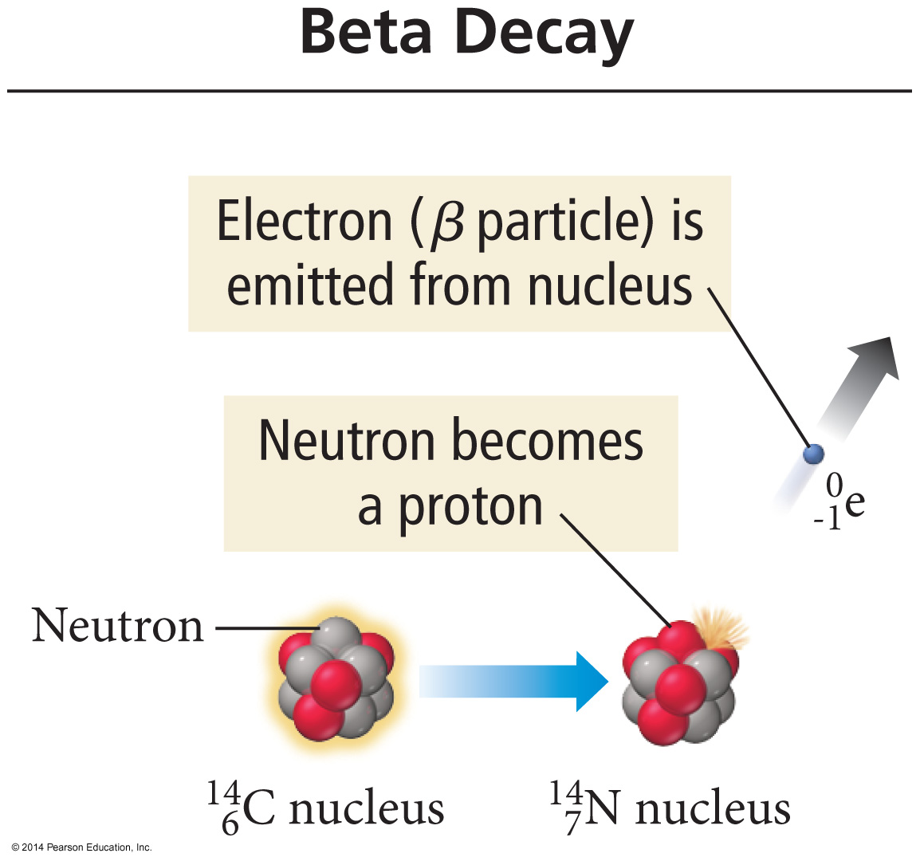
Beta decay converts a neutron into a proton.

Slide 25
Beta radiation
Composition | Symbol | Charge | Mass
Same as an electron | e⁻, β | -1 | 1/1837th (basically 0)
Shielding | Approx. Energy | Penetrating power
Aluminum foil | 0.05-1MeV | Moderate 4mm body tissue

Slide 26
Type of Decay - Positron Emission
Like a beta particle, but has a charge of +1

Slide 27
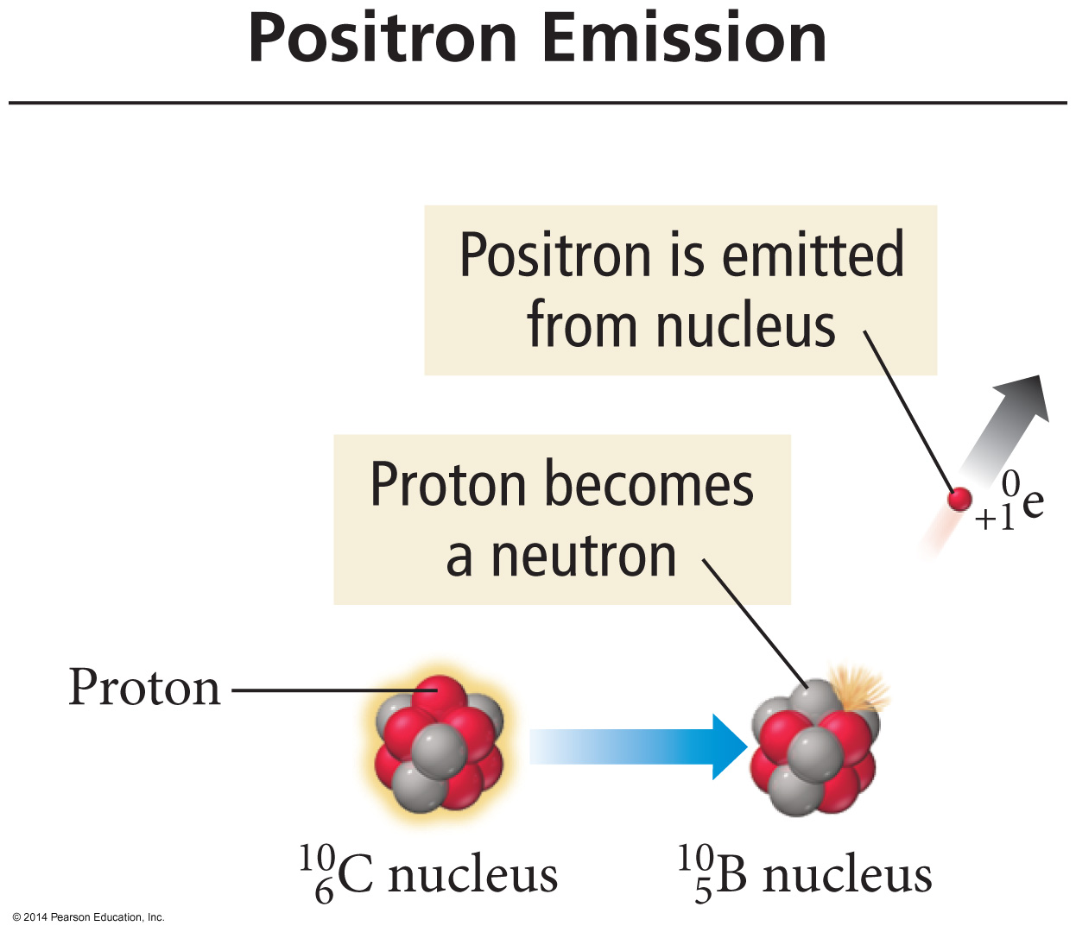
Positrons result from a proton changing into a neutron.

Slide 28
Type of Decay - Gamma Emission
High energy photons.
No loss of particles from the nucleus
Usually after the nucleus undergoes some other type of decay and the remaining particles rearrange
*

Slide 29
Gamma radiation
Composition | Symbol | Charge | Mass
High energy electromagnetic radiation | γ | 0 | 0
Shielding | Approx. Energy | Penetrating power
Lead, Concrete | 1MeV | High Penetrates easily

Slide 30
PART 2 –BALANCED NUCLEAR EQUATIONS

Slide 31
Nuclear Equations
Mass numbers and atomic numbers are conserved.
We can use this fact to determine the identity of a daughter nuclide if we know the parent and type of decay.

Slide 32
Example 1: Write the nuclear equation for the radioactive decay of polonium – 210 by alpha emission.
Step 1: Write the element that you are starting with.
Mass #
210
Po
84
Atomic #

Slide 33
Example 1: Write the nuclear equation for the radioactive decay of polonium – 210 by alpha emission.
Step 2: Draw the arrow.
Mass #
210
Po
84
Atomic #

Slide 34
Example 1: Write the nuclear equation for the radioactive decay of polonium – 210 by alpha emission.
Step 3: Write the alpha particle.
Mass #
210
Po
4
He
84
2
Atomic #

Slide 35
Example 1: Write the nuclear equation for the radioactive decay of polonium – 210 by alpha emission.
Step 4: Determine other product (ensuring everything is balanced).
Mass #
210
Po
4
He
206
Pb
84
2
82
Atomic #

Slide 36
Example 2: Write the nuclear equation for the radioactive decay of radium – 226 by alpha emission.
Step 1: Write the element that you are starting with.
Mass #
226
Ra
88
Atomic #

Slide 37
Example 2: Write the nuclear equation for the radioactive decay of radium – 226 by alpha emission.
Step 2: Draw the arrow.
Mass #
226
Ra
88
Atomic #

Slide 38
Example 2: Write the nuclear equation for the radioactive decay of radium – 226 by alpha emission.
Step 3: Write the alpha particle.
Mass #
226
Ra
4
He
88
2
Atomic #

Slide 39
Example 2: Write the nuclear equation for the radioactive decay of radium – 226 by alpha emission.
Step 4: Determine other product (ensuring everything is balanced).
Mass #
226
Ra
4
He
222
Rn
88
2
86
Atomic #

Slide 40
Example 3: Write the nuclear equation for the radioactive decay of zirconium – 97 by beta decay.
Step 1: Write the element that you are starting with.
Mass #
97
Zr
40
Atomic #

Slide 41
Example 3: Write the nuclear equation for the radioactive decay of zirconium – 97 by beta decay.
Step 2: Draw the arrow.
Mass #
97
Zr
40
Atomic #

Slide 42
Example 3: Write the nuclear equation for the radioactive decay of zirconium – 97 by beta decay.
Step 3: Write the beta particle.
Mass #
97
Zr
e
0
40
-1
Atomic #

Slide 43
Example 3: Write the nuclear equation for the radioactive decay of zirconium – 97 by beta decay.
Step 4: Determine other product (ensuring everything is balanced).
Mass #
97
Zr
e
0
97
Nb
40
-1
41
Atomic #

Slide 44
Example 4: What type of decay is it when carbon – 14 turns into nitrogen – 14 ?
Step 1: Write the element that you are starting with.
Mass #
14
C
6
Atomic #

Slide 45
Example 4: What type of decay is it when carbon – 14 turns into nitrogen – 14 ?
.
Step 2: Draw the arrow.
Mass #
14
C
6
Atomic #

Slide 46
Example 4: What type of decay is it when carbon – 14 turns into nitrogen – 14 ?
.
Step 3: Write the daughter product this time!
Mass #
14
C
14
N
6
7
Atomic #

Slide 47
Example 4: What type of decay is it when carbon – 14 turns into nitrogen – 14 ?
Step 4: Determine other product (ensuring everything is balanced).
Mass #
14
C
0
e
14
N
6
-1
7
Atomic #

Slide 48
Sometimes lots of parts! Still just adding/subtracting!
(2 x 1) + 235 = 237
(3 x 0) + 237 = 237
$$2{}_{ 0}^{1}{n+{}_{92}^{235}{U →} 3{}_{−1}^{0}e+ {}_{95}^{237}{Am}}$$
(2 x 0) + 92= 92
(3 x -1) + 95 = 92
By the way…This is called “neutron bombardment”

Slide 49
Sometimes lots of parts! Still just adding/subtracting!
0 + 218 = 218
218 + 0 = 218
$${}_{ −1}^{0}{e+{}_{85}^{218}{At →} {}_{84}^{218}{Po+γ_{0}^{0}}}$$
(-1) + 85= 84
84 + 0 = 84
By the way…This is called “electron capture”

Slide 50
YouTube Link to Presentation
https://youtu.be/LrCO_eciSLQ

