Slide 1
N9 – half life
Target: I can perform calculations related to how quickly radioactive substances decay.

Slide 2
Half-Life
Half Life is the time required for half of a radioisotope’s nuclei to decay into its products.
# of ½ lives | % Remaining
0 | 100%
1 | 50%
2 | 25%
3 | 12.5%
4 | 6.25%
5 | 3.125%
6 | 1.5625%

Slide 3
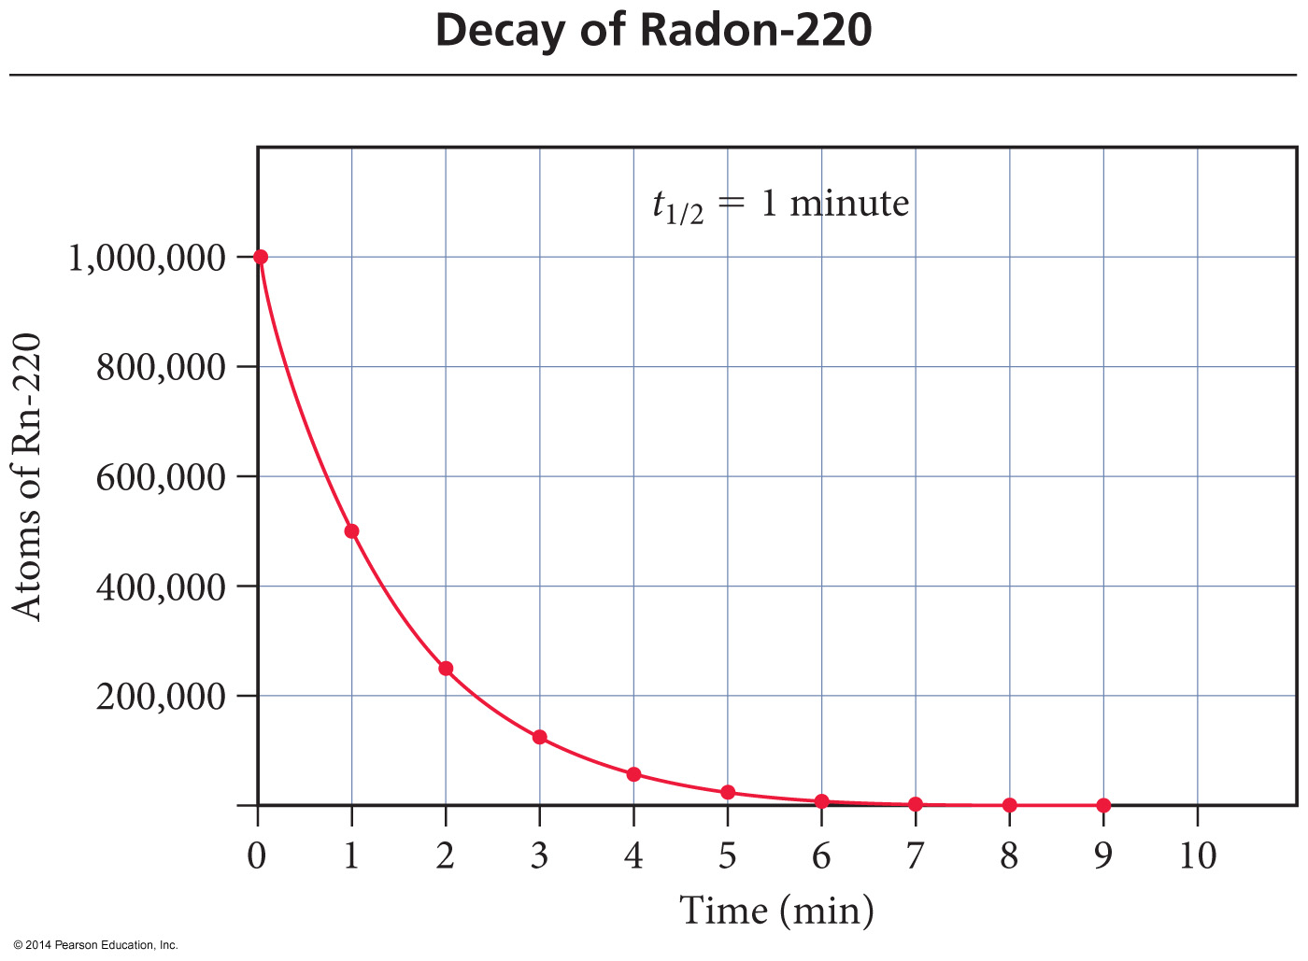
Graphing Half-Life
Half of the radioactive atoms decay each half-life.

Slide 4
Using a Table
Suppose you have 10.0 grams of strontium – 90, which has a half life of 29 years. How much will be remaining after x number of years?
# of ½ lives | Time (Years) | Amount Remaining (g)
0 | 0 | 10
1 | 29 | 5
2 | 58 | 2.5
3 | 87 | 1.25
4 | 116 | 0.625

Slide 5
Half-Life Equation
Use a handy dandy equation!
Amount Starting
A_{E} = A_{S} x (0.5)^{n}
# of half-lives
Amount Ending
Still Radioactive
n = t h
t = time passed
h = length of one half-life

Slide 6
Solving for % remaining
A_{E} = A_{S} x (0.5)^{n}
% remaining = A_{E} x 100
As
A_{E} = (0.5)^{n}
A_{S}
Then multiply your answer by 100 to put it in % format!

Slide 7
Example 1
If gallium – 68 has a half-life of 68.3 minutes, how much of a 160.0 mg sample is left after 1 half life? ________. After 2 half lives? __________. After 3 half lives? __________
80 mg
40 mg
20 mg
A_{E} = A_{s} x (0.5)^{n}
80 mg = 160.0 mg x (0.5)¹
40 mg = 160.0 mg x (0.5)²

Slide 8
Example 2
Cobalt – 60, with a half-life of 5 years, is used in cancer radiation treatments. If a hospital purchases a supply of 30.0 g, how much would be left after 15 years? ______________
3.75 g
A_{E} = A_{s} x (0.5)^{n}
A_{E} = 30.0g x (0.5)^{(15/5)} = 3.75 g

Slide 9
Example 3
Iron-59 is used in medicine to diagnose blood circulation disorders. The half-life of iron-59 is 44.5 days. How much of a 2.000 mg sample will remain after 133.5 days? ______________
A_{E} = A_{s} x (0.5)^{t/h}
A_{E} = 2.000 mg x (0.5)^{(133.5/44.5)}
0.2500 mg = 2.000 mg x 0.125

Slide 10
Solve for Time/Half-life
A_{E} = A_{s} x (0.5)^{t/h}
Isolate (0.5)^{t/h}
A_{E} = (0.5)^{t/h}
A_{s}
Bring down exponent using logs
Plug in your #’s then rearrange for t or h depending on what you want to solve for!
Log A_{E} = t Log (0.5)
A_{s} h

Slide 11
Example 4
The half-life of polonium-218 is 3.0 min. If you start with 20.0 g, how long before only 1.25 g remains?
Log A_{E} = t Log (0.5)
A_{s} h
Log 1.25 = t Log (0.5)
20.0 3
t = 12min

Slide 12
Example 5
A sample initially contains 150.0 mg of radon-222. After 11.4 days, it contains 18.75 mg of radon-222. Calculate the half-life.
Log A_{E} = t Log (0.5)
A_{s} h
Log 18.75 = 11.4 Log (0.5)
150.0 h
h = 3.8days

Slide 13
YouTube Link to Presentation
https://youtu.be/7152ocNo7ko

