Slide 1
Introduction to Electrons
Don’t need to write
The electron is a theory we use; it is so useful in understanding the way nature works that we can almost call it real.
- Richard P. Feynman
…will you understand what I’m going to tell you?...No, you're not gong to be able to understand it…I don’t understand it. Nobody does.
- Richard P. Feynman

Slide 2
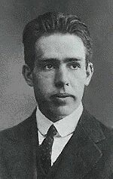
The Bohr Model of the Atom
Don’t need to write
I pictured electrons orbiting the nucleus much like planets orbiting the sun.
But I was wrong! They’re more like bees around a hive.
Neils Bohr

Slide 3
Quantum Mechanical Model of the Atom
Don’t need to write
Mathematical laws can identify the regions outside of the nucleus where electrons are most likely to be found.
The math is beyond the scope of this class…

Slide 4
A region where there is a high probability of finding an electron. A mathematical function…
Atomic Orbitals
“An area where an electron is most likely to be found.”
“A probability cloud”
Orbital shapes are defined as the surface that contains 90% of the total electron probability.

Slide 5
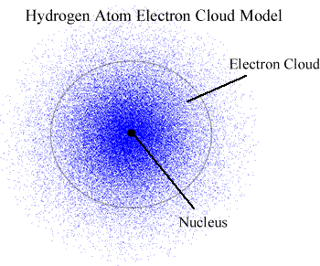

Slide 6
How do we describe orbitals?
Energy level
Shape
Orientation
How many electrons are in each orbital

Slide 7
Energy Levels
Different orbitals are in different energy levels
n = 1, 2, 3, 4, 5, 6, 7.
1 = lowest energy, closest to the nucleus
n = 1
n = 2
n = 3
n = 4

Slide 8
Orbital Shape
Different orbitals have different shapes s, p, d, f

Slide 9
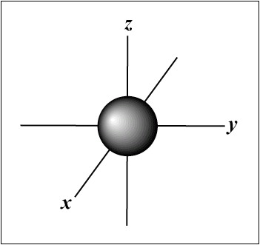
s Orbital shape
The s orbital has a spherical shape centered around
the origin of the three axes in space.

Slide 10
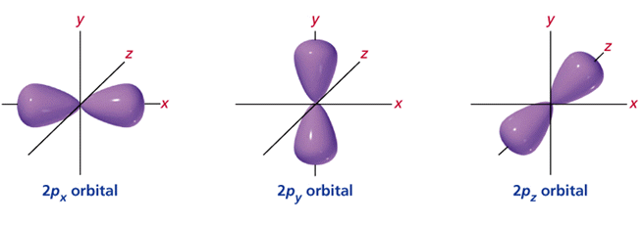
p orbital shape
There are three or double-lobed p orbitals in each energy level above n = 1, each assigned to its own axis (x, y and z) in space.
Petal shaped, dumbbell shaped, peanut shaped

Slide 11
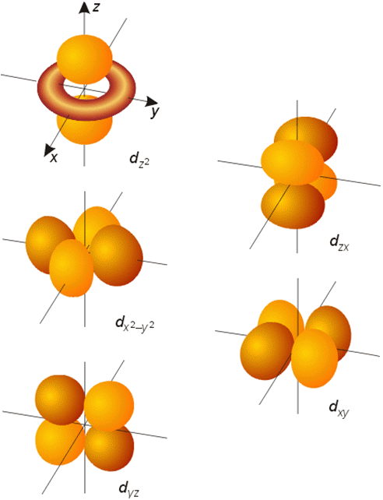
d orbital shapes
d orbitals are weird!
Five d orbitals that are found in the d sublevels beginning with n = 3.
“double dumbbells” or “dumbbell with a donut”!

Slide 12
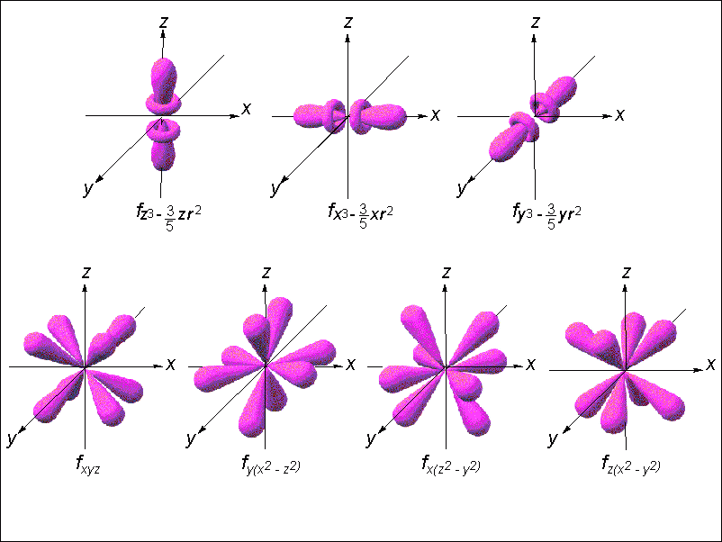
Shape of f orbitals
“funky” shaped!

Slide 13
Orbital Orientation
Different orbitals have different orientations
x, y, z (axis)

Slide 14
Electrons in an orbital
Each orbital is only allowed to have TWO e⁻s
“Spin Up”
“Spin Down”
Notes:
For info on Carbon-14 check out: http://science.howstuffworks.com/carbon-14.htm (decay rate of C-14 used to predict age of old organic materials)
Atomic Bomb and Nuclear Power – Great Movie “Meltdown at 3-Mile Island” by PBS
For info on Radon http://www.epa.gov/iaq/radon/pubs/ or http://www.nsc.org/ehc/radon.htm

Slide 15
So how do I tell someone exactly where an electron is???

Slide 16
Think about where you live…
California State
Pleasanton City
Ferdinand Avenue Street
#2345 House #
You can write an ADDRESS for where you live
So couldn’t you write an ADDRESS for where the
electrons are in an atom???
Notes:
For info on Carbon-14 check out: http://science.howstuffworks.com/carbon-14.htm (decay rate of C-14 used to predict age of old organic materials)
Atomic Bomb and Nuclear Power – Great Movie “Meltdown at 3-Mile Island” by PBS
For info on Radon http://www.epa.gov/iaq/radon/pubs/ or http://www.nsc.org/ehc/radon.htm

Slide 17
Where do e- live? What is the address for one?
State Energy Level
City Type/Shape of Orbital
Street Orientation
House # Spin up or Spin down
Notes:
For info on Carbon-14 check out: http://science.howstuffworks.com/carbon-14.htm (decay rate of C-14 used to predict age of old organic materials)
Atomic Bomb and Nuclear Power – Great Movie “Meltdown at 3-Mile Island” by PBS
For info on Radon http://www.epa.gov/iaq/radon/pubs/ or http://www.nsc.org/ehc/radon.htm

Slide 18
Electron Configuration is an address!
2p_{x +½}
Energy Level
Type/Shape of Orbital
Orientation
Spin up or Spin down + ½ , - ½
Notes:
For info on Carbon-14 check out: http://science.howstuffworks.com/carbon-14.htm (decay rate of C-14 used to predict age of old organic materials)
Atomic Bomb and Nuclear Power – Great Movie “Meltdown at 3-Mile Island” by PBS
For info on Radon http://www.epa.gov/iaq/radon/pubs/ or http://www.nsc.org/ehc/radon.htm

Slide 19
1s_{+½ ,}1s_{-½} ,2s_{+½ ,} 2s_{-½}
2p_{x +½ ,} 2p_{x -½ ,} 2p_{y +½} 2p_{y -½ ,} 2p_{z +½ ,} 2p_{z -½}
1s² 2s²2p⁶

Slide 20
Want to describe where ALL the e⁻s in an atom were?
Shrink it down and only list the basics!
Energy levels
Shapes of Orbitals
Number of electrons in each orbital
1s² 2s² 2p⁶ 3s² 3p⁴
= 2+2+6+2+4 = 16 e⁻ Sulfur!

Slide 21
Steps to finding all the electrons
Pick an atom
Find the number of electrons it has
Start putting electrons into the orbitals
Use an ORBITAL CHART/DIAGRAM
List which orbitals you used and how many electrons in each one

Slide 22
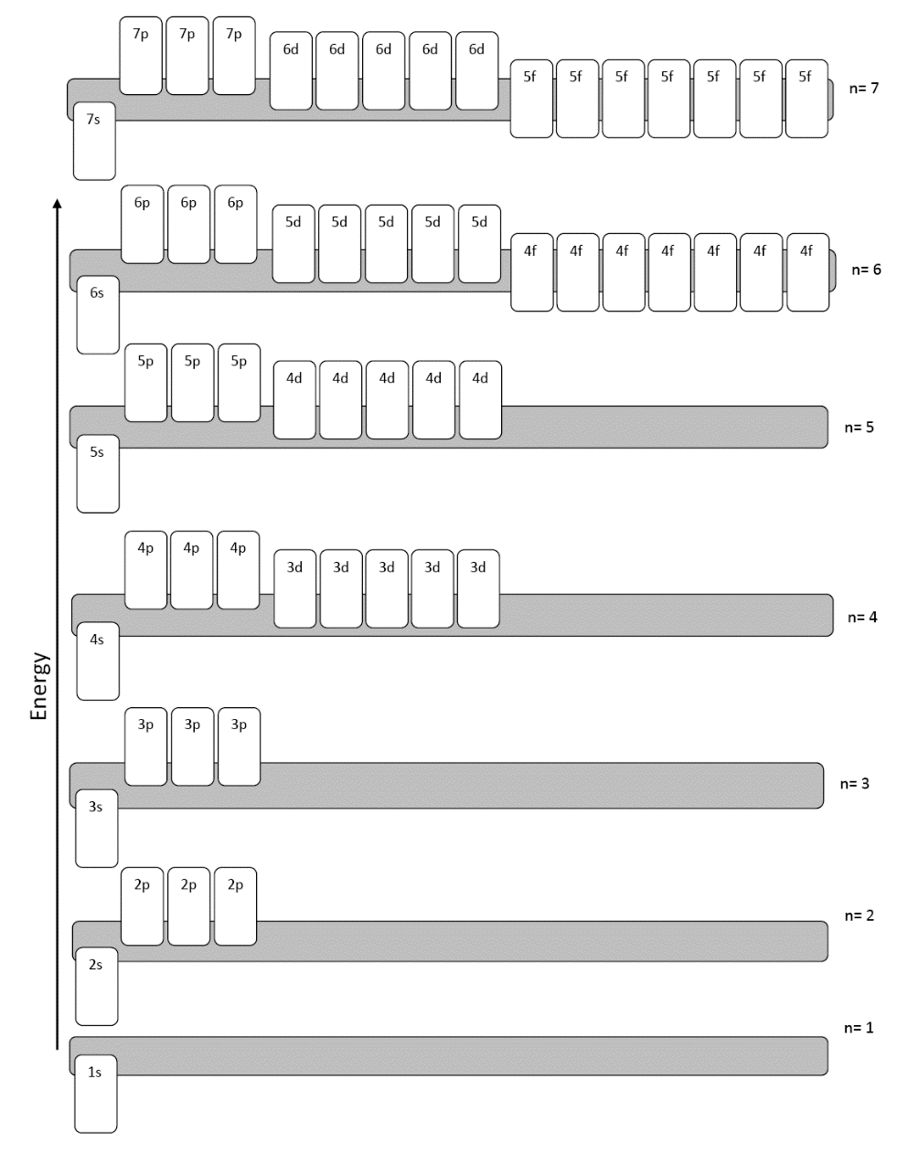
Orbital Diagram
A chart that shows you the order that the orbitals go in.

Slide 23
Rules for putting e⁻s in orbital diagrams
Aufbau Principle
An electron occupies the lowest energy
orbital that it can.
Means: Fill from the bottom up Electrons are lazy!

Slide 24
Rules for putting e⁻s in orbital diagrams
Pauli Exclusion Principle
No two electrons in the same atom can have
the same set of 4 quantum numbers
Means: If there are two e⁻s in one orbital, one must be spin up, one spin down.
They can’t have exactly the same “address”

Slide 25
Rules for putting e⁻s in orbital diagrams
Hund’s Rule
Orbitals of equal energy are each occupied by
one electron before any orbital is occupied by a
second electron.
Means: If there are more than one orbital at the same energy, put one electron into each orbital before pairing up
Don’t share a bedroom unless you have to!

