Slide 1
N-11 Orbital Diagrams
Target: I can show on an orbital diagram where the electrons are in an atom.
Link to YouTube Presentation: https://youtu.be/Unket5xtmjU

Slide 2
N-11 Orbital Diagrams How do you know what order the electrons and orbitals go in???

Slide 3
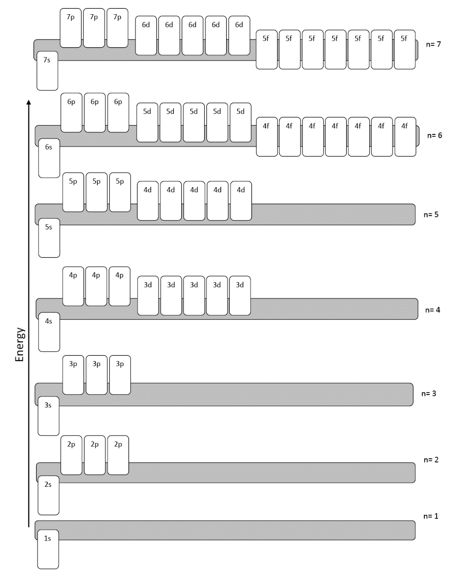
Orbital Diagram
A chart that shows
you the order that
the orbitals go in.

Slide 4
Electron Configuration Rules…
Aufbau Principle:
Electrons fill lowest possible energy level first.
They are lazy!

Slide 6
Electron Configuration Rules…
Pauli Exclusion Principle:
No two electrons may have the same set of four quantum numbers.
Any single orbital may only contain two electrons, BUT one has to be spin up, and one has to be spin down.

Slide 7
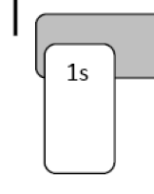

Slide 8
Electron Configuration Rules…
Hund’s Rule:
Electrons will fill each equal energy orbital before pairing up
Spread them out before your pair them up
“You don’t want to share a bedroom with your sibling unless you really have to!”
Electrons want elbow room!

Slide 9
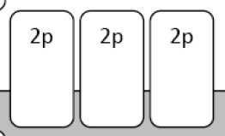
p_{x} p_{y} p_{z}

Slide 10
Steps to finding all the electrons
Find an atom on the periodic table
Find the number of electrons it has
Start putting electrons into the orbitals
Use an ORBITAL CHART/DIAGRAM
List which orbitals you used and how many electrons in each one

Slide 11
Let’s practice together under the document camera! (photos on next slides for those who were absent)

Slide 12
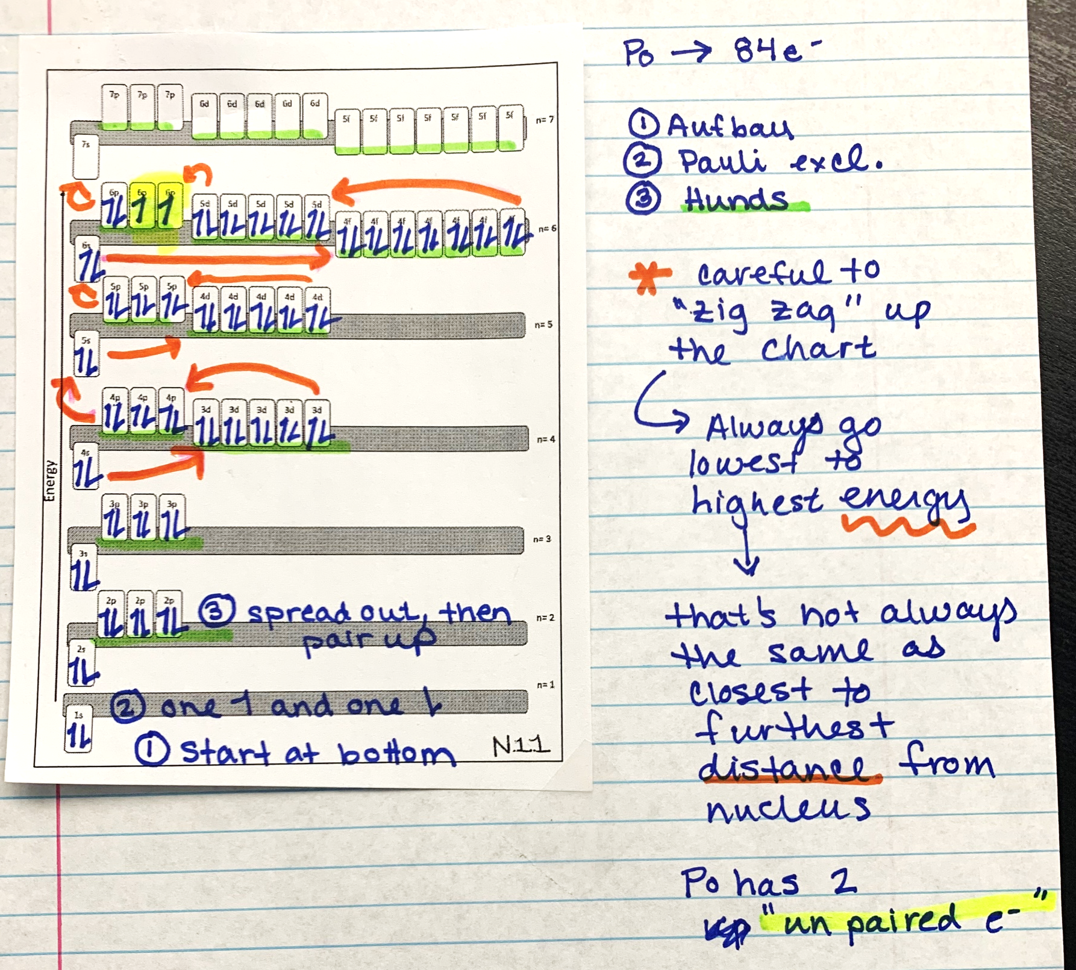

Slide 13
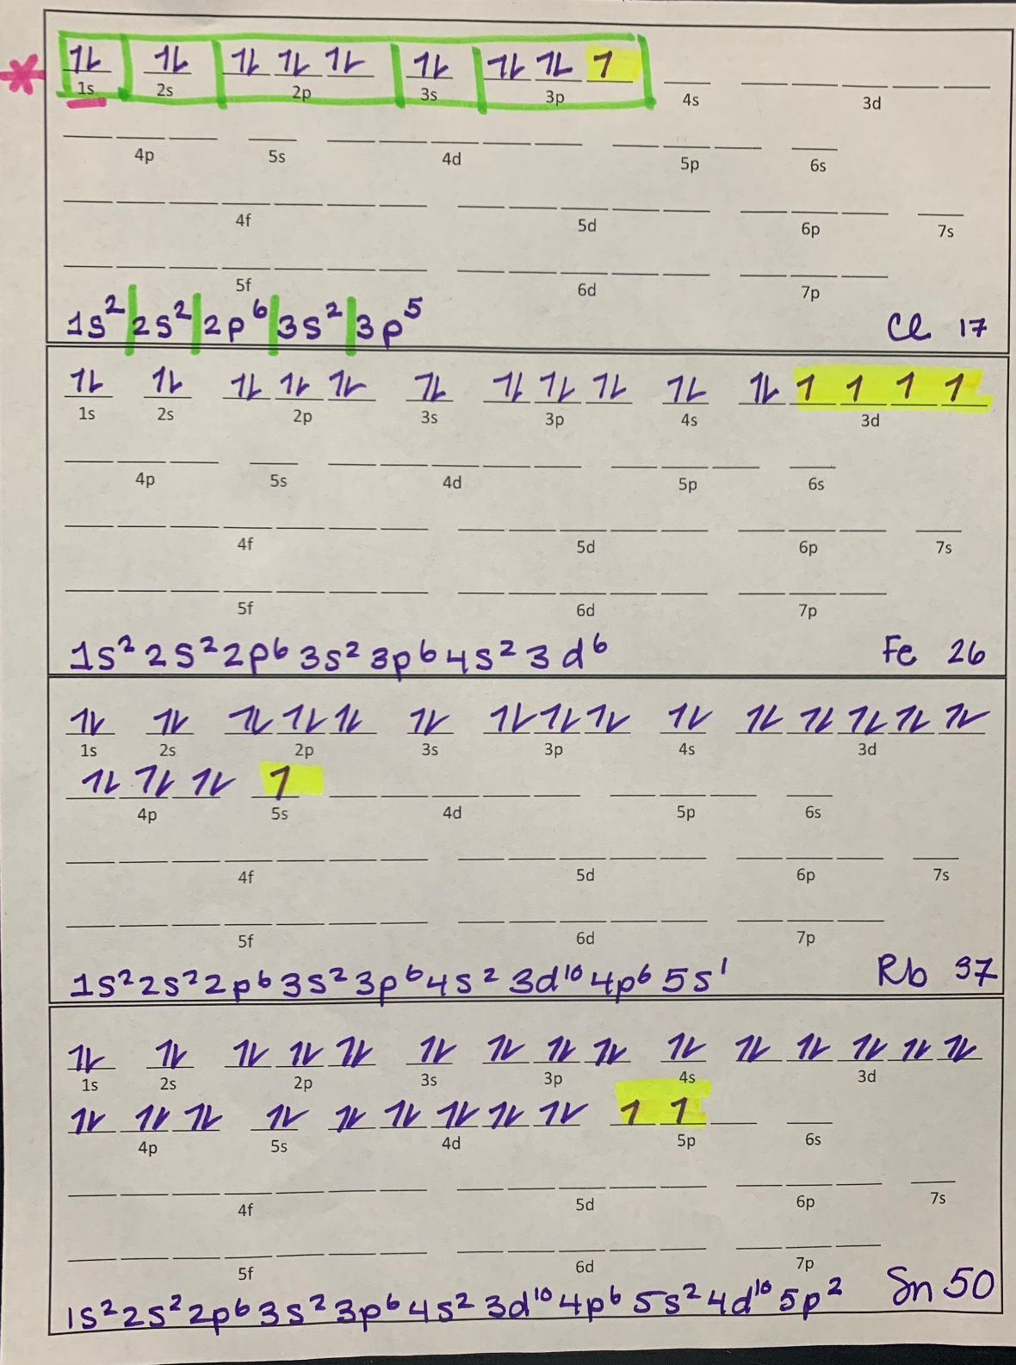

Slide 14
YouTube Link to Presentation
https://youtu.be/Unket5xtmjU

