Slide 1
Quantum Numbers and Orbital Diagrams

Slide 2
Quantum Numbers
Each electron in an atom has a unique set of 4 quantum numbers which describe it.
When you list all four quantum numbers it basically is writing an “address” to identify exactly which electron you are talking about and where it is located.
We should know what they represent, but we don’t need to “assign” them in any practice problems.

Slide 3
Quantum Numbers
Name | Symbol | Denotes
Principal quantum number | n
Angular momentum quantum number | l
Magnetic quantum number | m or m_{l}
Spin quantum number | s or m_{s}

Slide 4
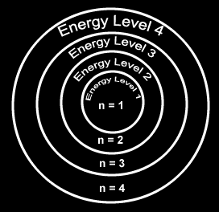
Principal Quantum Number
Denotes the shell (energy level) in which the electron is located.

Slide 5
Angular Momentum Quantum Number
Denotes the orbital shape (subshell) in which the electron is located.

Slide 6
Magnetic Quantum Number
Denotes the orientation of the electron’s orbital with respect to the three axes in space.

Slide 7
Spin Quantum Number
Denotes the behavior (direction of spin) of an electron within a magnetic field.
Possibilities for electron spin:

Slide 8
Electron Configuration is an address!
2p_{x +½}
Energy Level
Type/Shape of Orbital
Orientation
Spin up or Spin down + ½ , - ½
For every single electron…
Notes:
For info on Carbon-14 check out: http://science.howstuffworks.com/carbon-14.htm (decay rate of C-14 used to predict age of old organic materials)
Atomic Bomb and Nuclear Power – Great Movie “Meltdown at 3-Mile Island” by PBS
For info on Radon http://www.epa.gov/iaq/radon/pubs/ or http://www.nsc.org/ehc/radon.htm

Slide 9
1s_{+½ ,}1s_{-½} ,2s_{+½ ,} 2s_{-½}
2p_{x +½ ,} 2p_{x -½ ,} 2p_{y +½} 2p_{y -½ ,} 2p_{z +½ ,} 2p_{z -½}
1s² 2s²2p⁶

Slide 10
Want to describe where ALL the e⁻s in an atom were?
Shrink it down and only list the basics!
Energy levels
Shapes of Orbitals
Number of electrons in each orbital
1s² 2s² 2p⁶ 3s² 3p⁴
= 2+2+6+2+4 = 16 e⁻ Sulfur!

Slide 11
How do you know what order the electrons and orbitals go in???

Slide 12
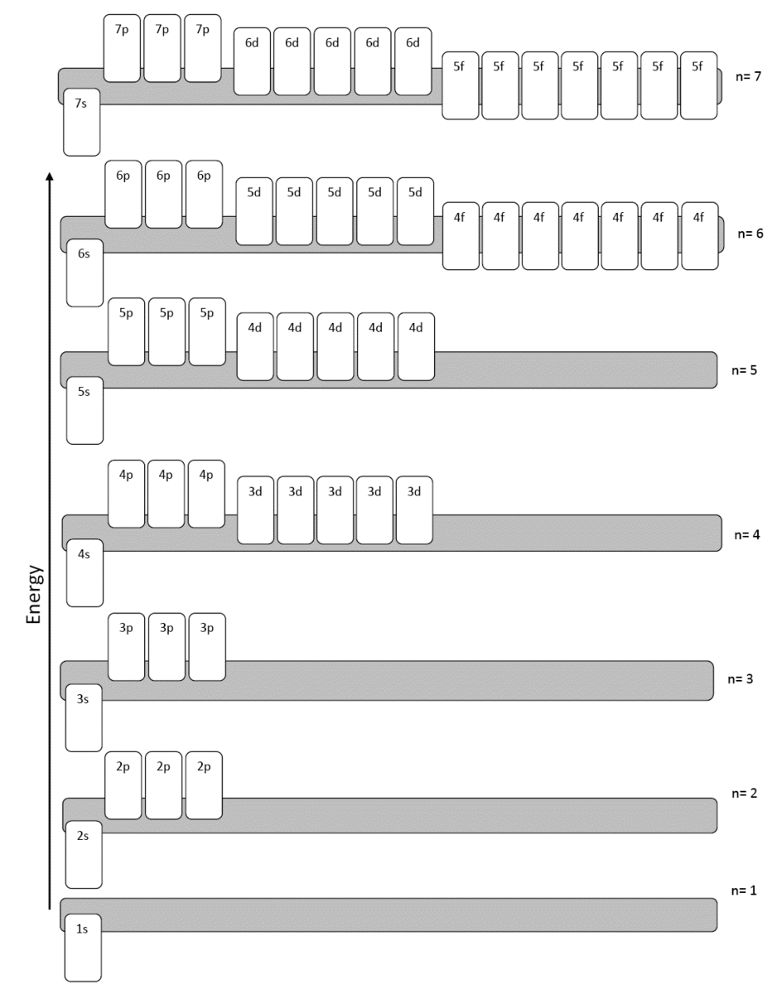
Orbital Diagram
A chart that shows you the order that the orbitals go in.

Slide 13
Electron Configuration Rules…
Aufbau Principle:
Electrons fill lowest possible energy level first.
They are lazy!

Slide 15
Electron Configuration Rules…
Pauli Exclusion Principle:
No two electrons may have the same set of four quantum numbers.
Any single orbital may only contain two electrons, BUT one has to be spin up, and one has to be spin down.

Slide 16
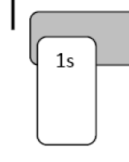

Slide 17
Electron Configuration Rules…
Hund’s Rule:
Electrons will fill each equal energy orbital before pairing up
Spread them out before your pair them up
“You don’t want to share a bedroom with your sibling unless you really have to!”
Electrons want elbow room!

Slide 18
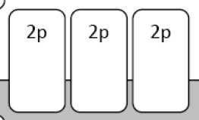
p_{x} p_{y} p_{z}

Slide 19
Steps to finding all the electrons
Pick an atom
Find the number of electrons it has
Start putting electrons into the orbitals
Use an ORBITAL CHART/DIAGRAM
List which orbitals you used and how many electrons in each one

Slide 20
Let’s practice together…

