Slide 1
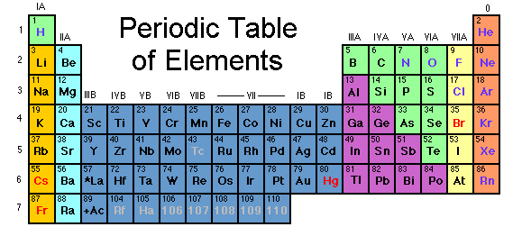
N-12
Periodic Table Trick for Electron Configurations
Target: I can use the layout of the periodic table to help me write electron configurations.
Link to YouTube Presentation: https://youtu.be/ZBficpKEfFI

Slide 2
N-12
Trick for writing electron configurations so you don’t have to use an orbital diagram

Slide 3
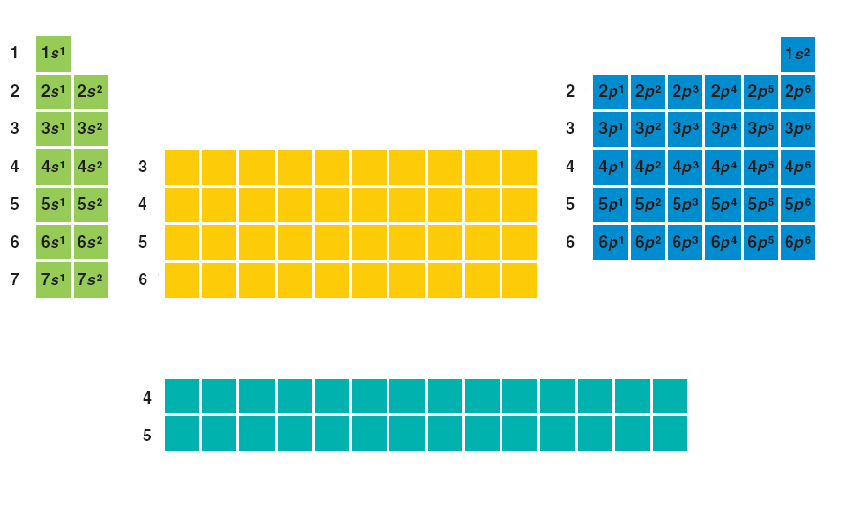
The periodic table orders elements for you!
s
p
d
3d¹ 3d² 3d³ 3d⁴ 3d⁵ 3d⁶ 3d⁷ 3d⁸ 3d⁹ 3d¹⁰
4d¹ 4d² 4d³ 4d⁴ 4d⁵ 4d⁶ 4d⁷ 4d⁸ 4d⁹ 4d¹⁰
5d¹ 5d² 5d³ 5d⁴ 5d⁵ 5d⁶ 5d⁷ 5d⁸ 5d⁹ 5d¹⁰
6d¹ 6d² 6d³ 6d⁴ 6d⁵ 6d⁶ 6d⁷ 6d⁸ 6d⁹ 6d¹⁰
f
Energy level
4f¹ 4f² 4f³ 4f⁴ 4f⁵ 4f⁶ 4f⁷ 4f⁸ 4f⁹ 4f¹⁰ 4f¹¹ 4f¹² 4f¹³ 4f¹⁴
5f¹ 5f² 5f³ 5f⁴ 5f⁵ 5f⁶ 5f⁷ 5f⁸ 5f⁹ 5f¹⁰ 5f¹¹ 5f¹² 5f¹³ 5f¹⁴

Slide 5
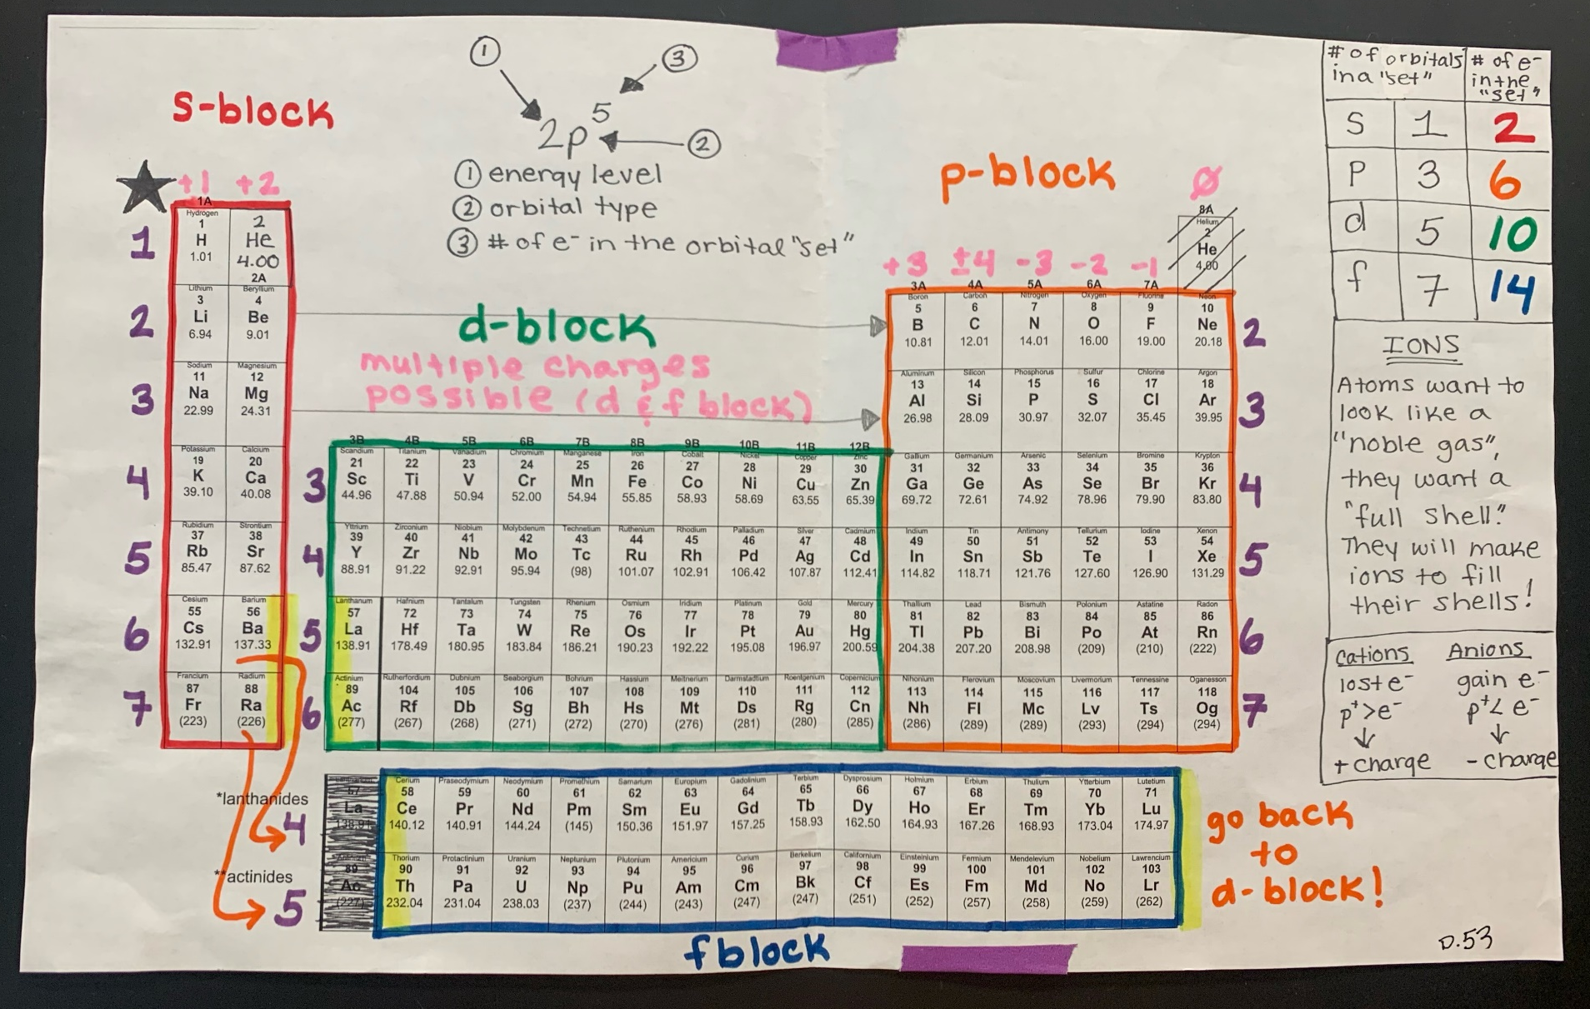

Slide 6
YouTube Link to Presentation of Mrs. Farmer setting up the Periodic Table and showing how to do the trick: https://youtu.be/ZBficpKEfFI
Another video on setting up your periodic table
https://www.youtube.com/watch?v=qb0hia__crM
Another video on using your periodic table to write configs.
https://www.youtube.com/watch?v=ououF9nHUhk

