Slide 1
N 13 – Noble Gas Configurations and Configurations of Ions
Target: I can write electron configurations in a short hand style, and can write configurations for ions.
Link to YouTube Presentation: https://youtu.be/0ArsAIYrWiM

Slide 2
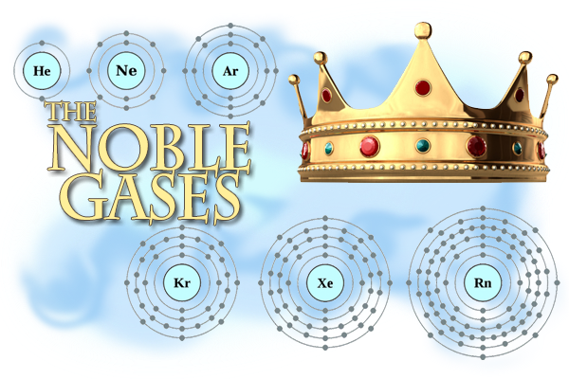
N 13 – Noble Gas Configurations and Configurations of Ions

Slide 3
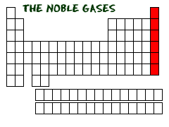
Noble Gases
Have a full “valence shell” – meaning their outer s and p orbitals are full! “8 is great!”
Makes them very stable
They don’t react with other things
They are “inert”

Slide 4
Noble Gases – Examples of Full Shells
He: 1s²
Ne: 1s² 2s² 2p⁶
Ar: 1s²2s²2p⁶ 3s² 3p⁶
Kr: 1s²2s²2p⁶3s²3p⁶ 4s² 3d¹⁰ 4p⁶
Xe: 1s²2s²2p⁶3s²3p⁶4s²3d¹⁰4p⁶ 5s² 4d¹⁰ 5p⁶

Slide 5
Finding Noble Gas Configuration
A short cut method of writing configurations
Since noble gases are “special” – reference all configurations against the PREVIOUS noble gas
Find the previous noble gas
Write that noble gas in brackets [ ]
List any remaining electron configuration left over until you get to the element you are trying to write

Slide 6
He: 1s²
He: 1s²
Ne: 1s²2s²2p⁶
Lithium
1s² 2s¹
Helium + extra!
Nitrogen
1s² 2s²2p³
Helium + extra!
Sodium
1s²2s²2p⁶ 3s¹
Neon + extra!
[He] 2s¹
[He] 2s²2p³
[Ne] 3s¹
Noble Gas Configurations!

Slide 7
Previous = Ar
Previous = Xe
Previous = Ar
Iron
1s²2s²2p⁶ 3s² 3p⁶
4s²3d⁶
Argon + extra!
Barium
1s²2s²2p⁶3s²3p⁶4s² 3d¹⁰4p⁶ 5s² 4d¹⁰ 5p⁶
6s²
Xenon + extra!
Krypton
1s²2s²2p⁶ 3s² 3p⁶
4s²3d¹⁰4p⁶
Argon + extra!
[Ar] 4s²3d⁶
[Ar] 4s²3d¹⁰4p⁶
[Xe] 6s²
Noble Gas Configuration!

Slide 8
Configurations of Ions
Ion
An atom with a charge
Has a change to it’s normal # of electrons
(normally #protons = #electrons → neutral, no charge)
Why make ions???
Atoms want to “look” like a noble gas!!!
They want to achieve more STABILITY!
They want a full s and p orbital set!

Slide 9
Making Ions
Cation
Lost e-
p+ > e-
+++ > --
+ Charge
Anion
Gained e-
p+ < e-
+++ < ----
- Charge
How do you know how many electrons to loose or gain?
Look for the CLOSEST noble gas! Adjust your # of electrons until you are at the closest one.

Slide 10
Finding the Closest Noble Gas
Lithium
3 e-
He = 2 e-
Ne = 10 e-
Helium is closer!
Lose 1 e- to look like Helium
Li⁺
Calcium
20 e-
Ar = 18 e-
Kr = 36 e-
Argon is closer!
Lose 2 e- to look like Argon
Ca²⁺
Phosphorus
15 e-
Ne = 10 e-
Ar = 18 e-
Argon is closer!
Gain 3 e- to look like Argon
P³⁻

Slide 11
Which electrons are you removing when making cations?
Always remove highest ENERGY LEVEL electrons first!
We do not REMOVE electrons from orbitals in the same order that we filled the orbitals!
Once orbitals have electrons in them, their energy levels shift around
BE CAREFUL with d-block and f-block elements!

Slide 12
Configuration of Ions - Examples
Highest Energy Level Electrons – 2 is highest!
LOSE THAT ELECTRON FIRST!
Li: 1s² 2s¹
Li⁺: 1s²
Now it looks just like Helium doesn’t it!

Slide 13
Configuration of Ions - Examples
Highest Energy Level Electrons – 4 is highest!
LOSE THOSE ELECTRONS FIRST!
Ca: 1s²2s²2p⁶ 3s² 3p⁶ 4s²
Ca²⁺: 1s²2s²2p⁶ 3s² 3p⁶
Now it looks just like Argon doesn’t it!

Slide 14
Configuration of Ions – d-block
d-block elements are called “transition metals.” They can make several different charges.
Cu: 1s²2s²2p⁶ 3s² 3p⁶ 4s² 3d⁹
Cu⁺: 1s²2s²2p⁶ 3s² 3p⁶ 4s¹ 3d⁹
Highest Energy Level Electrons –
4 is highest!
LOSE THOSE ELECTRONS FIRST!
CAREFUL!!!

Slide 15
Configuration of Ions – d-block
d-block elements are called “transition metals.” They can make several different charges.
Cu: 1s²2s²2p⁶ 3s² 3p⁶ 4s² 3d⁹
Cu²⁺: 1s²2s²2p⁶ 3s² 3p⁶ 3d⁹
Highest Energy Level Electrons –
4 is highest!
LOSE THOSE ELECTRONS FIRST!
CAREFUL!!!

Slide 16
Configuration of Ions
No matter what, take electrons from the highest energy level orbitals!
Take from highest p,
Then highest s,
Then come back and do lower d if needed

Slide 17
Configuration of Ions
Ga: 1s²2s²2p⁶ 3s² 3p⁶ 4s² 3d¹⁰4p¹
Ga⁺: 1s²2s²2p⁶ 3s² 3p⁶ 4s² 3d¹⁰
Ga²⁺: 1s²2s²2p⁶ 3s² 3p⁶ 4s¹ 3d¹⁰
Ga³⁺: 1s²2s²2p⁶ 3s² 3p⁶ 3d¹⁰
Ga⁴⁺: 1s²2s²2p⁶ 3s² 3p⁶ 3d⁹
Take 4p first
Take 4s next
Take last 4s
THEN you can take 3d !

Slide 18
YouTube Link to Presentation
^{https://youtu.be/0ArsAIYrWiM}

