Slide 1
Atomic Absorption and Emission

Slide 2
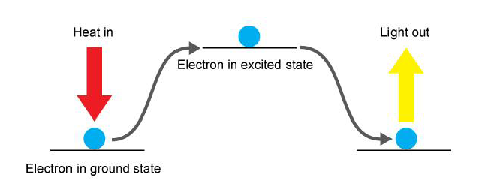
Atomic Absorption and Emission
Atoms can absorb energy which can push an electron up to a higher energy level – an “excited state”
Eventually they will fall back down to their “ground state”
Energy In
Energy Out

Slide 3
If it is the exact right amount of energy being released, sometimes it will be in the visible light range!
Fireworks, neon lights, etc.

Slide 4
Spectra
When that emitted light is passed through a prism, the prism splits the light into a pattern of particular wavelengths of light
unique to that type of atom or molecule
the pattern is called an emission spectrum.
Non-continuous
Can be used to identify the material
Flame tests

Slide 5
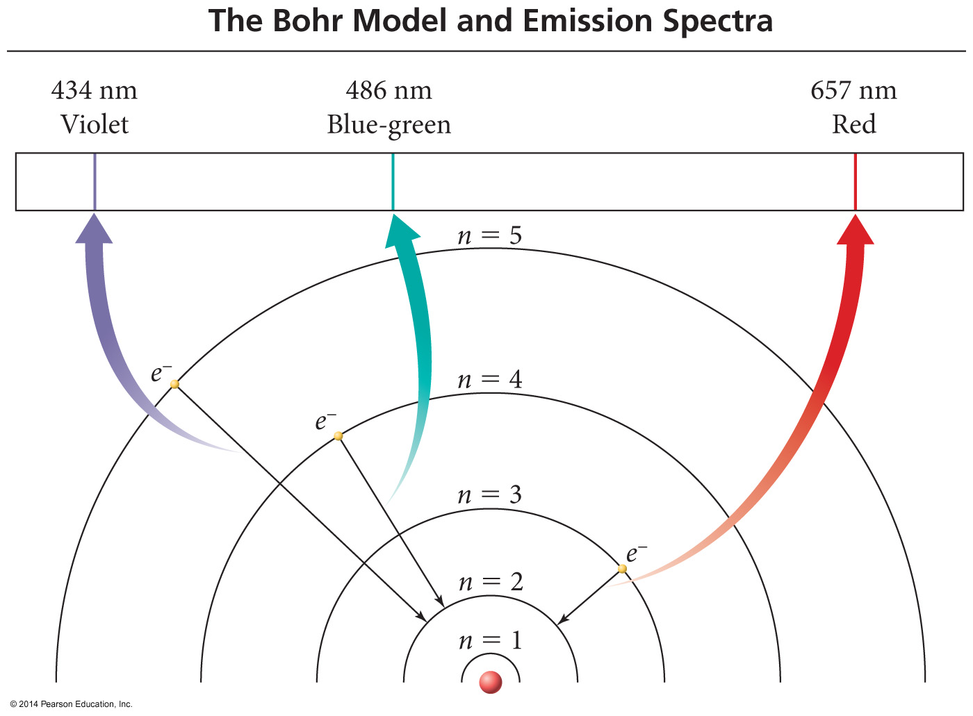
Bohr Model of H Atoms

Slide 6
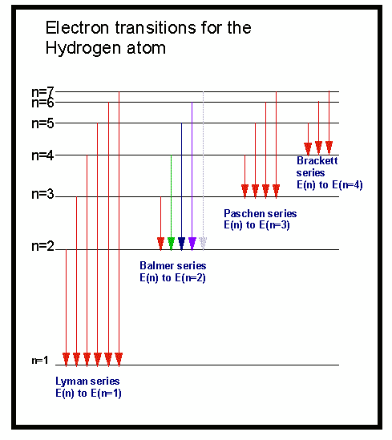
Electron transitions involve jumps of definite amounts of energy.
This produces bands
of light with definite wavelengths.

Slide 7
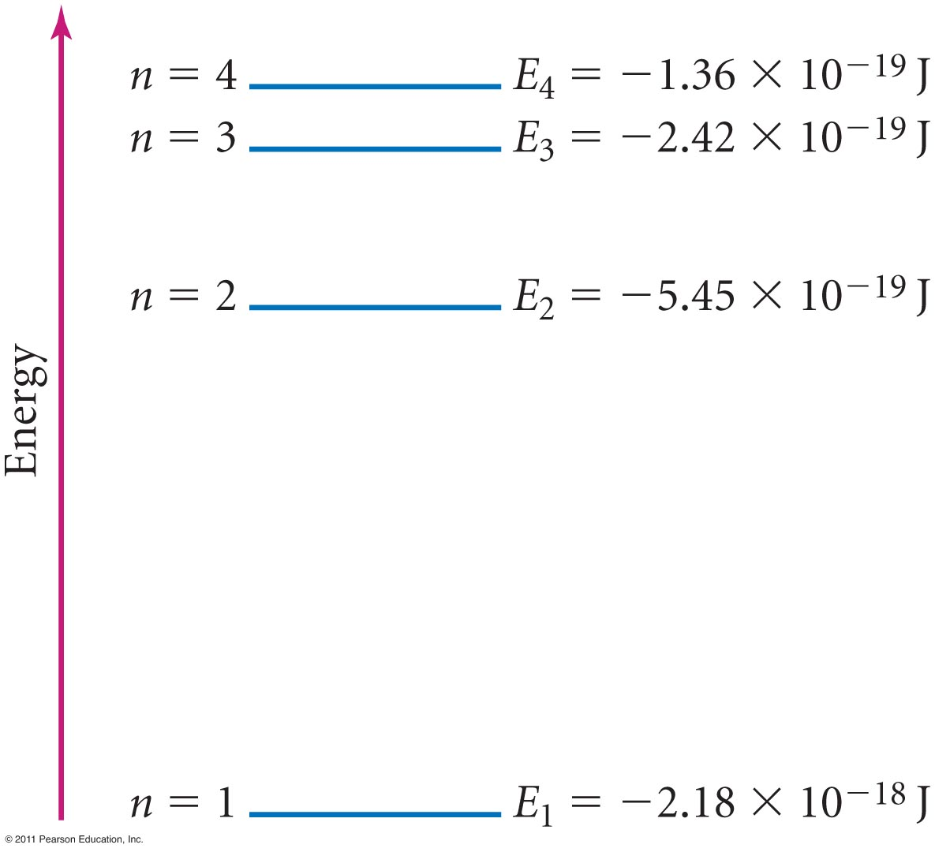
Principal Energy Levels in Hydrogen

Slide 8
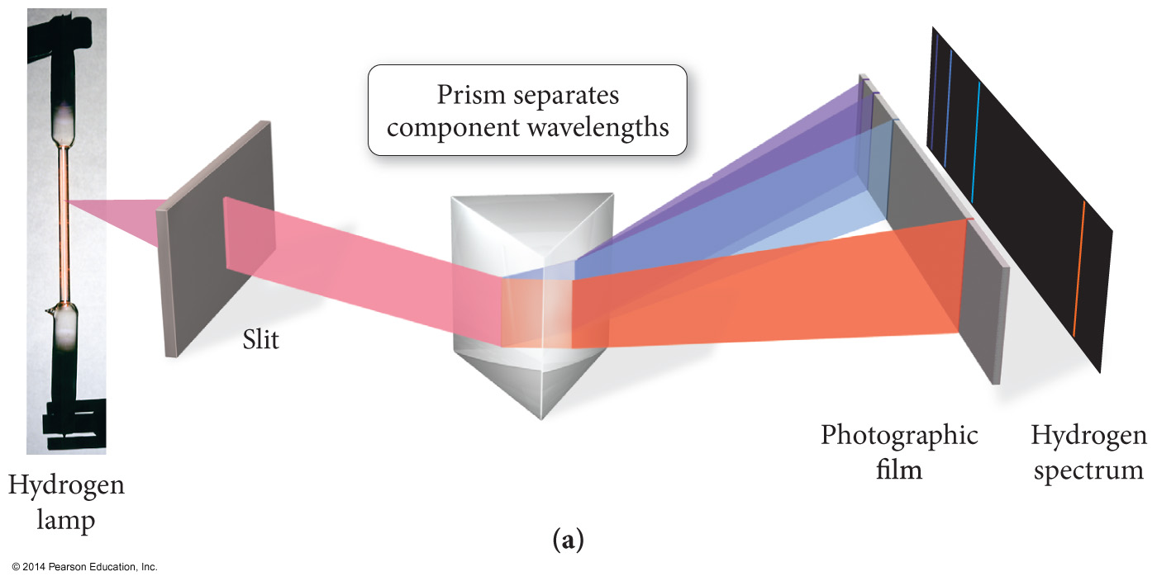
Emission Spectra

Slide 9
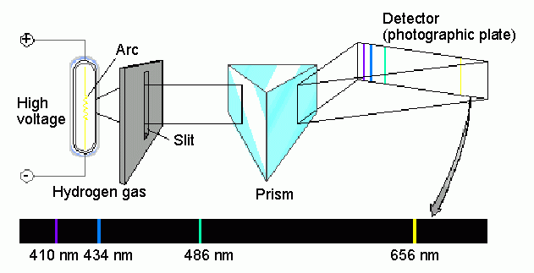
Spectroscopic analysis of the hydrogen spectrum…
…produces a “bright line” spectrum

Slide 10
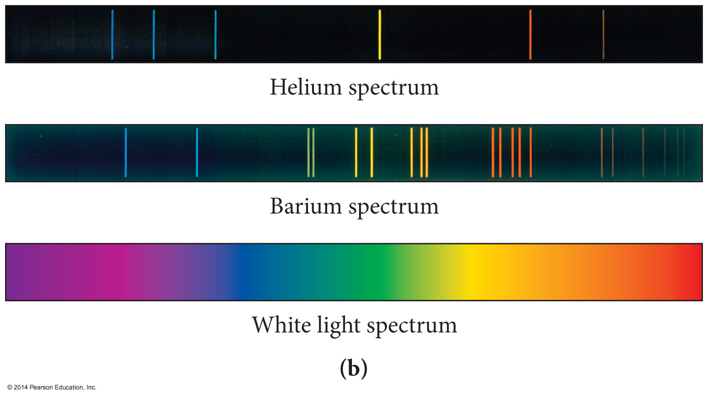
Examples of Spectra

Slide 11
Emission versus Absorption Spectra
Spectra of Mercury

Slide 12
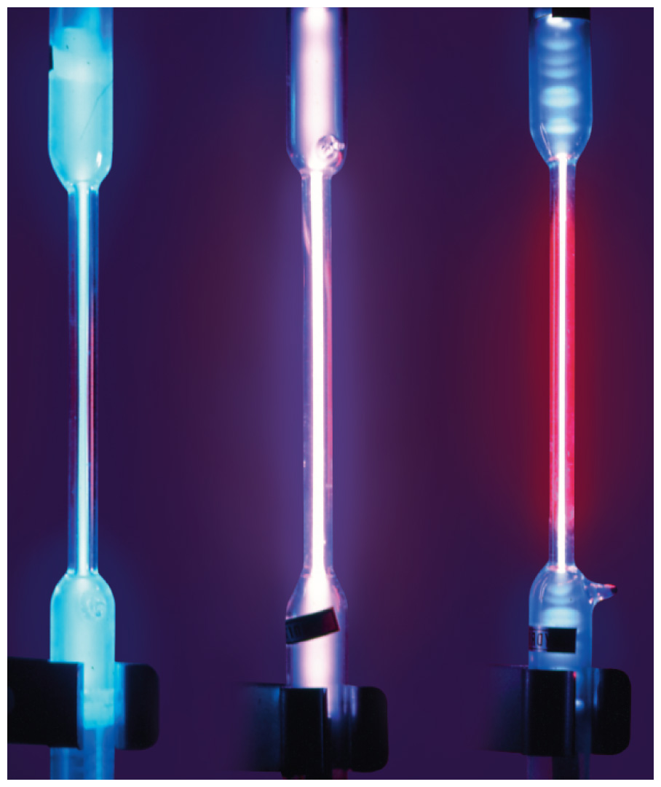
Exciting Gas Atoms to Emit Light with Electrical Energy

Slide 13
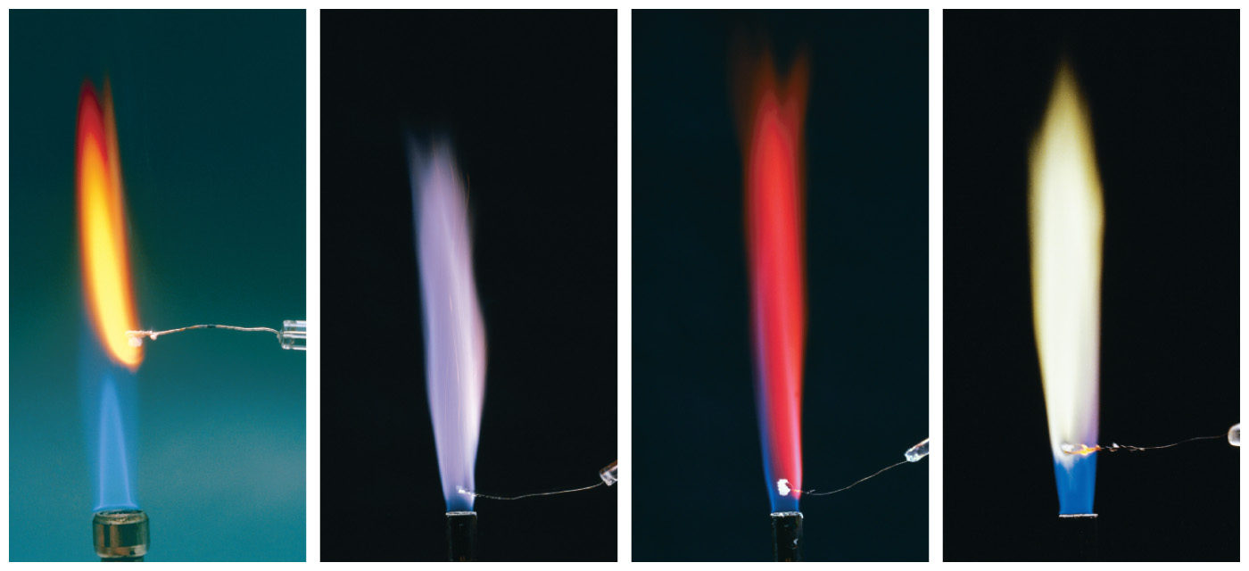
Identifying Elements with Flame Tests
Na
K
Li
Ba

