Slide 1
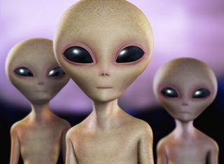
Periodic Table of Aliens!

Slide 2
Goals
Organize pictures of aliens in an organized way
Leave blank spots for two missing aliens.
Find the two missing aliens
Identify a potential NEXT alien that would exist if you expanded your table to be even bigger

Slide 3
How?
Arrange your table into GROUPS and PERIODS
It should make a rectangle!
Leave blank spots for the two missing aliens
Every GROUP should have:
Something that is the same as you go down.
Something that changes in a predictable way as you go down.
Every PERIOD should have:
Something that is the same as you go across.
Something that changes in a predictable way as you go across.

Slide 4
 | ?
 |  |  |  | ?
Next Alien?
Identify BOTH missing Aliens.
Describe/draw each.
Pick ONE “Next Alien” to predict and describe/draw
Next Alien?
Next Alien?
Next Alien?
Next Alien?
Next Alien?
Next Alien?
Next Alien?
Next Alien?
Next Alien?
Next Alien?

Slide 5
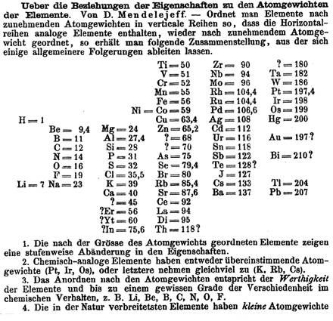
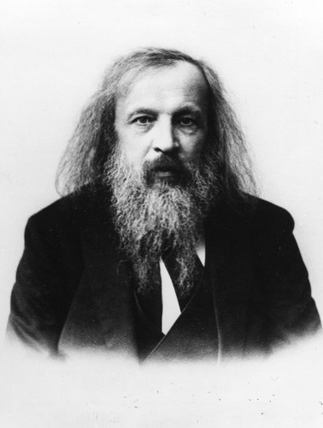
Why?
Dmetri Medeleev tried to organize the elements in a table (1860’s)
Based on PROPERTIES
He left blank spots for places he felt an element was missing
Elements that hadn’t been discovered yet!

Slide 6
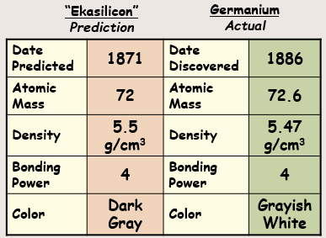
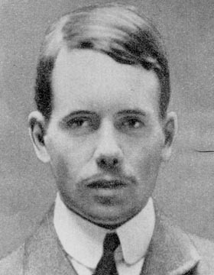
Why?
Mendeleev got SO close!
His predictions were really close!
Henry Mosely (1914)
Realized it should be organized by NUMBER OF PROTONS!
That fixed some of the problems with Medeleev’s table.

Slide 7
Why?
A periodic table is nothing more than someone’s idea of how to arrange the elements.
There are lots of ways to do it!
You could make a periodic table of anything!
Today you will arrange some aliens in A PERIODIC way
This chapter is all about patterns
Today gives me an idea of who struggles with patterns

Slide 8
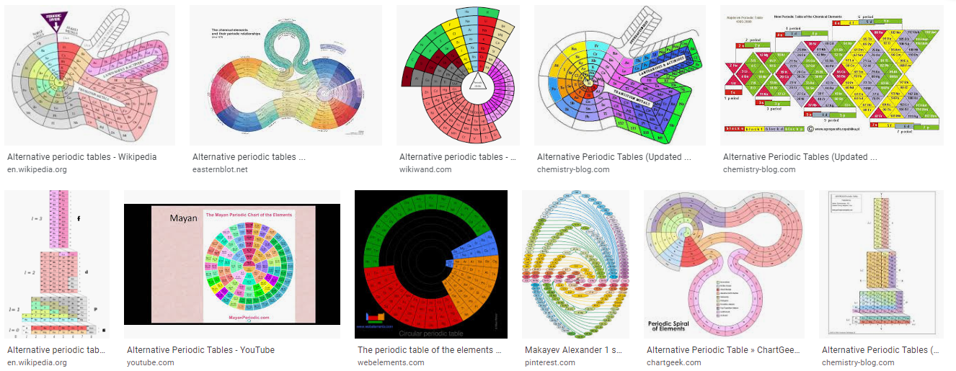
Why?

Slide 9
Why?

Slide 10
Why?

Slide 11
Crash Course - Periodic Table
https://youtu.be/0RRVV4Diomg

