Slide 1
Warning…
Don’t over think this stuff.
You can talk yourself into backwards answers.
Focus on the fact that there are only a set number of trends to learn.
Practice explaining each trend until you can do it in your sleep!
There will ALWAYS be exceptions. Don’t worry about that – focus on the pattern and answer questions based on the patterns.

Slide 2
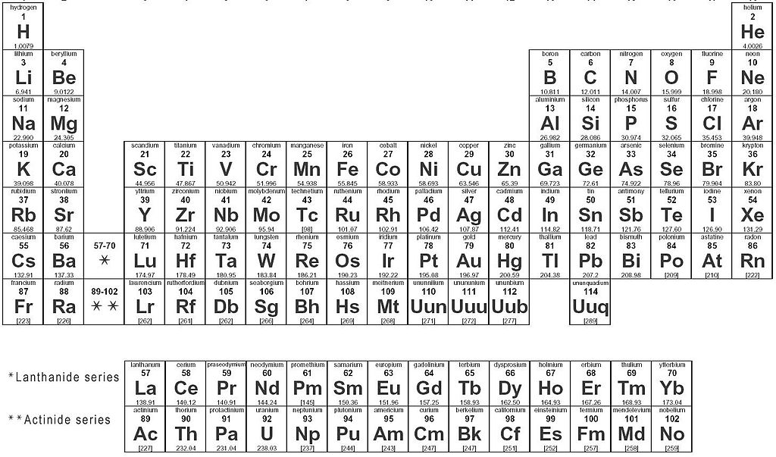
Periodic Trends

Slide 3
Periodic Trends
Target:
I can describe periodic trends and the reasons behind them.

Slide 4
Factors that contribute to trends we see on the periodic table

Slide 5
EVERYTHING is about...
Attractions
Repulsions

Slide 6
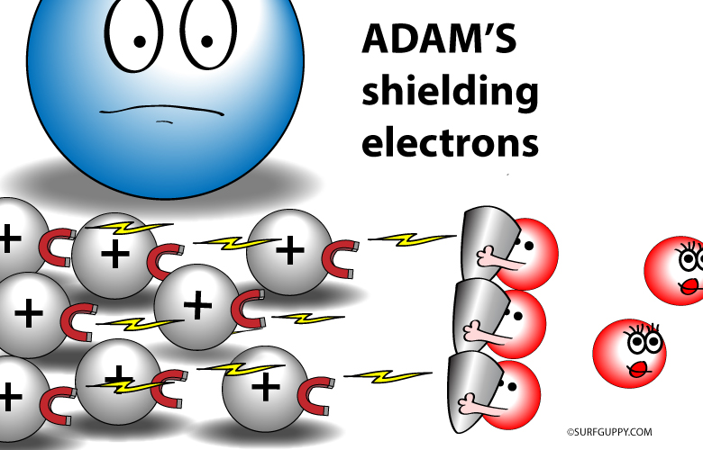
Shielding Effect
Inner shell electrons repel the outer valence electrons
Keeps valence e- from feeling the full attractive force of the nucleus.
Valence electrons

Slide 7
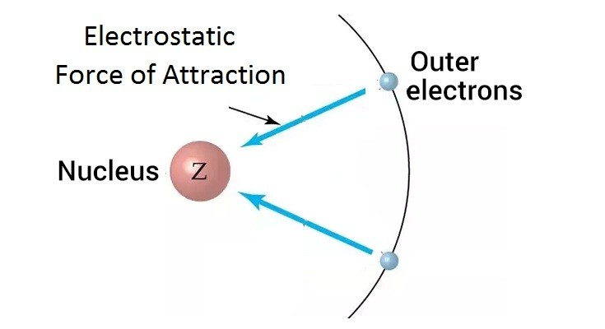
Effective Nuclear Charge (Z_{eff})
The relative attraction the valence electrons have for the protons in the nucleus

Slide 8
Effective Nuclear Charge (Z_{eff})
Adding a proton has a larger effect than adding an electron
p⁺
e⁻
p⁺
e⁻

Slide 9
Effective Nuclear Charge (Z_{eff})
The relative attraction the valence electrons have for the protons in the nucleus
Z_{eff} = Z - S
Z = nuclear attraction = # protons
S = the core/inner e- shielding the valence e-’s = the total number of e- minus the e- in the highest occupied s and p energy levels

Slide 10
Calculating Effective Nuclear Charge Z_{eff} = Z - S
Magnesium
Z = 12 protons
S = Previous noble gas = Neon = 10 electrons
Zeff = 12 - 10 = 2
Aluminum
Z = 13 protons
S = Previous noble gas = Neon = 10 electrons
Zeff = 13 – 10 = 3
Aluminum is smaller – valence electrons are pulled in harder by the nucleus

Slide 11
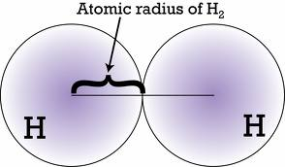
Radius

Slide 12
ATOMIC RADIUS
What | How
½ the distance between two bonded nuclei Cant measure to the edge b/c orbitals aren’t tangible!

Slide 13
ATOMIC RADIUS
Why
INCREASES DOWN because... Circle one: Increased or Increased Shielding Nuclear Charge More energy levels Further from nucleus More shielding Less attraction

Slide 14
ATOMIC RADIUS
Why
DECREASES TO RIGHT because... Circle one: Increased or Increased Shielding Nuclear Charge More protons Same # of energy levels so no increase in shielding Stronger nuclear attraction

Slide 15
IONIC RADIUS
Cation | Anion
Lost electrons Always smaller | Gained electrons Always bigger
Reduced e-repulsions May drop down an energy level | Extra valence e- = more repulsions = bigger

Slide 16
Isoelectric Species Atoms/Ions that have the same number of e- All these examples are 1s²2s²2p⁶
O²⁻
F⁻
Ne
Na⁺
Mg²⁺
8 protons
9 protons
10 protons
11 protons
12 protons
Increased protons pull harder on valence electrons - “Greater effective nuclear charge”
Radius ends up smaller

Slide 17
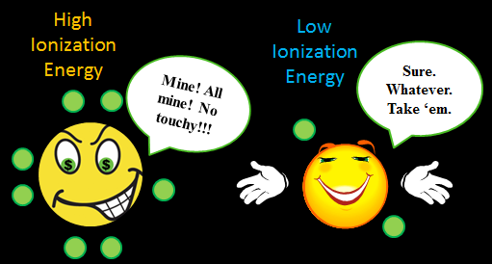
Ionization Energy

Slide 18
IONIZATION ENERGY
What | How
The energy required to remove on electron from a neutral atom of an element | Noble Gases are HIGHEST! They REALLY don’t want to let go of an e-

Slide 19
IONIZATION ENERGY
Why
DECREASES DOWN because... Circle one: Increased or Increased Shielding Nuclear Charge More energy levels Further from nucleus More shielding Less attraction → easier to take electron away!

Slide 20
IONIZATION ENERGY
Why
INCREASES TO RIGHT because... Circle one: Increased or Increased Shielding Nuclear Charge More protons Same # of energy levels so no increase in shielding Stronger nuclear attraction → Harder to take e- away!

Slide 21
Subsequent Ionizations
Each time e- removed →harder to take next one.
Radius is getting smaller → increased attraction
HUGE LEAP in I.E. once it’s achieved noble gas configuration – why would it want to lose another one?!

Slide 22
Electronegatvity

Slide 23
ELECTRONEGATIVITY
What | How
A measure of the ability of an atom in a chemical compound to attract electrons from another atom in the compound How strongly can one atom pull on the electrons being shared in a bond. | Noble Gases are LOWEST! They DON’T CARE about attracting electrons!

Slide 24
ELECTRONEGATIVITY
Why
DECREASES DOWN because... Circle one: Increased or Increased Shielding Nuclear Charge More energy levels Further from nucleus More shielding Less attraction

Slide 25
ELECTRONEGATIVITY
Why
INCREASE TO RIGHT because... Circle one: Increased or Increased Shielding Nuclear Charge More protons Same # of energy levels so no increase in shielding Stronger nuclear attraction

Slide 26
Reactivity

Slide 27
REACTIVITY
What | How
Elements in the same group have similar types of behaviors because they have the same # of valence e- ! BUT The MAGNITUDE of their reactions changes! | Metals and Non-metals are opposite trends! Noble gases are “INERT” or non-reactive

Slide 28
REACTIVITY
Why
METALS INCREASE DOWN because... Circle one: Increased or Increased Shielding Nuclear Charge More energy levels Further from nucleus More shielding Less attraction → easier to LOSE an electron!

Slide 29
REACTIVITY
Why
INCREASE UP because... Circle one: Increased or Increased Shielding Nuclear Charge FEWER energy levels CLOSER to nucleus LESS shielding MORE attraction → easier to GAIN an electron!
Ha! TRICKY!!!!!!
Decreased

Slide 30
Summary

Slide 31
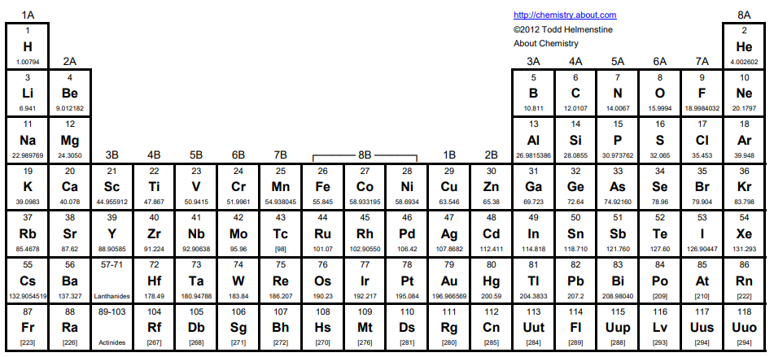
IONIZATION ENERGY
ELECTRONEGATIVITY
ELECTRON AFFINITY
EFFECTIVE NUCLEAR CHARGE - Z_{EFF}
RADIUS
RADIUS SHIELDING
IONIZATION ENERGY
ELECTRONEGATIVITY
ELECTRON AFFINITY

Slide 32
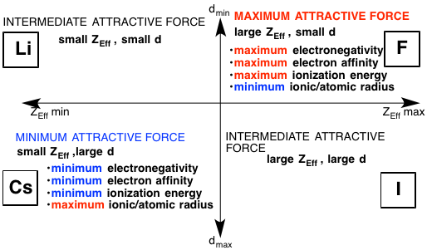

Slide 33
Brainiac Video – note: they augmented the reactions, but it is such a fun, silly, memorable video I think it is still worth watching ☺
Disposal of Sodium – old footage from WWII. Neat to see such old footage and how they actually disposed of the sodium after the war!

Slide 34
Quick summary. Also has a quick but good explanation of some exceptions to the trends
https://www.youtube.com/watch?v=hePb00CqvP0

Slide 35
YouTube Link to this Presentation
Part 1
https://youtu.be/jmy5tlVlFTs
Part 2
https://youtu.be/lTGOnu_WJ5I

Slide 36
Things past this slide are not being taught this year

Slide 37
Electron Affinity

Slide 38
ELECTRON AFFINITY
What | How
How much energy is released when the atom gains an electron to make a negative ion. How much stability does it gain once it is an anion. More energy released – more stable. | Noble Gases are LOWEST! They DON’T CARE about attracting electrons!

Slide 39
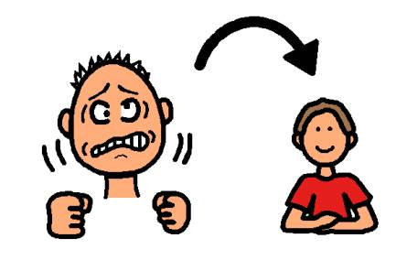

Slide 40
ELECTRON AFFINITY
Why
DECREASES DOWN Electrons are further from nucleus in higher energy levels Increased shielding from core e-’s causes the nucleus to not pull as hard on valence e-’s So atom doesn’t notice as much if it gains an electron – doesn’t gain much stability | INCREASES TO RIGHT Closer to filling valence shell – noble gas configuration is most stable

