Slide 1
N15a - Periodic Table Structure
Target:
I can describe the layout of the periodic table.
Link to YouTube Presentation: https://youtu.be/y505agaAfdc
(video is older version of the PowerPoint – it is the same info but just looks different)

Slide 2
Periodic → Periodic Law → Periodic Table
Periodic – occurs at regular, predictable intervals
Periodic law – physical and chemical properties of the elements are periodic –
By atomic number!
Periodic Table of Elements – arranged by atomic number - shows patterns in properties

Slide 3
There are tons of periodic tables out there!
A periodic table is just a way to organize the elements to try and show various patterns
The periodic table we are used to is just the most commonly used one, not the only one! Some are trying to show different patterns than we are usually using

Slide 4
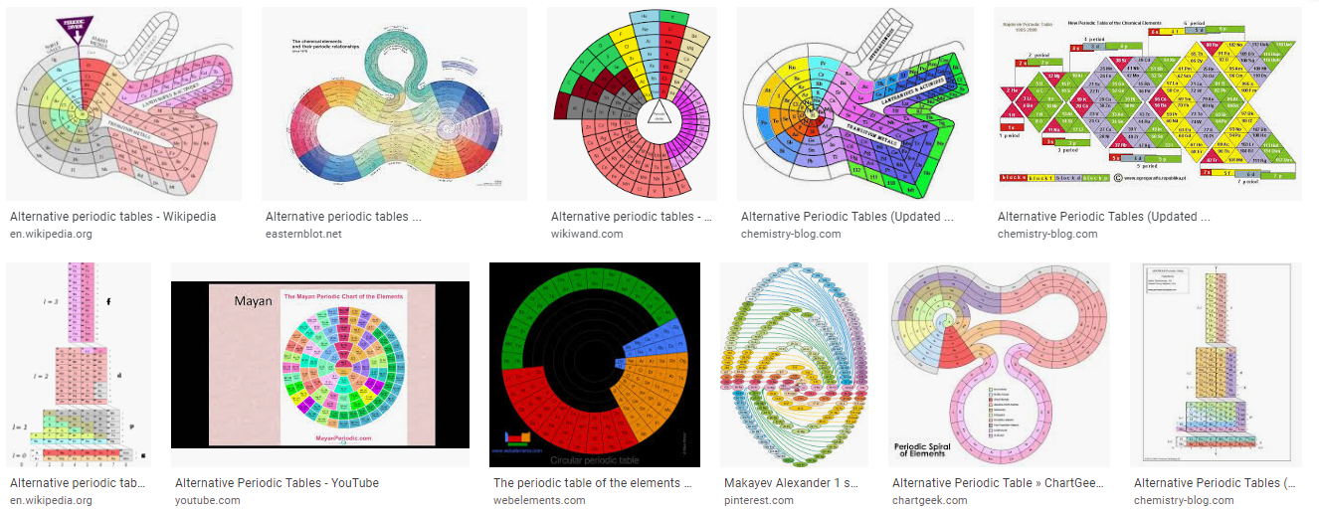

Slide 6
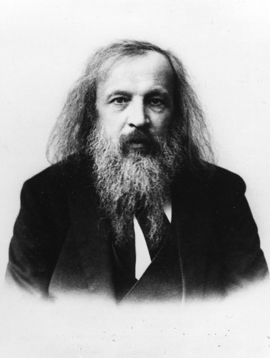
Dmitri Mendeleev
1860’s
Grouped elements according to atomic masses and properties
Image taken from:
http://jscms.jrn.columbia.edu/cns/2006-04-18/fido-luxuriantflowinghair/mendeleev/

Slide 7
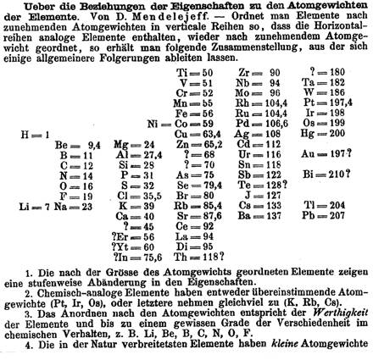
Mendeleev’s Published Periodic Table of Elements
Why do you think there are question marks here?
Image taken from: http://www.chemsoc.org/networks/learnnet/periodictable/post16/develop/mendeleev.htm

Slide 8
Mendeleev’s Predictions
Mendeleev’s Table had missing elements or gaps,” BUT he was able to predict the characteristics of these missing elements because of Periodic Law.
“Ekasilicon”
Prediction
Germanium
Actual
Notice how Mendeleev’s
predictions (orange column) were very
accurate when compared to Germanium’s actual characteristics (green column)
Date Predicted | 1871 | Date Discovered | 1886
Atomic Mass | 72 | Atomic Mass | 72.6
Density | 5.5 g/cm³ | Density | 5.47 g/cm³
Bonding Power | 4 | Bonding Power | 4
Color | Dark Gray | Color | Grayish White

Slide 9

Henry Moseley
1914
Rearranged the elements by
atomic numbers
He determined
# protons = atomic #
The periodic table we use today!
Image taken from:
http://dewey.library.upenn.edu/sceti/smith/

Slide 10
3 Classes of Elements
Using this as a guide, color code your periodic table to show the three classes. Start by highlighting the “zig-zag.”
Class | Color
Metal
Non-Metal
Metalloid

Slide 11
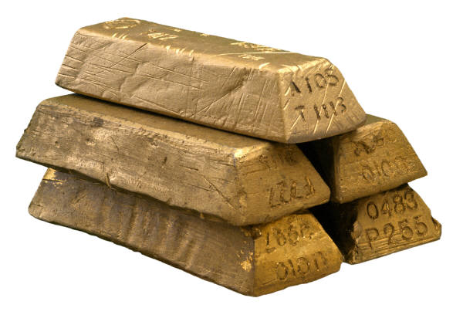
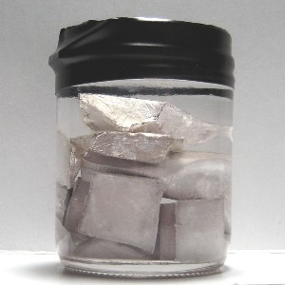
Metals
Chemical Prop. | Physical Prop.
Few electrons in VALENCE shell (outer shell) | Ductile Malleable
Lose electrons easily | Good conductors
POSITIVE charge Ca²⁺ | Shiny
Make Cations | Solid at room temp
79 Au 196.967
11 Na 22.990
What metal is not a solid
@ room temperature?

Slide 12
Atoms with Few Electrons in their Outer Energy Level
Notice: only 1 electron in outer level
11 Na 22.990
-
+
-
+
+
-
-
+
-
-
-
-
+
+
+
+
+
-
+
+
+
-
+
-
4 Be 9.012
+
+
Notice: only 2 electrons in outer level
-
-
-
-

Slide 13
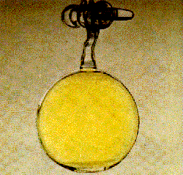
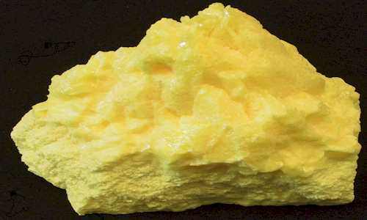
Non-Metals
Chemical Prop. | Physical Prop.
Almost full, or totally full valence shell | NOT Ductile NOT malleable
Tend to gain electrons | BAD conductors
NEGATIVE charge N³⁻ | Mostly solid
Make ANIONS | Some are gas at room temp
17 Cl 35.453
16 S 32.066

Slide 14
Atoms with Full or Almost Full Outer Energy Level
8 O 15.999
-
-
Notice: 2 electrons in outer level – FULL
-
-
+
+
+
-
+
+
+
+
+
-
-
+
+
-
-
2 He 4.003
-
-
-
-
Notice: 6 electrons in outer level – almost full
-
+
+
+
+
+
+
+
-
Notice: 7 electrons in outer level – almost full
+
+
-
9 F 18.998
-
-
-

Slide 15
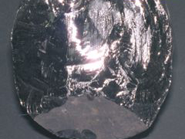
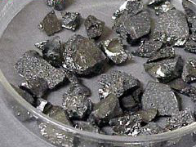
Metalloids
(Semi-metals)
Chemical Prop. | Physical Prop.
Most have half full valence shell | Have properties of metals AND non-metals
Make anions OR cations depending on their environment | No way to know which properties of each
14 Si 28.086
5 B 10.811

Slide 16
Atoms with ~½ Complete Outer Energy Level
-
Notice: only 4 electrons in outer level
5 B 10.811
-
+
+
-
+
+
-
+
-
-
-
-
-
-
+
+
+
+
+
+
+
Notice: only 3 electrons in outer level
+
+
+
-
-
-
-
+
+
+
+
-
14 Si 28.086
-
-
-
-

Slide 17
Important Features of the Periodic Table:
Period (Row)
each horizontal row of elements on the periodic table
How many
periods (rows)
are on the
Periodic Table
Of Elements?
FROM LEFT TO RIGHT OR RIGHT TO LEFT

Slide 18
Period Properties
Seven periods (numbered from the top down)
Atomic #’s and masses increase as you move from the left to the right in a period
All elements in the same period have the
same number of energy levels
  Period 1 = 1 energy level
  Period 2 = 2 energy levels
  Period 3 = 3 energy levels
  Etc…

Slide 19
Examples of Period elements having the same number of energy levels in their atoms
-
-
-
In what period do
you think these atoms
reside?
-
+
+
+
+
+
+
-
+
+
+
-
-
+
-
+
+
-
-
-
-
-
-
-
In what period (row) do
you think these atoms
reside?
-
-
-
-
-
-
-
+
+
+
+
+
+
+
+
+
+
+
+
+
+
+
+
+
+
-
+
-
-
-
+
-
-
+
+
+
+
+
-
-
-
-
-
-
-
-
-

Slide 20
Important Features of the Periodic Table: Group (Family)
each column of elements on the periodic table
How many groups (families)
are on the
Periodic Table
Of Elements?
FROM TOP TO BOTTOM OR BOTTOM TO THE TOP

Slide 21
Group (Family) Properties
18 groups (numbered from left to right)
Atomic # and masses increase
from the top down
Atoms in same group have
same number of valence electrons
Exceptions: d block and f block
similar physical and chemical properties
BECAUSE THEY HAVE THE SAME NUMBER OF VALENCE ELECTRONS

Slide 22
Examples of Group Elements with the same # of valence electrons
How many electrons do each of these atoms have in their outer orbital/level?
1
H
1.008
3
Li
6.941
11
Na
22.990
-
-
-
19
K
39.098
-
-
+
37
Rb
85.468
+
+
+
+
+
+
+
-
+
-
+
+
55
Cs
132.905
-
87
Fr
(223)
-
-
What group (family) do these elements reside in?
-

Slide 23
Identify the Element
Group 14 - Period 2 →
Carbon - C

Slide 24
Identify the Element
Group 2 - Period 5 →
Strontium - Sr

Slide 25
Identify the Element
Period 6 - Group 17 →
Astatine - At

Slide 26
YouTube Link to Lecture
https://youtu.be/y505agaAfdc
(the video is the older version of the PowerPoint – it is the same info but just looks different)

