Slide 1
Warning…
There is about to be a lot of notes because it takes a lot of words to explain
You don’t need EVERY word written down to understand it.
Focus on listening and understanding.
You can add to your notes at home.
Capture enough to pay attention, leave space to come back and add/annotate.

Slide 2
Warning…
Don’t over think this stuff.
You can talk yourself into backwards answers.
Focus on the fact that there are only a set number of trends to learn.
Practice explaining each trend until you can do it in your sleep!
There will ALWAYS be exceptions. Don’t worry about that – focus on the pattern and answer questions based on the patterns.

Slide 3
Warning…
Make sure you capture:
What
How
Why
Make sure you can tell me:
What
How
Why

Slide 4
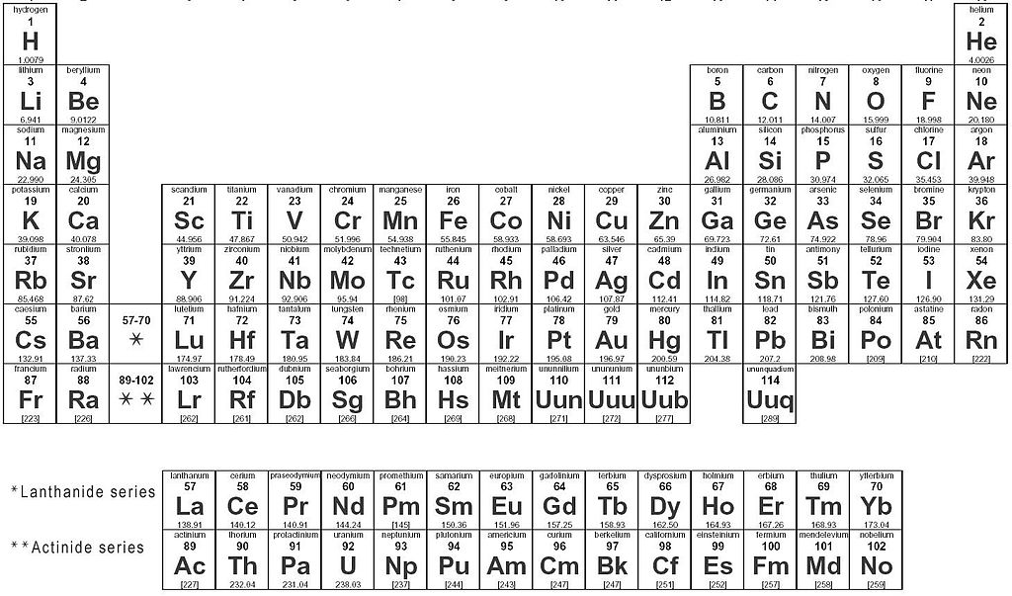
Periodic Trends

Slide 5
Part #1

Slide 6
Atomic Radius

Slide 7
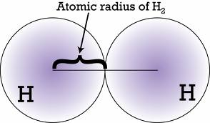
ATOMIC RADIUS
What | How
½ the distance between two bonded nuclei Cant measure to the edge b/c orbitals aren’t tangible!

Slide 8
ATOMIC RADIUS
Why
INCREASES DOWN Adding energy levels Adding energy levels further from the nucleus resulting in larger radius. Inner e- keep valence e- from “feeling” the nucleus Outer e⁻s are not as pulled in by the protons in the nucleus – there is more “shielding” by the inner electrons | DECREASES TO RIGHT Adding a proton = bigger change than adding an e- More protons pull the valence electrons in closer - “Greater Effective Nuclear Charge” No increase in shielding b/c no new energy levels

Slide 9
Effective Nuclear Charge (Z_{eff})
The relative attraction the valence electrons have for the protons in the nucleus
Shielding Effect
The inner shell electrons repel the outer valence electrons – keeps the valence e- from “feeling” the nucleus. More repulsion results in less attraction between nucleus and valence e-.

Slide 10
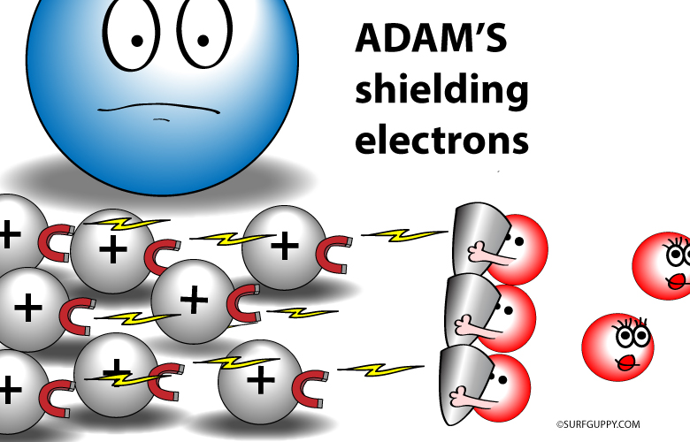
Valence electrons

Slide 11
Calculating Effective Nuclear Charge
The relative attraction the valence electrons have for the protons in the nucleus
Z_{eff} = Z - S
Z = nuclear attraction = # protons
S = the core/inner e- shielding the valence e-’s = the total number of e- minus the e- in the highest occupied s and p energy levels
= (# of e- in previous noble gas + any d or f e-’s past the noble gas in the element)

Slide 12
Calculating Effective Nuclear Charge Z_{eff} = Z - S
Magnesium
Z = 12 protons
S = Previous noble gas = Neon = 10 electrons
Zeff = 12 - 10 = 2
Aluminum
Z = 13 protons
S = Previous noble gas = Neon = 10 electrons
Zeff = 13 – 10 = 3
Aluminum is smaller – valence electrons are pulled in harder by the nucleus

Slide 13
IONIC RADIUS
What | How
The radius of an ion Cation – lost electrons Anion – gained electrons | Cation – always smaller Anion – always bigger

Slide 14
IONIC RADIUS
Why
CATION SMALLER Reduced repulsion between electrons If you lose enough electrons you even drop down an energy level! Much smaller! | ANION LARGER Extra valence electrons repel each other a bit more so it gets larger.

Slide 15
Isoelectric Species Atoms/Ions that have the same number of e- All these examples are 1s²2s²2p⁶ Increased protons can pull harder on the valence electrons – greater effective nuclear charge – so the radius is smaller even though they have the same number of electrons and energy levels
O²⁻
F⁻
Ne
Na⁺
Mg²⁺
8 protons
9 protons
10 protons
11 protons
12 protons

Slide 16
Ionization Energy

Slide 17
IONIZATION ENERGY
What | How
The energy required to remove on electron from a neutral atom of an element | Noble Gases are HIGHEST! They REALLY don’t want to let go of an e-

Slide 18
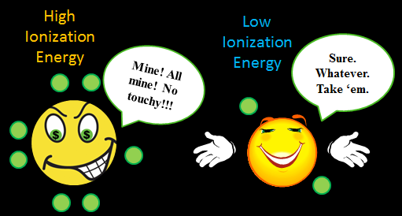

Slide 19
IONIZATION ENERGY
Why
DECREASES DOWN Electrons are further from nucleus in higher energy levels Increased shielding from core e- causes nucleus to not pull as hard on valence e- | INCREASES TO RIGHT Closer to having a full stable valence shell Increased effective nuclear charge means nucleus is pulling harder on the valence e- so they are harder to remove

Slide 20
Subsequent Ionizations Every time you take an e- away it gets harder to take the next one. Radius is getting smaller, so nucleus can pull harder on the valence - harder to remove the next one. HUGE LEAP in I.E. once it’s achieved noble gas configuration – why would it want to lose another one?!

Slide 21
Part #2

Slide 22
Electronegatvity

Slide 23
ELECTRONEGATIVITY
What | How
A measure of the ability of an atom in a chemical compound to attract electrons from another atom in the compound How strongly can one atom pull on the electrons being shared in a bond. | Noble Gases are LOWEST! They DON’T CARE about attracting electrons!

Slide 25
ELECTRONEGATIVITY
Why
DECREASES DOWN e- are further from nucleus in higher energy levels Increased shielding from core e- causes nucleus to not pull as hard on valence e- So nucleus doesn’t pull as hard on the bonding e-’s from another atom | INCREASES TO RIGHT Smaller radius, increased effective nuclear charge Nucleus is pulling harder on the valence electrons – which is where the bonding is occurring.

Slide 26
Reactivity

Slide 27
REACTIVITY
What | How
Elements in the same group have similar types of behaviors because they have the same number of valence e- BUT The MAGNITUDE of their reactions changes! | Metals and Non-metals are opposite trends! Noble gases are “INERT” or non-reactive

Slide 28
REACTIVITY
Why
METALS INCREASE DOWN Larger radius and increased shielding means lower ionization energy so it is easier to remove electrons | NON-METALS INCREASE UP Smaller radius and greater effective nuclear charge means higher electronegativity and electron affinity so it can attract an electron easier

Slide 29
Summary

Slide 30
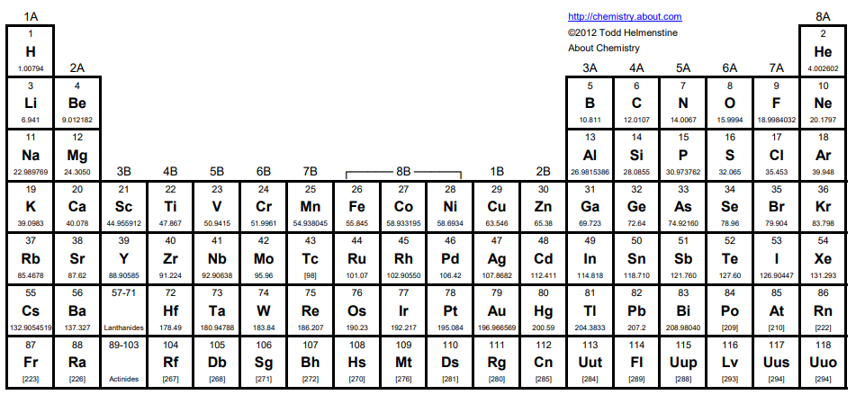
IONIZATION ENERGY
ELECTRONEGATIVITY
ELECTRON AFFINITY
EFFECTIVE NUCLEAR CHARGE - Z_{EFF}
RADIUS
RADIUS SHIELDING
IONIZATION ENERGY
ELECTRONEGATIVITY
ELECTRON AFFINITY

Slide 31
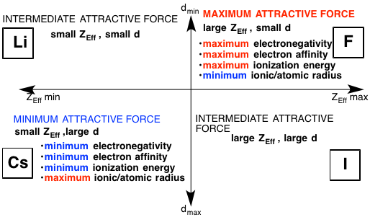

Slide 32
Brainiac Video – note: they augmented the reactions, but it is such a fun, silly, memorable video I think it is still worth watching ☺
Disposal of Sodium – old footage from WWII. Neat to see such old footage and how they actually disposed of the sodium after the war!

Slide 33
Quick summary. Also has a quick but good explanation of some exceptions to the trends
https://www.youtube.com/watch?v=hePb00CqvP0

Slide 34
YouTube Link to this Presentation
Part 1
https://youtu.be/jmy5tlVlFTs
Part 2
https://youtu.be/lTGOnu_WJ5I

Slide 35
Things past this slide are not being taught this year

Slide 36
Electron Affinity

Slide 37
ELECTRON AFFINITY
What | How
How much energy is released when the atom gains an electron to make a negative ion. How much stability does it gain once it is an anion. More energy released – more stable. | Noble Gases are LOWEST! They DON’T CARE about attracting electrons!

Slide 38
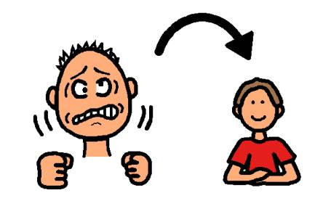

Slide 39
ELECTRON AFFINITY
Why
DECREASES DOWN Electrons are further from nucleus in higher energy levels Increased shielding from core e-’s causes the nucleus to not pull as hard on valence e-’s So atom doesn’t notice as much if it gains an electron – doesn’t gain much stability | INCREASES TO RIGHT Closer to filling valence shell – noble gas configuration is most stable

