Slide 1
Warning…
There is about to be a lot of notes because it takes a lot of words to explain
You don’t need EVERY word written down to understand it.
Focus on listening and understanding.
You can add to your notes at home.
Capture enough to pay attention, leave space to come back and add/annotate.

Slide 2
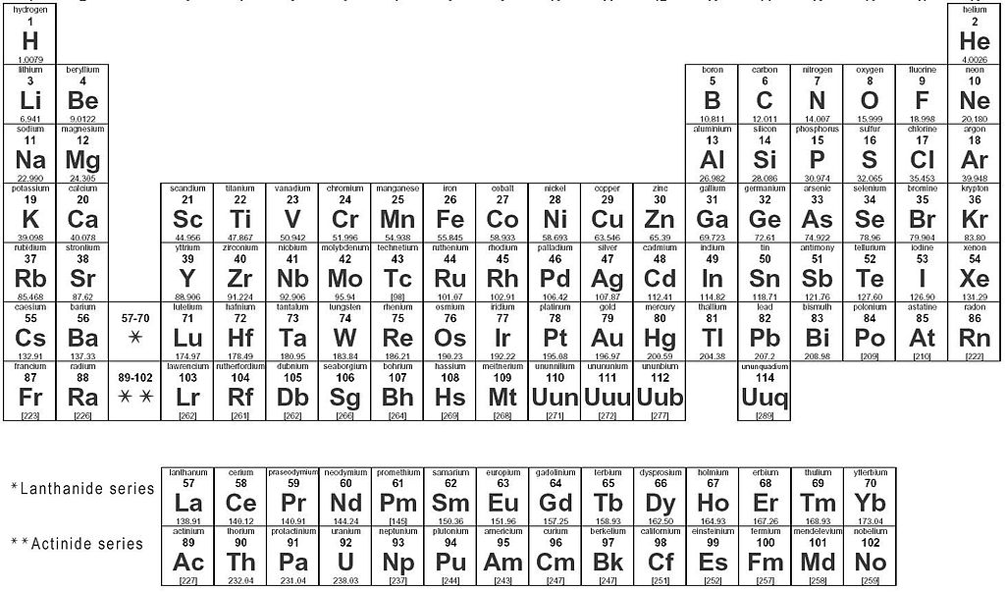
N15 - Periodic Trends
Target: I can describe periodic trends, and the reasons behind them

Slide 3
Warning…
Don’t over think this stuff.
You can talk yourself into backwards answers.
Focus on the fact that there are only a set number of trends to learn.
Practice explaining each trend until you can do it in your sleep!
There will ALWAYS be exceptions. Don’t worry about that – focus on the pattern and answer questions based on the patterns.

Slide 4
Warning…
Make sure you capture:
What
How
Why
Make sure you can tell me:
What
How
Why

Slide 5
Periodic Trends

Slide 6
Part #1

Slide 7
Atomic Radius

Slide 8
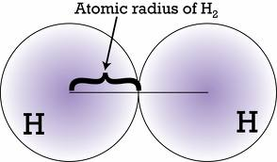
ATOMIC RADIUS
What | How
½ the distance between two bonded nuclei Cant measure to the edge b/c orbitals aren’t tangible!

Slide 9
ATOMIC RADIUS
Why
INCREASES DOWN Adding energy levels Adding energy levels further from the nucleus resulting in larger radius. Inner e- keep valence e- from “feeling” the nucleus Outer e⁻s are not as pulled in by the protons in the nucleus – there is more “shielding” by the inner electrons | DECREASES TO RIGHT Adding a proton = bigger change than adding an e- More protons pull the valence electrons in closer - “Greater Effective Nuclear Charge” No increase in shielding b/c no new energy levels

Slide 10
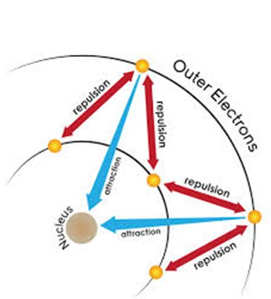
Effective Nuclear Charge (Z_{eff})
The relative attraction the valence electrons have for the protons in the nucleus
Shielding Effect
The inner shell electrons repel the outer valence electrons – keeps the valence e- from “feeling” the nucleus. More repulsion results in less attraction between nucleus and valence e-.

Slide 11
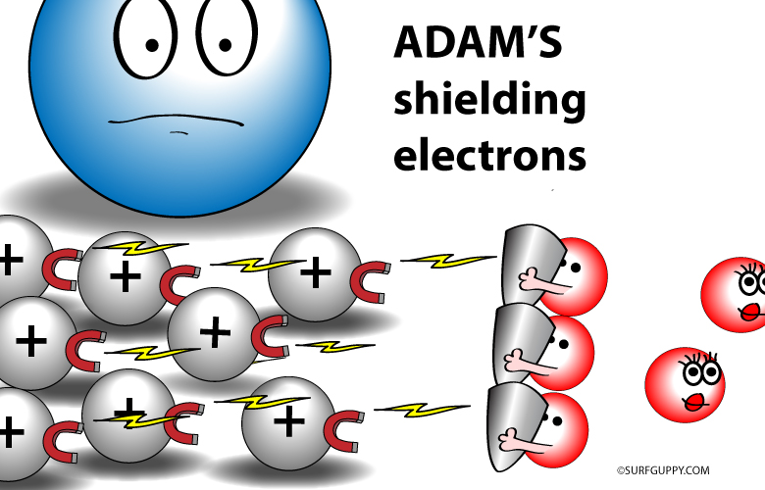
Valence electrons

Slide 12
Calculating Effective Nuclear Charge
The relative attraction the valence electrons have for the protons in the nucleus
Z_{eff} = Z - S
Z = nuclear attraction = # protons
S = the core/inner e- shielding the valence e-’s
= the total number of e- minus the e- in the
highest occupied s and p energy levels
= (# of e- in previous noble gas + any d or f e-’s
past the noble gas in the element)

Slide 13
Calculating Effective Nuclear Charge
Z_{eff} = Z - S
Magnesium
Z = 12 protons
S = Previous noble gas
= Neon = 10 electrons
Zeff = 12 - 10 = 2
Aluminum
Z = 13 protons
S = Previous noble gas
= Neon = 10 electrons
Zeff = 13 – 10 = 3
Aluminum is smaller – valence electrons are pulled in harder by the nucleus

Slide 14
IONIC RADIUS
What | How
The radius of an ion Cation – lost electrons Anion – gained electrons | Cation – always smaller Anion – always bigger

Slide 15
IONIC RADIUS
Why
CATION SMALLER Reduced repulsion between electrons If you lose enough electrons you even drop down an energy level! Much smaller! | ANION LARGER Extra valence electrons repel each other a bit more so it gets larger.

Slide 16
Isoelectric Species
Atoms/Ions that have the same number of e-
All these examples are 1s²2s²2p⁶
Increased protons can pull harder on the valence electrons – greater effective nuclear charge – so the radius is smaller even though they have the same number of electrons and energy levels
O²⁻
F⁻
Ne
Na⁺
Mg²⁺
8 protons
9 protons
10 protons
11 protons
12 protons

Slide 17
Ionization Energy

Slide 18
IONIZATION ENERGY
What | How
The energy required to remove on electron from a neutral atom of an element | Noble Gases are HIGHEST! They REALLY don’t want to let go of an e-

Slide 19
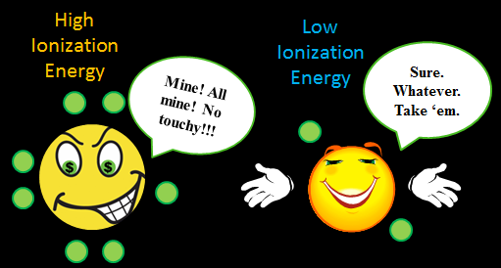

Slide 20
IONIZATION ENERGY
Why
DECREASES DOWN Electrons are further from nucleus in higher energy levels Increased shielding from core e- causes nucleus to not pull as hard on valence e- | INCREASES TO RIGHT Closer to having a full stable valence shell Increased effective nuclear charge means nucleus is pulling harder on the valence e- so they are harder to remove

Slide 21
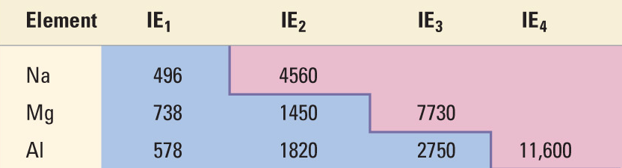
Subsequent Ionizations
Every time you take an e- away it gets harder to take the next one. Radius is getting smaller, so nucleus can pull harder on the valence - harder to remove the next one. HUGE LEAP in I.E. once it’s achieved noble gas configuration – why would it want to lose another one?!

Slide 22
Part #2

Slide 23
Warning…
There is about to be a lot of notes because it takes a lot of words to explain
You don’t need EVERY word written down to understand it.
Focus on listening and understanding.
You can add to your notes at home.
Capture enough to pay attention, leave space to come back and add/annotate.

Slide 24
Warning…
Don’t over think this stuff.
You can talk yourself into backwards answers.
Focus on the fact that there are only a set number of trends to learn.
Practice explaining each trend until you can do it in your sleep!
There will ALWAYS be exceptions. Don’t worry about that – focus on the pattern and answer questions based on the patterns.

Slide 25
Electronegatvity

Slide 26
ELECTRONEGATIVITY
What | How
A measure of the ability of an atom in a chemical compound to attract electrons from another atom in the compound How strongly can one atom pull on the electrons being shared in a bond. | Noble Gases are LOWEST! They DON’T CARE about attracting electrons!

Slide 27
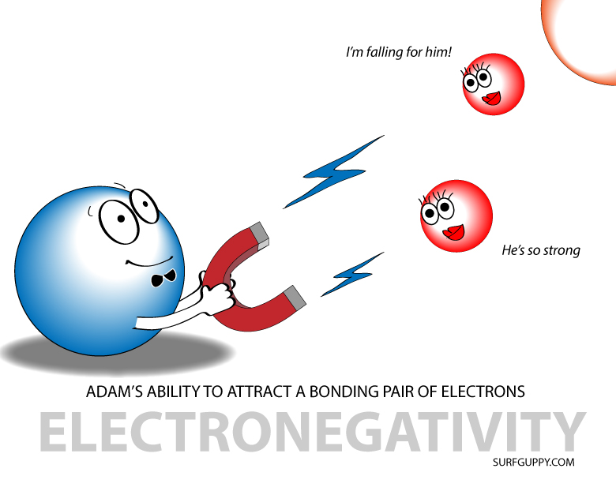

Slide 28
ELECTRONEGATIVITY
Why
DECREASES DOWN e- are further from nucleus in higher energy levels Increased shielding from core e- causes nucleus to not pull as hard on valence e- So nucleus doesn’t pull as hard on the bonding e-’s from another atom | INCREASES TO RIGHT Smaller radius, increased effective nuclear charge Nucleus is pulling harder on the valence electrons – which is where the bonding is occurring.

Slide 29
Reactivity

Slide 30
REACTIVITY
What | How
Elements in the same group have similar types of behaviors because they have the same number of valence e- BUT The MAGNITUDE of their reactions changes! | Metals and Non-metals are opposite trends! Noble gases are “INERT” or non-reactive

Slide 31
REACTIVITY
Why
METALS INCREASE DOWN Larger radius and increased shielding means lower ionization energy so it is easier to remove electrons | NON-METALS INCREASE UP Smaller radius and greater effective nuclear charge means higher electronegativity and electron affinity so it can attract an electron easier

Slide 32
Summary

Slide 33
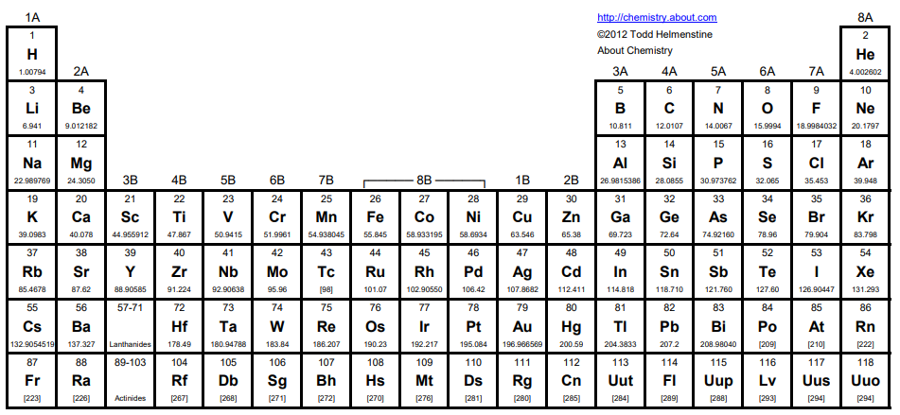
IONIZATION ENERGY
ELECTRONEGATIVITY
ELECTRON AFFINITY
EFFECTIVE NUCLEAR CHARGE - Z_{EFF}
RADIUS
RADIUS SHIELDING
IONIZATION ENERGY
ELECTRONEGATIVITY
ELECTRON AFFINITY

Slide 34
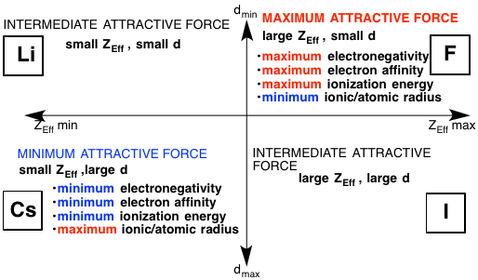

Slide 35
  Brainiac Video – note: they augmented the reactions, but it is such a fun, silly, memorable video I think it is still worth watching ☺
  Disposal of Sodium – old footage from WWII. Neat to see such old footage and how they actually disposed of the sodium after the war!

Slide 36
Quick summary. Also has a quick but good explanation of some exceptions to the trends
https://www.youtube.com/watch?v=hePb00CqvP0

Slide 37
YouTube Link to this Presentation
Part 1
https://youtu.be/jmy5tlVlFTs
Part 2
https://youtu.be/lTGOnu_WJ5I

Slide 38
Things past this slide are not being taught this year

Slide 39
Electron Affinity

Slide 40
ELECTRON AFFINITY
What | How
How much energy is released when the atom gains an electron to make a negative ion. How much stability does it gain once it is an anion. More energy released – more stable. | Noble Gases are LOWEST! They DON’T CARE about attracting electrons!

Slide 41
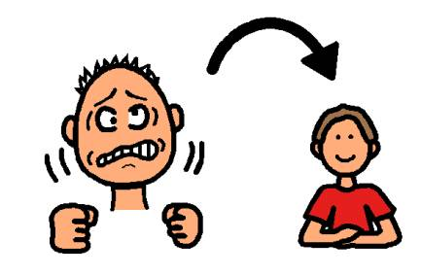

Slide 42
ELECTRON AFFINITY
Why
DECREASES DOWN Electrons are further from nucleus in higher energy levels Increased shielding from core e-’s causes the nucleus to not pull as hard on valence e-’s So atom doesn’t notice as much if it gains an electron – doesn’t gain much stability | INCREASES TO RIGHT Closer to filling valence shell – noble gas configuration is most stable

