Slide 1
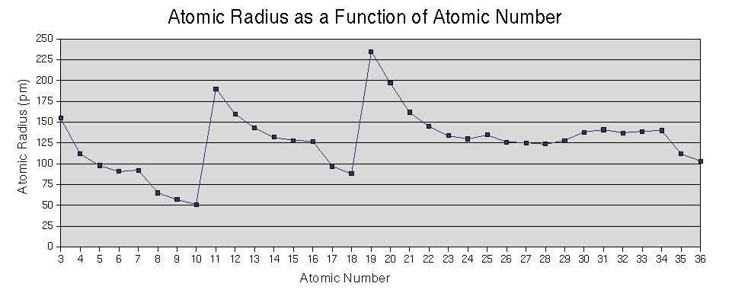
Periodic Trends

Slide 2
Shielding and Effective Nuclear Charge
Each electron in a multielectron atom experiences both the attraction to the nucleus and repulsion by other electrons in the atom.
These repulsions cause the electron to have a net reduced attraction to the nucleus; it is shielded from the nucleus.
The total amount of attraction that an electron feels for the nucleus is called the effective nuclear charge Z_{eff} of the electron.

Slide 3
Atomic Radius
Definition: Half of the distance between nuclei in covalently bonded diatomic molecule
Radius decreases across a period
Increased effective nuclear charge due to decreased shielding
Radius increases down a group
Each row on the periodic table adds a “shell” or energy level to the atom
Increased shielding

Slide 4
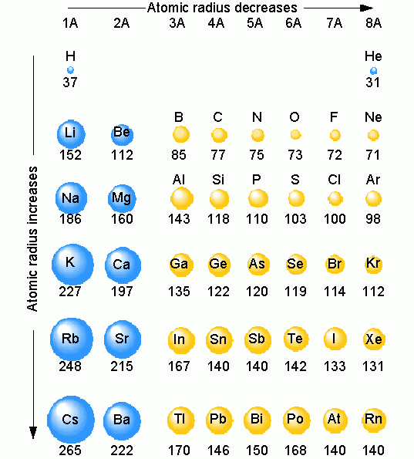
Table of Atomic Radii

Slide 5
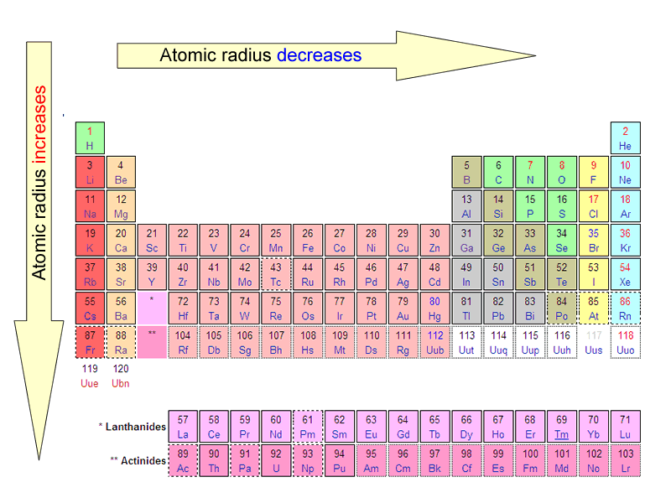
Period Trend: Atomic Radius

Slide 6
Ionization Energy
Definition: the energy required to remove an electron from an atom in a gaseous state
Tends to increase across a period
As radius decreases across a period, the electron you are removing is closer to the nucleus and harder to remove
Tends to decrease down a group
Outer electrons are farther from the nucleus and easier to remove
More energy levels (shells)
More shielding

Slide 7
Periodic Trend: Ionization Energy

Slide 8
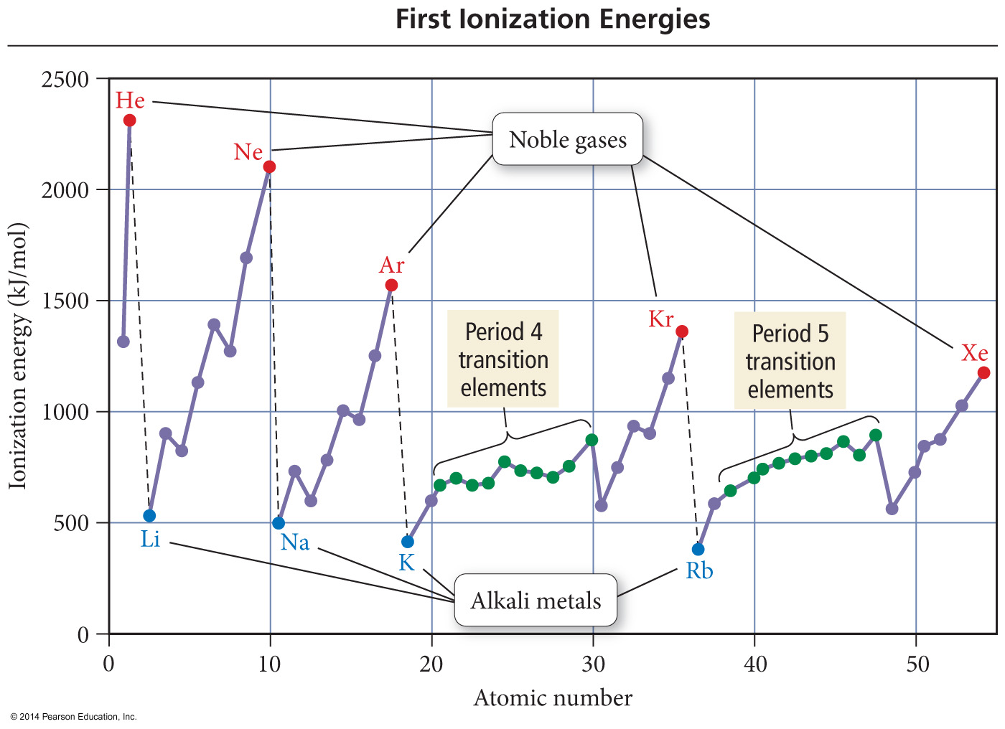

Slide 9
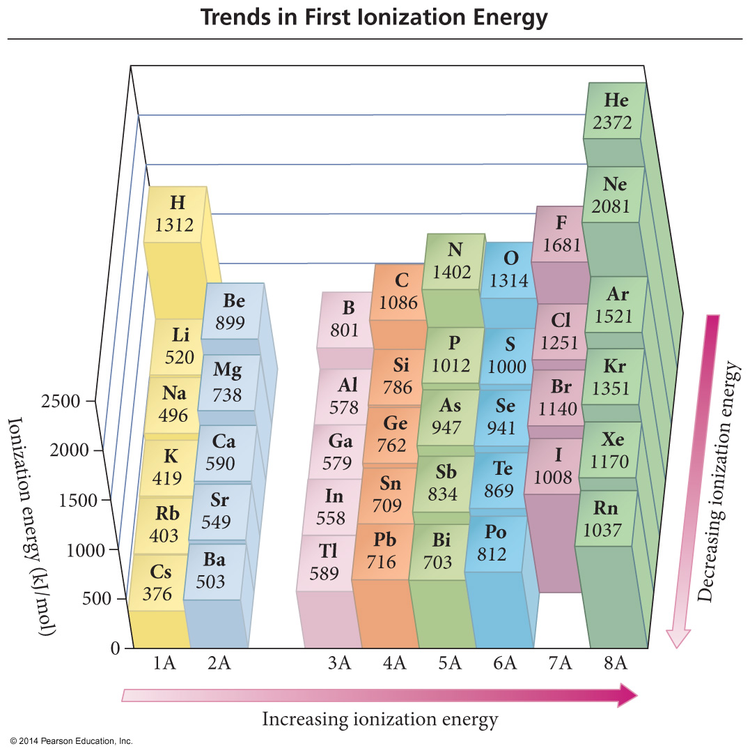

Slide 10
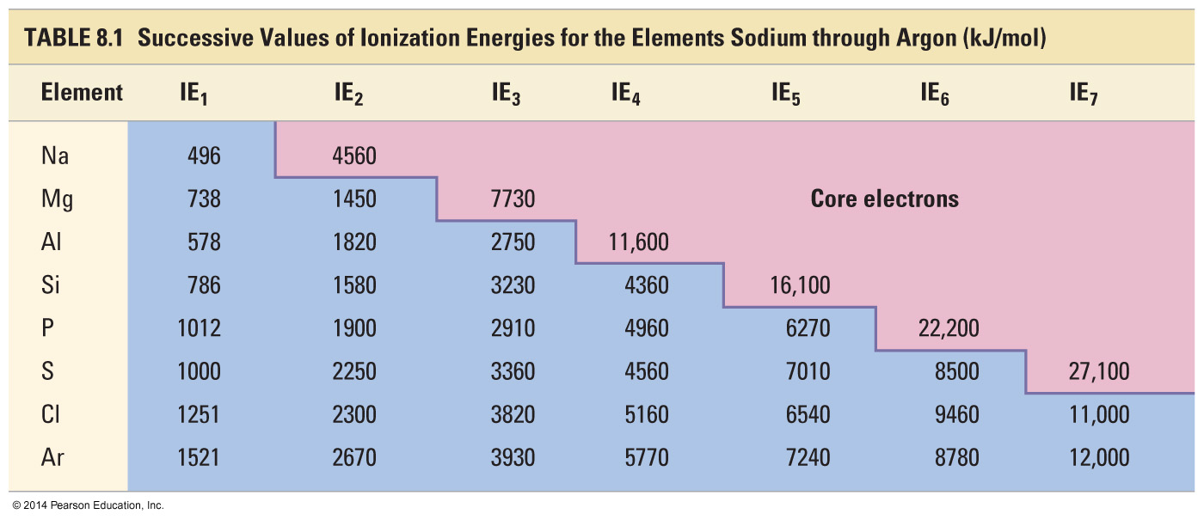
Trends in Second and Successive Ionization Energies

Slide 11
Electronegativity
Definition: A measure of the ability of an atom in a chemical compound to attract electrons
Electronegativity tends to increase across a period
As radius decreases, electrons get closer to the bonding atom’s nucleus
Electronegativity tends to decrease down a group or remain the same
As radius increases, electrons are farther from the bonding atom’s nucleus

Slide 12
Periodic Trend: Electronegativity

Slide 13
Periodic Table of Electronegativities

Slide 14
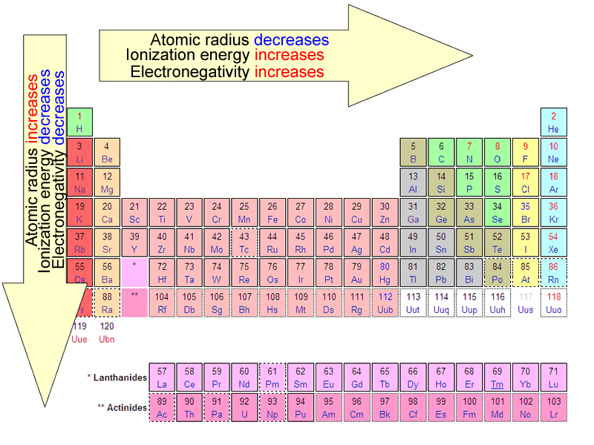
Summary of Periodic Trends

Slide 15
Ionic Radii
Positively charged ions formed when
an atom of a metal loses one or
more electrons
Cations
Smaller than the corresponding
atom
Negatively charged ions formed
when nonmetallic atoms gain one
or more electrons
Anions
Larger than the corresponding
atom

Slide 16
Table of Ion Sizes

Slide 17
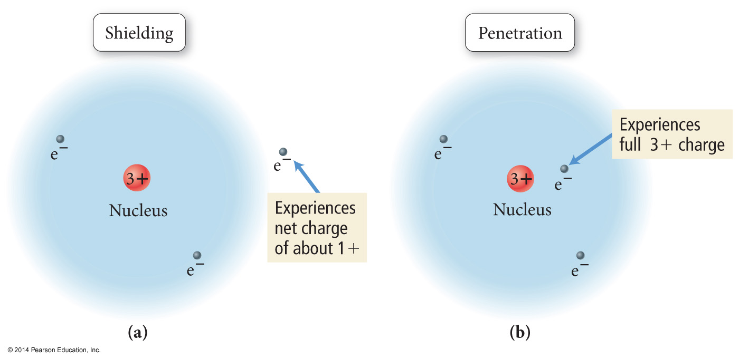
Shielding and Penetration

Slide 18
Electron orbital Penetration
The closer an electron is to the nucleus, the more attraction it experiences.
The better an outer electron is at penetrating through the electron cloud of inner electrons, the more attraction it will have for the nucleus.
The degree of penetration is related to the orbital’s radial distribution function.
In particular, the distance the maxima of the function are from the nucleus

Slide 19
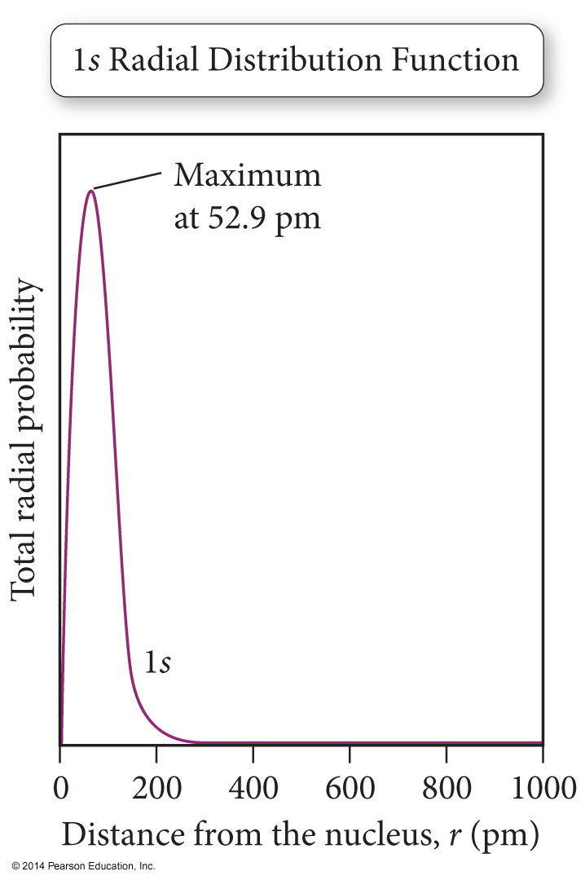
Radial Distribution Function
The radial distribution function represents the total probability of finding an electron within a thin spherical shell at a distance r from the nucleus.
The probability at a point decreases with increasing distance from the nucleus, but the volume of the spherical shell increases.
The net result is a plot that indicates the most probable distance of the electron in a 1s orbital of H is 52.9 pm.

Slide 20
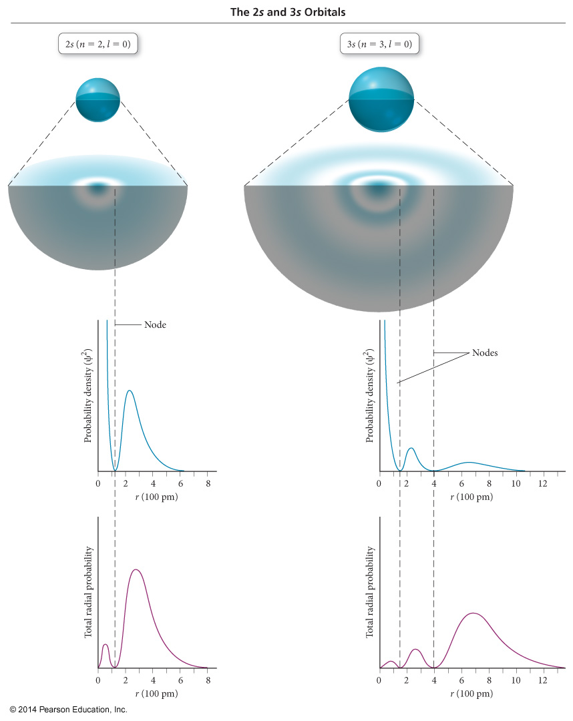
2s and 3s

