Slide 1
Worksheet #10 Molecular Geometry Activity

Slide 2
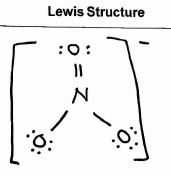
NO₃⁻
Steric #: 3
Electronic: Trigonal Planar
AXE Form:
AX₃
Molecular: Trigonal Planar

Slide 3
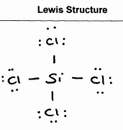
SiCl₄
Steric #:
4
Electronic: Tetrahedral
AXE Form:
AX₄
Molecular: Tetrahedral

Slide 4
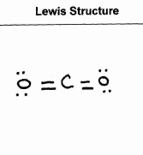
CO₂
Steric #:
2
Electronic: Linear
AXE Form:
AX₂
Molecular: Linear

Slide 5
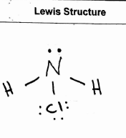
NClH₂
Steric #:
4
Electronic: Tetrahedral
AXE Form:
AX₃E₁
Molecular:
Trigonal Pyramidal

Slide 6
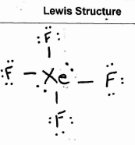
XeF₄
Steric #: 6
Electronic: Octahedral
AXE Form:
AX₄E₂
Molecular: Square Planar

Slide 7
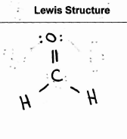
CH₂O
Steric #: 3
Electronic: Trigonal Planar
AXE Form:
AX₃
Molecular: Trigonal Planar

Slide 8
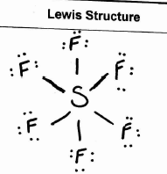
SF₆
Steric #: 6
Electronic: Octahedral
AXE Form:
AX₆
Molecular: Octahedral

Slide 9
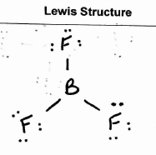
BF₃
Steric #: 3
Electronic: Trigonal Planar
AXE Form:
AX₃
Molecular: Trigonal Planar

Slide 10
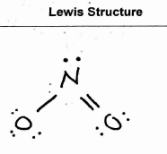
NO₂⁻
Steric #: 3
Electronic: Trigonal Planar
-
AXE Form:
AX₂E₁
Molecular: Bent

Slide 11
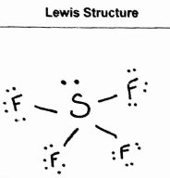
SF₄
Steric #: 5
Electronic: Trigonal Bipyramidal
AXE Form: AX₄E₁
Molecular: Seesaw

Slide 12
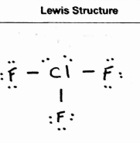
ClF₃
Steric #: 5
Electronic: Trigonal Bipyramidal
AXE Form:
AX₃E₂
Molecular: T-Shaped

Slide 13
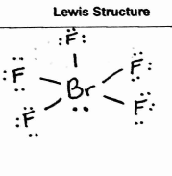
BrF₅
Steric #: 6
Electronic: Octahedral
AXE Form:
AX₅E₁
Molecular: Square Pyramidal

Slide 14
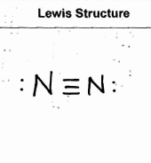
N₂
Steric #: 2
Electronic: Linear
AXE Form:
AX₁E₁
Molecular: Linear

Slide 15
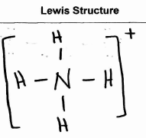
NH₄⁺
Steric #: 4
Electronic: Tetrahedral
AXE Form:
AX₄
Molecular: Tetrahedral

