Slide 1
“Quick” Guide to Bonding and Naming
N-16
Target: I can identify the types of bonds made in compounds/ molecules, and can name them.
Link to YouTube Presentation: https://youtu.be/ktPW9-jld0s

Slide 2
“Quick” Guide to Bonding and Naming
N-16
More details are found in the “reader” in your reference section, and will appear in practice problems on worksheets. Naming rules get very complex – as always focus on patterns and common exceptions

Slide 3
Why do bonds form?
Lowers the potential energy between the charged particles that compose atoms.
Bonds forms when the potential energy of the bonded atoms is less than the potential energy of the separate atoms.

Slide 4
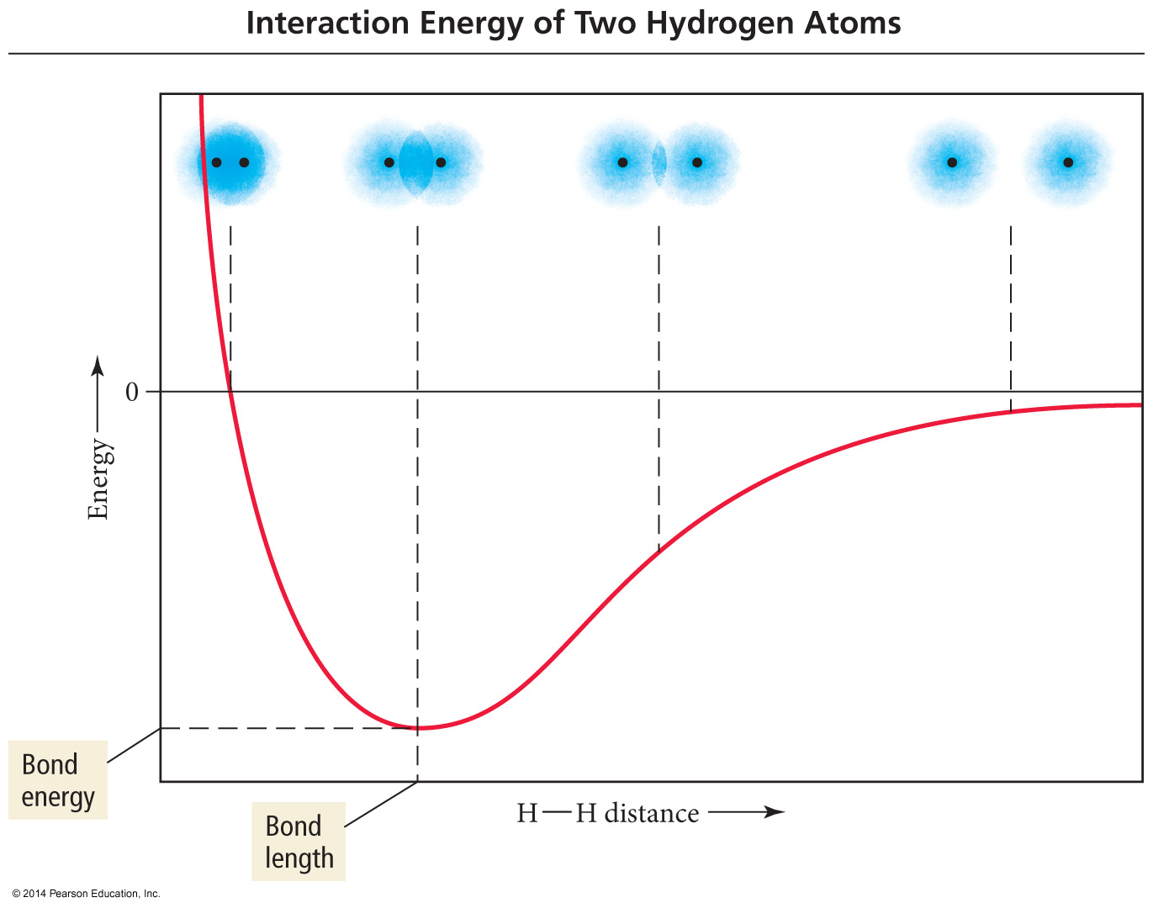
Energy
Distance between H atoms

Slide 5
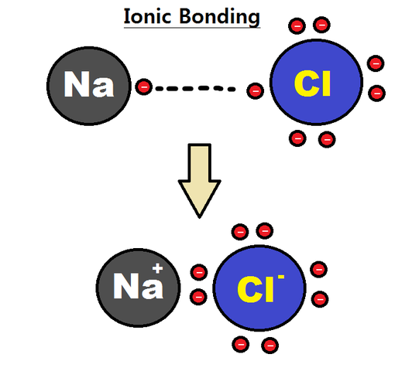
Ionic Bonds
Transfer of electrons - makes charges
Electrostatic bond between a positive charge and a negative charge
Metal + Nonmetal Ca²⁺ O²⁻
Polyatomic Ions, even if nonmetals NH₄⁺, SO₄²⁻

Slide 6
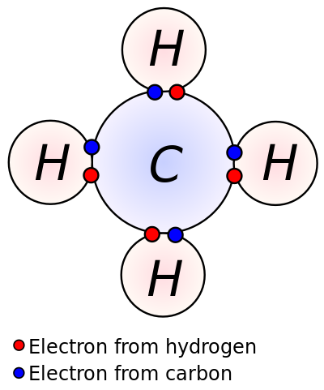
Covalent Bonds
Atoms can’t fully transfer electrons, so they share them
Nonmetal + Nonmetal CH₄

Slide 7
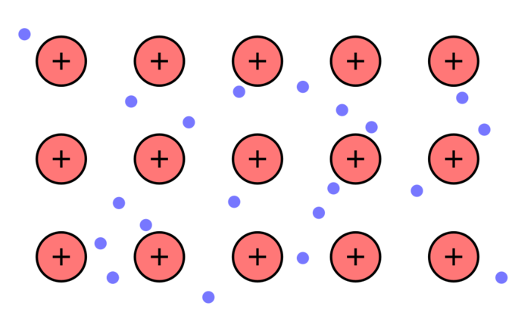
Metallic Bonds
Electrons “detach” from the atoms they came from
Creates a “sea of electrons” that can flow when a charge is applied

Slide 8
Ions
Cation: A positive ion
Mg²⁺, NH₄⁺
Anion: A negative ion
Cl⁻, SO₄²⁻

Slide 9
Ions
Monatomic Ion: consists of only one element
Mg²⁺, Na⁺
Polyatomic Ion: consists of 2 or more elements
CN⁻, SO₄²⁻

Slide 10
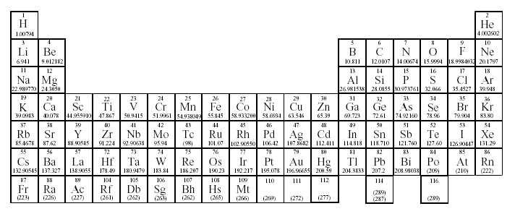
Predicting Ionic Charges of Single Atoms
Group 1:
Lose 1 electron to form 1+ ions
H⁺
Li⁺
Na⁺
K⁺

Slide 11
Predicting Ionic Charges of Single Atoms
Group 2:
Loses 2 electrons to form 2+ ions
Be²⁺
Mg²⁺
Ca²⁺
Sr²⁺
Ba²⁺

Slide 12
Predicting Ionic Charges of Single Atoms
Group 13:
B³⁺
Al³⁺
Ga³⁺
Loses 3
electrons to form 3+ ions

Slide 13
Predicting Ionic Charges of Single Atoms
Group 14:
Lose 4 electrons or gain 4 electrons

Slide 14
Predicting Ionic Charges of Single Atoms
N³⁻
Nitride
Group 15:
Gains 3 electrons to form 3- ions
P³⁻
Phosphide
As³⁻
Arsenide

Slide 15
Predicting Ionic Charges of Single Atoms
O²⁻
Oxide
Group 16:
S²⁻
Sulfide
Gains 2 electrons to form 2- ions
Se²⁻
Selenide

Slide 16
Predicting Ionic Charges of Single Atoms
F¹⁻
Fluoride
Group 17:
Cl¹⁻
Chloride
Gains 1 electron to form 1- ions
Br¹⁻
Bromide

Slide 17
Predicting Ionic Charges of Single Atoms
Group 18:
Stable Noble gases do not form ions!

Slide 18
Predicting Ionic Charges of Single Atoms
Groups 3 - 12:
Many transition elements have more than one possible oxidation state.
Iron(II) = Fe²⁺
Iron(III) = Fe³⁺

Slide 19
Predicting Ionic Charges of Single Atoms
Groups 3 - 12:
Some transition elements have only one possible oxidation state.
Zinc = Zn²⁺
Silver = Ag⁺
Cadmium = Cd²⁺

Slide 20
Naming Ionic Compounds
Cation first, then anion
Monatomic cation = name of the element
Ca²⁺ = calcium ion
Monatomic anion = root + -ide
Cl⁻ = chloride
CaCl₂ = calcium chloride

Slide 21
Naming Ionic Compounds
With Polyatomic Ions
Poly atomic ions always keep their special names, don’t change them!
K₃(PO₃)
Potassium phosphite

Slide 22
Naming Ionic Compounds
Metals with variable charges
Some metal forms more than one cation
Use Roman numeral in name
PbCl₂
Pb²⁺ is cation
PbCl₂ = lead(II) chloride
FeO
Fe²⁺ is cation
FeO = Iron(II) oxide

Slide 23
Naming Ionic Compounds
To figure out the charge on the metal
Work backwards
FeCl₃
Fe? is cation
Cl₃ = 3 atoms with (-1) charge each = -3 charge
Fe must be Fe³⁺ to balance out that -3
Iron (III) Chloride

Slide 24
Naming Ionic Compounds
To figure out the charge on the metal
Work backwards
Ni₃N₂
Ni? is cation
N₂ = 2 atoms with (-3) charge each = -6 charge
3 Ni atoms must balance out the -6 charge, so each Ni must be
+2
Nickel (II) Nitride

Slide 25
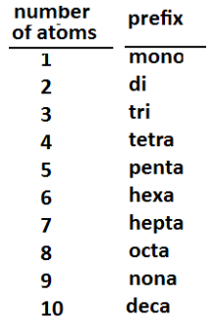
Naming Covalent Molecules
Two (or more) nonmetals
All elements keep their normal names EXCEPT the last element changes its ending to -ide
Use prefixes
NEVER use “mono” for the first element!

Slide 26
Naming Covalent Molecules
Double vowels – when using prefixes we don’t like some double vowel combos – drop the last vowel from the prefix portion of the name
Any double vowel with an I is ok!
Diiodide = ok
Pentaiodide = ok
Monoiodide = ok
Monooxide = no! → monoxide

Slide 27
Naming Covalent Molecules
P₂O₅ =
diphosphorus pentoxide
CO₂ =
carbon dioxide
CO =
carbon monoxide
N₂O =
dinitrogen monoxide

Slide 28
Naming Metallic Substances
SUPER EASY….
Name the metal. The end.
Cu
Copper

Slide 29
Odds and Ends
Are the exceptions? Weird rules? YES. ALWAYS.
Diatomic elements – some elements come as a pair and not by themselves
H₂, N₂, O₂, F₂, Cl₂, Br₂, I₂

Slide 30
Odds and Ends
Are the exceptions? Weird rules? YES. ALWAYS.
Probably lots I can’t think of right now! That is why we need to practice a lot of actual examples!

Slide 31
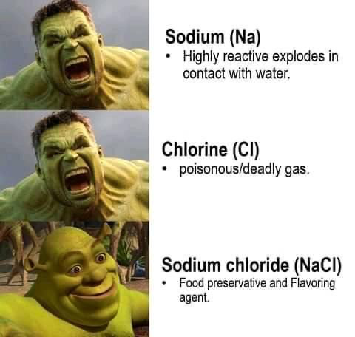
Odds and Ends
Properties change when bonds form!
Electrons are in different arrangements, and properties relate to the electrons!

Slide 32
YouTube Link to Presentation
https://youtu.be/ktPW9-jld0s

