Slide 1
N-18 Lewis Structures
Target: I can draw the structures of atoms, ions, ionic bonded compounds, and covalent molecules.
Links to YouTube Presentations:
Part A – Intro https://youtu.be/on_-k2-jvns
Part B – Single Bonds https://youtu.be/HeX66BXt2-w
Part C – Double/Triple Bonds https://youtu.be/KBP_sUPYK3E

Slide 2

N-18 Lewis Structures
Intro Lesson

Slide 3
Things Bond with Valence Electrons
Valence electrons - on the outside
  What another atom can see when they “bump into” each other to bond.
You have to know the # of valence electrons for EACH atom in the molecule.
  From the periodic table pattern of groups 1A, 2A, 3A…etc.
    Li = 1
    Be = 2
    N = 5

Slide 4
The Octet “Rule”
Most atoms want to have 8 electrons
Is broken a LOT!
COMMON EXCEPTIONS
Element | H | Li | Be | B | P | S
# of ve- it is happy with | 2 | 2 | 4 | 6 | 10 | 12
More than 8 is called an
“expanded octet”

Slide 5
Single Atoms
Each dot is a valence electron!
Li
Be
B
C
N
O
F
Ne

Slide 6
Ions - Anions
Adjust the # of valence e⁻ because of the charge!
Draw square brackets and the charge when drawing an ion!
[ ]²⁻
O
6 ve- versus 8 ve-
O
[ ]³⁻
N
5 ve- versus 8 ve-
N

Slide 7
Ions - Cations
Mg

Slide 8
Ions - Cations
Mg

Slide 9
Ions - Cations
Mg

Slide 10
Ions - Cations
Mg

Slide 11
Ions - Cations
Adjust the # of valence electrons because of the charge!!!!
When atoms lose all their valence electrons, they drop down to the previous level which already is a full shell. HOWEVER – when we draw our structures we want to draw the ORIGINAL valence shell – which is now empty! We do this because we want to show how it changed more than what it looks like now.
Mg
2 ve- in original valence shell
[ ]²⁺
0 ve- in original valence shell
Mg

Slide 12
Ionic Compounds
Super easy! Just draw the cation and anion next to each other. Done!
[ ]²⁺
[ ]²⁻
Mg
O
More than one of a particular ion?
Then just add a subscript outside the brackets!
[ ]¹⁻
[ ]²⁺
Mg
F
2

Slide 13
Covalent Molecules
STEPS
Count & sum ve-
Place your atoms
Bond all atoms w/
a single bond
Give all atoms a full shell
Re-count the ve- you used
Fix if needed
Used too few? Put extra on
the central atom
Used to many ve-? Then try
double or triple bonds to fix
Covalent molecules will share electrons – they each donate one (or more) to a shared bond. Do NOT just randomly throw dots all over your paper!!!! No “guessing and checking” allowed! Follow a systematic set of steps so you never make mistakes!

Slide 14
Covalent Molecules
Knowing where to place your atoms can be hard. There are some guidelines to follow but they can be broken often. You always draw the best structure possible. It may not be great, but you can only do the best you can do!
PLACEMENT “RULES”
Hydrogen always goes on the outside of the molecule
  - it is a “dead end”
  - it “terminates” the molecule
  - it “caps off” the molecule
  - Because it can only make 1 bond
H H O no!
H O H yes!

Slide 15
Covalent Molecules
Knowing where to place your atoms can be hard. There are some guidelines to follow but they can be broken often. You always draw the best structure possible. It may not be great, but you can only do the best you can do!
PLACEMENT “RULES”
The least electronegative atom goes in the inside/center
  - except for hydrogen!

Slide 16
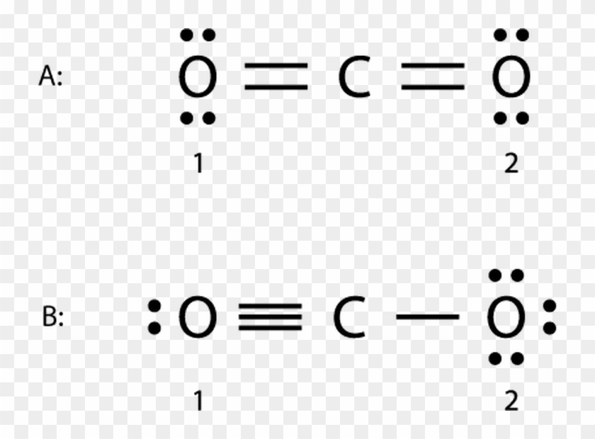
Covalent Molecules
Knowing where to place your atoms can be hard. There are some guidelines to follow but they can be broken often. You always draw the best structure possible. It may not be great, but you can only do the best you can do!
PLACEMENT “RULES”
Symmetry is good!
  - When possible!
Fine but not great
Better! Symmetrical!

Slide 17

Lesson will continue in class
I show you how to draw covalent molecules using the basics you learned here. Make sure you know this stuff!

Slide 18
YouTube Links to Lessons
Part A – Intro
https://youtu.be/on_-k2-jvns
Part B – Single Bonds
https://youtu.be/HeX66BXt2-w
Part C – Double/Triple Bonds
https://youtu.be/KBP_sUPYK3E

