Slide 1
N19 - VSEPR and the 3D Geometry of Molecules
Target:
I can identify the 3-dimensional shape of molecules.
Link to YouTube Presentation: https://youtu.be/zvTSm6kT7C0

Slide 2
Make a big obvious note to yourself in your notebook...
LOOK AT VSEPR CHART IN REFERENCE SHEET SECTION OF BINDER!!!!!

Slide 3
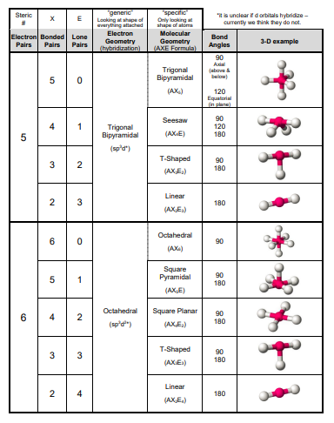
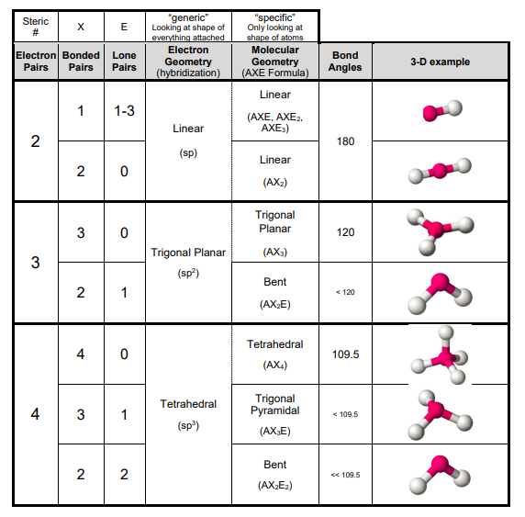

Slide 4
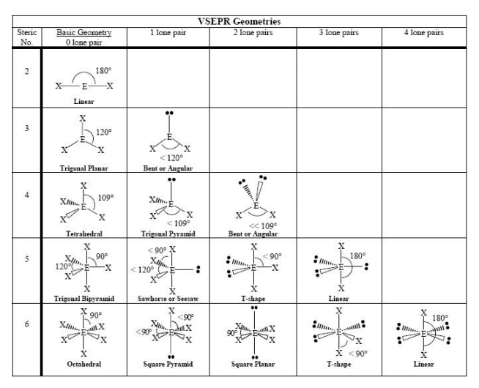

Slide 5
VSEPR Model
(Valence Shell Electron Pair Repulsion)
The structure around a given atom is determined (mostly) by minimizing electron pair repulsions.
They try to maximize the distance between electrons

Slide 6
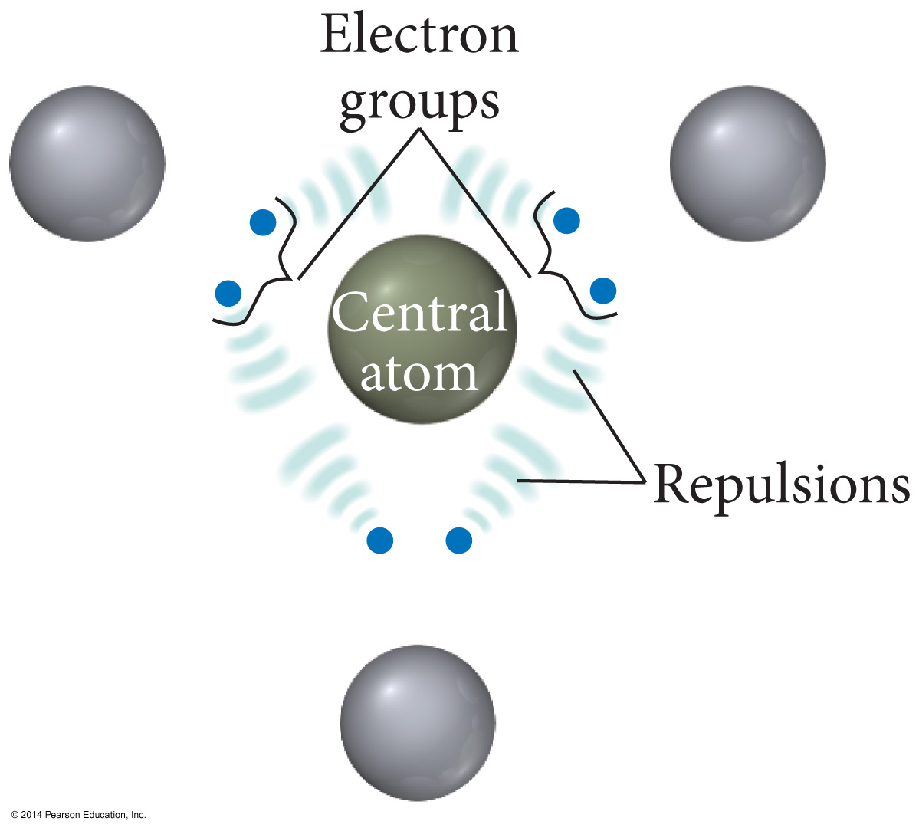

Slide 7
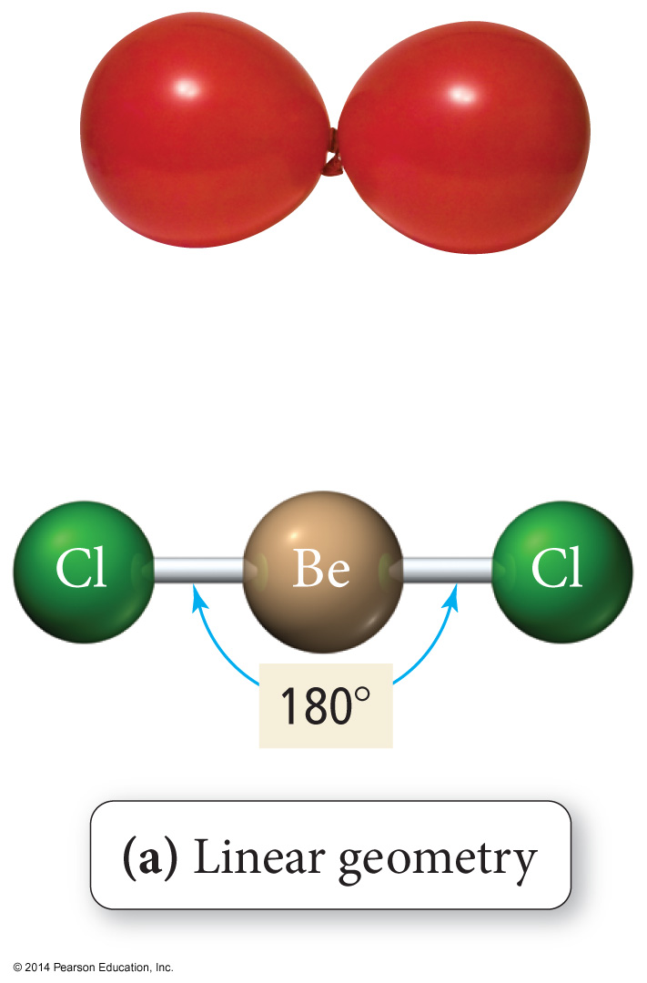
Linear Geometry

Slide 8
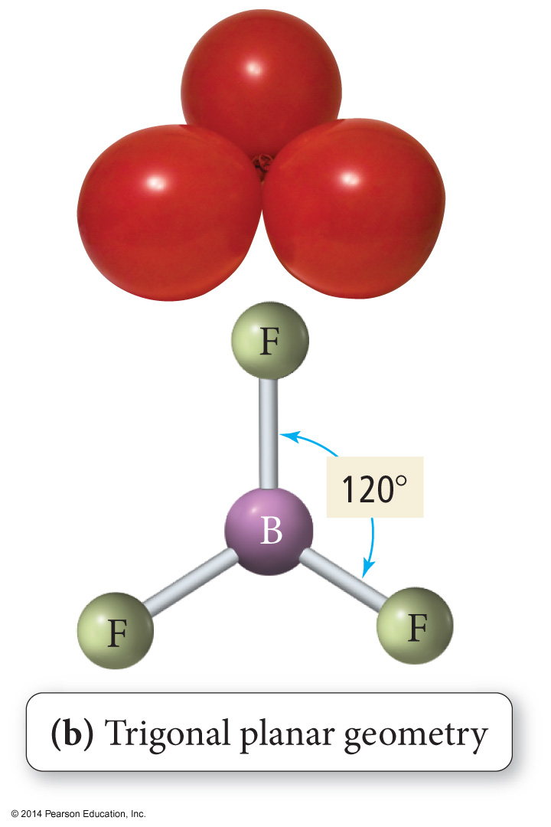
Trigonal Planar Geometry

Slide 9
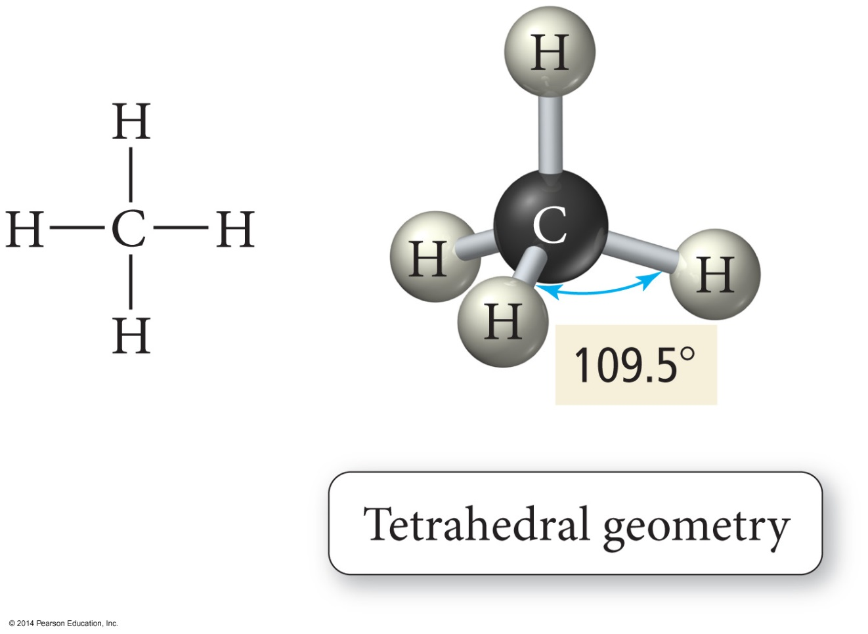
Tetrahedral Geometry

Slide 10
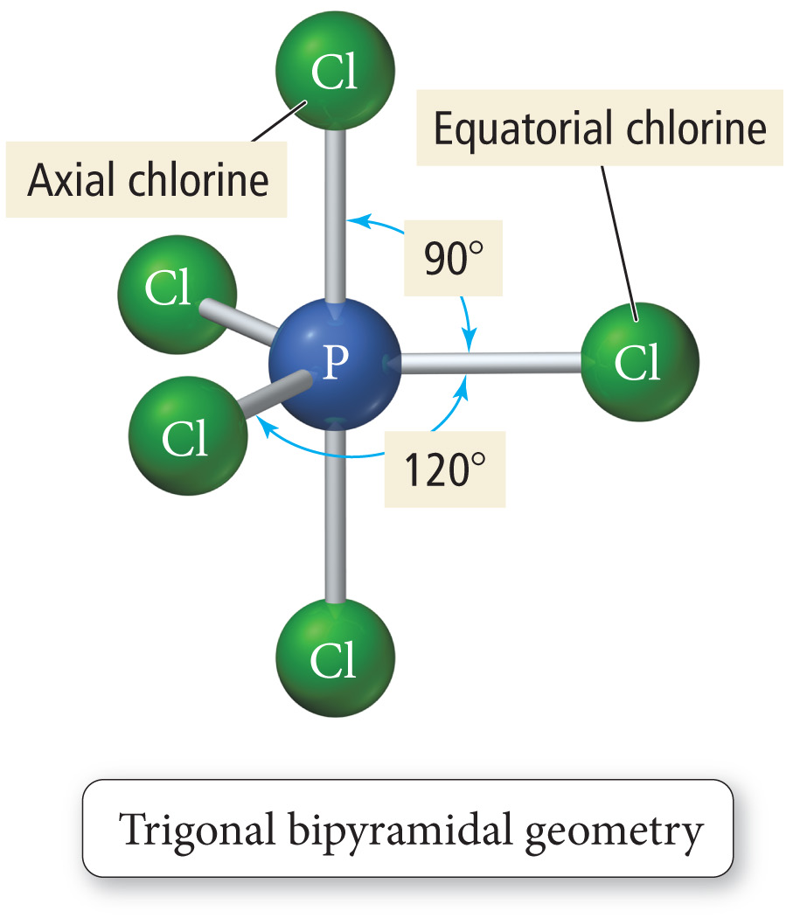
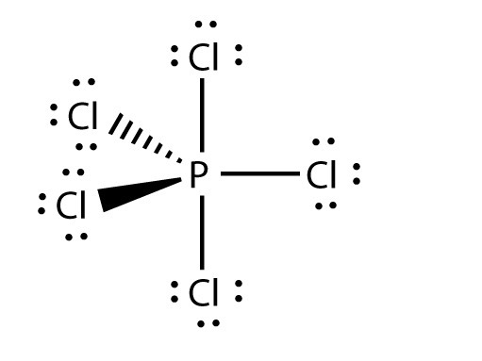
Trigonal Bipyramidal

Slide 11
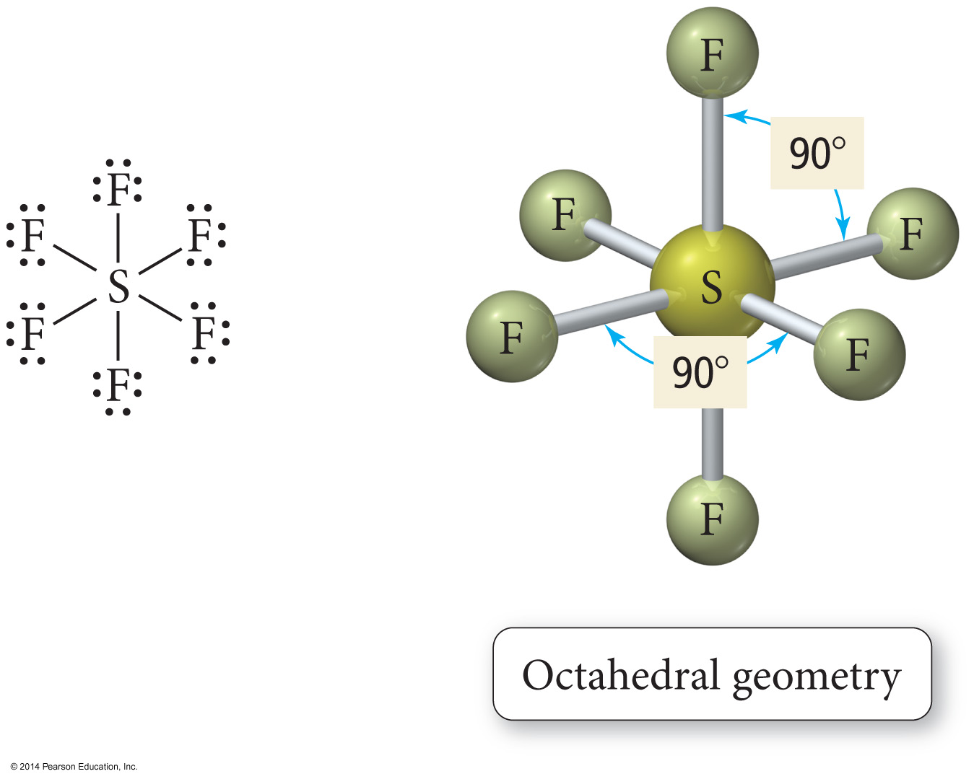
Octahedral Geometry

Slide 12
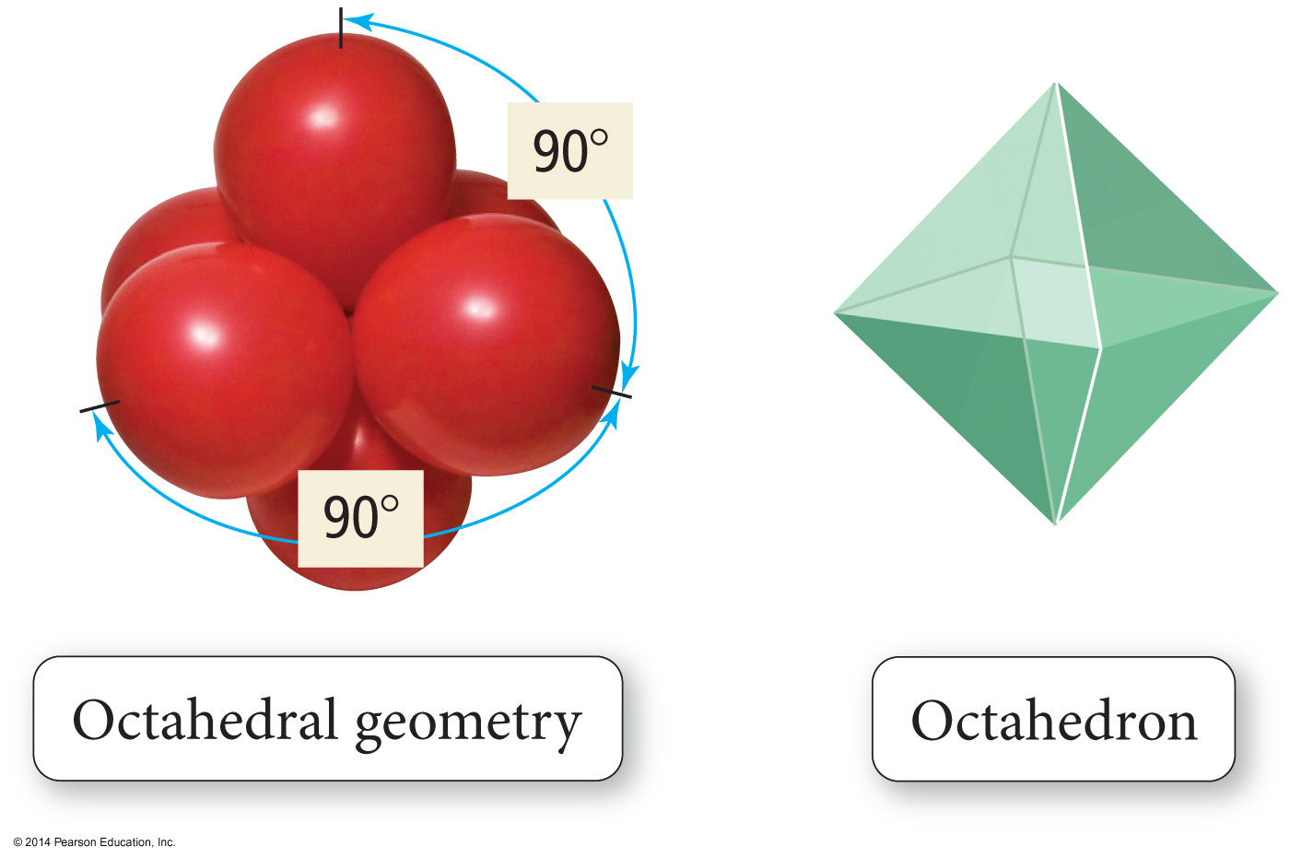
Octahedral Geometry

Slide 13
The Effect of Lone Pairs
Lone pair = “occupy more space”
This affects the bond angles, making the bonding pair angles smaller than expected.
Pushes the atoms out of the way
Relative sizes of repulsive force interactions is as follows:
Lowest: Bonding Pair – Bonding Pair
Medium: Lone Pair – Bonding Pair
Highest: Lone Pair – Lone Pair

Slide 14
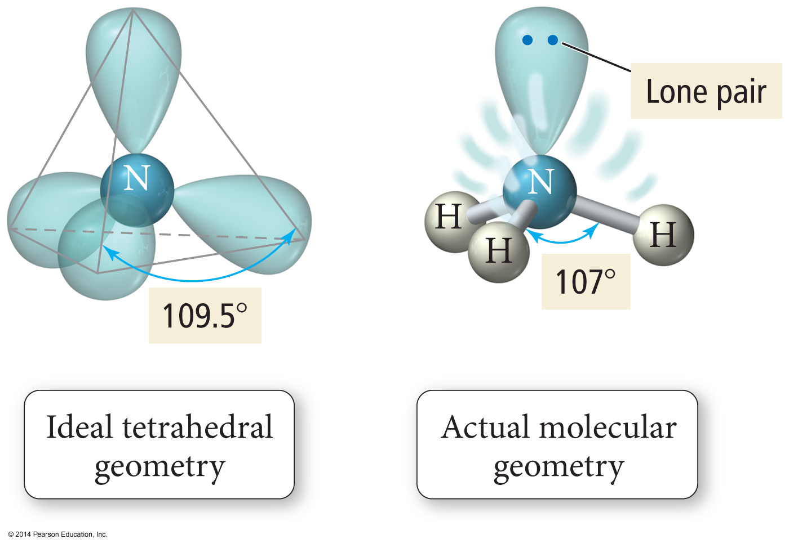
Bond Angle Distortion from Lone Pairs

Slide 15
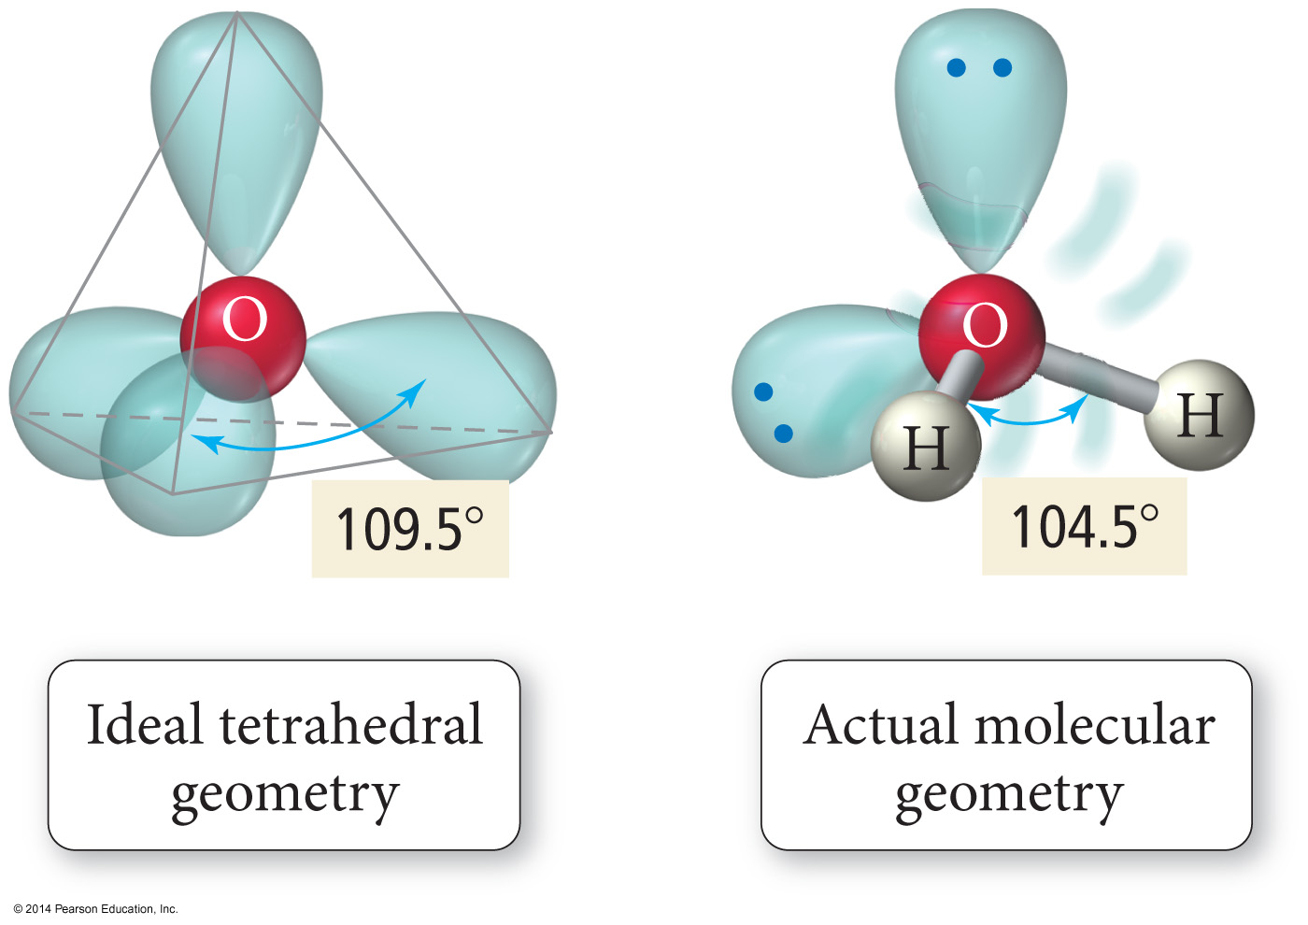
Bond Angle Distortion from Lone Pairs

Slide 16
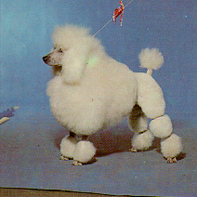
Hybridization - The Blending of Orbitals
+
=
Poodle
+
Labrador
=
Labradoodle
Labradoodle
Hybridization is the combining of two or more orbitals of nearly equal energy within the same atom into
orbitals of equal energy.

Slide 20
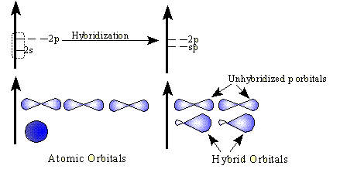
sp Hybrid Orbitals
One s orbital combines with one p orbital
Two p orbitals are left the same

Slide 21
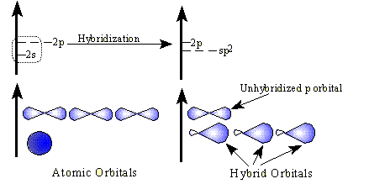
sp² Hybrid Orbitals
One s orbital combines with two p orbitals
One p orbital remains unchanged.

Slide 22
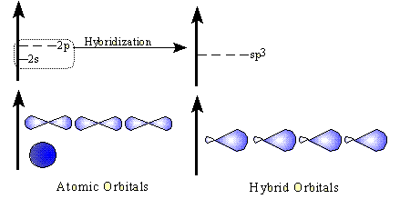
sp³ Hybrid Orbitals
One s orbital combines with three p orbitals

Slide 23
VSEPR – AXE Method
The A represents the central atom.
The X represents how many bonded atoms.
The E represents the number of lone electron pairs present on the central atom.
The sum of X and E, sometimes known as the steric number.

Slide 24
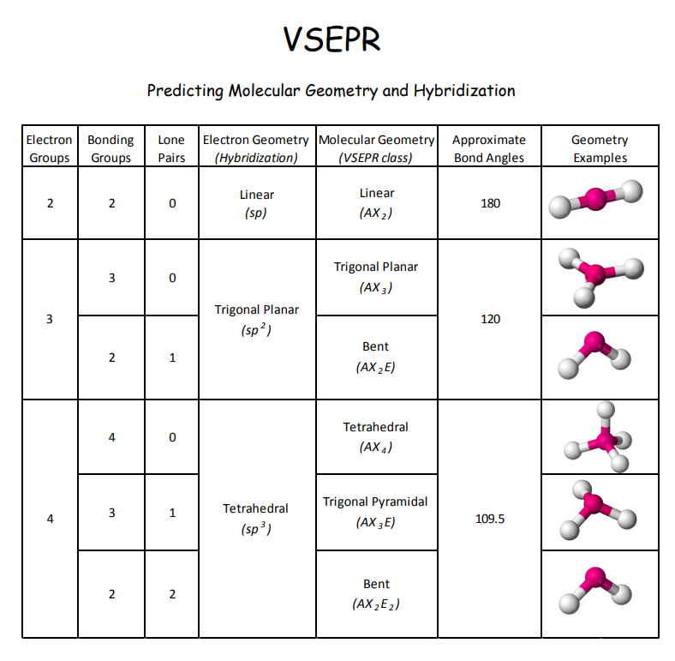
Steric #
“generic” shape
“specific” shape – Only looking at atoms
X
E

Slide 25
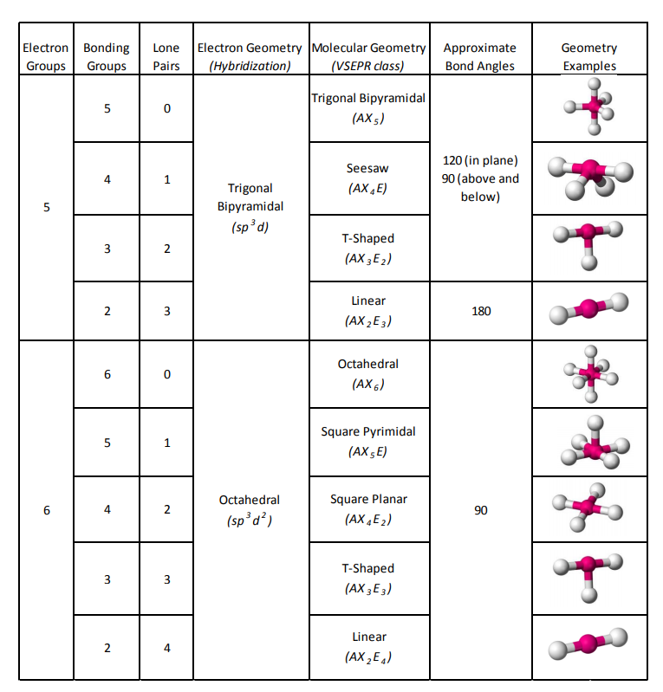

Slide 27
Great Hybridization Video:
https://m.youtube.com/watch?feature=youtu.be&v=vHXViZTxLXo
Online 3D Shape Simulation:
https://phet.colorado.edu/sims/html/molecule-shapes/latest/molecule-shapes_en.html

Slide 28
Link to YouTube Presentation
https://youtu.be/zvTSm6kT7C0

