Slide 1
N-21 Intermolecular Forces

Slide 2
Target: I can identify the types of IMFs present in a molecule, and can use that to make predictions about the properties of a molecule.
N-21 Intermolecular Forces
Link to YouTube Presentation: https://youtu.be/6JedE3a9LrI

Slide 3
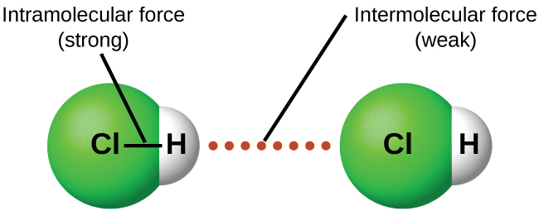
Vocabulary
INTRAmolecular Forces
Forces holding together the atoms INSIDE a molecule or compound.
Types: Ionic forces, covalent forces
INTERmolecular Forces
Attractions or repulsions which act between neighboring molecules

Slide 4
Types of IMFs

Slide 5
INTER molecular forces (forces between neighboring molecules)
London < Dipole-dipole < Hydrogen Dispersion bonding
WEAKEST
STRONGEST
“Van der Waals Forces” are London Dispersion Forces and Dipole-Dipole Forces added together

Slide 6
INTER molecular forces (forces between neighboring molecules)
London < Dipole-dipole < Hydrogen Dispersion bonding
WEAKEST
STRONGEST
“Van der Waals Forces” are London Dispersion Forces and Dipole-Dipole Forces added together

Slide 7
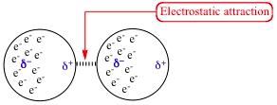
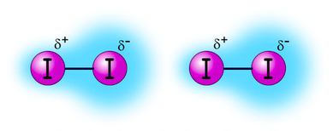
London Dispersion Forces
VERY WEAK and TEMPORARY!!!!
Caused by temporary unequal electron distribution that makes weak and temporary dipoles. Also called “instantaneous dipole”
Example I₂

Slide 8
London Dispersion Forces Continued…
EVERYTHING HAS LONDON DISPERSION FORCES BECAUSE EVERYTHING HAS ELECTRONS!
“Bigger” molecules will have more LDFs – more surface area/volume to get temporary unequal electrons
C₈H₁₈ will have more LDFs than C₃H₈

Slide 9
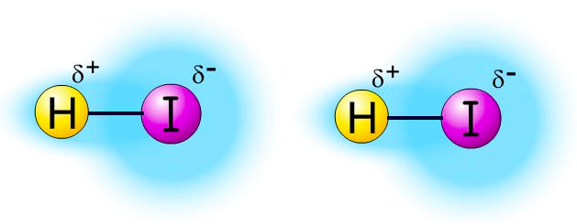
Dipole - Dipole
ONLY OCCURS IN POLAR MOLECULES
Partially negative portion of one polar molecule attracted to Partially positive portion of the second polar molecule
Example: 2 molecules of HI

Slide 10
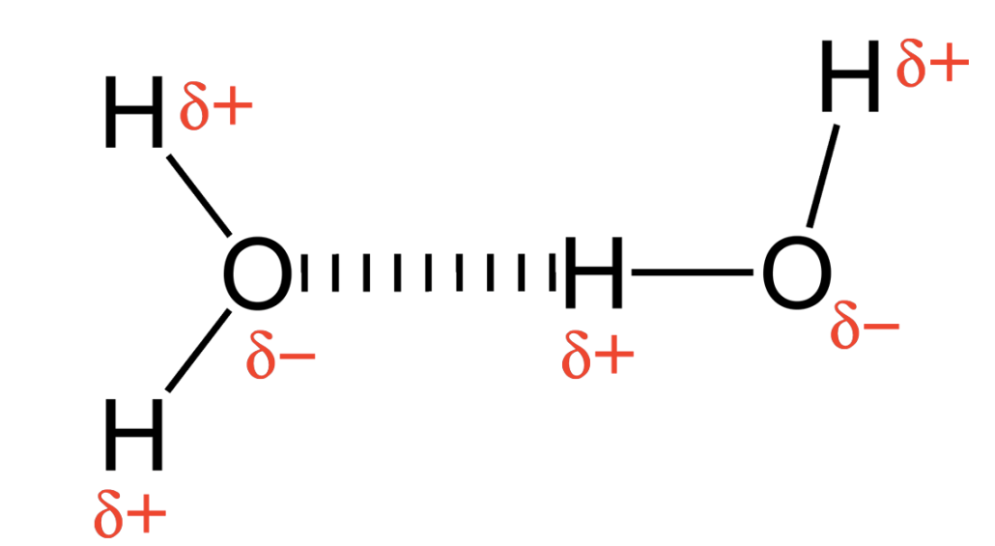
Hydrogen Bonding
A TYPE OF DIPOLE-DIPOLE! (Strongest Kind of IMF!)
Must have: “H-NOF:”
ATTRACTION BETWEEN:
Hydrogen end of an O-H, N-H, or F-H bond
the partially negative part of a lone pair on an N, O, or F, atom
-
+

Slide 11
NO
Is the molecule polar?
YES
London Dispersion Forces (ONLY)
Does the molecule have any of the following bonds: H-N H-O
H-F
WITH LONE PAIR(S)!
NO
Dipole-Dipole (and London dispersion)
YES
Hydrogen Bonds (and Dipole-Dipole and London dispersion)

Slide 12
Properties due to Intermolecular Forces

Slide 13
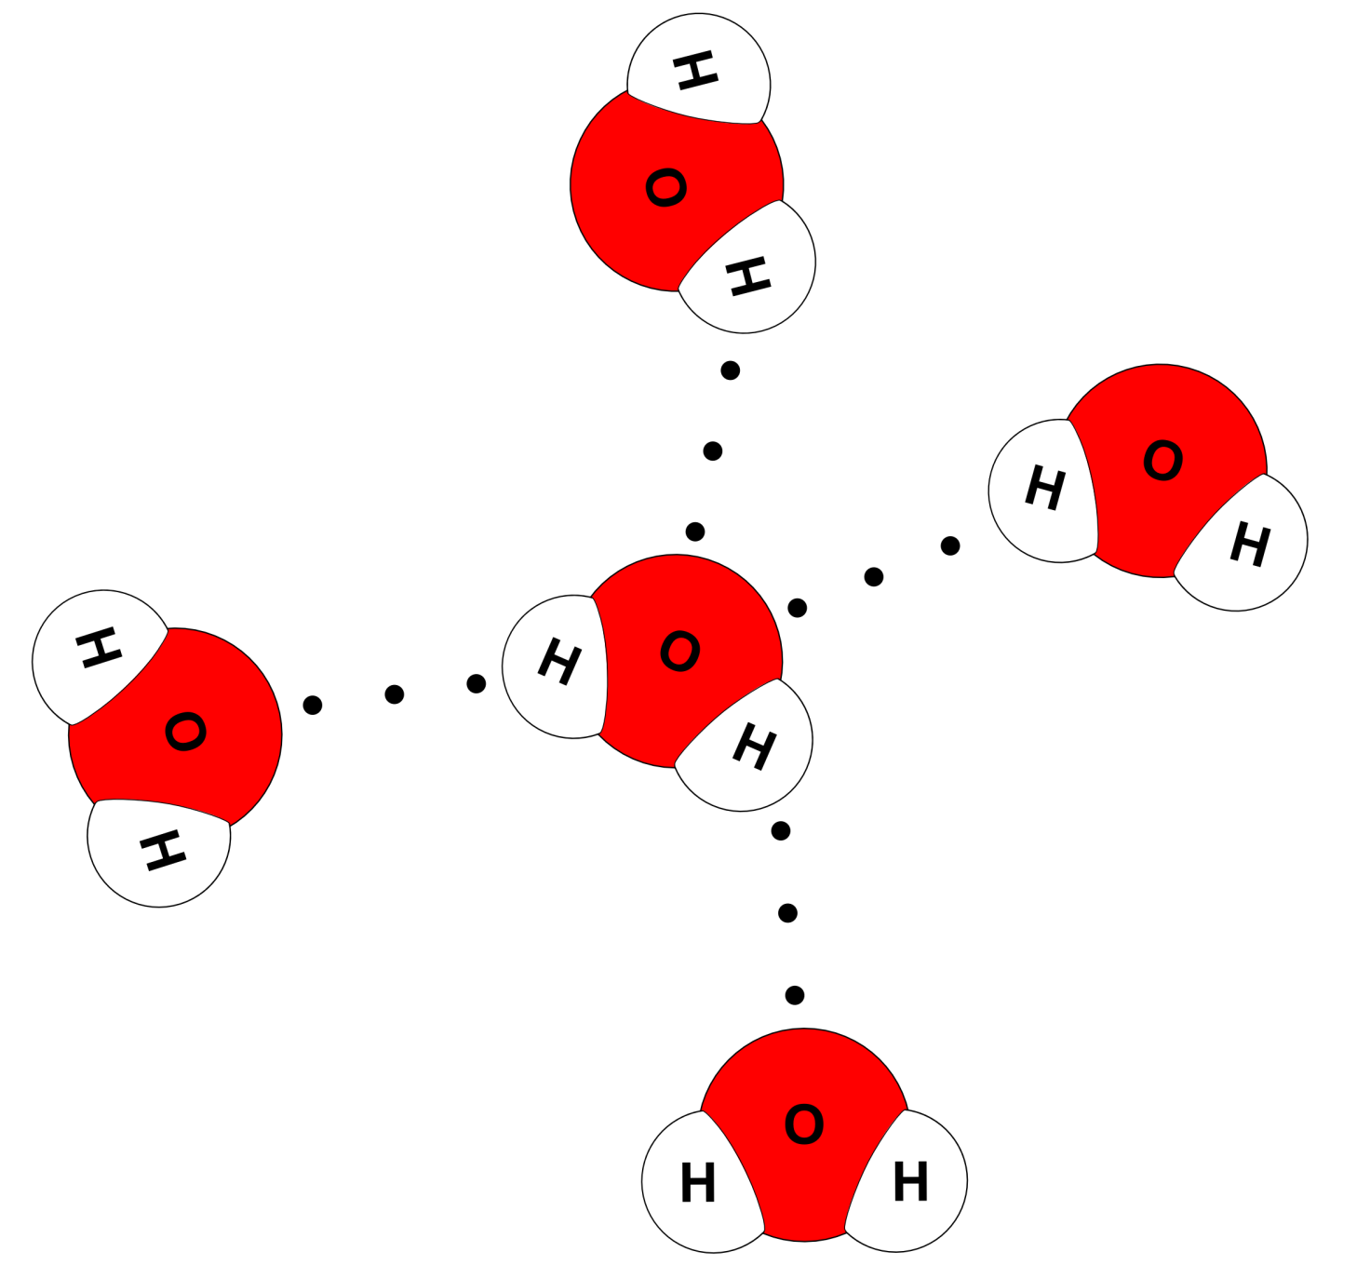

Slide 14
Some properties that relate to intermolecular forces
Boiling point | When you increase IMFs Properties increase too! More forces=higher props
Melting point
Viscosity
Surface tension
Miscibility (Mixing) | “Like dissolves like”
 | Polar with polar | Non-polar with non-polar

Slide 15
Special Examples of IMFs

Slide 16
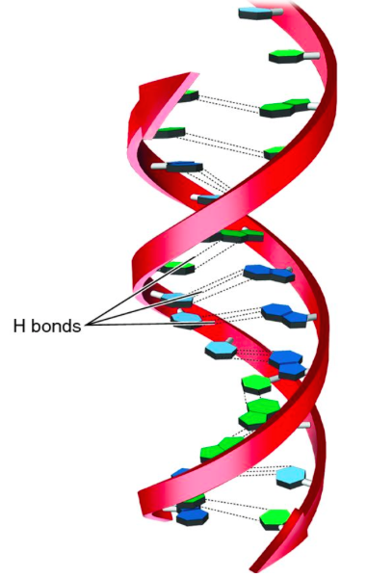
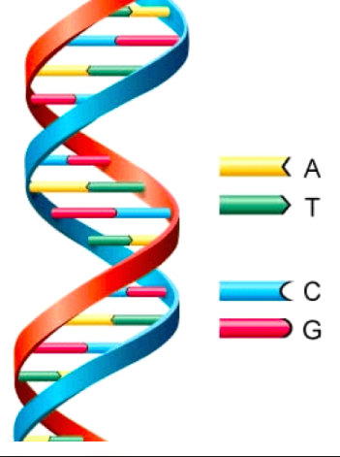
Important Example of H-Bonding
DNA Alpha helix shape-
Nucleic acids “bond” A to T and C to G
H bonds
Generic DNA picture

Slide 18
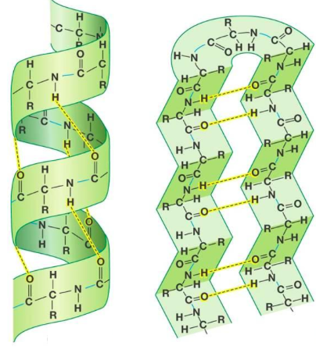
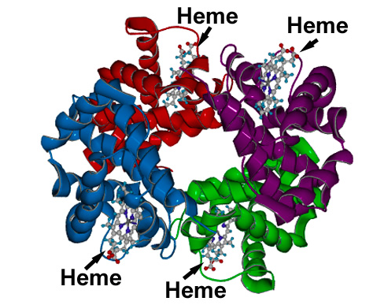
H bonding in protein shapes
Proteins – chain of amino acids
Secondary structures: beta sheets and alpha helix
Alpha helix
Beta sheets
Hemoglobin protein

Slide 19
Bulk Solids

Slide 20
Interactions in solids
COMBINATION OF: intramolecular AND intermolecular forces in a “large” or “bulk” scale
3 TYPES
Metallic (weakest) Ionic Lattice (middle)
Network covalent (strongest)
Bulk solids have very high melting/boiling points because there are so many inter and intra molecular forces holding the atoms close together

Slide 21
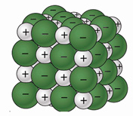
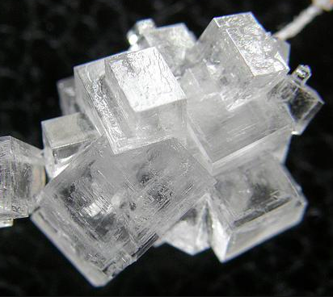
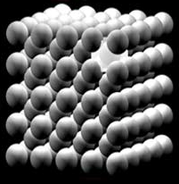
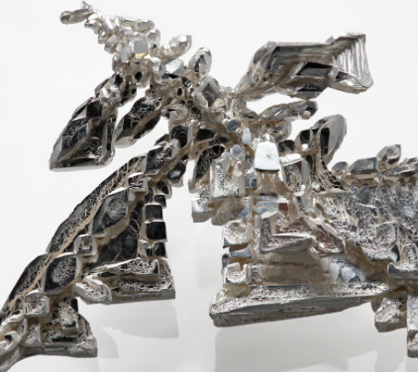
IONIC LATTICE ions stack in an ordered fashion to form crystals
Example: NaCl
METALLIC
Metal ions stack in an
ordered fashion held together
by the “sea of electrons” and
the positive metal ions
Example: Fe

Slide 22
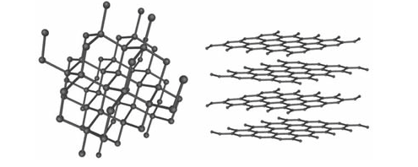
NETWORK COVALENT
covalently bonded atoms in a continuous network
Example: Carbon
DIAMONDS GRAPHITE

Slide 23
Overall Ranking
Nonpolar Covalent
LDF
Polar Covalent
DP-DP
Polar Covalent
H-Bond
Metallic Bond
Ionic Bond
Network Covalent
Weakest Strongest Least Most
IMFs IMFs

Slide 24
Geckos
https://www.youtube.com/watch?v=YeSuQm7KfaE&feature=youtu.be

Slide 25
Crash Course - Liquids
https://www.youtube.com/watch?v=BqQJPCdmIp8&feature=youtu.be

Slide 26
Link to YouTube of this Presentation
https://youtu.be/6JedE3a9LrI

