Slide 1
N24- Predicting Products
Target: I can predict products based on patterns of reaction types
Synthesis
Combustion
Decomposition
Double Replacement
Single Replacement

Slide 2
Steps
Given words? Turn into formulas
- Neutral compounds! Cross over!
- Diatomics
Identify type of reaction
- Use flow chart to help if needed!
3) Write products
- Neutral compounds! Cross over from scratch!
- Diatomics!
4) Balance Equation at the end to fix the numbers!

Slide 3
Does it happen?
Not all reactions happen in real life!
So many things factor into if it happens in real life For this class we will only care about:
Activity Series
Solubility Rules
R-6 in your notebook

Slide 4
Don’t worry!
You do NOT have to memorize them! Only worry about them if you are told to.
You will be given the chart.

Slide 5
Lithium
Potassium
Calcium
Sodium
Magnesium
Aluminum
Zinc
Chromium
Iron
Nickel
Lead
Hydrogen
Bismuth
Copper
Mercury
Silver
Platinum
Gold
Activity Series of Metals
Metals can replace other metals IF they are ABOVE the metal that they are trying to replace
Metals above hydrogen can replace hydrogen in acids.
Metals from sodium upward can replace hydrogen in water

Slide 6
Activity Series of Halogens
Halogens can replace other halogens in compounds IF they are ABOVE the halogen that they are trying to replace.
Fluorine
Chlorine
Bromine
Iodine
2NaCl(s) + F₂(g) →
???
2NaF(s) + Cl₂(g)
MgCl₂(s) + Br₂(g) →
???
No Reaction

Slide 7
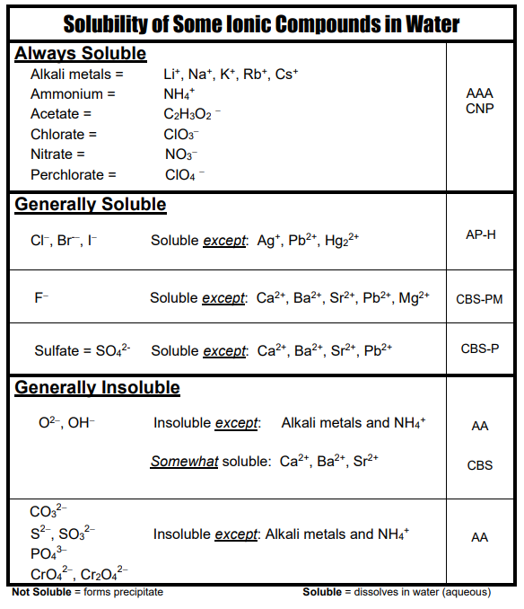
Solubility Chart
Soluble means it dissolves in water.
The right hand column are some acronyms to help you remember the rules. We don’t memorize, but might speed up your homework!
Copy in your notebook!

Slide 8
Solubility Chart
Na₂O SOLUBLE b/c it has Na⁺ in it!
Mg(OH)₂ INSOLUBLE b/c OH⁻ insoluble and Mg²⁺ not one of the exceptions

Slide 9
Prediction Products Practice #1
Sodium plus Oxygen yields ???
Na + O₂ →
What type of reaction does this look like?
Synthesis
Ionic so cross over! Don’t steal subscripts!
Na + O₂ → NaO₂ NO!!!
+1 -2
Na + O₂ → Na₂O
Fix numbers with balancing
4Na + O₂ → 2Na₂O

Slide 10
Prediction Products Practice #2
Sodium chloride breaks into its components
NaCl→ ???
What type of reaction does this look like?
Decomposition
NaCl→ Na + Cl NO!!!
Diatomic
NaCl→ Na + Cl₂
Balance
2NaCl→ 2Na + Cl₂

Slide 11
Prediction Products Practice #3
Aluminum is added Lead(II) Nitrate
Al + Pb(NO₃)₂ → ???
What type of reaction does this look like?
Is Al above Pb on Activity Series?
Yes! So rxn will happen!
Single Replacement
Does Al make cation or anion?
Cation
Ionic so cross over!
Al + Pb(NO₃)₂ → Pb + Al(NO₃)₂ NO!!!
+3 -1
Al + Pb(NO₃)₂ → Pb + Al(NO₃)₃
Balance
2Al + 3Pb(NO₃)₂ → 3Pb + 2Al(NO₃)₃
NOT DONE!!!! NEED TO THINK ABOUT PHASES!

Slide 12
Prediction Products Practice #3
NOT DONE!!!! NEED TO THINK ABOUT PHASES!
The Balanced Equation
2Al + 3Pb(NO₃)₂ → 3Pb + 2Al(NO₃)₃
The Overall Equation
2Al_{(s)} + 3Pb(NO₃)_{2(aq)} → 3Pb_{(s)} + 2Al(NO₃)_{3(aq)}
The Complete Ionic Equation
2Al_{(s)}+3Pb²⁺_{(aq)}+6NO₃⁻_{(aq)}→3Pb_{(s)}+2Al³⁺_{(aq)}+6NO₃⁻_{(aq)}
The Net Ionic Equation
Spectator Ions
2Al_{(s)}+3Pb²⁺_{(aq)}→3Pb_{(s)}+2Al³⁺_{(aq)}

Slide 13
Prediction Products Practice #4
Pb(NO₃)₂ + KI → ???
What type of reaction does this look like?
Double Replacement
Ionic so cross over!
Pb(NO₃)₂ + KI → PbI + K(NO₃) NO!!!
Pb(NO₃)₂ + KI → PbI₂ + K(NO₃)
Balance
Pb(NO₃)₂ + 2KI → PbI₂ + 2K(NO₃)
NOT DONE!!!! NEED TO THINK ABOUT PHASES!

Slide 14
Prediction Products Practice #4
NOT DONE!!!! NEED TO THINK ABOUT PHASES!
The Balanced Equation
Pb(NO₃)₂ + 2KI → PbI₂ + 2K(NO₃)
The Overall Equation
Pb(NO₃)_{2(aq)} + 2KI_{(aq)} → PbI_{2(s)} + 2K(NO₃)_{(aq)}
The Complete Ionic Equation
Pb²⁺_{(aq)}+2NO₃⁻_{(aq)}+2K⁺_{(aq)}+2 I⁻_{(aq)}→ PbI_{2(s)}+2K⁺_{(aq)} +2NO₃⁻_{(aq)}
The Net Ionic Equation
Spectator Ions
Pb²⁺_{(aq)} + 2 I⁻_{(aq)} → PbI_{2(s)}

Slide 15
Prediction Products Practice #5
A solution of Silver Nitrate with a solution of potassium chloride
What type of reaction does this look like?
Double Replacement
Already neutral!
AgNO₃ + KCl → AgCl + KNO₃
Already Balanced!
AgNO₃ + KCl → AgCl + KNO₃
NOT DONE!!!! NEED TO THINK ABOUT PHASES!

Slide 16
Prediction Products Practice #5
NOT DONE!!!! NEED TO THINK ABOUT PHASES!
The Balanced Equation
AgNO₃ + KCl → AgCl + KNO₃
The Overall Equation
AgNO_{3(aq)} + KCl_{(aq)} → AgCl_{(s)} + KNO_{3(aq)}
The Complete Ionic Equation
Ag⁺_{(aq)}+NO₃⁻_{(aq)}+ K⁺_{(aq)}+Cl⁻_{(aq)}→AgCl_{(s)}+K⁺_{(aq)}+NO₃⁻_{(aq)}
The Net Ionic Equation
Spectator Ions
Ag⁺_{(aq)} + Cl⁻_{(aq)} → AgCl_{(s)}

Slide 17
Particulate Diagrams
Particulate Diagrams help our brains!
Use little color coded (or labeled) circles to represent particles
A “particle” can be an atom, an ion, a polyatomic ion, compound or molecule.
Use the right number of circles! Draw them to represent phases too!
GAS
LIQUID
SOLID

Slide 18
Prediction Products Practice #3
Particulate Diagrams help our brains!
The Balanced Equation
2Al + 3Pb(NO₃)₂ → 3Pb + 2Al(NO₃)₃
Dump into beaker…
Al
Pb(NO₃)₂
Jars of chemicals in stock room

Slide 19
Prediction Products Practice #4
Particulate Diagrams help our brains!
The Balanced Equation
Pb(NO₃)₂ + 2KI → PbI₂ + 2K(NO₃)
Dump into beaker…
Pb(NO₃)₂
KI
Jars of chemicals in stock room

Slide 20
Prediction Products Practice #5
Particulate Diagrams help our brains!
The Balanced Equation
AgNO₃ + KCl → AgCl + KNO₃
Dump into beaker…
AgNO₃
KCl
Jars of chemicals in stock room

Slide 21
You Try One!
Particulate Diagrams help our brains!
The Balanced Equation
2AgNO₃ + CaBr₂ → 2AgBr + Ca(NO₃)₂
Dump into beaker…
AgNO₃
CaBr₂
Jars of chemicals in stock room

Slide 22
YouTube Link to Presentation https://youtu.be/Jw0uwkF568s

